Slide 1
Introduction Data Science

Slide 2
Who AM I
Data Scientist PT Len (Persero)
Data Science Instructure PT The Datanomics Indonesia
Review Contents (DQLabs)
Community Parnertship Data Science Indonesia
Volunteer Facebook Developer Circles Bandung

Slide 3

Data Science ?

Slide 4
JOBS FUNCTION ??
Data Analyst
Data Engineer
Data Wrangling
Data Scientist
Machine Learning Engineer

Slide 5
Characteristics
Supervised learning
Unsupervised learning

Slide 6
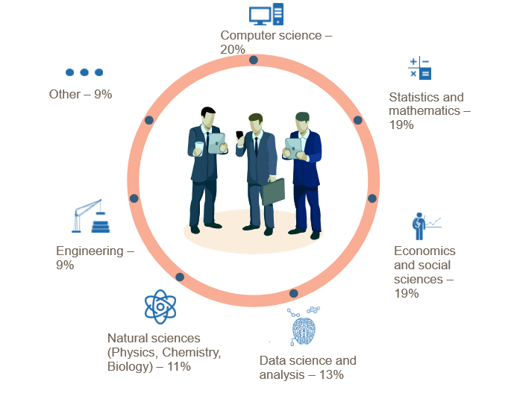

Slide 7
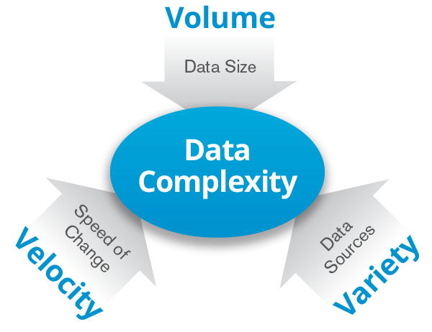
WHEN

Slide 8
BIG CONCEPT

Slide 9
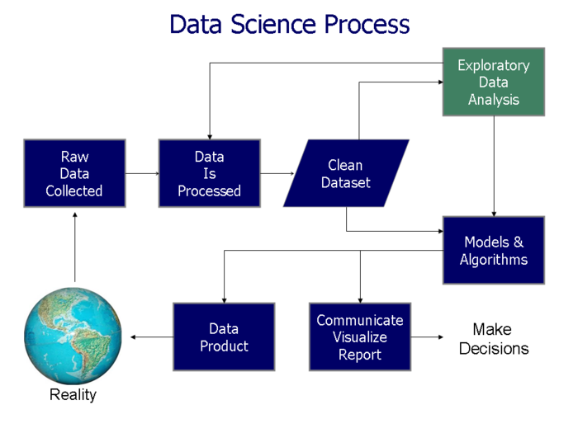

Slide 10
Raw Data Collected ?

Slide 11
Data Preparation / Wrangling

Slide 12



Concept

Slide 13
SCHEMA
Validalitas
Akurasi
Kelengkapan
Konsistensi
Keseragaman
NA (Not Avalaible)
Null
Not And Number
DATA KOTOR
PROFILING
Data Clensing Standarisasi
Data Clensing
Missing Value
Data Enrichment
Data Clensing
Duplikasi

Slide 14
Model & Algorithms

Slide 15
Data Visualization

Slide 16
Role Data Scientist
Memecahkan Teka-Teki
Informasi Berbasis Data
Mengelola SDM Industri 4.0

Slide 17
BIG INCOME

Slide 18
TOOL And Resources
PYTHON, R, SQL, MATLAB Dll
POWER BI, QLIKVIEW, TABLEAU, HIGHTCARTS, SISENCE, PLOOTY, R and Shinny
Hadoop, Spark, Pentahoo , TensorFlow
https://datascience.or.id/
http://data.bandung.go.id/
Online Course ( Udemy, Data Camp,Cloudera, Udacity)

Slide 19
Thanks FOR ATTENTION
Contact
firmanbriliant@gmail.com
firmanbr@len.co.id
087821731259

