Slide 1


Trappist
Major Project (CS 892)

Slide 2
Designed By: Developed By: Tested By: | Firoja Parveen(27600114021) Priti Shreya(27600114030) Rupam Dhar(27600114040)
Guided By: | Shreel Bhatt Rushi Soni

Slide 3
Index
1
Introduction
4
UI Design
2
Objectives
5
Database Design
3
Description
6
UML Diagrams

Slide 4
7
System Requirements
8
Testing Plan and Test Suites
10
8
Project Modules
11
Conclusion
9
Drawbacks & Future Enhancements
12
References

Slide 5
Introduction
Project is developed
In Visual Studio 2017.
It is an online test
conducting platform.
Technology: C#,.NET Core,
Angular
Project is a web application.

Slide 6
Objectives
Test monitoring
Test generation
&
Test Conduction
Test comparison

Slide 7
Description
It provides feature like Test analysis and Candidate analysis.
It is a online test conducting platform.
It provides feature like Test comparison on various terms.
It provides facilities to generate tests and also prebuilt questions catalogue.

Slide 8
Design of UI
User Management
Tests
Report
Questions
Conduct
Test Comparison

Slide 9
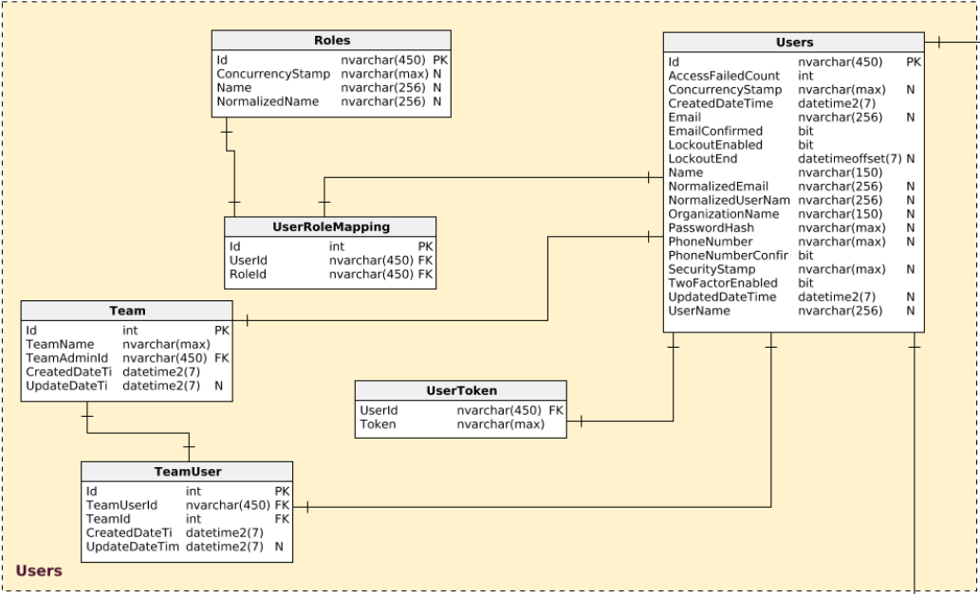
Database Design

Slide 10
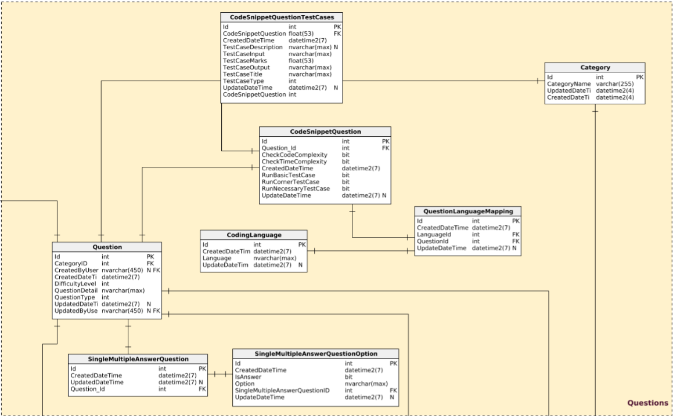

Slide 11
UML Diagrams
Super Admin
Admin
Team Admin
Team User
Candidate
Super Admin
Admin
Team Admin
Team User
Candidate
ACTIVITY DIAGRAM
USE CASE DIAGRAM

Slide 12
Hardware Required
Software Required
Processor
Operating System
800 MHz Or Above
Windows Family (Above Windows XP),
MacOS (Above Leopard), Ubuntu
RAM
Developing Tools
1 GB Or Above
Visual Studio Community 2017,
Visual Code, GitBash, TFS
I/O Devices
Database
CPU, Monitor, Keyboard & Mouse
MS SQL Server 2012

Slide 13
Project Modules Following are the modules in project :
User Management
Test
Question
Report
Test Comparison
Analysis
Profile
Account Controls

Slide 14
Drawbacks
Future Enhancement
The test comparison is supported to some basic level.
Test analysis and candidate analysis is limited to some level.
Include more test comparison scenarios and test reports.
Include more and more statistics in analysis feature.

Slide 15
Backend Framework: xUnit
Frontend Framework: Karma
The testing of the project is done through unit testing and Travis CI.
Testing Plan
&
Test Suites
The unit test case are generated for both front end and back end.
The other tests like code coverage, AOT checks are executed at every build.

Slide 16
Conclusion
Trappist is a reliable and efficient test conducting platform.
It provides features like question catalogue, test monitoring, test comparison and test analysis.
The website has good and interactive user interface.
The website is supported by almost all the well known browsers.

Slide 17
Preferences
www.unity3d.com

Slide 18
Thank you

