Slide 1
Cryptography
Lecture 15

Slide 2
Summary and review
We have finished our treatment of private-key schemes!
(Though they will come up again later)
Private-key crypto is used extensively in practice
Arguably more than public-key crypto

Slide 3
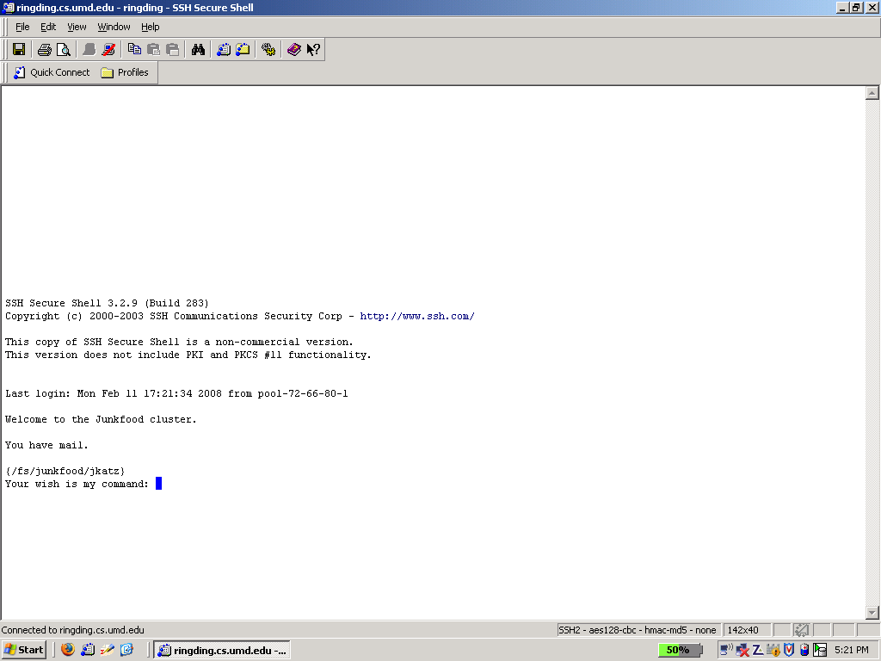

Slide 4
So far…
We have seen how to construct schemes based on various lower-level primitives
Stream ciphers/PRGs
Block ciphers/PRFs
Hash functions
How do we construct these primitives?

Slide 5
Two approaches
Construct from even lower-level assumptions
Can prove secure (given lower-level assumption)
Inefficient
Build directly
Much more efficient!
Need to assume security, but…
We have formal definitions to aim for
We can concentrate our analysis on these primitives
We can develop/analyze various design principles

Slide 6
Stream ciphers/PRGs

Slide 7
Terminology
Init algorithm
Takes as input a key [+ initialization vector (IV)]
Outputs initial state
GetBits algorithm
Takes as input the current state
Outputs next bit/byte/chunk and updated state
Allows generation of as many bits as needed

Slide 8
Stream ciphers
Can use (Init, GetBits) to generate any desired number of output bits from an initial seed
s
IV
Init
GetBits
GetBits
st₀
st₁
st₂
y₁
y₂

Slide 9
Security requirements
If there is no IV, then (for a uniform key) the output of GetBits should be indistinguishable from a uniform, independent stream of bits
If there is an IV, then (for a uniform key) the outputs of GetBits on multiple, uniform IVs should be indistinguishable from multiple uniform, independent streams of bits
Even if the attacker is given the IVs

Slide 10
Security requirements
In practice, want near-optimal concrete security
Not just asymptotic security
Stream cipher with n-bit key should be secure against attackers running in time ≈2^{n}

Slide 11
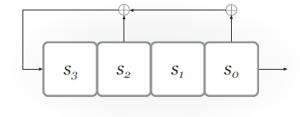
LFSRs
Degree n ⇒ n registers
State: bits s_{n-1}, …, s₀ (contents of the registers)
Feedback coefficients c_{n-1}, …, c₀ (do not change, though can depend on key)
Registers updated and output generated in each “clock tick”

Slide 12
Example
Assume initial content of registers is 0100
First 4 state transitions: 0100 → 1010 → 0101 → 0010 → …
First 3 output bits: 0 0 1 …

Slide 13
LFSRs as stream ciphers
Key [+ IV] used to initialize state of the LFSR (possibly including feedback coefficients)
One bit of output per clock tick
State is updated each clock tick

Slide 14
LFSRs
State (and output) “cycles” if state ever repeated
Short cycles are bad for security
How long can a cycle be?
A maximal-length LFSR cycles through all 2^{n} - 1 nonzero states
Known how to set feedback coefficients so as to achieve maximal length

Slide 15
LFSRs
Maximal-length LFSRs have good statistical properties…
…but they are not cryptographically secure!

Slide 16
Security?
If feedback coefficients are fixed (and hence known to the attacker), then the key just determines the initial register contents
First n bits of the output reveal the entire key!

Slide 17
Security?
Even if feedback coefficients are unknown (and determined by the key), can use linear algebra to learn everything from initial 2n output bits
Moral: linearity is bad for pseudorandomness (because linear algebra is so powerful)

Slide 18
Nonlinear FSRs
Add nonlinearity to prevent attacks
Nonlinear feedback
Output is a nonlinear function of the state
Multiple (coupled) LFSRs
…or some combination of the above
Still want to preserve statistical properties of the output, and long cycle length
From now on, assume design is fixed
Key only determines the initial register contents

Slide 19
Nonlinear feedback
s₄
s₃
s₂
s₁
s₀

Slide 20
Nonlinear feedback
Need to avoid bias!
⊕
s₄
s₃
s₂
s₁
s₀

Slide 21
Nonlinear filter
Update of state is still linear…
…but output is a nonlinear function of the entire state
⊕
⊕
s₄
s₃
s₂
s₁
s₀

Slide 22
Nonlinear filter
Need to avoid bias!
⊕
⊕
s₄
s₃
s₂
s₁
s₀
⊕

Slide 23
Combination generator
⊕
⊕
r₄
r₃
r₂
r₁
r₀
⊕
MAJ
s₃
s₂
s₁
s₀
⊕
t₂
t₁
t₀

Slide 24
Correlation attacks
Consider previous example, and let R, S, and T be the output sequence generated by each LFSR
So the overall output is MAJ(R, S, T)
Let ρ, σ, τ denote the degree of each LFSR
Key has length ρ + σ + τ
Want security for attacks running in time 2^{ρ + σ + τ}

Slide 25
Correlation attacks
Key observation: R, S, and T are each highly correlated with the output
Assuming S, T are unbiased, Pr[R_{i} = output_{i}] = ¾ for all i (and similarly for S, T)
Alternately, for large enough sequences, ¾ of the bits in R should be equal to the corresponding output bits
Can do a brute-force search over the state of each LFSR individually!
Key-recovery attack runs in time 2^{ρ} + 2^{σ} + 2^{τ} < 2^{ρ + σ + τ}

Slide 26
Trivium
Designed by De Cannière and Preneel in 2006 as part of eSTREAM competition
Intended to be simple and efficient (especially in hardware)
No attacks better than brute-force search are known!

Slide 27
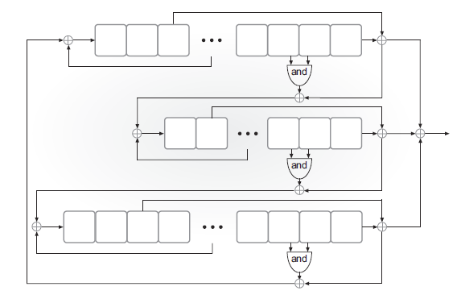
Trivium

Slide 28
Trivium
Three FSRs of degree 93, 84, and 111
Initialization:
80-bit key in left-most registers of first FSR
80-bit IV in left-most registers of second FSR
Remaining registers set to 0, except for three right-most registers of third FSR
Run for 4 x 288 clock ticks

Slide 29
RC4
Designed in 1987
Designed to have good performance in software, rather than hardware
No longer considered secure, but still interesting to study
Simple description; not LFSR-based
Still encountered in practice
Interesting attacks

Slide 30
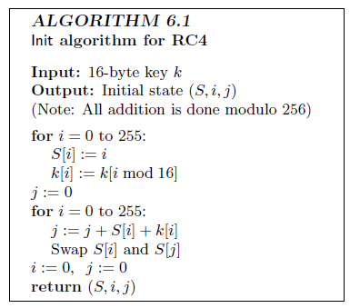
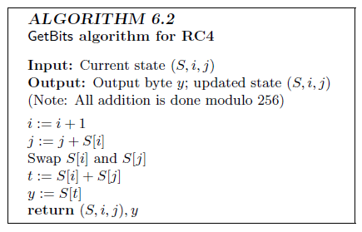
RC4

Slide 31
RC4
Not designed to take an IV, but often used with an IV anyway
E.g., prepend IV to the key

Slide 32
Attack: bias in 2nd output byte
Let S_{t} denote permutation after t steps
Treat S₀ as uniform for simplicity
Say X = S₀[1] ≠ 2 and S₀[2] = 0
Occurs with probability ≈1/256
Then:
After 1 step, S₁[X]=X, i=1, j=X
After 2 steps, j=X; output S₂[X]=0
Otherwise, S₂[X] is uniform
Overall probability 2nd byte is 0 is ≈2/256

Slide 33
RC4 bias
Statistical bias in other output bytes was determined experimentally
Enough to break pseudo-OTP encryption based on RC4!
See http://www.isg.rhul.ac.uk/tls

