Slide 1
Cryptography
Lecture 17

Slide 2
Feistel networks

Slide 3
Feistel networks
Build (invertible) permutation from non-invertible components
One round:
Keyed round function f: {0,1}^{n} x {0,1}^{l/2} →{0,1}^{l/2}
F_{k1}(L0, R0) → (L1, R1) where L1 = R0; R1 = L0 ⊕ f_{k1}(R0)
Always invertible!

Slide 4
L₀
R₀
⊕
f_{k}
L₁
R₁

Slide 5
Security?
Security of 1-round Feistel?
Security of 2-round Feistel (with independent keys)?
Security of 3/4-round Feistel?
(When round functions are random and independent)

Slide 6
Data Encryption Standard (DES)
Standardized in 1977
56-bit keys, 64-bit block length
16-round Feistel network
Same round function (“mangler function”) in all rounds
Different sub-keys in each round, each derived from the master key
The round function is basically an SPN!

Slide 7
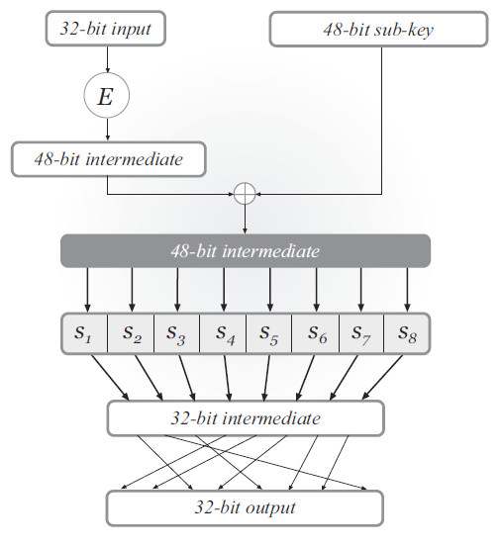
DES mangler function

Slide 8
DES mangler function
S-boxes
Each S-box is 4-to-1
Changing 1 bit of input changes at least 2 bits of output
Mixing permutation
The 4 bits of output from any S-box affect the input to 6 S-boxes in the next round

Slide 9
Key schedule
56-bit master key, 48-bit subkey in each round
Each subkey takes 24 bits from the left half of the master key, and 24 bits from the right half of the master key

Slide 10
Avalanche effect
Consider 1-bit difference in left half of input
After 1 round, 1-bit difference in right half
S-boxes cause a 2-bit difference, implying a 3-bit difference overall after 2 rounds
Mixing permutation spreads differences into different S-boxes
…

Slide 11
Security of DES
DES is extremely well-designed
Except for some attacks that require large amounts of plaintext, no attacks better than brute-force are known
But … parameters are too small!

Slide 12
56-bit key length
A concern as soon as DES was released
Brute-force search over 2⁵⁶ keys is possible
1997: 1000s of computers, 96 days
1998: distributed.net, 41 days
1999: Deep Crack ($250,000), 56 hours
Today: 48 FPGAs, ~1 day

Slide 13
64-bit block length
Birthday collisions relatively likely
E.g., encrypt 2³⁰ (≈ 1 billion) records using CTR mode; chances of a collision are ≈ 2⁶⁰/2⁶⁴ = 1/16

Slide 14
Increasing key length?
DES has a key that is too short
How to fix?
Design new cipher
Tweak DES so that it takes a larger key
Build new cipher using DES as a black box

Slide 15
Double encryption
Let F: {0,1}^{n} x {0,1}^{l} → {0,1}^{l}
(i.e., n=56, l=64 for DES)
Define F² : {0,1}^{2n} x {0,1}^{l} → {0,1}^{l} as follows: F²_{k1, k2}(x) = F_{k1}(F_{k2}(x)) (still invertible)
If best attack on F takes time 2^{n}, can we hope that the best attack on F² takes time 2^{2n}?

Slide 16
Meet-in-the-middle attack
No! There is an attack taking 2^{n} time…
(And 2^{n} memory)
The attack applies any time a block cipher can be “factored” into 2 independent components

Slide 17
Triple encryption
Define F³ : {0,1}^{3n} x {0,1}^{l} → {0,1}^{l} as follows: F³_{k1, k2, k3}(x) = F_{k1}(F_{k2}(F_{k3}(x)))
What is the best attack now?

Slide 18
Two-key triple encryption
Define F³ : {0,1}^{2n} x {0,1}^{l} → {0,1}^{l} as follows: F³_{k1, k2}(x) = F_{k1}(F_{k2}(F_{k1}(x)))
Best attack takes time 2^{2n} – optimal given the key length!
This approach is taken by triple-DES

Slide 19
Advanced encryption standard (AES)
Public design competition run by NIST
Began in Jan 1997
15 algorithms submitted
Workshops in 1998, 1999
Narrowed to 5 finalists
Workshop in early 2000; winner announced in late 2000
Factors besides security taken into account

Slide 20
AES
128-bit block length
128-, 192-, and 256-bit key lengths
Basically an SPN structure!
1-byte S-box (same for all bytes)
Mixing permutation replaced by invertible linear transformation
If two inputs differ in b bytes, outputs differ in ≥ 5-b bytes
No attacks better than brute-force known

