Slide 1
Cryptography
Lecture 22

Slide 2
Recall…
Cyclic group G of order q with generator g ∈ G
⇒ G = {g⁰, g¹, …, g^{q-1}}
For any h ∈ G, define log_{g} h ∈ {0, …, q-1} as log_{g} h = x ⇔ g^{x} = h
The discrete logarithm problem in G is to compute log_{g} h
We also discussed the (related, but not identical) Diffie-Hellman problems

Slide 3
Group selection
The discrete logarithm problem is not hard in all groups!
For example, it is easy in ℤ_{N} (for any N, and for any generator)
Nevertheless, there are certain groups where the problem is believed to be hard
Note: since all cyclic groups of the same order are isomorphic, the group representation matters!

Slide 4
Group selection
For cryptographic applications, best to use prime-order groups
The dlog problem becomes easier if the order of the group has small prime factors
Prime-order groups have several nice features
E.g., every element except identity is a generator
Two common choices of groups for cryptography…
DDH believed to be as hard as dlog in these groups

Slide 5
Group selection: choice 1
Prime-order subgroup of ℤ*_{p}, p prime
E.g., let p = tq + 1 for p, q prime
So ℤ*_{p} has order p-1 = tq
Take the subgroup of t^{th} powers, i.e., G = { [x^{t} mod p]| x ∈ ℤ*_{p} } ⊂ ℤ*_{p}
G is a group
Can show that it has order (p-1)/t = q
Since q is prime, G must be cyclic
Generalizations based on finite fields also used

Slide 6
Group selection: choice 2
Prime-order subgroup of an elliptic curve group
See book for the basic details…
These have the advantage of giving stronger security with smaller parameters (for reasons to be explained shortly)

Slide 7
Group selection
We will describe cryptographic schemes in an “abstract” cyclic group
Can ignore details of the underlying group in the analysis
Can instantiate with any (appropriate) group in an implementation

Slide 8
Concrete parameters?
We have discussed two classes of cryptographic assumptions
Factoring-based (factoring, RSA assumptions)
Dlog-based (dlog, CDH, and DDH assumptions)
In two classes of groups
All these problems are believed to be “hard,” i.e., to have no polynomial-time algorithms
But how hard are they, exactly?

Slide 9
Disclaimer
The goal here is just to give an idea as to how parameters are calculated, and what relevant parameters are
In practice, other important considerations come into play

Slide 10
Security
Recall: For symmetric-key algorithms…
Block cipher with n-bit key ≈ security against 2^{n}-time attacks = n-bit security
Hash function with 2n-bit output ≈ security against 2^{n}-time attacks = n-bit security
Factoring of a modulus of size 2^{n} (i.e., length n) using exhaustive search takes 2^{n/2} time
Computing discrete logarithms in a group of order 2^{n} takes 2^{n} time
Are these the best possible algorithms?

Slide 11
Algorithms for factoring
There exist algorithms factoring an integer N that run in much less than 2^{ǁNǁ/2} time
Best known algorithm (asymptotically): general number field sieve
Running time (heuristic): 2^{O(ǁNǁ1/3 log2/3 ǁNǁ)}
Makes a huge difference in practice!
Exact constant term also important!

Slide 12
Algorithms for dlog
Two classes of algorithms:
Ones that work for arbitrary (“generic”) groups
Ones that target specific groups
Recall that in some groups the problem is not even hard

Slide 13
Algorithms for dlog
Best “generic” dlog algorithms in a group of order ≈ 2^{n} take time 2^{n/2}
This is known to be optimal (for generic algorithms)

Slide 14
Algorithms for dlog
Best known algorithm for (subgroups of) ℤ*_{p}: number field sieve
Running time (heuristic): 2^{O(ǁpǁ1/3 log2/3 ǁpǁ)}
For (appropriately chosen) elliptic-curve groups, nothing better than generic algorithms is known!
This is why elliptic-curve groups can allow for more-efficient cryptography

Slide 15
Choosing parameters
As recommended by NIST (112-bit security):
Factoring: 2048-bit modulus
Dlog, order-q subgroup of ℤ*_{p}: ǁqǁ=224, ǁpǁ=2048
Addresses both generic and specific algorithms
Dlog, elliptic-curve group of order q: ǁqǁ=224 bits
Much longer than for symmetric-key algorithms!
Explains in part why public-key crypto is less efficient than symmetric-key crypto

Slide 16
Back to cryptography…

Slide 17
Private-key cryptography
Private-key cryptography allows two users who share a secret key to establish a “secure channel”
The need to share a secret key has several drawbacks…

Slide 18
The key-distribution problem
How do users share a key in the first place?
Need to share the key using a secure channel…
This problem can be solved in some settings
E.g., physical proximity, trusted courier, …
Note: this does not make private-key cryptography useless!
Can be difficult, expensive, or impossible to solve in other settings

Slide 19
The key-management problem
Imagine an organization with N employees, where each pair of employees might need to communicate securely
Solution using private-key cryptography:
Each user shares a key with all other users
Each user must store/manage N-1 secret keys!
O(N²) keys overall!

Slide 20
Lack of support for “open systems”
Say two users who have no prior relationship want to communicate securely
When would they ever have shared a key?
This happens all the time!
Customer sending credit-card data to merchant
Contacting a friend-of-a-friend on social media
Emailing a colleague

Slide 21
“Classical” cryptography offers no solution to these problems!

Slide 22
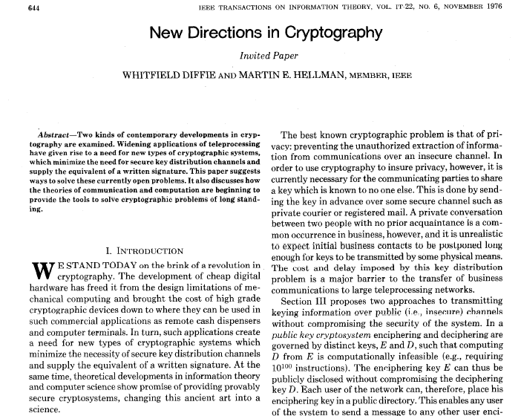

Slide 23
New directions…
Main ideas:
Some problems exhibit asymmetry – easy to compute, but hard to invert (factoring, RSA, group exponentiation, …)
Use this asymmetry to enable two parties to agree on a shared secret key via public discussion(!)
Key exchange

Slide 24
Key exchange
…
…
k
Enc_{k}(m)
k
Secure against an eavesdropper who sees everything!

Slide 25
More formally…
transcript
· · ·
k∈{0,1}^{n}
k∈{0,1}^{n}
Security goal: even after observing the transcript, the shared key k should be indistinguishable from a uniform key

Slide 26
Formally
Fix a key-exchange protocol Π and an attacker (passive eavesdropper) A
Define the following experiment KE_{A,} _{Π}(n):
Honest parties run Π using security parameter n, resulting in a transcript trans and (shared) key k
Choose uniform bit b. If b=0, then set k’=k; if b=1, then choose uniform k’∈{0,1}^{n}
Give trans and k’ to A, which outputs a bit b’
Exp’t evaluates to 1 (A succeeds) if b’=b

Slide 27
Security
Key-exchange protocol Π is secure (against passive eavesdropping) if for all probabilistic, poly-time A it holds that Pr[KE_{A,} _{Π}(n) = 1] ≤ ½ + negl(n)

Slide 28
Notes
Being unable to compute the key given the transcript is not a strong enough guarantee
Indistinguishability of the shared key from uniform is a much stronger guarantee…
…and is necessary if the shared key will subsequently be used for private-key crypto!

Slide 29
Diffie-Hellman key exchange
G, q, g, h₁
h₂
k₁ = (h₂)^{x} = g^{yx}
k₂ = (h₁)^{y} = g^{xy}
(G, q, g) ← G(1^{n})
x ← ℤ_{q}
h₁ = g^{x}
y ← ℤ_{q}
h₂ = g^{y}

Slide 30
In practice…
G, q, g
h₁
h₂
k₁ = (h₂)^{x} = g^{xy}
k₂ = (h₁)^{y} = g^{xy}
h₁ = g^{x}
h₂ = g^{y}

Slide 31
Recall…
Decisional Diffie-Hellman (DDH) assumption:
Given g^{x}, g^{y}, cannot distinguish g^{xy} from a uniform group element

Slide 32
Security?
Eavesdropper sees G, q, g, g^{x}, g^{y}
Shared key k is g^{xy}
Computing k from the transcript is exactly the computational Diffie-Hellman problem
Distinguishing k from a uniform group element is exactly the decisional Diffie-Hellman problem
⇒ If the DDH problem is hard relative to G, this is a secure key-exchange protocol!

Slide 33
A subtlety
We want our key-exchange protocol to give us a uniform(-looking) key k∈{0,1}^{n}
Instead we have a uniform(-looking) group element k∈G
Not clear how to use this as, e.g., an AES key
Solution: key derivation
Set k’ = H(k) for suitable hash function H
Secure if H is modeled as a random oracle

Slide 34
Modern key-exchange protocols
Security against passive eavesdroppers is insufficient
Generally want authenticated key exchange
This requires some form of setup in advance
Modern key-exchange protocols provide this
We will return to this later

