Slide 1
Cryptography
Lecture 2

Slide 2
Clicker quiz
Using the English-language shift cipher (as described in the book), what is the encryption of “good” using the key ‘b’?
XYYD
HPPE
QRST
GNNE

Slide 3
Clicker quiz
Using the English-language shift cipher (as described in the book), which of the following plaintexts could correspond to ciphertext AZC?
can
bad
dog
run

Slide 4
Byte-wise shift cipher
Work with an alphabet of bytes rather than (English, lowercase) letters
Works natively for arbitrary data!
Use XOR instead of modular addition
Essential properties still hold

Slide 5
ASCII
Characters (often) represented in ASCII
1 byte/char = 2 hex digits/char

Slide 6
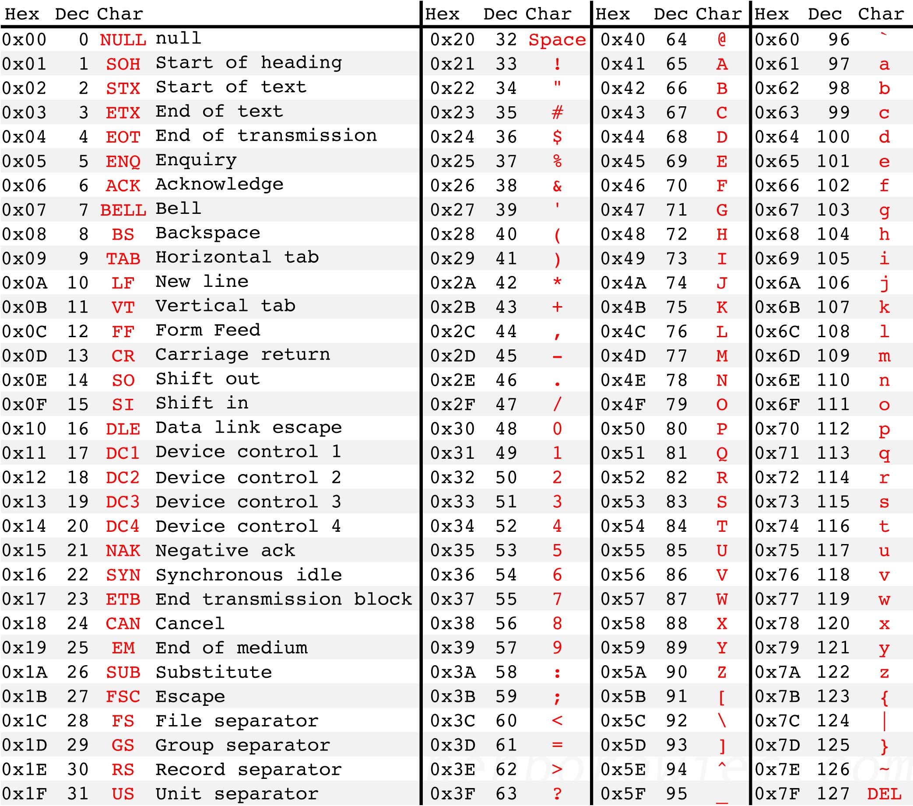
Source: http://benborowiec.com/2011/07/23/better-ascii-table/

Slide 7
Useful observations
Only 128 valid ASCII chars (128 bytes invalid)
Only 0x20-0x7E printable
0x41-0x7a includes upper/lowercase letters
Uppercase letters begin with 0x4 or 0x5
Lowercase letters begin with 0x6 or 0x7

Slide 8
Byte-wise shift cipher
M = {strings of bytes}
Gen: choose uniform k∈K = {0x00, …, 0xFF}
256 possible keys
Enc_{k}(m₁…m_{t}): output c₁…c_{t}, where c_{i} := m_{i} ⊕ k
Dec_{k}(c₁…c_{t}): output m₁…m_{t}, where m_{i} := c_{i} ⊕ k
Verify that correctness holds…

Slide 9
Code for byte-wise shift cipher
// read key from key.txt (hex) and message from ptext.txt (ASCII);
// output ciphertext to ctext.txt (hex)
#include <stdio.h>
main(){
FILE *keyfile, *pfile, *cfile;
int i;
unsigned char key, ch;
keyfile = fopen("key.txt", "r"), pfile = fopen("ptext.txt", "r"), cfile = fopen("ctext.txt", "w");
if (fscanf(keyfile, "%2hhX", &key)==EOF) printf("Error reading key.\n");
for (i=0; ; i++){
if (fscanf(pfile, "%c", &ch)==EOF) break;
fprintf(cfile, "%02X", ch^key);
}
fclose(keyfile), fclose(pfile), fclose(cfile);
}

Slide 10
Is this scheme secure?
No -- only 256 possible keys!
Given a ciphertext, try decrypting with every possible key
If ciphertext is long enough, only one plaintext will “make sense”
Can further optimize
First nibble of plaintext likely 0x4, 0x5, 0x6, 0x7 (assuming letters only)
Under plausible assumptions, can reduce exhaustive search to 26 keys (how?)

Slide 11
Sufficient key space principle
The key space must be large enough to make exhaustive-search attacks impractical
How large do you think that is?
Technical note (more next lecture): this is only true when the ciphertext is sufficiently long

Slide 12
The Vigenère cipher
The key is now a string, not just a character
To encrypt, shift each character in the plaintext by the amount dictated by the next character of the key
Wrap around in the key as needed
Decryption just reverses the process
tellhimaboutme
cafecafecafeca veqpjiredozxoe

Slide 13
The Vigenère cipher
Size of key space?
If keys are 14-character strings over the English alphabet, then key space has size 26¹⁴ ≈ 2⁶⁶
If variable length keys, even more…
Brute-force search infeasible
Is the Vigenère cipher secure?
(Believed secure for many years…)

Slide 14
Attacking the Vigenère cipher
(Assume a 14-character key)
Observation: every 14th character is “encrypted” using the same shift
Looking at every 14th character is (almost) like looking at ciphertext encrypted with the shift cipher
Though a direct brute-force attack doesn’t work…
Why not?
veqpjiredozxoeualpcmsdjquiqndnossoscdcusoakjqmxpqrhyycjqoqqodhjcciowieii
veqpjiredozxoeualpcmsdjquiqndnossoscdcusoakjqmxpqrhyycjqoqqodhjcciowieii
veqpjiredozxoeualpcmsdjquiqndnossoscdcusoakjqmxpqrhyycjqoqqodhjcciowieii

Slide 15
Using plaintext letter frequencies

Slide 16
Attacking the Vigenère cipher
Look at every 14th character of the ciphertext, starting with the first
Call this a “stream”
Let α be the most common character appearing in this stream
Most likely, α corresponds to the most common plaintext character (i.e., ‘e’)
Guess that the first character of the key is α - ’e’
Repeat for all other positions
This is somewhat haphazard…and does not use all the information available

Slide 17
A better attack
Let p_{i} (0 ≤ i ≤ 25) denote the frequency of the i^{th} English letter in normal English plaintext
One can compute that Σ_{i} p_{i}² ≈ 0.065
Let q_{i} denote the observed frequency of the i^{th} letter in a given stream of the ciphertext
If the shift for that stream is j, expect q_{i+j} ≈ p_{i} for all i
So expect Σ_{i} p_{i} q_{i+j} ≈ 0.065
Test for every value of j to find the right one
Repeat for each stream

Slide 18
Finding the key length
The previous attack assumes we know the key length
What if we don’t?
Note: can always try the previous attack for all possible key lengths
# of key lengths << # keys
Possible to do better!

Slide 19
Finding the key length
When using the correct key length, the ciphertext frequencies {q_{i}} of a stream will be shifted versions of the {p_{i}}
So Σ q_{i}² ≈ Σ p_{i}² ≈ 0.065
When using an incorrect key length, expect (heuristically) that ciphertext letters are uniform
So Σ q_{i}² ≈ Σ (1/26)² = 1/26 = 0.038
In fact, good enough to find the key length N that maximizes Σ q_{i}²
Can verify by looking at other streams…

Slide 20
Byte-wise Vigenère cipher
The key is a string of bytes
The plaintext is a string of bytes
To encrypt, XOR each character in the plaintext with the next character of the key
Wrap around in the key as needed
Decryption just reverses the process

Slide 21
Example
Say plaintext is “Hello!” and key is 0xA1 2F
“Hello!” = 0x48 65 6C 6C 6F 21
XOR with 0xA1 2F A1 2F A1 2F
0x48 ⊕ 0xA1
0100 1000 ⊕ 1010 0001 = 1110 1001 = 0xE9
Ciphertext: 0xE9 4A CD 43 CE 0E

Slide 22
Attacking the (variant) Vigenère cipher
As before, two steps:
Determine the key length
Determine each byte of the key
Let p_{i} (for 0 ≤ i ≤ 255) be the frequency of byte i in normal English (ASCII) plaintext
I.e., p_{i} =0 for i < 32 or i > 127
I.e., p₉₇ = frequency of ‘a’
If {p_{i}} are known, use same principles as before…
What if they are not known?

Slide 23
Determining the key length
If the key length is N, every N^{th} character of plaintext is encrypted using the same “shift”
If we take every N^{th} character and calculate frequencies, we get the {p_{i}} in permuted order
If we take every Mth character (M not a multiple of N) and calculate frequencies, we get something close to uniform
We don’t need to know the {p_{i}} to distinguish these two!

Slide 24
Determining the key length
For some candidate key length, tabulate q₀, …, q₂₅₅ for first stream and compute Σ q_{i}²
If close to uniform, Σ q_{i}² ≈ 256 · (1/256)² = 1/256
If a permutation of p_{i}, then Σ q_{i}² ≈ Σ p_{i}²
Key point: will be much larger than 1/256
So: compute Σ q_{i}² for each possible key length, and look for maximum value
Correct key length N should yield a large value for all N streams

Slide 25
Determining the i^{th} byte of the key
Assume the key length N is known
Look at i^{th} ciphertext stream
As before, all bytes in this stream were generated by XORing plaintext with the same byte of the key
Try decrypting the stream using every possible byte value B
Get a candidate plaintext stream for each value

Slide 26
Determining the i^{th} byte of the key
When the guess B is correct:
All bytes in the plaintext stream will be between 32 and 126
Frequency of space character should be high
Frequencies of lowercase letters (as a fraction of all lowercase letters) should be close to known English-letter frequencies
Tabulate observed letter frequencies q’₀, …, q’₂₅ (as fraction of all lowercase letters) in the candidate plaintext
Should find Σ q’_{i} p’_{i} ≈ Σ p’_{i}² ≈ 0.065, where p’_{i} corresponds to English-letter frequencies
In practice, take B that maximizes Σ q’_{i} p’_{i}, subject to caveats above (and possibly others)

Slide 27
Attack time?
Say the key length is between 1 and L
Determining the key length: ≈ 256 L
Determining all bytes of the key: < 256² L
Brute-force key search: ≈ 256^{L}

Slide 28
The attack in practice
Attack is more reliable as the ciphertext length grows larger
Attack still works for short(er) ciphertexts, but more “tweaking” and manual involvement may be needed

Slide 29
First programming assignment
Decrypt ciphertext (provided online) that was generated using the Vigenère cipher

Slide 30
So far…
“Heuristic” constructions; construct, break, repeat, …
Can we prove that some encryption scheme is secure?
First need to define what we mean by “secure” in the first place…

Slide 31
Historically…
Cryptography was an art
Heuristic design and analysis
This isn’t very satisfying
How do we know when a scheme is secure?

Slide 32
Modern cryptography
In the late ‘70s and early ‘80s, cryptography began to develop into more of a science
Based on three principles that underpin most crypto work today

Slide 33
Core principles of modern crypto
Formal definitions
Precise, mathematical model and definition of what security means
Assumptions
Clearly stated and unambiguous
Proofs of security
Move away from design-break-patch

