Slide 1
Cryptography
Lecture 26

Slide 2
Digital signatures

Slide 3
Signature schemes
A signature scheme is defined by three PPT algorithms (Gen, Sign, Vrfy):
Gen: takes as input 1^{n}; outputs pk, sk
Sign: takes as input a private key sk and a message m∈{0,1}*; outputs signature σ σ ← Sign_{sk}(m)
Vrfy: takes public key pk, message m, and signature σ as input; outputs 1 or 0
For all m and all pk, sk output by Gen, Vrfy_{pk}(m, Sign_{sk}(m)) = 1

Slide 4
Security?
Threat model
“Adaptive chosen-message attack”
Assume the attacker can induce the sender to sign messages of the attacker’s choice
Security goal
“Existential unforgeability”
Attacker should be unable to forge valid signature on any message not signed by the sender
Attacker gets the public key…

Slide 5
Formal definition
Fix A, Π
Define randomized experiment Forge_{A,Π}(n):
pk, sk ← Gen(1^{n})
A given pk, and interacts with oracle Sign_{sk}(·) ; let M be the set of messages sent to this oracle
A outputs (m, σ)
A succeeds, and the experiment evaluates to 1, if Vrfy_{pk}(m, σ)=1 and m∉M

Slide 6
Security for signature schemes
Π is secure if for all PPT attackers A, there is a negligible function ε such that Pr[Forge_{A,Π}(n) = 1] ≤ ε(n)

Slide 7
Replay attacks
Replay attacks need to be addressed just as in the symmetric-key setting

Slide 8
Hash-and-sign paradigm
Given
A signature scheme Π = (Gen, Sign, Vrfy) for “short” messages of length n
Hash function H: {0,1}* → {0,1}^{n}
Construct a signature scheme Π’=(Gen, Sign’, Vrfy’) for arbitrary-length messages:
Sign’_{sk}(m) = Sign_{sk}(H(m))
Vrfy’_{pk}(m, σ) = Vrfy_{pk}(H(m), σ)

Slide 9
Hash-and-sign paradigm
Theorem: If Π is secure and H is collision-resistant, then Π’ is secure
Proof: Say the sender signs m₁, m₂, …
Let h_{i} = H(m_{i})
Attacker outputs forgery (m, σ), m ≠ m_{i} for all i
Two cases:
H(m) = h_{i} for some i
Collision in H!
H(m) ≠ h_{i} for all i
Forgery in the underlying signature scheme

Slide 10
Hash-and-sign paradigm
Same idea as in the hash-and-MAC paradigm
Can be viewed as analogous to hybrid encryption
The functionality of digital signatures at the asymptotic cost of a symmetric-key operation

Slide 11
Signature schemes
We will discuss how to construct signature schemes for “short” messages
Using hash-and-sign, this implies signatures for arbitrary length messages

Slide 12
Signature schemes in practice
RSA-based signatures
Can be proven secure (based on RSA assumption, in random-oracle model)
Dlog-based signatures
Shorter signatures, faster signing than RSA-based signatures
(EC)DSA
Widely used, no proof of security
Schnorr
Can be prove secure (based on dlog assumption, in random-oracle model)

Slide 13
RSA-based signatures

Slide 14
Recall…
Choose random, equal-length primes p, q
Compute modulus N=pq
Choose e, d such that e · d = 1 mod φ(N)
The e^{th} root of m modulo N is [m^{d} mod N] (m^{d})^{e} = m^{de} = m^{[ed mod φ(N)]} = m mod N
RSA assumption: given N, e only, hard to compute the e^{th} root of a uniform m ∈ ℤ*_{N}

Slide 15
“Plain” RSA signatures
N, e
m, σ
(N, e, d) ← RSAGen(1^{n})
pk = (N, e)
sk = d
?
m = [σ^{e} mod N]
σ = [m^{d} mod N]

Slide 16
Security?
Intuition
Signature of m is the e^{th} root of m – supposedly hard to compute!

Slide 17
Attack 1
Can sign specific messages
E.g., easy to compute the e^{th} root of m = 1, or the cube root of m = 8

Slide 18
Attack 2
Can generate signatures on “random” messages
Choose arbitrary σ; set m = [σ^{e} mod N]

Slide 19
Attack 3
Can combine two signatures to obtain a third
Say σ₁, σ₂ are valid signatures on m₁, m₂ with respect to public key N, e
Then σ’ = [σ₁ · σ₂ mod N] is a valid signature on the message m’ = [m₁ · m₂ mod N]
(σ₁ · σ₂)^{e} = σ₁e · σ₂e = m₁ · m₂ mod N

Slide 20
RSA-FDH
Main idea: apply a “cryptographic transformation” to messages before signing
Public key: (N, e) private key: d
Sign_{sk}(m) = H(m)^{d} mod N
H must map onto all of ℤ*_{N}
Vrfy_{pk}(m, σ): output 1 iff σ^{e} = H(m) mod N
(This also handles long messages without additional hashing)

Slide 21
Intuition for security?
Look at the three previous attacks…
Not easy to compute the e^{th} root of H(1), …
Choose σ…, but how do you find an m such that H(m) = σ^{e} mod N?
Computing inverses of H should be hard
H(m₁) · H(m₂) = σ₁e · σ₂e = (σ₁ · σ₂)^{e} ≠ H(m₁ · m₂)

Slide 22
Security of RSA-FDH
If the RSA assumption holds, and H is modeled as a random oracle (mapping onto ℤ*_{N}), then RSA-FDH is secure
In practice, H is instantiated with a (modified) cryptographic hash function
Must ensure that the range of H is large enough!

Slide 23
RSA-FDH in practice
The RSA PKCS #1 v2.1 standard includes a signature scheme inspired by RSA-FDH
Essentially a randomized variant of RSA-FDH

Slide 24
dlog-based signatures

Slide 25
Digital signature standard (DSS)
US government standard for digital signatures
DSA, based on discrete-logarithm problem in subgroup of ℤ_{p}*
ECDSA, based on elliptic-curve groups
See book for details
Compared to RSA-based signatures
Shorter signatures and public keys (for EDCSA)
Can have faster signing
Slower verification

Slide 26
Public-key infrastructure (PKI)

Slide 27
Public-key distribution
Alice, pk*
pk
X
Alice, pk
Alice, pk*
Alice, pk
pk, sk

Slide 28
Public-key distribution
pk
Alice, pk
Alice, pk
X
Alice, pk*
pk, sk

Slide 29
Use signatures for secure key distribution!
Assume a trusted party with a public key known to everyone
CA = certificate authority
Public key pk_{CA}
Private key sk_{CA}

Slide 30
Use signatures for secure key distribution!
Alice asks the CA to sign the binding (Alice, pk)
cert_{CA→Alice} = Sign_{skCA}(Alice, pk)
(CA must verify Alice’s identity out of band)

Slide 31
Use signatures for secure key distribution!
Bob obtains Alice, pk, and the certificate cert_{CA→Alice} …
… check that Vrfy_{pKCA}((Alice, pk), cert_{CA→Alice}) = 1
Bob is then assured that pk is Alice’s public key
As long as the CA is trustworthy…
Honest, and properly verifies Alice’s identity
…and the CA’s private key has not been compromised

Slide 32
Chicken-and-egg problem?
How does Bob get pk_{CA} in the first place?
Several possibilities…

Slide 33
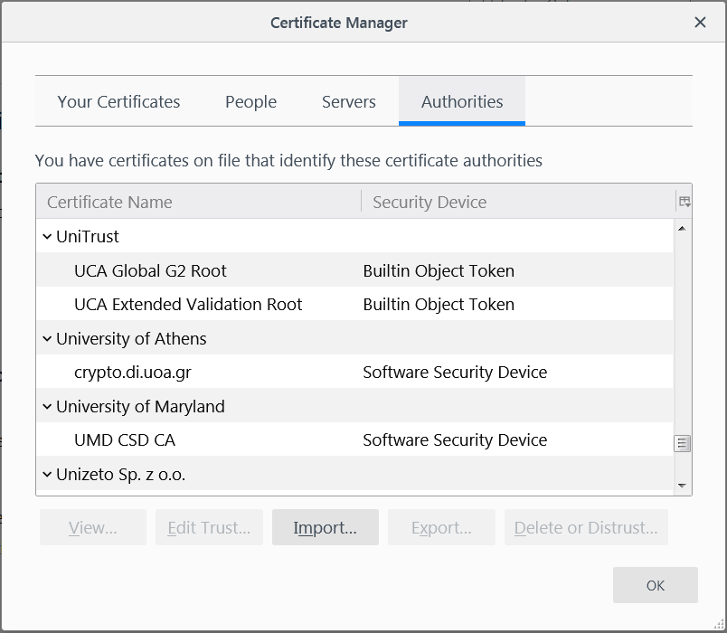
“Roots of trust”
Bob only needs to securely obtain a small number of CA’s public keys
Need to ensure secure distribution only for these few, initial public keys
E.g., distribute as part of an operating system, or web browser
Firefox: Tools->Options->Privacy & Security->View Certificates->Authorities

Slide 34
“Web of trust”
Obtain public keys in person
“Key-signing parties”
Obtain “certificates” on your public key from people who know you
If A knows pk_{B}, and B issued a certificate for C, then C can send that certificate to A
What trust assumptions are being made here?

