Slide 1
Cryptography
Lecture 4

Slide 2
Clicker quiz
Which of the following is NOT a drawback of the one-time pad?
A given key can only be used to encrypt one message
The key is as long as the message
The key must be chosen uniformly
The scheme is insecure against chosen-plaintext attacks

Slide 3
A brief detour:
randomness generation

Slide 4
Key generation
When describing algorithms, we assume access to uniformly distributed bits/bytes
Where do these actually come from?
Random-number generation

Slide 5
Random-number generation
Precise details depend on the system
Linux or unix: /dev/random or /dev/urandom
Do not use rand() or java.util.Random
Use crypto libraries instead

Slide 6
Random-number generation
Two steps:
Continually collect a “pool” of high-entropy (i.e., “unpredictable”) data
When random bits are requested, process this data to generate a sequence of uniform, independent bits/bytes
May “block” if insufficient entropy available

Slide 7
Step 1
Collect a “pool” of high-entropy data
Must ultimately come from some physical process (since computation is deterministic)
External inputs
Keystroke/mouse movements
Delays between network events
Hard-disk access times
Other external sources
Hardware random-number generation (e.g., Intel)

Slide 8
Min-entropy
I.e., “guessing entropy”
The min-entropy of a random variable X is defined as H∞(X) = -log₂ max_{x}{ Pr[X=x] } (in bits)
If X ranges over n-bit strings, then H∞(X) ≤ n
Equality iff X has uniform distribution

Slide 9
Random-number generation
Request random bits
Processing/ smoothing

Slide 10
Step 2: Smoothing
Need to eliminate both bias and dependencies
von Neumann technique for eliminating bias:
Collect two bits per output bit
01 -> 0
10 -> 1
00, 11 -> skip
Note that this assumes independence (as well as constant bias)

Slide 11
Smoothing
Can use randomness extraction
Unkeyed extraction is possible for some input distributions; impossible for others
Keyed extraction possible for all distributions
Extracted randomness is less than the input min-entropy
Where does the key come from?
In practice, computational extraction is used

Slide 12
Implementing the one-time pad

Slide 13
Key generation
Read desired number of bytes from /dev/urandom
Output the result to a file

Slide 14
Encryption
Plaintext = sequence of ASCII characters
Key = sequence of hex digits
Read them; XOR them to get the ciphertext

Slide 15
Decryption
Reverse encryption
Read ciphertext and key; XOR them to recover the message

Slide 16
One-time pad
The one-time pad achieves perfect secrecy!
One-time pad has historically been used in the real world
E.g., “red phone” between DC and Moscow
Not currently used!
Why not?

Slide 17
One-time pad
Several limitations
The key is as long as the message
Only secure if each key is used to encrypt a single message
(Trivially broken by a known-plaintext attack)
⇒ Parties must share keys of (total) length equal to the (total) length of all the messages they might ever send

Slide 18
Using the same key twice?
Say c₁ = k ⊕ m₁ c₂ = k ⊕ m₂
Attacker can compute c₁ ⊕ c₂ = (k ⊕ m₁) ⊕ (k ⊕ m₂) = m₁ ⊕ m₂
This leaks information about m₁, m₂!

Slide 19
Using the same key twice?
m₁ ⊕ m₂ is information about m₁, m₂
Is this significant?
No longer perfectly secret!
m₁ ⊕ m₂ reveals where m₁, m₂ differ
Frequency analysis
Exploiting characteristics of ASCII…

Slide 20
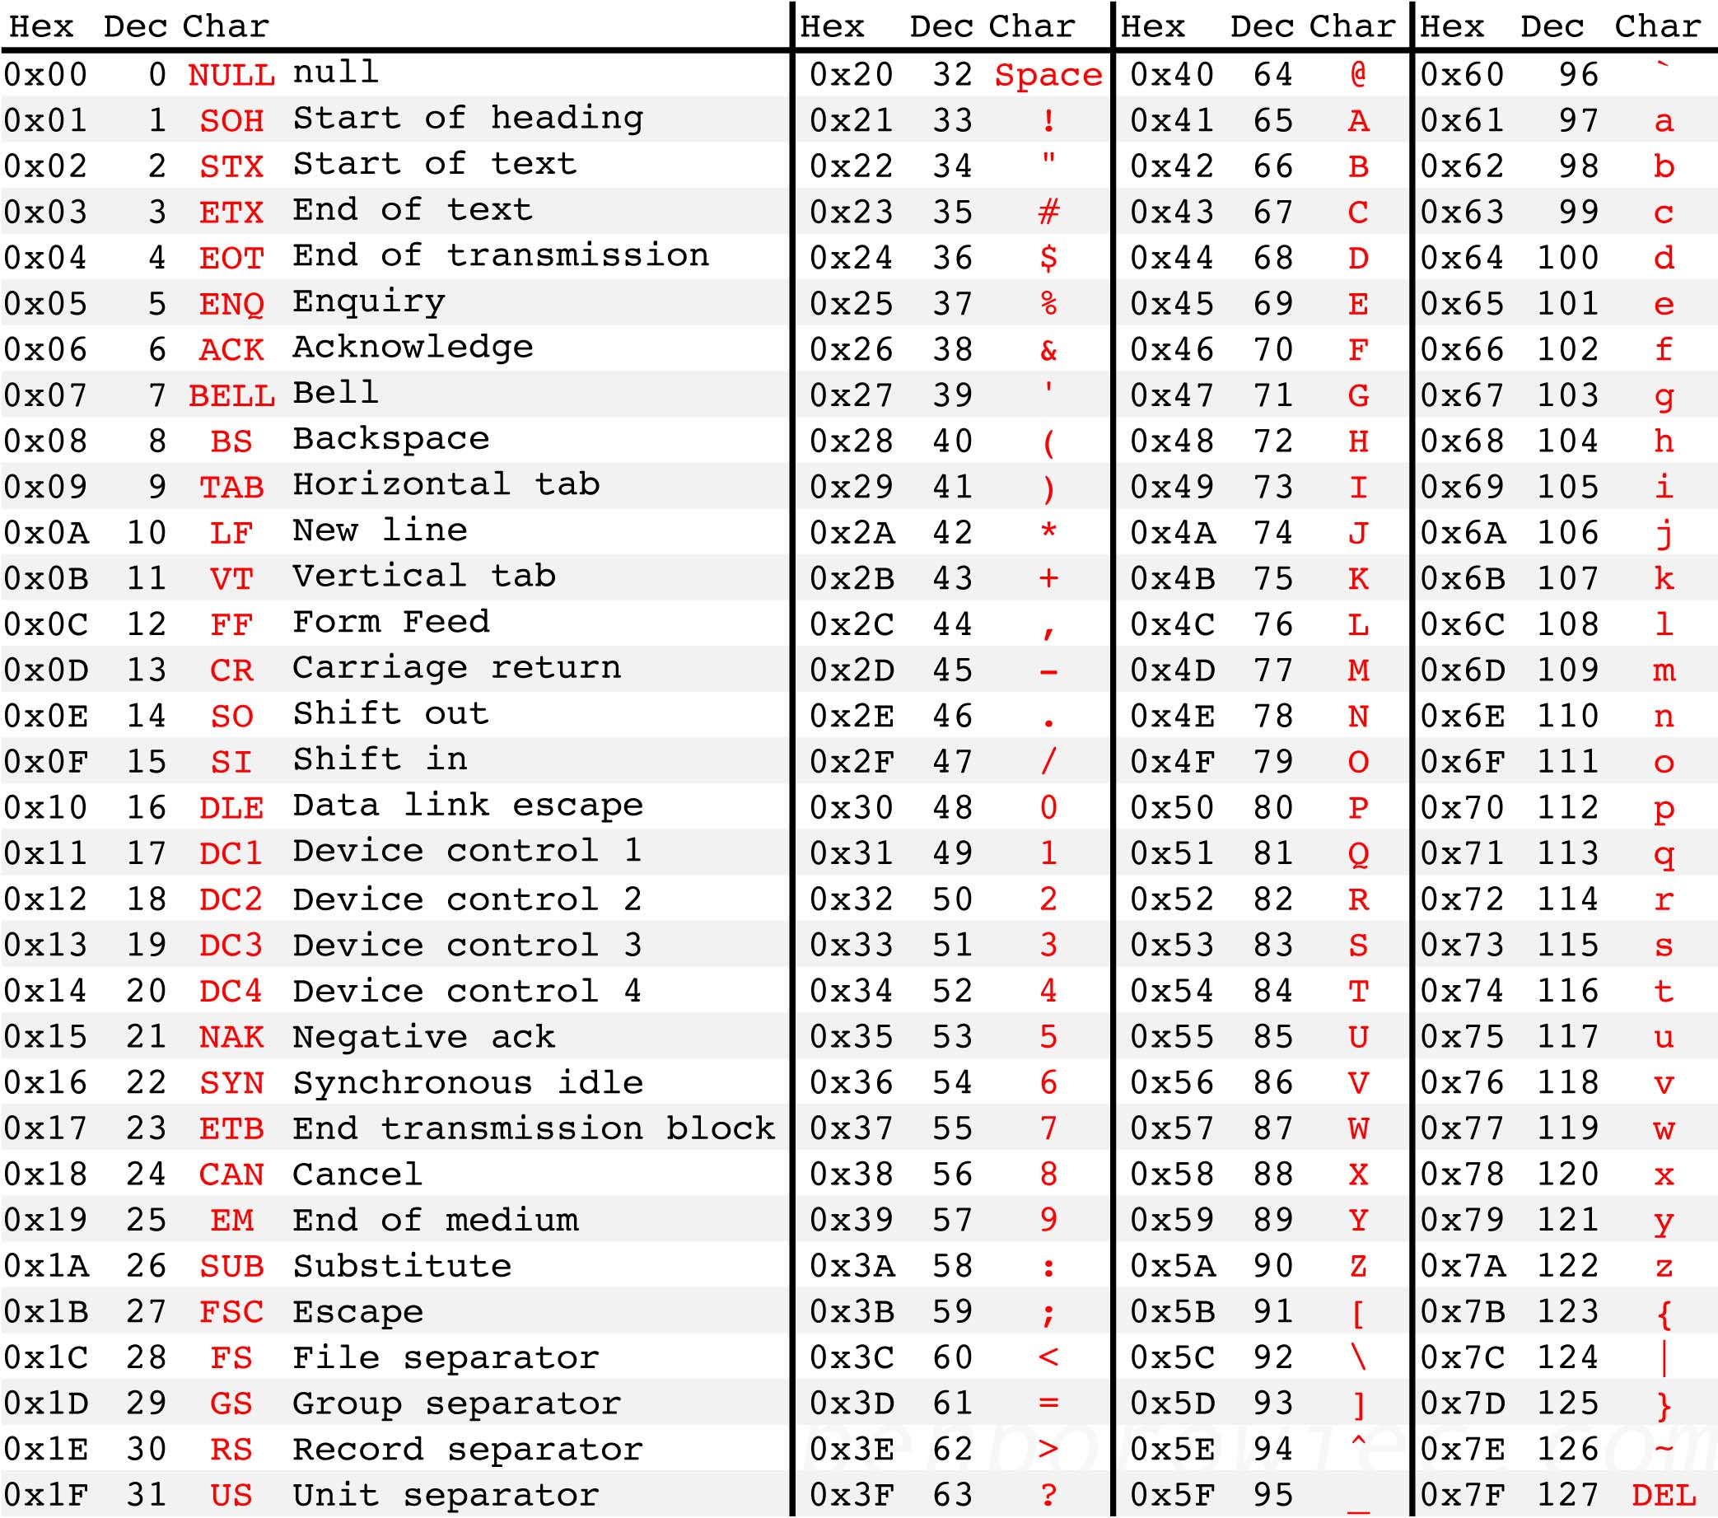
Letters all begin with 01…
The space character begins with 00…
XOR of two letters gives 00…
XOR of letter and space gives 01…
Easy to identify XOR of letter and space!
Source: http://benborowiec.com/2011/07/23/better-ascii-table/

Slide 21
In pictures
01…
01…
01…
00…
…
00…
…
01…
01…
01…
01…
01…
…
00…
00…
00…
01…
01010000
01010000 = 00100000 ⊕ ‘p’
01010000 = 00100000 ⊕ ??

Slide 22
One-time pad
Drawbacks
Key as long the message
Only secure if each key is used to encrypt once
Trivially broken by a known-plaintext attack
These limitations are inherent for schemes achieving perfect secrecy

Slide 23
Optimality of the one-time pad
Theorem: if (Gen, Enc, Dec) with message space M is perfectly secret, then |K| ≥ |M|.
Intuition:
Given any ciphertext, try decrypting under every possible key in K
This gives a list of up to |K| possible messages
If |K| < |M|, some message is not on the list

Slide 24
Optimality of the one-time pad
Theorem: if (Gen, Enc, Dec) with message space M is perfectly secret, then |K| ≥ |M|.
Proof:
Assume |K| < |M|
Need to show that there is a distribution on M, a message m, and a ciphertext c such that Pr[M=m | C=c] ≠ Pr[M=m]

Slide 25
Optimality of the one-time pad
Proof, continued
Take the uniform distribution on M
Take any ciphertext c
Consider the set M(c) = { Dec_{k}(c) }_{k∈K}
These are the only possible messages that could yield the ciphertext c
|M(c)| ≤ |K| < |M|, so there is some m that is not in M(c)
Pr[M=m | C=c] = 0 ≠ Pr[M=m]

Slide 26
Where do we stand?
We defined the notion of perfect secrecy
We proved that the one-time pad achieves it!
We proved that the one-time pad is optimal!
I.e., we cannot improve the key length
Are we done?
Do better by relaxing the definition
But in a meaningful way…

Slide 27
Perfect secrecy
Requires that absolutely no information about the plaintext is leaked, even to eavesdroppers with unlimited computational power
Has some inherent drawbacks
Seems unnecessarily strong

Slide 28
Computational secrecy
Would be ok if a scheme leaked information with tiny probability to eavesdroppers with bounded computational resources
I.e., we can relax perfect secrecy by
Allowing security to “fail” with tiny probability
Restricting attention to “efficient” attackers

Slide 29
Tiny probability of failure?
Say security fails with probability 2⁻⁶⁰
Should we be concerned about this?
With probability > 2⁻⁶⁰, the sender and receiver will both be struck by lightning in the next year…
Something that occurs with probability 2⁻⁶⁰/sec is expected to occur once every 100 billion years

Slide 30
Bounded attackers?
Consider brute-force search of key space; assume one key can be tested per clock cycle
Desktop computer ≈ 2⁵⁷ keys/year
Supercomputer ≈ 2⁸⁰ keys/year
Supercomputer since Big Bang ≈ 2¹¹² keys
Restricting attention to attackers who can try 2¹¹² keys is fine!
Modern key space: 2¹²⁸ keys or more…

Slide 31
Roadmap
We will give an alternate (but equivalent) definition of perfect secrecy
Using a randomized experiment
That definition has a natural relaxation
Warning: the material gets much more difficult now

Slide 32
Perfect indistinguishability
Π = (Gen, Enc, Dec), message space M
Informally:
Two messages m₀, m₁; one is chosen and encrypted (using unknown k) to give c ← Enc_{k}(m_{b})
Adversary A is given c and tries to determine which message was encrypted
Π is perfectly indistinguishable if no A can guess correctly with probability any better than ½

Slide 33
Perfect indistinguishability
Let Π=(Gen, Enc, Dec) be an encryption scheme with message space M, and A an adversary
Define a randomized exp’t PrivK_{A,Π}:
A outputs m₀, m₁ ∈ M
k ← Gen, b ← {0,1}, c ← Enc_{k}(m_{b})
b’ ← A(c)
Adversary A succeeds if b = b’, and we say the experiment evaluates to 1 in this case
Challenge ciphertext

Slide 34
Perfect indistinguishability
Easy to succeed with probability ½ …
Π is perfectly indistinguishable if for all attackers (algorithms) A, it holds that Pr[PrivK_{A,Π} = 1] = ½

