Slide 1
CMSC 414
Computer and Network Security
Lecture 17
Jonathan Katz

Slide 2
Database privacy
Two general methods to deal with database privacy
  Query restriction: Limit what queries are allowed. Allowed queried are answered correctly, while disallowed queries are simply not answered
  Perturbation: Queries answered “noisily”. Also includes “scrubbing” (or suppressing) some of the data

Slide 3
Perturbation
Data perturbation: Add noise to entire table, then answer queries accordingly (or release entire perturbed dataset)
Output perturbation: Keep table intact, but add noise to answers

Slide 4
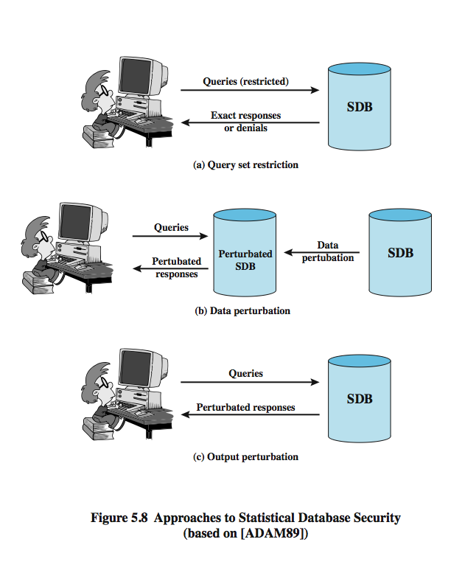
(From: “Computer Security,” by Stallings)

Slide 5
Perturbation
Trade-off between privacy and utility!
No randomization – bad privacy but perfect utility
Complete randomization – perfect privacy but no utility

Slide 6
Data perturbation
One technique: data swapping
  Substitute and/or swap values, while maintaining low-order statistics
Restriction to any
two columns is
identical
F | Bio | 4.0
F | CS | 3.0
F | EE | 3.0
F | Psych | 4.0
M | Bio | 3.0
M | CS | 4.0
M | EE | 4.0
M | Psych | 3.0
F | Bio | 3.0
F | CS | 4.0
F | EE | 4.0
F | Psych | 3.0
M | Bio | 4.0
M | CS | 3.0
M | EE | 3.0
M | Psych | 4.0

Slide 7
Data perturbation
Second technique: (re)generate the table based on derived distribution
  For each sensitive attribute, determine a probability distribution that best matches the recorded data
  Generate fresh data according to the determined distribution
  Populate the table with this fresh data
Queries on the database can never “learn” more than what was learned initially

Slide 8
Data perturbation
Data cleaning/scrubbing: remove sensitive data, or data that can be used to breach anonymity
k-anonymity: ensure that any “identifying information” is shared by at least k members of the database
Example…

Slide 9
Example: 2-anonymity
Race | ZIP | Smoke? | Cancer?
Asian | 02138 | Y | Y
Asian | 02139 | Y | N
Asian | 02141 | N | Y
Asian | 02142 | Y | Y
Black | 02138 | N | N
Black | 02139 | N | Y
Black | 02141 | Y | Y
Black | 02142 | N | N
White | 02138 | Y | Y
White | 02139 | N | N
White | 02141 | Y | Y
White | 02142 | Y | Y
- | 02138
- | 02139
- | 02141
- | 02142
- | 02138
- | 02139
- | 02141
- | 02142
- | 02138
- | 02139
- | 02141
- | 02142
Asian | 0213x
Asian | 0213x
Asian | 0214x
Asian | 0214x
Black | 0213x
Black | 0213x
Black | 0214x
Black | 0214x
White | 0213x
White | 0213x
White | 0214x
White | 0214x

Slide 10
Problems with k-anonymity
Hard to find the right balance between what is “scrubbed” and utility of the data
Not clear what security guarantees it provides
  For example, what if I know that the Asian person in ZIP code 0214x smokes?
    Does not deal with out-of-band information
  What if all people who share some identifying information share the same sensitive attribute?

Slide 11
Output perturbation
One approach: replace the query with a perturbed query, then return an exact answer to that
  E.g., a query over some set of entries C is answered using some (randomly-determined) subset C’ ⊆ C
  User only learns the answer, not C’
Second approach: add noise to the exact answer (to the original query)
  E.g., answer SUM(salary, S) with
  SUM(salary, S) + noise

Slide 12
A negative result [Dinur-Nissim]
Heavily paraphrased:
Given a database with n rows, if roughly n queries are made to the database then essentially the entire database can be reconstructed even if O(n^{1/2}) noise is added to each answer
On the positive side, it is known that very small error can be used when the total number of queries is kept small

Slide 13
Formally defining privacy
A problem inherent in all the approaches we have discussed so far (and the source of many of the problems we have seen) is that no definition of “privacy” is offered
Recently, there has been work addressing exactly this point
  Developing definitions
  Provably secure schemes!

Slide 14
A definition of privacy
Differential privacy [Dwork et al.]
Roughly speaking:
  For each row r of the database (representing, say, an individual), the distribution of answers when r is included in the database is “close” to the distribution of answers when r is not included in the database
    No reason for r not to include themselves in the database!
  Note: can’t hope for “closeness” better than 1/|DB|
Further refining/extending this definition, and determining when it can be applied, is an active area of research

Slide 15
Achieving privacy
A “converse” to the Dinur-Nissim result is that adding some (carefully-generated) noise, and limiting the number of queries, can be proven to achieve privacy
An active area of research

Slide 16
Achieving privacy
E.g., answer SUM(salary, S) with
SUM(salary, S) + noise,
where the magnitude of the noise depends on the range of plausible salaries (but not on |S|!)
Automatically handles multiple (arbitrary) queries, though privacy degrades as more queries are made
Gives formal guarantees

Slide 17
Buffer overflows

Slide 18
Buffer overflows
Previous focus in this class has been on secure protocols and algorithms
For real-world security, it is not enough for the protocol/algorithm to be secure -- the implementation must also be secure
  We have seen this already when we talked about side-channel attacks
  Here, the attacks are active rather than passive
  Also, here the attacks exploit the way programs are run by the machine/OS

Slide 19
Importance of the problem
Most common cause of Internet attacks
  Over 50% of CERT advisories related to buffer overflow vulnerabilities
Morris worm (1988)
  6,000 machines infected
CodeRed (2001)
  300,000 machines infected in 14 hours
Etc.

Slide 20
Buffer overflows
Fixed-sized buffer that is to be filled with unknown data, usually provided directly by user
If more data “stuffed” into the buffer than it can hold, that data spills over into adjacent memory
If this data is executable code, the victim’s machine may be tricked into running it
Can overflow on the stack or the heap…

Slide 21
A glimpse into memory
Registers
ebp
esp
eip
function
frame
stack
heap
code

Slide 22
Stack overview
Each function that is executed is allocated its own frame on the stack
When one function calls another, a new frame is initialized and placed (pushed) on the stack
When a function is finished executing, its frame is taken off (popped) the stack

Slide 23
Function calls
frame for
caller function
callee
function
arguments
saved eip
memory grows this way
saved ebp
frame for
callee function
local
variables

Slide 24
“Simple” buffer overflow
Overflow one variable into another
gets(color)
  What if I type “blue 1” ?
  (Actually, need to be more clever than this)
color
price
ebp
ret
addr
args
Frame of the
calling function
locals vars

Slide 25
More devious examples…
strcpy(buf, str)
What if str has more than buf can hold?
Problem: strcpy does not check that str is shorter than buf
overflow
buf
ebp
ret
addr
Frame of the
calling function
Pointer to
previous
frame
Execute
code at
this address
after func()
finishes
This will be
interpreted
as a return address!

Slide 26
Even more devious…
overflow
buf
sfp
ret
addr
Frame of the
calling function
In the overflow, a pointer back
into the buffer appears in
the location where the system
expects to find return address
Attacker puts actual assembly
instructions into his input string, e.g.,
binary code of execve(“/bin/sh”)

Slide 27
Severity of attack?
Theoretically, attacker can cause machine to execute arbitrary code with the permissions of the program itself
Actually carrying out such an attack involves many more details
  See “Smashing the Stack…”

Slide 28
Heap overflows
The examples just described all involved overflowing the stack
Also possible to overflow the heap
More difficult to get arbitrary code to execute, but imagine the effects of overwriting
  Passwords
  Usernames
  Filenames
  Variables
  Function pointers (possible to execute arbitrary code)

Slide 29
Exam review

Slide 30
Exam statistics
Max: 100
Average: 69
Median: 71
Grade breakdown (approximate!):
  80-100: A
  60-80: B
  45-60: C
  < 45: D/F

