Slide 1
CMSC 414
Computer and Network Security
Lecture 18
Jonathan Katz

Slide 2
Buffer overflows

Slide 3
HW3
Out shortly…
Buffer overflow attacks
  Will need to use gdb

Slide 4
Using gdb

Slide 5
Input validation
Buffer overflows can be viewed as an example of improper input validation
Other notable examples:
  Format string vulnerabilities
  SQL injection attacks
Two general mechanisms to prevent attacks
  Better input validation
  Safe programming techniques; techniques for detecting potential buffer overflows in code; …
more later

Slide 6
Defenses (briefly!)
Secure programming techniques
Penetration testing
Static analysis
Dynamic analysis

Slide 7
Secure programming techniques
Validate all input
Avoid buffer overflows (use safe string manipulation functions, careful length checking, etc., …)

Slide 8
Validating input
Determine acceptable input, check for match --- don’t just check against list of “non-matches”
  Limit maximum length
  Watch out for special characters, escape chars.
Check bounds on integer values
  Check for negative inputs
  Check for large inputs that might cause overflow!

Slide 9
Validating input
Filenames
  Disallow *, .., etc.
Command-line arguments
  Even argv[0]…
Commands
  E.g., SQL (see later)
URLs, http variables
  E.g., cross site scripting, more
  Next lecture

Slide 10
Avoiding buffer overflows
Use arrays instead of pointers
Make buffers (slightly) longer than necessary to avoid “off-by-one” errors
Careful length checking

Slide 11
Avoid strcpy, …
We have seen that strcpy is unsafe
  strcpy(buf, str) simply copies memory contents into buf starting from *str until “\0” is encountered, ignoring the size of buf
Avoid strcpy(), strcat(), gets(), etc.
  Use strncpy(), strncat(), instead
  Even these are not perfect… (e.g., no null termination)
  Always a good idea to do your own validation when obtaining input from untrusted source
  Still need to be careful when copying multiple inputs into a buffer

Slide 12
Does range checking help?
strncpy(char *dest, const char *src, size_t n)
  No more than n characters will be copied from *src to *dest
    Programmer has to supply the right value of n!
Bad:
… strcpy(record,user);
strcat(record,”:”);
strcat(record,cpw); …
Published “fix” (do you see the problem?):
… strncpy(record,user,MAX_STRING_LEN-1);
strcat(record,”:”);
strncat(record,cpw,MAX_STRING_LEN-1); …

Slide 13
Off-by-one overflow
Consider the following code:
char buf[512]; int i;
for (i=0; i <= 512; i++)
buf[i] = input[i];
1-byte overflow: can’t change return address, but can change pointer to previous stack frame
  On little-endian architecture, make it point into buffer

Slide 14
Static/dynamic analysis
Static analysis: run on the source code prior to deployment; check for known flaws
  E.g., flawfinder, cqual
Dynamic analysis: try to catch (potential) buffer overflows during program execution
Comparison?
  Static analysis very useful, but not perfect
  Dynamic analysis can be better (in tandem with static analysis), but can slow down execution

Slide 15
Dynamic analysis: Libsafe
Intercepts all calls to, e.g., strcpy (dest, src)
  Validates sufficient space in current stack frame:
  |frame-pointer – dest| > strlen(src)
  If so, executes strcpy; otherwise, terminates application

Slide 16
Preventing buffer overflows
Basic stack exploit can be prevented by marking
stack segment as non-executable, or randomizing stack location
Problems:
  Does not defend against `return-to-libc’ exploit
    Overflow sets ret-addr to address of libc function
  Some apps need executable stack
  Does not prevent general buffer overflow flaws, or heap overflow

Slide 17
StackGuard
Embed random “canaries” in stack frames and verify their integrity prior to function return
This is actually used!
  Helpful, but not foolproof…
Frame 2
Frame 1
local
canary
sfp
ret
str
local
canary
sfp
ret
str

Slide 18
More methods …
Address obfuscation
  Encrypt return address on stack by XORing with random string. Decrypt just before returning from function
  Attacker needs decryption key to set return address to desired value

Slide 19
More input validation flaws

Slide 20
Format string vulnerabilities
What is the difference between
printf(buf);
and
printf(“%s”, buf);
?
What if buf holds %x ?
Look at memory, and what printf expects…

Slide 21
What happens?
printf(“%x”) expects an additional argument…
What if we could write that value instead?
  See “Blended attacks…”
“%x”
ebp
ret
addr
buf
Frame of the
calling function
args
Will print the value
sitting here

Slide 22
Other input validation bugs
Say a program reads from a user-specified file
Program running in directory /secure, but only allows access to files in /secure/pub
  Checks that the filename supplied by the user begins with /pub
What if the user supplies the filename “/pub/../top_secret” ?

Slide 23
Other input validation bugs
Integer overflow…
Consider the code:
strncpy(msg+offset, str, slen);
where the adversary may control offset
By setting the value high enough, it will wrap around and be treated as a negative integer!

Slide 24
SQL injection attacks
Affect applications that use untrusted input as part of an SQL query to a back-end database
Specific case of a more general problem: using untrusted input in commands

Slide 25
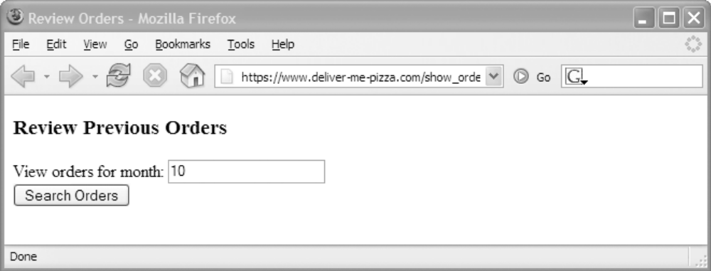
SQL injection: example
Consider a browser form, e.g.:
When the user enters a number and clicks the button, this generates an http request like
https://www.pizza.com/show_orders?month=10

Slide 26
Example continued…
Upon receiving the request, a java script might generate an SQL query as follows:
A normal query would look like:
sql_query
= "SELECT pizza, quantity, order_day "
+ "FROM orders "
+ "WHERE userid=" + session.getCurrentUserId()
+ " AND order_month= "
+ request.getParameter("month");
SELECT pizza, quantity, order_day
FROM orders
WHERE userid=4123
AND order_month=10

Slide 27
Example continued…
What if the user makes a modified http request:
https://www.pizza.com/show_orders?month=0%20OR%201%3D1
(Parameters transferred in URL-encoded form, where meta-characters are encoded in ASCII)
This has the effect of setting
request.getParameter(“month”)
equal to the string
0 OR 1=1

Slide 28
Example continued
So the script generates the following SQL query:
Since AND takes precedence over OR, the above always evaluates to TRUE
  The attacker gets every entry in the database!
SELECT pizza, quantity, order_day
FROM orders
WHERE userid=4123
AND order_month=0 OR 1=1
(
)

Slide 29
Even worse…
Craft an http request that generates an SQL query like the following:
Attacker gets the entire credit card database as well!
SELECT pizza, quantity, order_day
FROM orders
WHERE userid=4123
AND order_month=0 OR 1=0
UNION SELECT cardholder, number, exp_date
FROM creditcards

Slide 30
More damage…
SQL queries can encode multiple commands, separated by ‘;’
Craft an http request that generates an SQL query like the following:
Credit card table deleted!
  DoS attack
SELECT pizza, quantity, order_day
FROM orders
WHERE userid=4123
AND order_month=0 ;
DROP TABLE creditcards

Slide 31
More damage…
Craft an http request that generates an SQL query like the following:
User (with chosen password) entered as an administrator!
  Database owned!
SELECT pizza, quantity, order_day
FROM orders
WHERE userid=4123
AND order_month=0 ;
INSERT INTO admin VALUES (‘hacker’, ...)

Slide 32
May need to be more clever…
Consider the following script for text queries:
Previous attacks will not work directly, since the commands will be quoted
But easy to deal with this…
sql_query
= "SELECT pizza, quantity, order_day "
+ "FROM orders "
+ "WHERE userid=" + session.getCurrentUserId()
+ " AND topping= ‘ "
+ request.getParameter(“topping") + “’”

Slide 33
Example continued…
Craft an http request where
request.getParameter(“topping”)
is set to
abc’; DROP TABLE creditcards; --
The effect is to generate the SQL query:
(‘--’ represents an SQL comment)
SELECT pizza, quantity, order_day
FROM orders
WHERE userid=4123
AND toppings=‘abc’;
DROP TABLE creditcards ; --’

Slide 34
Second order attacks
Attack where two consecutive queries cause the attack
E.g.,
What if a user sets uname = admin’ -- ?
  (uname = admin causes a conflict)
query1 = “INSERT INTO users(name,passwd)
VALUES (‘” + uname + “’,‘”
+ password + “’)” ;
query2 = “UPDATE users SET passwd=‘” +
+ new_password + “’ WHERE name=‘”
+ uname + “’” ;

Slide 35
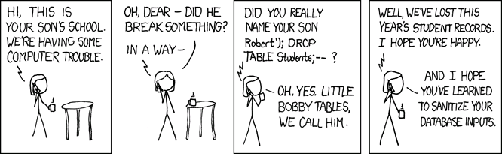
Source: http://xkcd.com/327/

Slide 36
Solutions?
Defense-in-depth…
  Use several solutions, as appropriate
Blacklisting
Whitelisting
Prepared statements/bind variables
Mitigate the impact of SQL injection

Slide 37
Blacklisting?
I.e., searching for/preventing ‘bad’ inputs
E.g., for previous example:
…where kill_chars() deletes, e.g., quotes and semicolons
sql_query
= "SELECT pizza, quantity, order_day "
+ "FROM orders "
+ "WHERE userid=" + session.getCurrentUserId()
+ " AND topping= ‘ "
+ kill_chars(request.getParameter(“topping"))
+ “’”

Slide 38
Drawbacks of blacklisting
How do you know if/when you’ve eliminated all possible ‘bad’ strings?
  If you miss one, could allow successful attack
Does not prevent first set of attacks (numeric values)
  Although similar approach could be used, starts to get complex!
May conflict with functionality of the database
  E.g., user with name O’Brien

Slide 39
Whitelisting
Check that user-provided input is in some set of values known to be safe
  E.g., check that month is an integer in the right range
If invalid input detected, better to reject it than to try to fix it
  Fixes may introduce vulnerabilities
  Principle of fail-safe defaults

Slide 40
Prepared statements/bind variables
Prepared statements: static queries with bind variables
  Variables not involved in query parsing
Bind variables: placeholders guaranteed to be data in correct format

Slide 41
Example (Java)
PreparedStatement ps =
db.prepareStatement(
"SELECT pizza, quantity, order_day "
+ "FROM orders WHERE userid=?
AND order_month=?");
ps.setInt(1, session.getCurrentUserId());
ps.setInt(2,
Integer.parseInt(request.getParameter("month")));
ResultSet res = ps.executeQuery();
Bind variables

Slide 42
Mitigating the impact
Limit privileges
  I.e., allow SELECT queries on the orders database, but no queries on creditcards database
  Can limit commands, or tables to which access is given (or both)
  Principle of least privilege
  Not a complete fix, but it helps
Encrypt sensitive data stored in database
  E.g., orders in the clear but credit card numbers encrypted

