Slide 1
CMSC 414
Computer and Network Security
Lecture 6
Jonathan Katz

Slide 2
Authenticating longer messages?
Two widely used schemes (among several):
  CBC-MAC
  HMAC

Slide 3
CBC-MAC
Fix a message length L⋅n, where the block cipher has n-bit block length
To compute MAC_{k}(m₁, …, m_{L}), with |m_{i}|=n do:
  Set t₀ = 0^{n}
  For i=1 to L, set t_{i} := F_{k}(t_{i-1} ⊕ m_{i})
  Output t_{L}
To verify, re-compute and check…
Note the similarities to (and differences from) CBC mode encryption

Slide 4
Security of CBC-MAC?
Secure for fixed-length messages
Insecure (as described) for variable-length messages
  There are secure variants of CBC-MAC if variable-length messages will be authenticated
  Make sure to use these!

Slide 5
HMAC
Can be viewed as a version of “hash-and-MAC”, using collision-resistant hashing…

Slide 6
Hash functions
A (cryptographic) hash function H maps arbitrary length inputs to a fixed-length output
Main goal is collision resistance:
  Hard to find distinct x, x’ such that H(x) = H(x’)

Slide 7
Hash functions in practice
MD5
  128-bit output
  Introduced in 1991…collision attacks found in 2004…several extensions and improvements to the attacks since then
  Still widely deployed(!)
SHA-1
  160-bit output
  No collisions (yet?) known, but theoretical attacks exist
SHA-x
  256-/512-bit outputs
Competition to design new hash standard in progress

Slide 8
Hash-and-MAC
Hash message to short “digest”
MAC the digest
HMAC uses essentially this idea
k
m
H
H(m)
MAC
t

Slide 9
(Informal) sketch of security
Say the adversary sees tags on m₁, …, m_{q,}, and outputs a valid forgery on m ∉ {m₁, …, m_{q}}
Two possibilities:
  H(m) = H(m_{i}) for some i ⇒ collision in H
  H(m) ∉ {H(m₁), …, H(m_{q})} ⇒ forgery in the underlying MAC for short messages

Slide 10
Encryption + integrity
In most settings, confidentiality and integrity are both needed --- i.e., authenticated encryption
  How to obtain both?
Use ‘encrypt-then-authenticate’
Other natural possibilities are problematic!

Slide 11
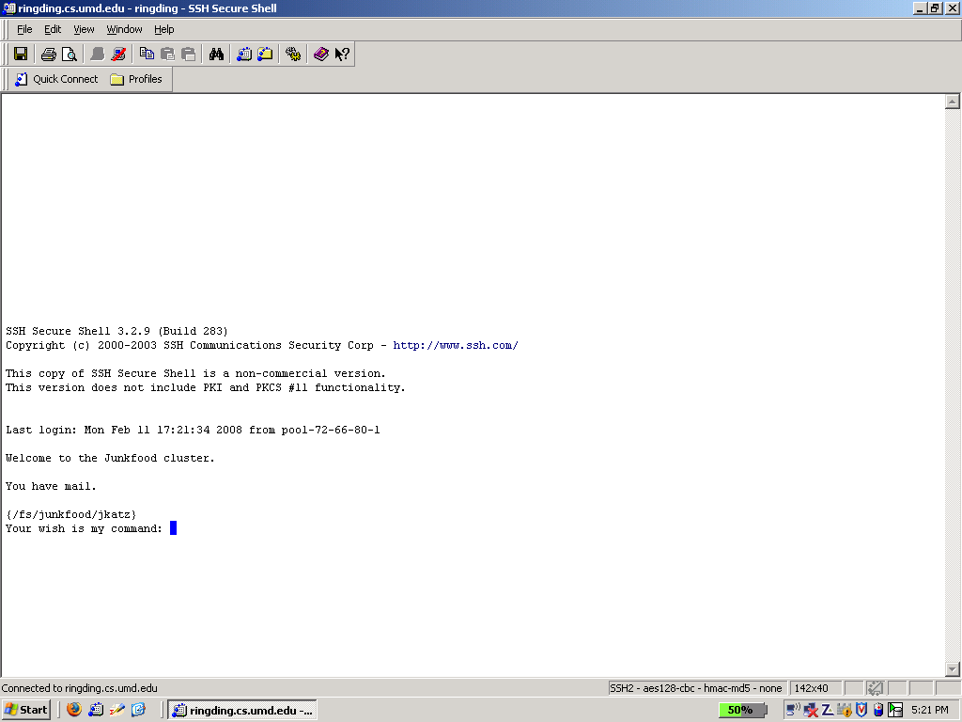
What you now know

Slide 12
Sharing keys?
Secure sharing of a key is necessary for private-key crypto
  How do parties share a key in the first place?
One possibility is a secure physical channel
  E.g., in-person meeting
  Dedicated (un-tappable) phone line
  USB stick via courier service
Another possibility: key-exchange protocols
  Parties can agree on a key over a public channel
  This is amazing! (And began a revolution in crypto…)

Slide 13
Diffie-Hellman key exchange
First, some number theory…
  Modular arithmetic, Z_{p}, Z_{p}*
  Generators: e.g., 3 is a generator of Z₁₇*, but 2 is not
  The discrete logarithm assumption

Slide 14
The Diffie-Hellman protocol
prime p, element g ∈ Z_{p}*
h_{A} = g^{x} mod p
h_{B} = g^{y} mod p
K_{AB} = (h_{B})^{x}
K_{BA} = (h_{A})^{y}

Slide 15
Security?
Consider security against a passive eavesdropper
  We will cover stronger notions of security for key exchange in more detail later in the semester
Under the computational Diffie-Hellman (CDH) assumption, hard for eavesdropper to compute K_{AB} = K_{BA}
  Not sufficient for security!
  Can hash the key before using
Under the decisional Diffie-Hellman (DDH) assumption, the key K_{AB} looks pseudorandom to an eavesdropper

Slide 16
Technical notes
p and g must be chosen so that the CDH/DDH assumptions hold
  Need to be chosen with care – in particular, g should be chosen as a generator of a subgroup of Z_{p}*
  Details in CMSC456
Can use other groups
  Elliptic curves are also popular
Modular exponentiation can be done quickly (in particular, in polynomial time)
  But the naïve algorithm does not work!

Slide 17
Security against active attacks?
The basic Diffie-Hellman protocol we have shown is not secure against a ‘man-in-the-middle’ attack
In fact, impossible to achieve security against such attacks unless some information shared in advance
  E.g., private-key setting
  Or public-key setting (next)
Will cover authenticated key exchange later

