Slide 1
Analyzing Taxi Trips in Chicago

Slide 2
Dataset Overview
The dataset we're working with contains detailed information about taxi trips in Chicago from January to July 2023. It includes data on trip duration, distance, fares, payment types, and more. Analyzing this dataset helps us understand customer preferences, optimize operations, and make data-driven decisions for improving taxi services in Chicago.

Slide 3
Data Preprocessing
The dataset has undergone extensive cleaning and formatting procedures.
Missing values in numerical columns were handled by filling them with the mean.
Categorical variables were encoded using techniques like one-hot encoding.
Feature engineering was performed to extract additional relevant information.
Numerical features were normalized using Min-Max scaling.
Unnecessary columns that do not contribute significantly to the analysis were dropped from the dataset.
These preprocessing steps ensure that the dataset is well-prepared and suitable for detailed analysis and modeling purposes.

Slide 4
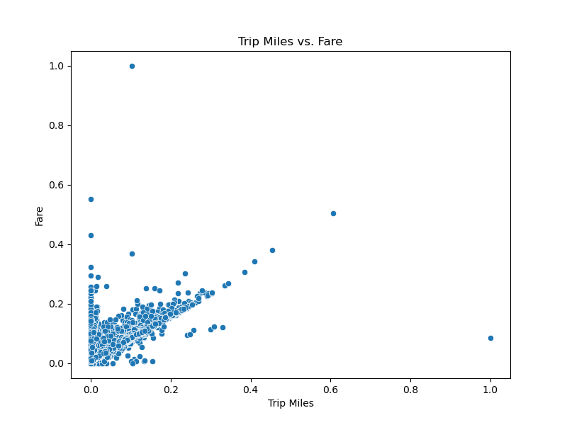
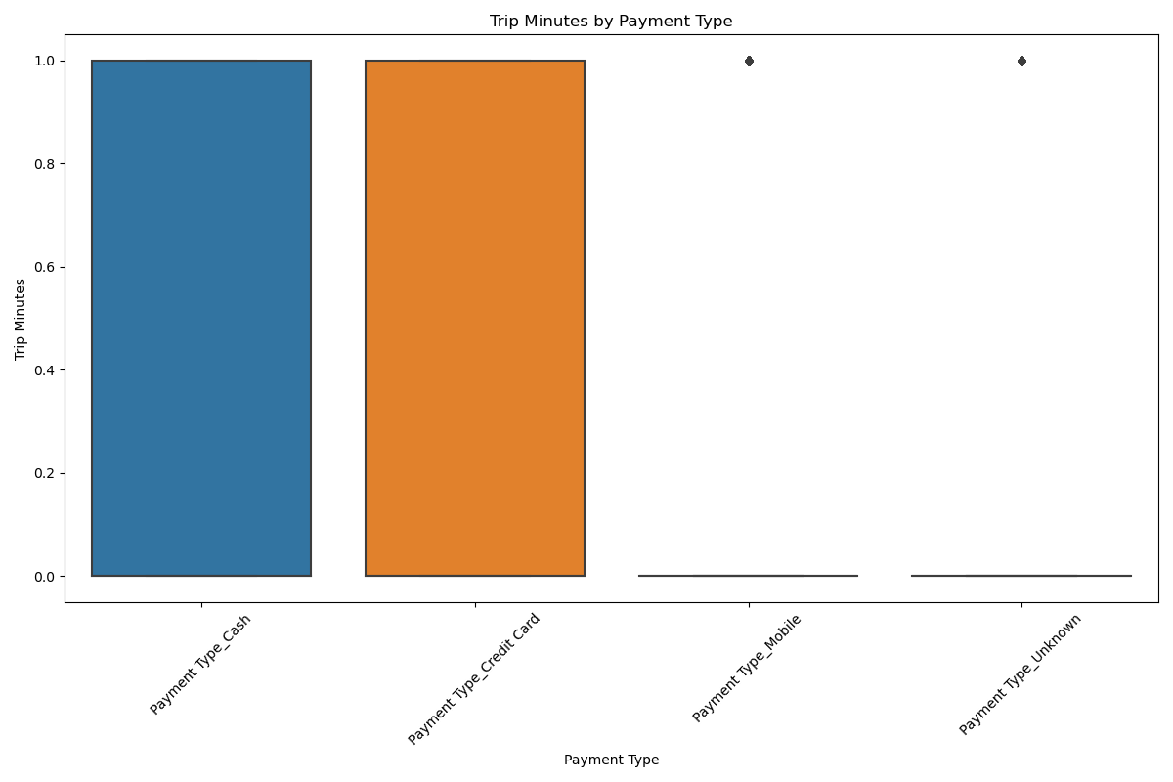

Slide 7
Payment Types Analysis
Distribution of Payment Types:
Cash payments: 32.61%
Credit card payments: 43.58%
Mobile payments: 18.20%
Unknown payment type: 5.62%
Variability in Payment Methods:
Higher standard deviation indicates wider payment method range.
Dominance of Cash and Credit Cards:
Higher mean values for cash and credit card payments.
Preference for Digital Payments:
Growing preference for mobile payments (18.20%).
Identification of Unknown Payments:
Need for further investigation into 5.62% unknown payment types.
Overall Payment Trends:
Insights into trends for strategic decision-making.

Slide 8
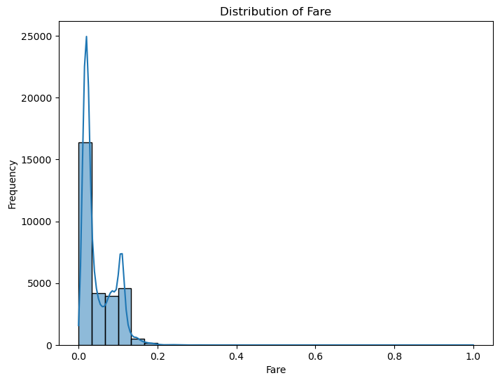

Slide 9
Optimizing Routes for Efficiency
Key Findings:
Wide range in trip durations (mean: 19.44 mins, std dev: 28.88 mins).
Opportunities to reduce trip durations through route optimization.
Strategic Recommendations:
Use real-time traffic data for optimal route planning.
Identify and avoid common traffic bottlenecks.

Slide 10
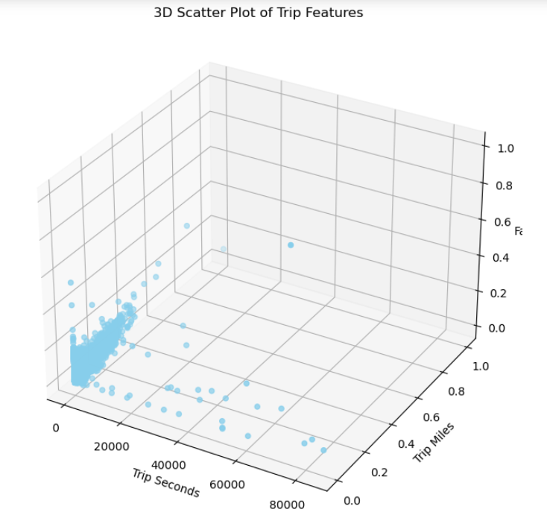

Slide 12
Reducing Trip Distances for Cost Savings
Key Findings:
Average trip distance: 0.07 miles (std dev: 0.08 miles).
Potential to reduce mileage through optimized pickup/dropoff locations.
Strategic Recommendations:
Implement route optimization strategies.
Encourage drivers to take efficient routes.

Slide 13
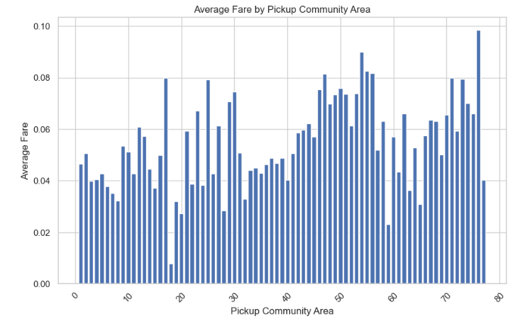
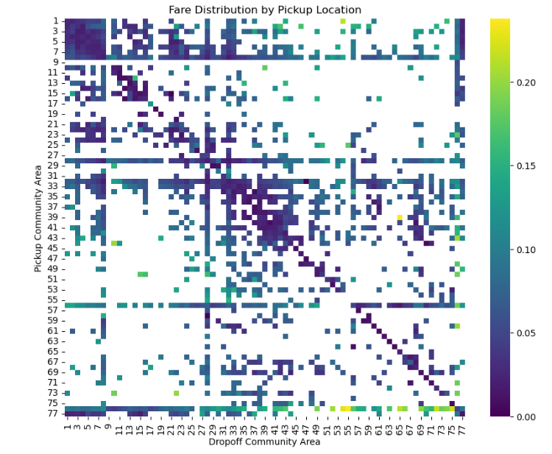

Slide 15
Implementing Digital Payment Solutions
Key Findings:
Digital payments account for 61.78% of transactions.
Clear preference for cashless transactions.
Strategic Recommendations:
Expand digital payment options.
Enhance payment experience for customers.

Slide 16
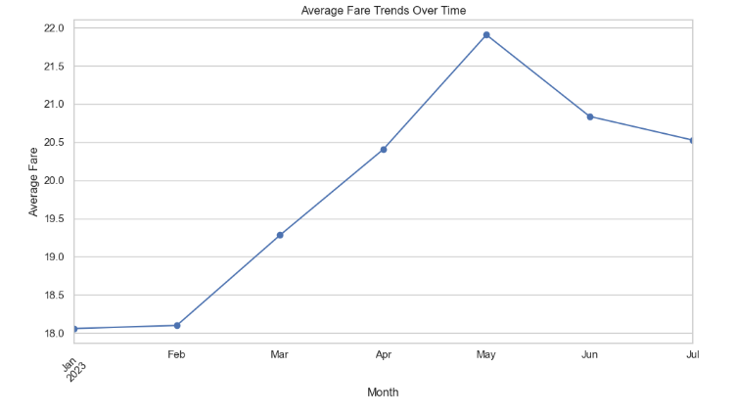

Slide 18
Analyzing Fare Structures
Key Findings:
Average fare per trip: 4.93 cents (std dev: 4.07 cents).
Variability in fare amounts based on trip characteristics.
Strategic Recommendations:
Conduct thorough analysis of fare structures.
Set competitive yet sustainable fare pricing.

Slide 19
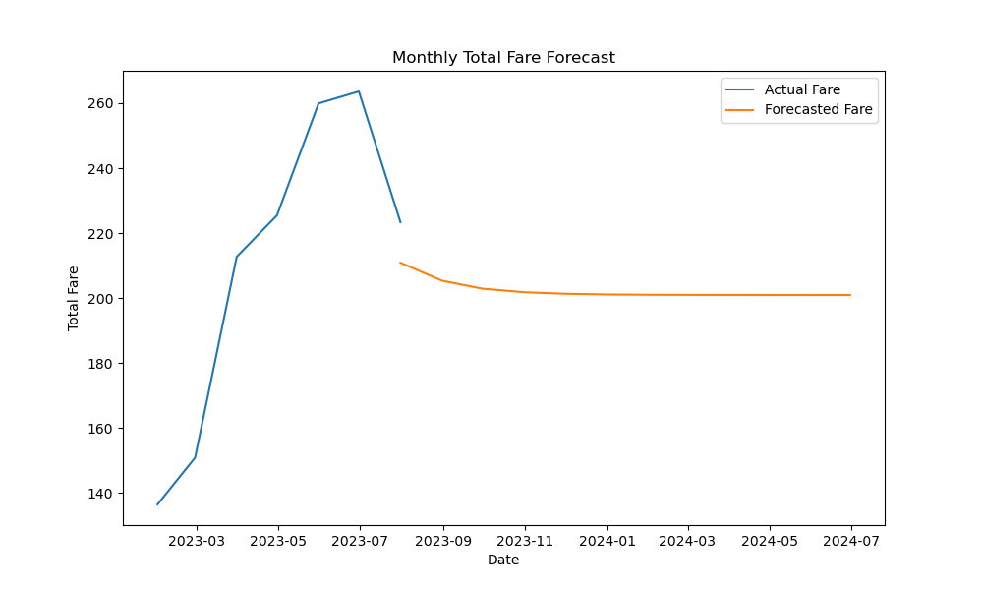

Slide 20
Forecasting Total Fare
Forecasted Fare Range:
From $200.96 to $210.90 per month.
Indicates a stable trend in revenue generation from taxi trips.
Strategic Insights:
Aligns with previous trends observed in the data.
Consider external factors influencing fare trends.

Slide 21
Regression Analysis
Correlations:
Trip duration has a small positive correlation with fare.
Distance has a strong positive correlation with fare.
Statistical Significance:
Both time and distance are statistically significant factors.
Model Fit:
Explains about 70.4% of fare variability based on time and distance.
Interpretation:
Each additional second of trip duration increases fare slightly.
Each additional mile traveled increases fare substantially.

Slide 22
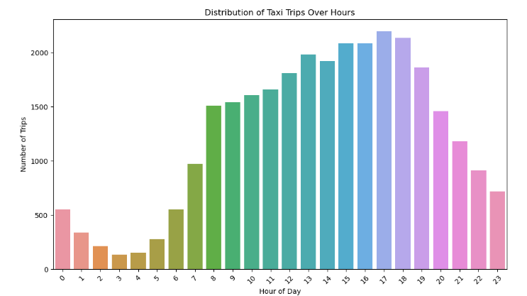
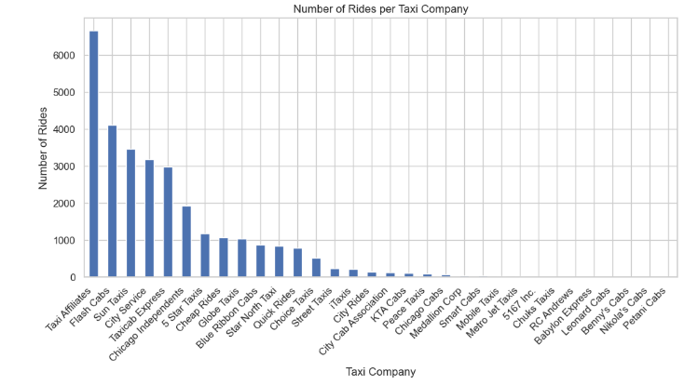
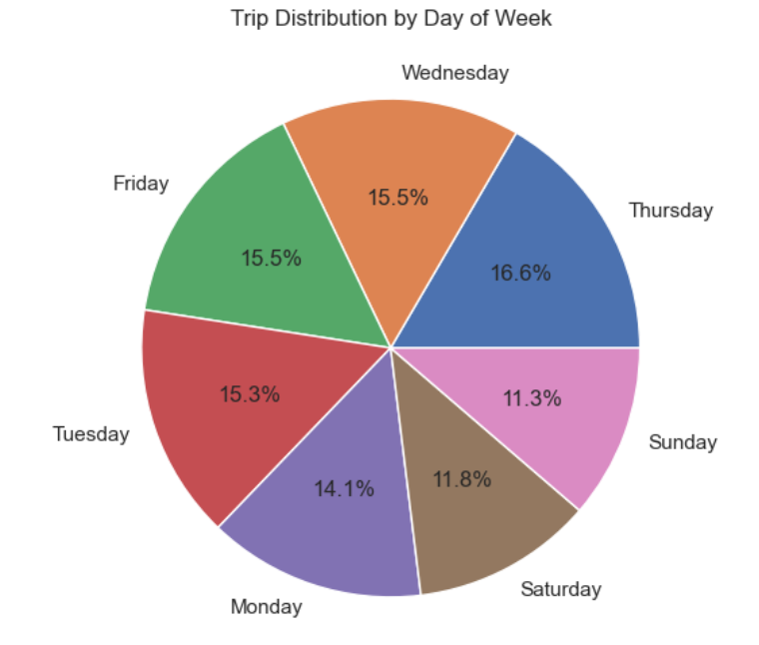
Additional Visuals

Slide 23
Additional Visuals

Slide 24
Additional Visuals

Slide 25
Additional Visuals

Slide 26
Conclusion
Payment Types: Cash, credit card, and mobile payments are prevalent, suggesting a need for enhanced digital payment solutions.
Route Optimization: Trip duration and distance analysis indicate opportunities for optimizing routes to improve efficiency and cost savings.
Digital Payments: Growing preference for digital payments highlights the importance of expanding digital payment options.
Fare Analysis: Variability in fare structures calls for a comprehensive analysis to ensure competitiveness and profitability.
Forecasting: ARIMA forecasting predicts stable total fare trends, aiding in strategic planning and resource allocation.

