Slide 1


Slide 2
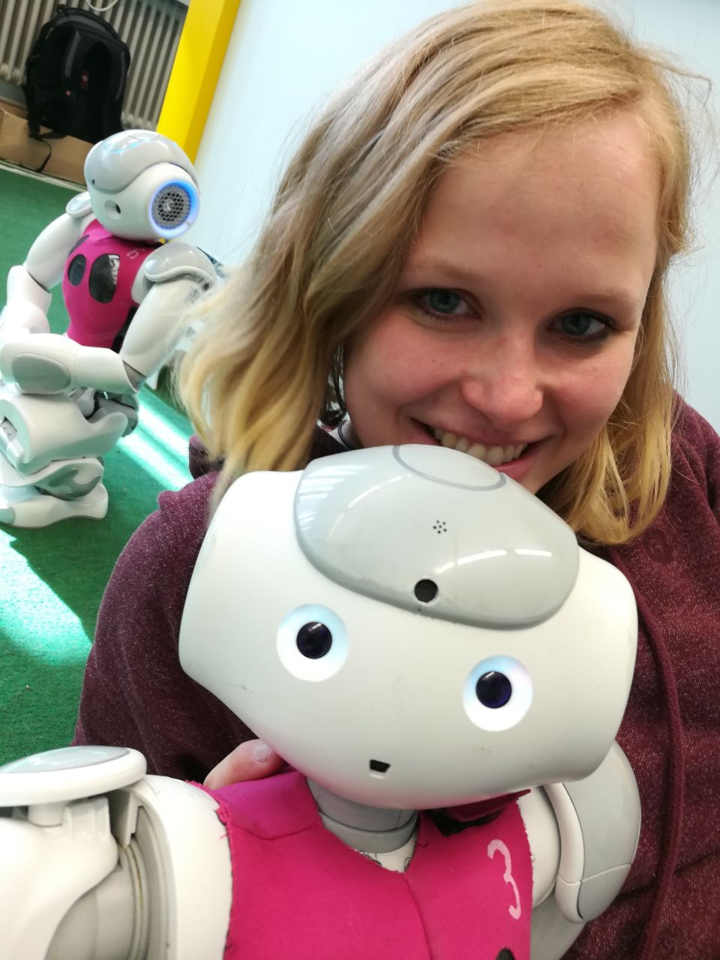
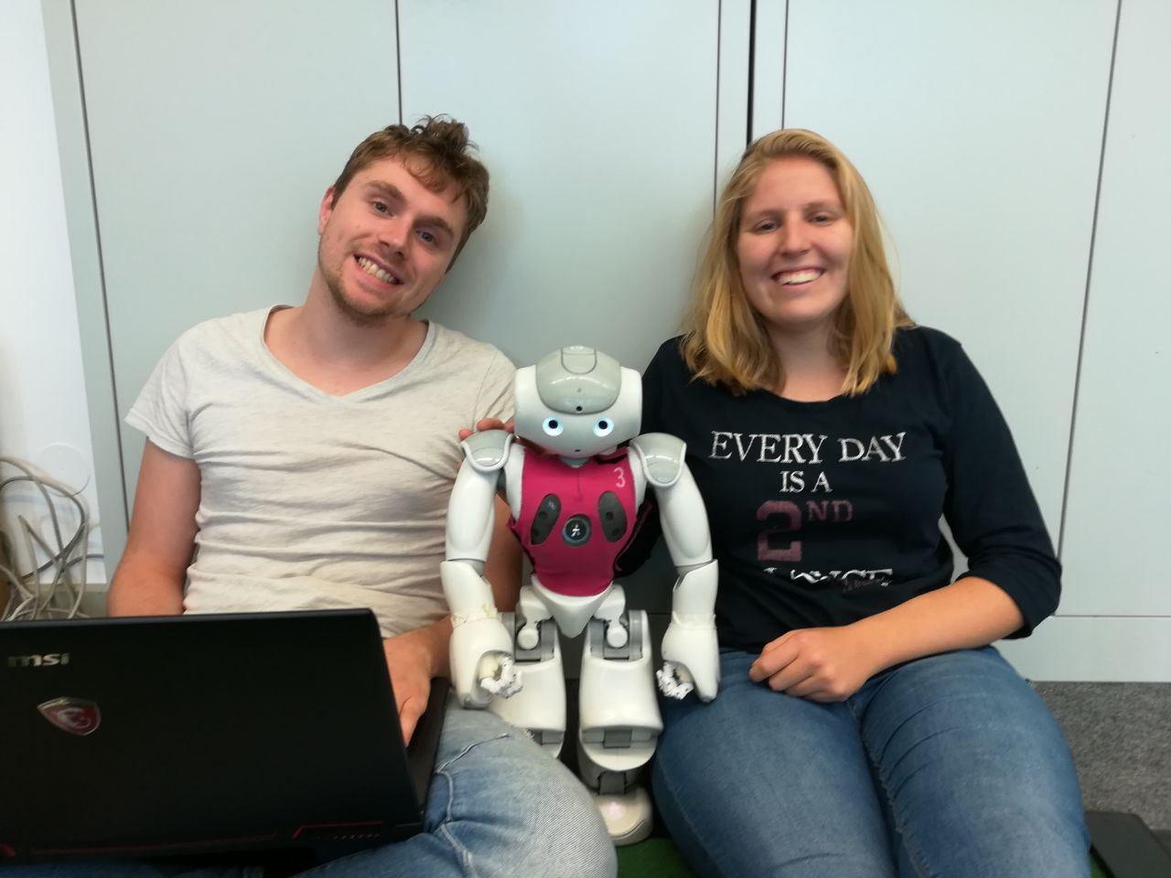
Robi and us
Notes:
HERE WE CAN SPEAK ABOUT OUR GROUP. AT THE BEGINNING WE WERE 6 PEOPLE BUT NOW ONLY 3. WE THOUGH TO DO SOMETHING MORE COMPLEX BUT WE DIDN'T HAVE TIME ENOUGH.

Slide 3
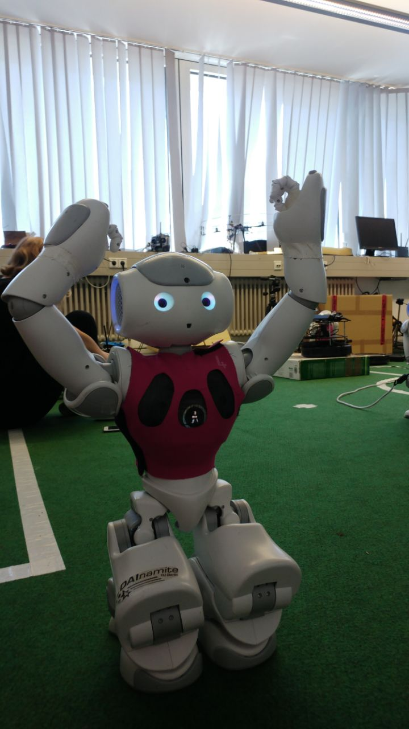
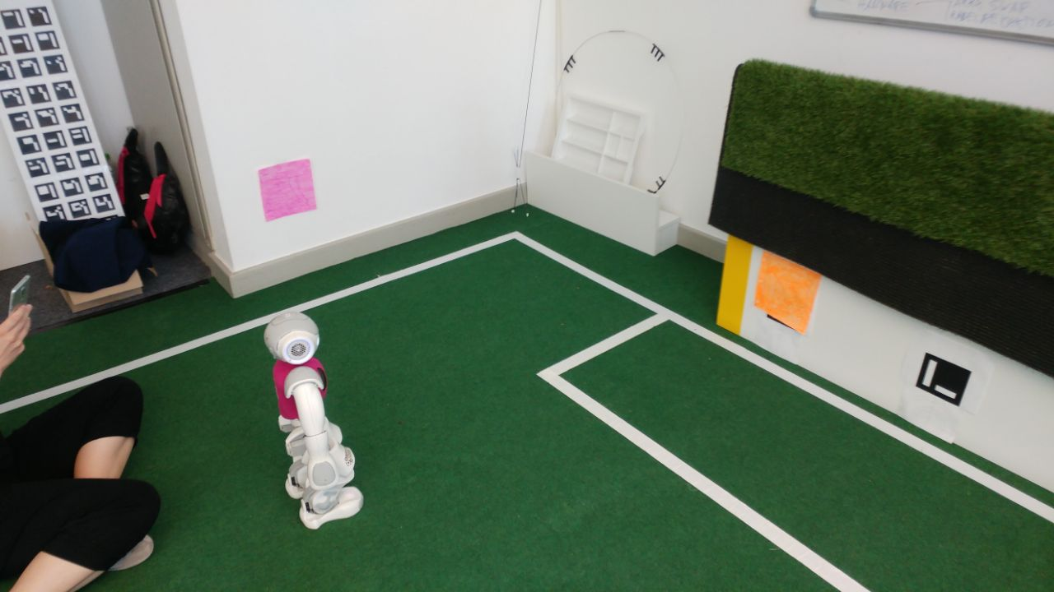
Robi's work
Notes:
HERE WE EXPLAIN THE PROJECT AND HOW ROBI WORKS

Slide 4
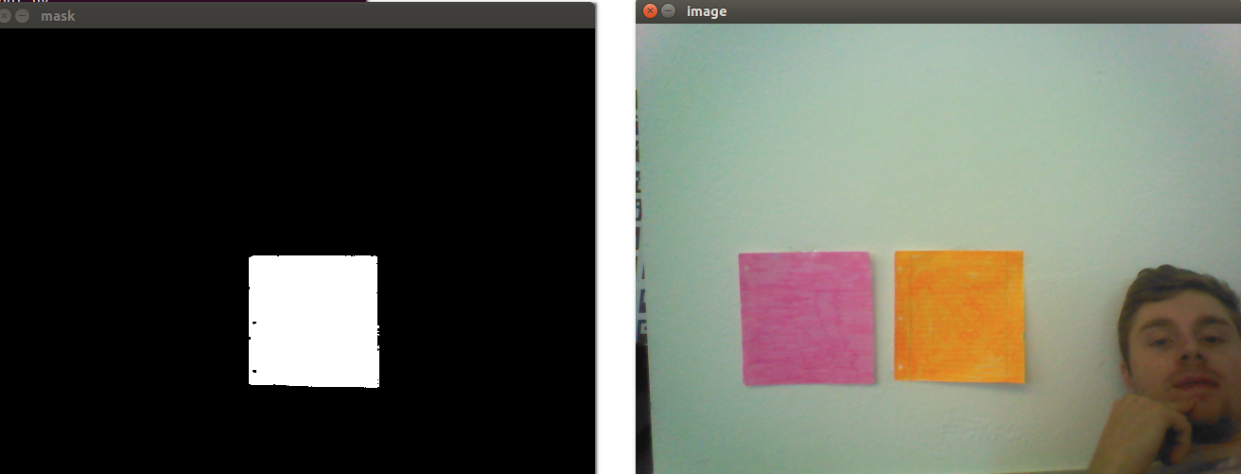
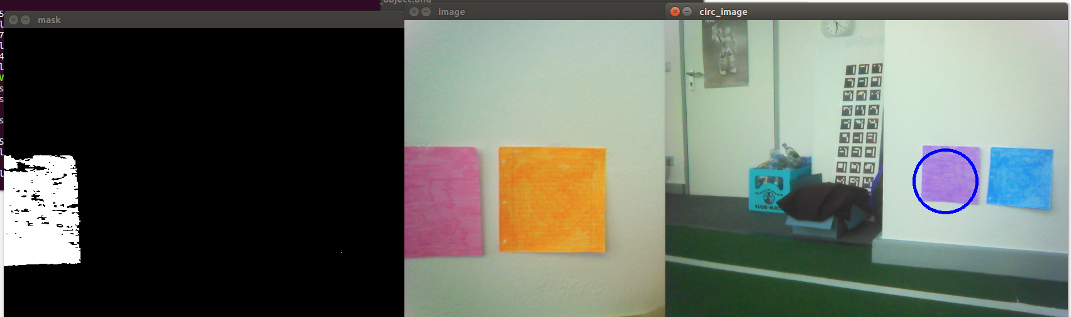

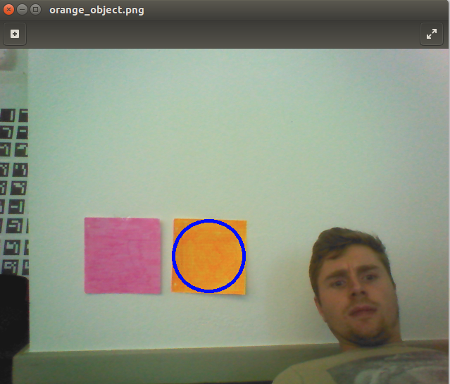
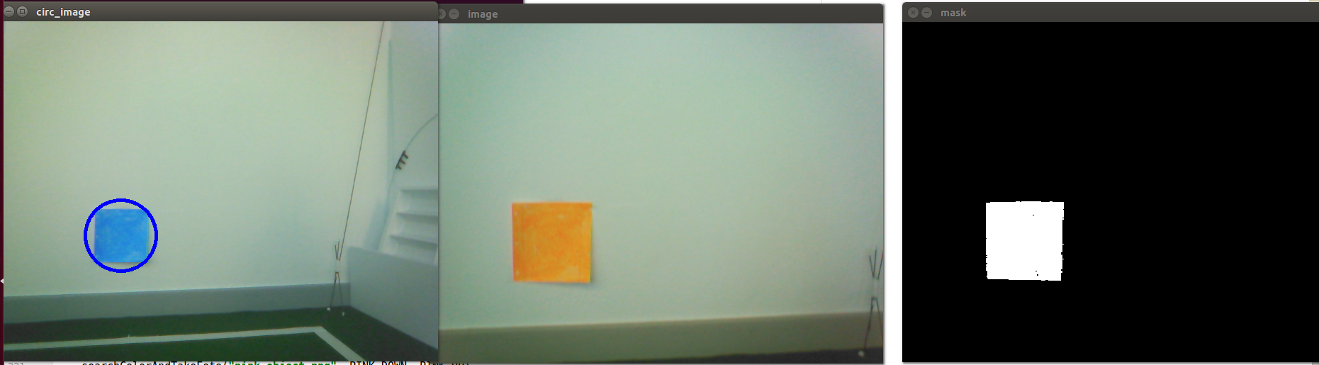
Robi
Notes:
HERE WE CAN EXPLAIN THE OUTPUT OF THE "CODE" . WE CAN EXPLAIN HOW FAR AWAY CAN THE ROBOT BE TO MAKE THE PHOTO OF THE OBJECT....

Slide 5
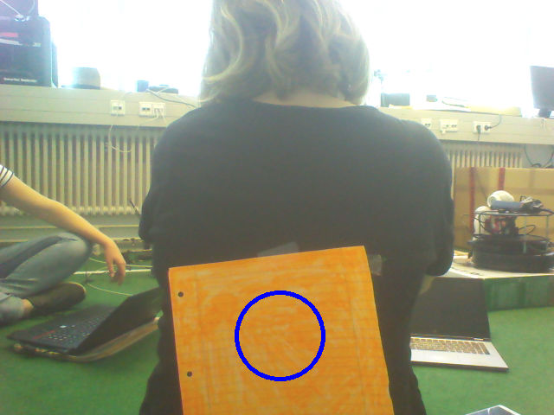
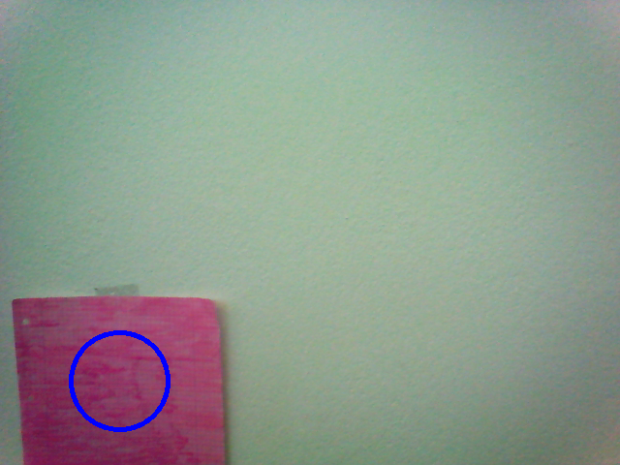
Robi's Target
Notes:
HERE WE EXPLAIN THE PROJECT AND HOW ROBI WORKS

Slide 6

Robi Questions

