Slide 1
First Title & Escrow, Inc.
Training Materials
Page 2: Ordering and Instant HUD-1
Page 13: Closing Cost Calculator
Page 16: Dashboard Transaction Manager
Page 22: Closing Calendar

Slide 2
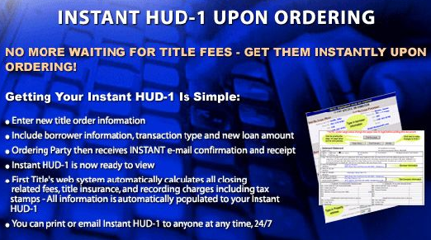
First Title & Escrow, Inc.
Training Materials
Section I – Ordering and Instant HUD-1

Slide 3

Click here to
Log in.

Slide 4

Enter your username and password.

Slide 5
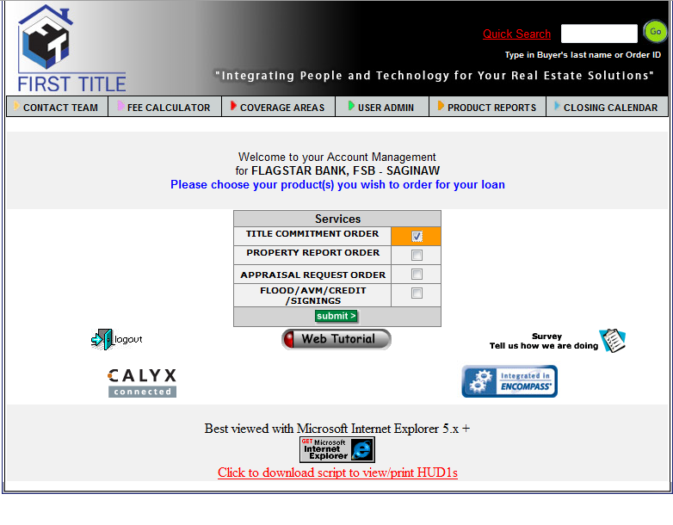
Select a service and click Submit to begin.

Slide 6
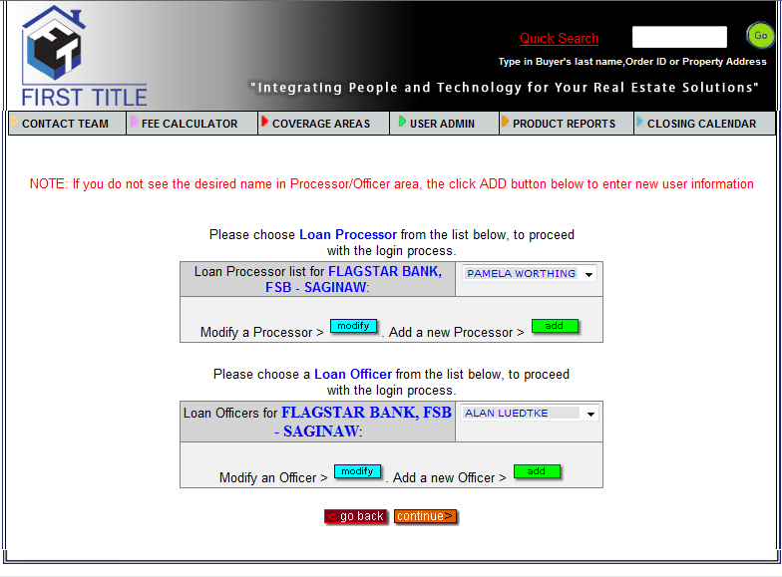
Select Processor from the list.
Select Loan Officer and click “Continue”

Slide 7

Enter the City and State. ZIPCODE is optional (enter 0 if you don’t know).

Slide 8
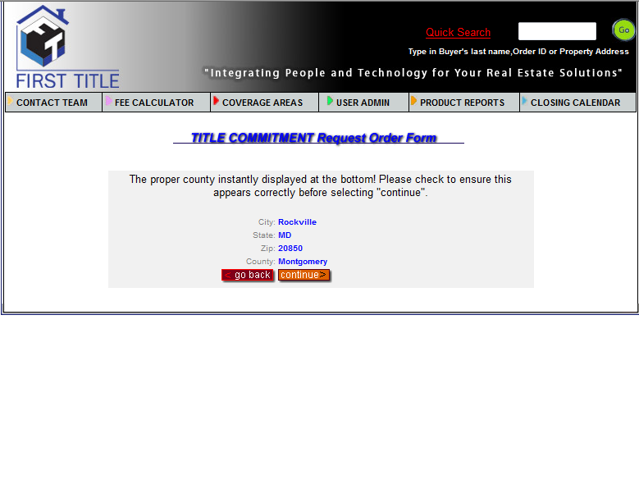
Verify that the information is correct and click Continue to proceed.

Slide 9
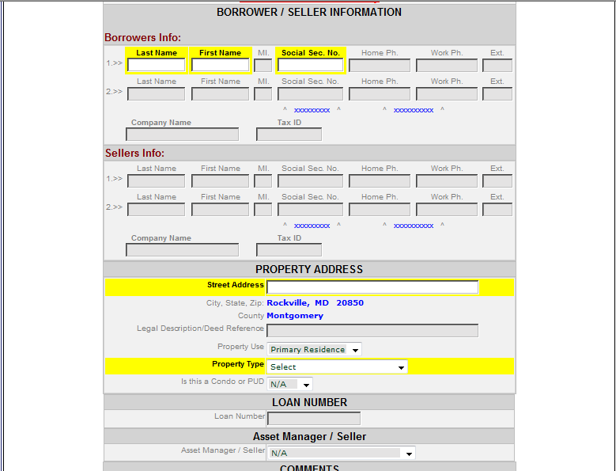
Fill in the required info (highlighted).
Press Submit at the bottom of the form

Slide 10
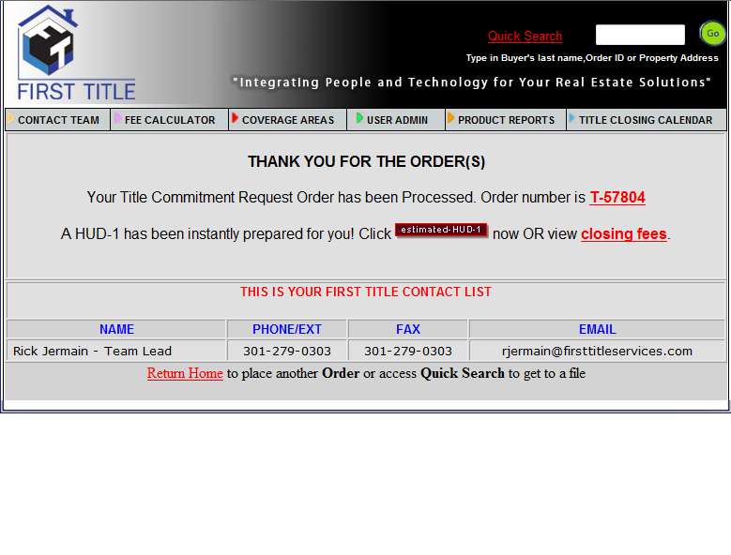
Your order is complete. Click the “Estimated HUD-1” button to view your instant HUD-1.

Slide 11
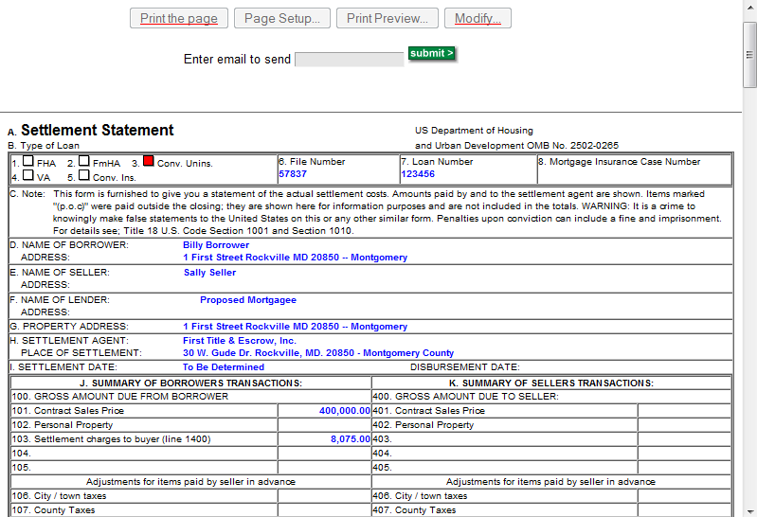
Use the controls at the top of the page to modify and/or email.

Slide 12
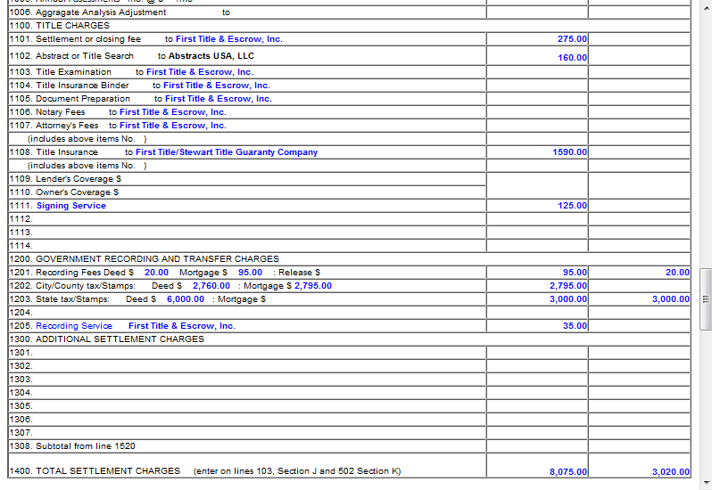
All closing related title insurance and recording fees calculated in seconds!

Slide 13

First Title & Escrow, Inc.
Training Materials
Section II – Closing Cost Calculator

Slide 14
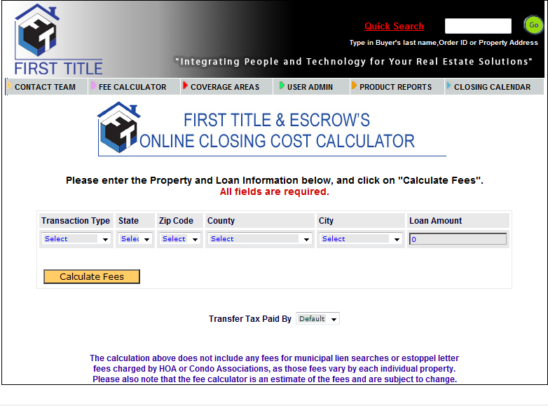
Click here to get instant closing cost quote.
Choose from the available options and click “Calculate Fees” to continue.

Slide 15
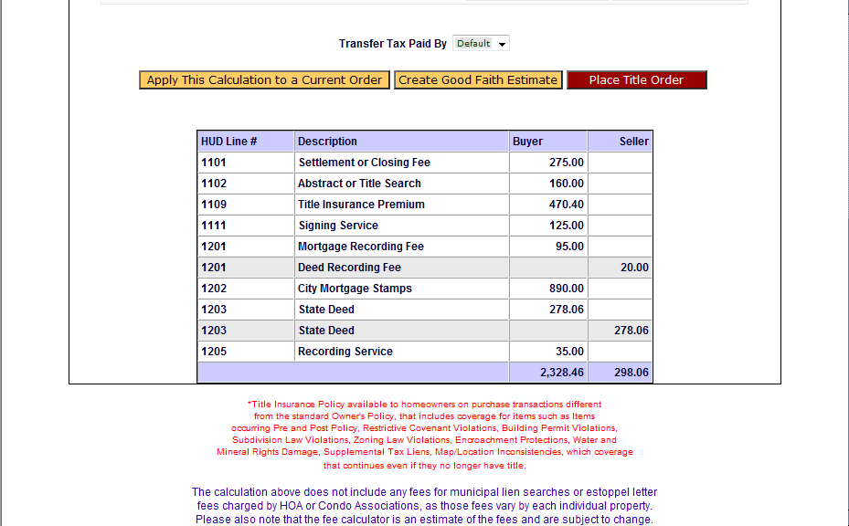
Fees are displayed by Line number!

Slide 16
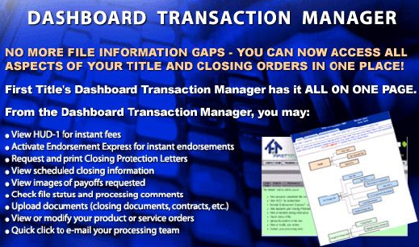
First Title & Escrow, Inc.
Training Materials
Section III – Dashboard Transaction Manager

Slide 17
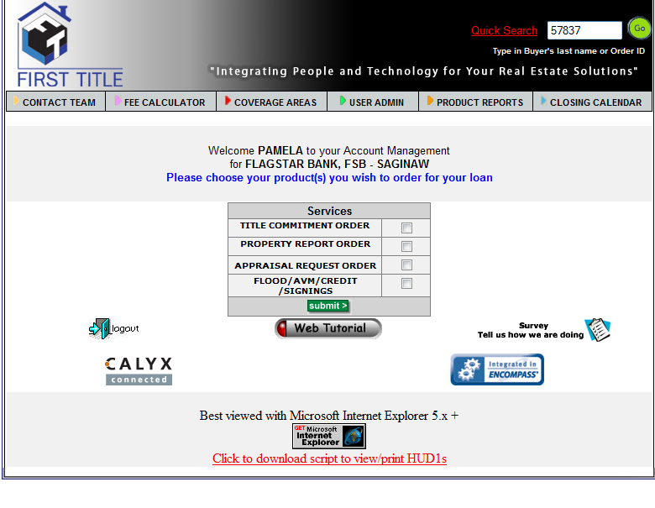
Type in the Order number or borrower last name you wish to see and click GO.

Slide 18
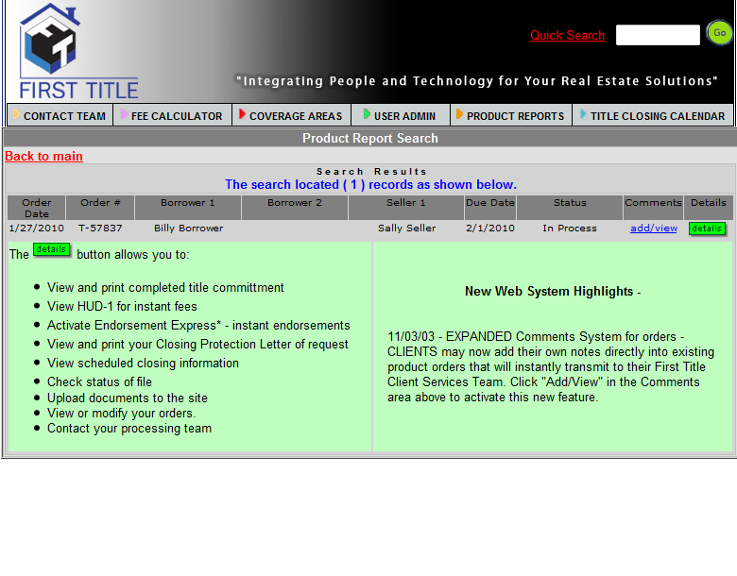
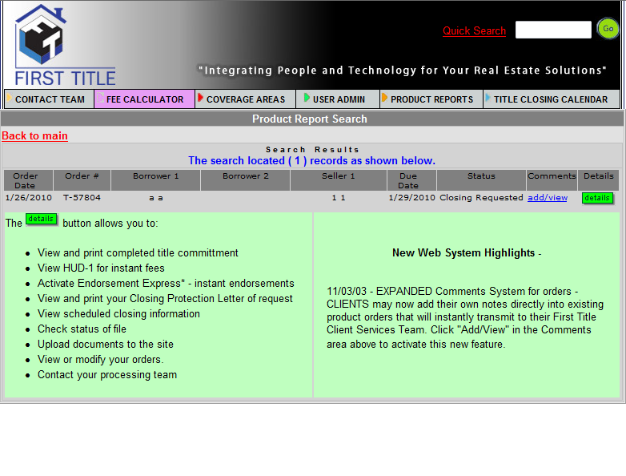
Note the features of the details section.

Slide 19
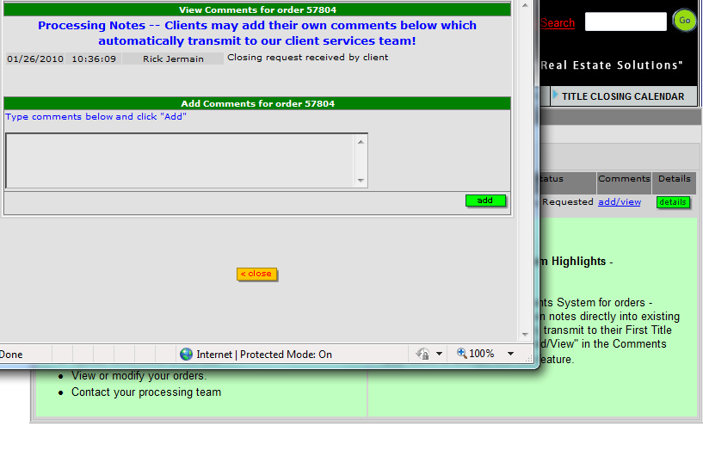
Click to view/add comments to the order.

Slide 20
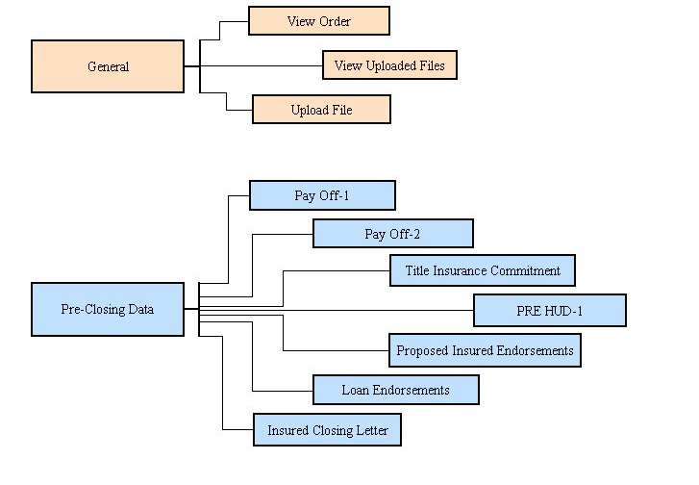
Details Screen 1. All boxes are clickable!

Slide 21
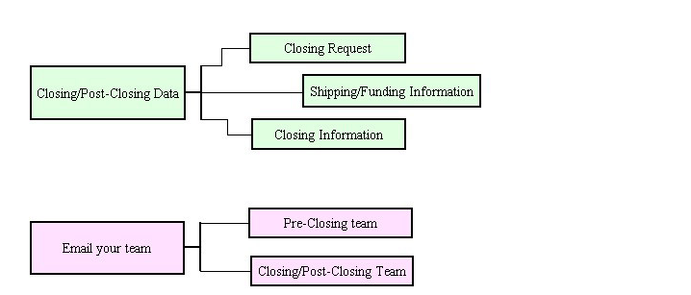
Details Screen 2. All boxes are clickable!

Slide 22
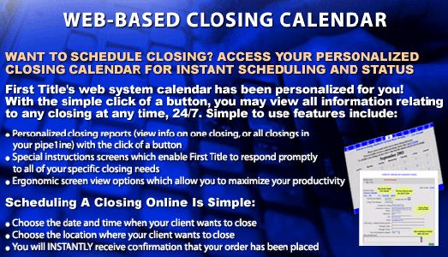
First Title & Escrow, Inc.
Training Materials
Section IV – Closing Calendar

Slide 23
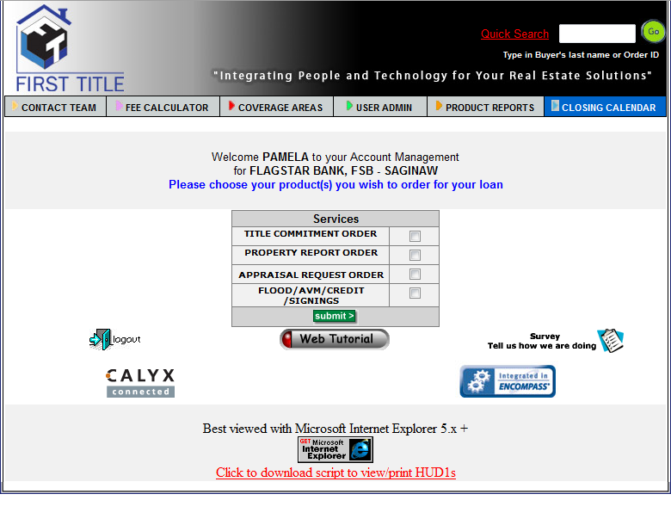
Schedule your closing or simply view your personalized company calendar.

Slide 24
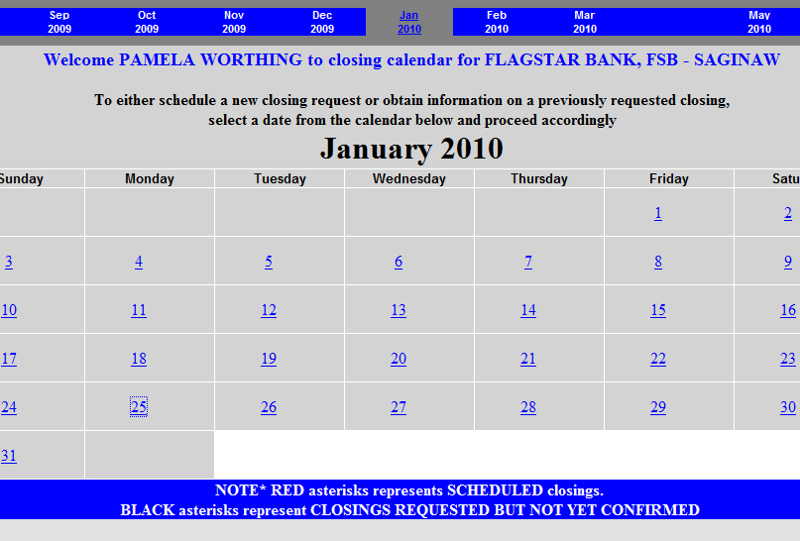
Select a date to request a new closing.

Slide 25
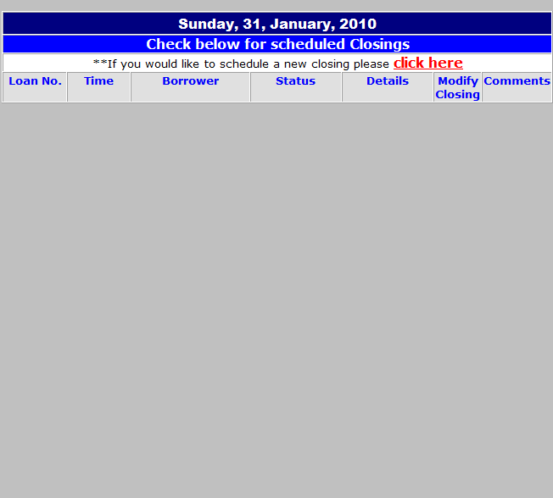
This is the detail screen for the date you chose. Click to schedule a new closing.

Slide 26
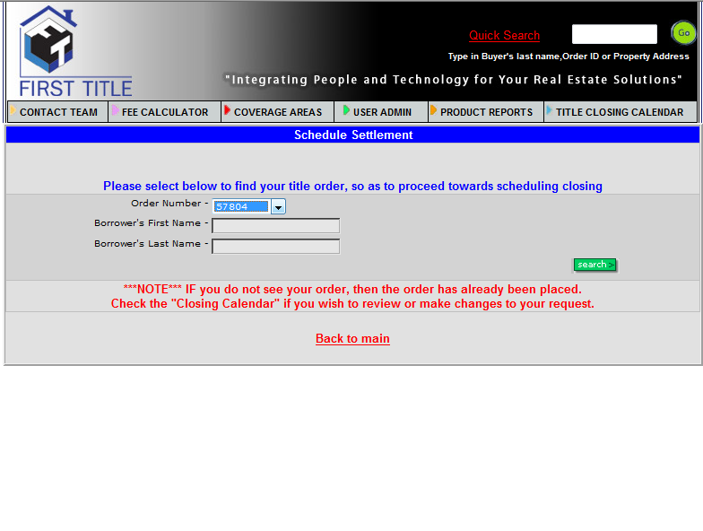
Choose the order or borrower for which you’d like to schedule a closing and click Search.

Slide 27
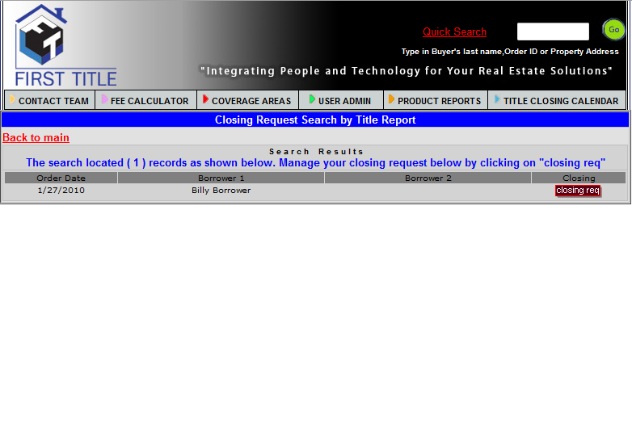
Review order information and click here to request closing.

Slide 28
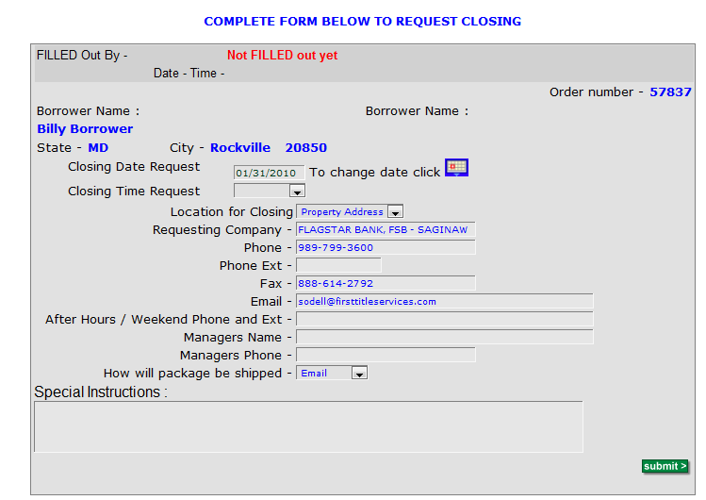
Select a time of day and adjust any other info as necessary and, finally, submit.

Slide 29
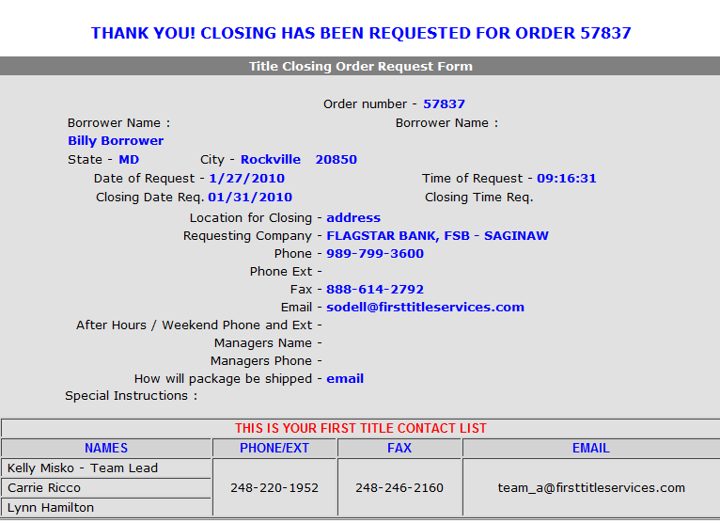
Your order has been placed and you have a handy receipt!

