Slide 1

Check In / Check out Framework Development
BY:
Fisseha Abebe Chari
Jivan Nepali
Umesh Paudyal
Application - Car Rental System

Slide 2
Overview
Check in/Checkout System
Mindsets for Framework Development
GOF Design Patterns Used
Design Diagram [Class Diagram]
Application – Car Rental System
Features
Application Architecture
Demo

Slide 3
Check in / Check out System
Car Rental System
Book Rental System
Library Management
Asset Tracking – e.g. Red-beam Check In Check out Software

Slide 4
Mindsets for Framework Development
Broader level of thinking to include related domains
Equipped with technical knowledge
Special focus on providing cross-cutting features, reducing complexity, simplifying the development work
Decoupling

Slide 5
GOF Patterns Used
Creational
Singleton
Factory
Structural
Decorator
Proxy
Façade
Bridge
Behavioral
Command
Strategy
Template
Iterator

Slide 6
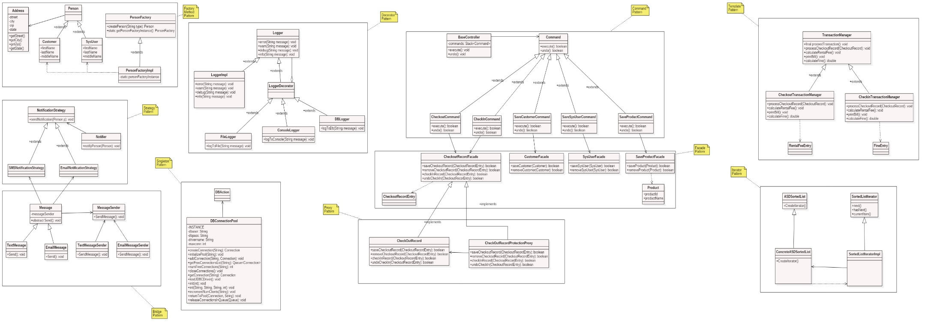
Design Diagram - Class Diagram

Slide 7
Application – Car Rental System
Features - Entities
Features - Transactions
Login/Logout
Car Add/Update/Delete
User Add/Update/Delete
Customer Add/Update/Delete
System Logging
Car Checkout for Rent
Pay Rental Fee
Check back Car In
Pay Overdue Fine
Notify Customer after Checkout
MySQL database for Persistence

Slide 8
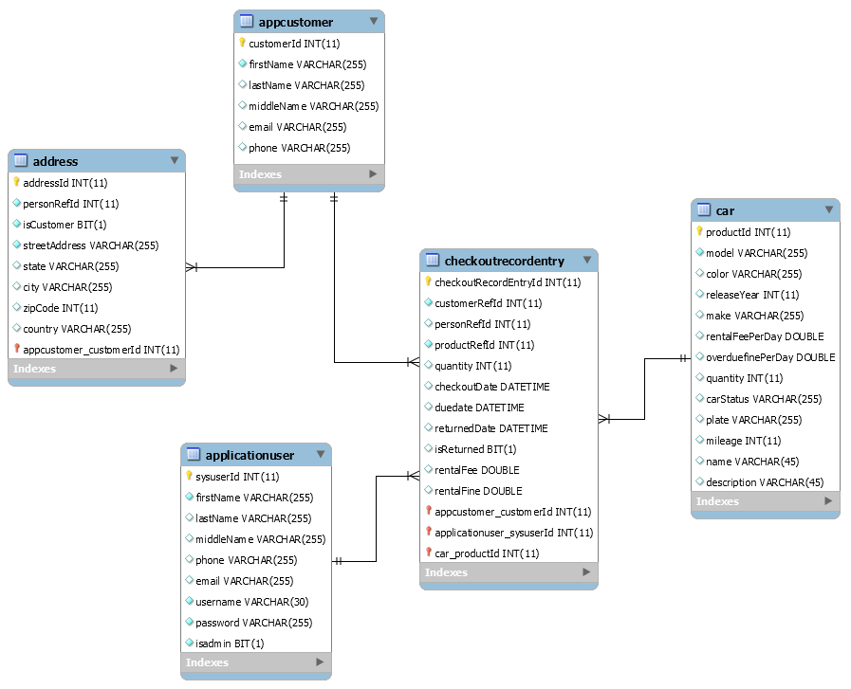
ER Diagram

Slide 9
DEMO – yay!

Slide 10

Questions & Answers Session

