Slide 1




$$V_{world}=WorldTransform∙V_{local}$$
$$WorldTransform=ParentWorldTransform∙T∙T_{pre}∙R_{pre}∙R∙R_{post}^{−1}∙T_{post}^{−1}$$
$$R=R_{axis}$$
$$R=R_{axis_2}R_{axis_1}$$
$$R=R_{z}R_{y}R_{x}$$

Slide 2

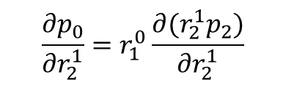


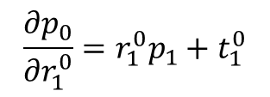
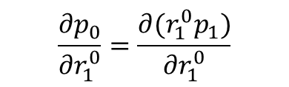

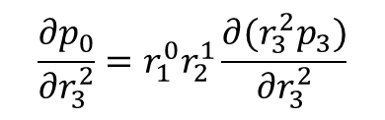
$$V_{world}=WorldTransform∙V_{local}$$
$$WorldTransform=ParentWorldTransform∙T∙T_{pre}∙R_{pre}∙R∙R_{post}^{−1}∙T_{post}^{−1}$$
$$R=R_{axis}$$
$$R=R_{axis_2}R_{axis_1}$$
$$R=R_{z}R_{y}R_{x}$$
$$\frac{{∂p}_{0}}{{∂r}_{1}^{0}}=r_{1}^{0}p_{1}+t_{1}^{0}$$
Joint1
Joint2
$$p_{0}=r_{1}^{0}p_{1}+t_{1}^{0}$$
$$\frac{{∂p}_{0}}{{∂r}_{1}^{0}}=\frac{∂(r_{1}^{0}p_{1})}{{∂r}_{1}^{0}}$$
$$\frac{{∂p}_{0}}{{∂r}_{2}^{1}}=r_{1}^{0}\frac{∂(r_{2}^{1}p_{2})}{{∂r}_{2}^{1}}$$
World
$$p_{1}=r_{2}^{1}p_{2}+t_{2}^{1}$$
$$\frac{∂p_{0}}{∂t_{1}^{0}}=I$$
$$\frac{{∂p}_{0}}{{∂r}_{3}^{2}}=r_{1}^{0}r_{2}^{1}\frac{∂(r_{3}^{2}p_{3})}{{∂r}_{3}^{2}}$$
$$p_{2}=r_{3}^{2}p_{3}+t_{3}^{2}$$
Joint3
Marker

Slide 3





$$R=R_{3}R_{2}R_{1}$$
$$R_{1}=I+\left(1−cosθ_{1}\right){[n_{1}]}_{×}^{2}+sinθ_{1}{[n_{1}]}_{×}$$
$$R_{2}=I+\left(1−cosθ_{2}\right){[n_{2}]}_{×}^{2}+sinθ_{2}{[n_{2}]}_{×}$$
$$R_{3}=I+\left(1−cosθ_{3}\right){[n_{3}]}_{×}^{2}+sinθ_{3}{[n_{3}]}_{×}$$
$$\frac{∂R}{∂θ_{1}}=R_{3}R_{2}\frac{∂R_{1}}{∂θ_{1}}=R_{3}R_{2}(sinθ_{1}{\left[n_{1}\right]}_{×}^{2}+cosθ_{1}{[n_{1}]}_{×})$$
$$\frac{∂R}{∂θ_{2}}=R_{3}\frac{∂R_{2}}{∂θ_{2}}R_{1}=R_{3}(sinθ_{2}{\left[n_{2}\right]}_{×}^{2}+cosθ_{2}{[n_{2}]}_{×})R_{1}$$
$$\frac{∂R}{∂θ_{3}}=\frac{∂R_{3}}{∂θ_{3}}R_{2}R_{1}=(sinθ_{3}{\left[n_{3}\right]}_{×}^{2}+cosθ_{3}{[n_{3}]}_{×})R_{2}R_{1}$$

Slide 4



















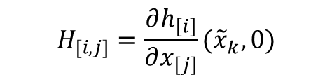







$$x_{k}=f(x_{k−1},u_{k−1},w_{k−1})$$
$$r$$
$$t$$
$$z_{k}=h(x_{k},v_{k})$$
$$x_{j}^{T}=\{r,t\}$$
$$x_{j}^{T}=\{r,\dot{r},t,\dot{t}\}$$
$${\tilde{x}}_{k}=f\left({\hat{x}}_{k−1},u_{k−1},0\right)={\hat{x}}_{k−1}$$
$$x_{j}^{T}=\{r,\dot{r},\ddot{r},t,\dot{t},\dot{t}\}$$
$$z_{k}=h(x_{k},v_{k})$$
$${\tilde{z}}_{k}=h({\tilde{x}}_{k},0)$$
$$x^{T}=\left\{x_{1}^{T},x_{2}^{T},…,x_{J}^{T}\right\}$$
$$F=W=I$$
$$V=I$$
$$x_{k}≈{\tilde{x}}_{k}+F\left(x_{k}−{\hat{x}}_{k−1}\right)+Ww_{k−1}$$
$$H$$
$$z_{k}≈{\tilde{z}}_{k}+H\left(x_{k}−{\tilde{x}}_{k}\right)+Vv_{k}$$
$$x_{k}$$
$$z_{k}$$
$$w_{k−1}$$
$$v_{k}$$
$$H_{[i,j]}=\frac{∂h_{\left[i\right]}}{∂x_{\left[j\right]}}({\tilde{x}}_{k},0)$$
$${\tilde{x}}_{k}$$
$${\tilde{z}}_{k}$$
$$F$$
$$W$$
$$H$$
$$V$$

