Slide 1
Build a recommender system for users to live better with Yelp
Jiachen Zhou 901091
Xintong Yao 991477
Yiran Wang 987751
Ruoyu Wu 947132

Slide 2



Background
Yelp: a matchmaker between customers and business
recommender system
Customer reviews
Business

Slide 3
Motivation
Users have difficulty to unpack long text reviews
Lack of personalized recommendation: each user receives a generic top n most trendy recommendation
Proposed solution: built a user recommender system
Recommend business based on users’ profiles AND/OR their reviews

Slide 4
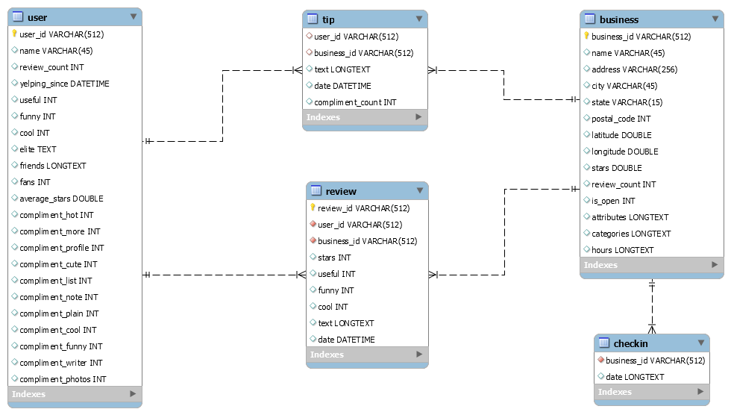
Dataset structure
2 million
0.2 million
8 million

Slide 5


Slide 6
META DATA

Slide 7
NLP CONTENT-BASED

Slide 8
Methodology -- Content-Based Recommender System
Stochastic Gradient Descent (SGD)
Act as Baseline
Pros
Fast Computation
Converge faster with large data
Cons
Sensitive to feature scaling
Random Forest (RF) Regressor
Combine with metadata
Pros
Good performance with high dimensional data
Toleration on data types

Slide 9
Methodology -- NLP Content-Based Recommender System
Procedures:
Natural Language Processing (NLP) Preparation
Simple Neural Network
Long Short-term Memory Neural Network (LSTM)
Bidirectional Encoder Representations from Transformers

Slide 10
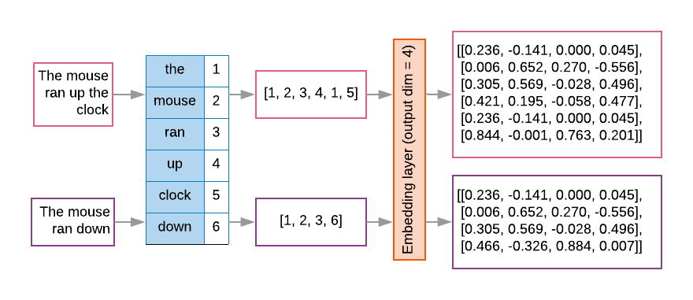
Natural Language Processing (NLP) Preparation
Spacy
Multiple size of dictionaries integrated
Utility for Entity-linking
Tensorflow Tokenizer
Word Embedding
NLTK
Corpus - Stopwords
Stemming words cleaning
Vectors

Slide 11
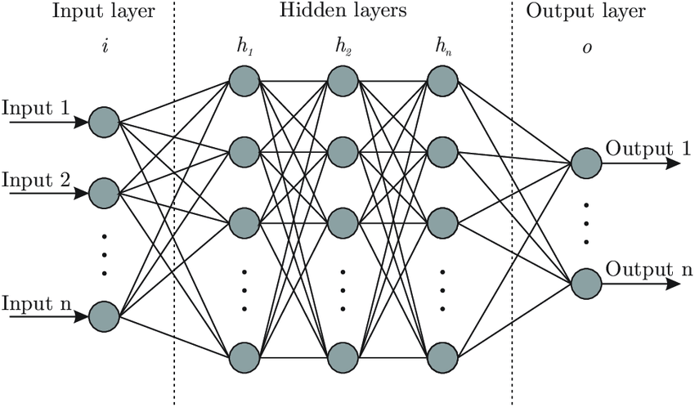
Simple Neural Network

Slide 12
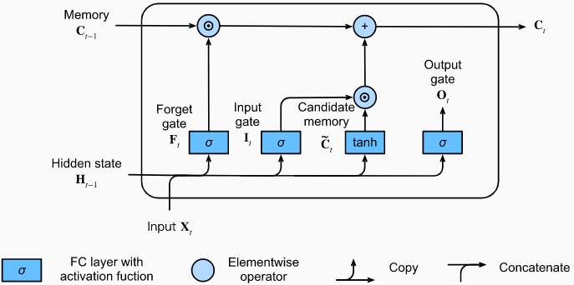
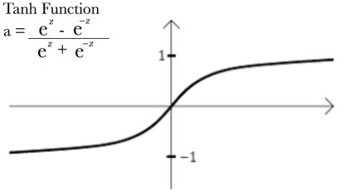
Long Short-term Memory Neural Network (LSTM)

Slide 13
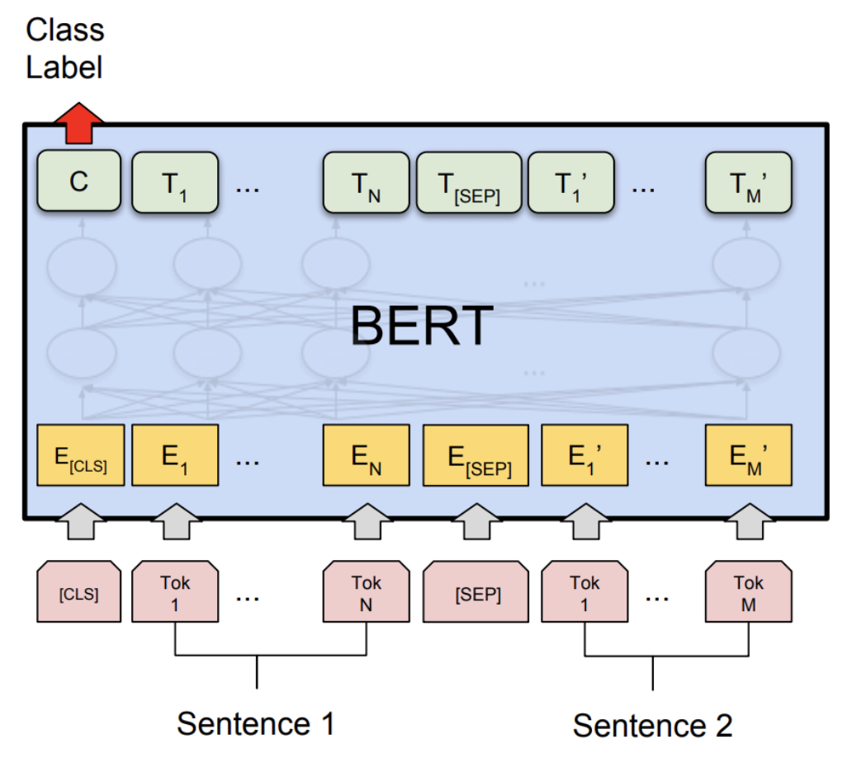
Bidirectional Encoder Representations from Transformers (BERT)

Slide 14
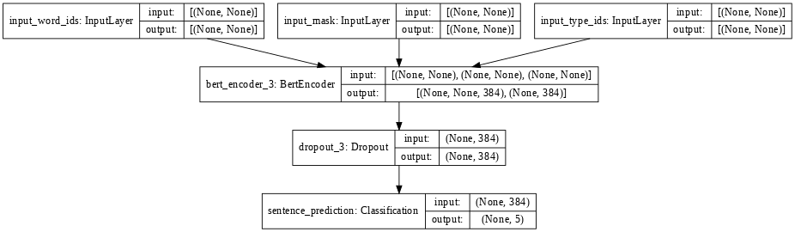
Bidirectional Encoder Representations from Transformers (BERT)
Hidden size

Slide 15



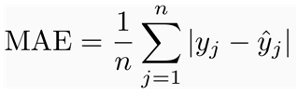
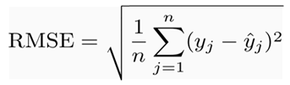
Evaluation
Goal: minimise error for predicting user’s rating
Mean Absolute Error (MAE)
Equal weight on individuals
Expected error magnitude
No bias to extreme values
Holistic view
Root Mean Squared Error (RMSE)
Higher weight to larger errors
Spreadness of residuals
Sensitive to outliers
Similarity between MAE and RMSE
Average model prediction error
Negatively oriented scores

Slide 16
Expectation and Conclusion
Method | MAE (temp) | RMSE (temp)
SGD Baseline | 1.4844 | 1.2774
Random Forest | 0.8590 | 1.1968
Simple Neural Network | 0.7670 | 0.9721
LSTM | 0.5117 | 0.7346
Bidirectional LSTM | 0.4899 | 0.7232
BERT-Custom (Tiny) | 0.4791 | 0.7365

Slide 17
Reference
Bre, F. (2017). Fig. 1. Artificial neural network architecture (ANN i-h 1-h 2-h n-o). In ResearchGate. https://www.researchgate.net/figure/Artificial-neural-network-architecture-ANN-i-h-1-h-2-h-n-o_fig1_321259051
Donges, N. (2019, August 2). Activation Functions within Neural Networks. Experfy Insights. https://www.experfy.com/blog/activation-functions-within-neural-networks/
Google Developer. (2020a). Step 3: Prepare Your Data | ML Universal Guides. In Google Developers. https://developers.google.com/machine-learning/guides/text-classification/step-3
PyTorch. (2020b). WELCOME TO PYTORCH TUTORIALS. In Pytorch.org. https://pytorch.org/tutorials/_images/bert.png
says, K. D. (2012). Using Mean Absolute Error to Forecast Accuracy. In Contemporary Analysis. https://canworksmart.com/using-mean-absolute-error-forecast-accuracy/#:~:text=MAE%20is%20simply%2C%20as%20the
Zhang, A. (2020). 9.2. Long Short Term Memory (LSTM) — Dive into Deep Learning 0.14.4 documentation. D2l.Ai. https://d2l.ai/chapter_recurrent-modern/lstm.html

Slide 18
THANK YOU!

