Slide 1
Highcharts
Getting started

Slide 2
Getting Started
0. Add index.html and app.js to the project folder.
1. Include HighCharts CDN in your html.
2. Attach Highcharts to the DOM as a eventlistener to the ‘DOMContentLoaded’ event.
3. Define ‘categories’ array for xAxis
4. Define series array for yAxis.
5. Output from above should be a line chart.
6. add chart:{
type:'column'
},

Slide 3
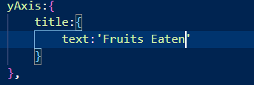

7. Output from the changes in Step 6 should be a ‘column chart’
8. Change the chart type to ‘bar’ , ‘scatter’, ‘area’ and ‘areaspline’ and check the output
9. Add
10. Add
11. For more
https://api.highcharts.com/highcharts/

