Slide 1
Future of SRM
Supply Chain Attacks
“Supply chain attacks are a major cyber threat facing organisations and incidents can have a profound, long-lasting impact on businesses and customers,” (NCSC, 2022).
742% increase in supply chain attacks in past 3 years (Sonatype, 2023)
New, detailed guidance issued for businesses by NCSC in 2022

Slide 2
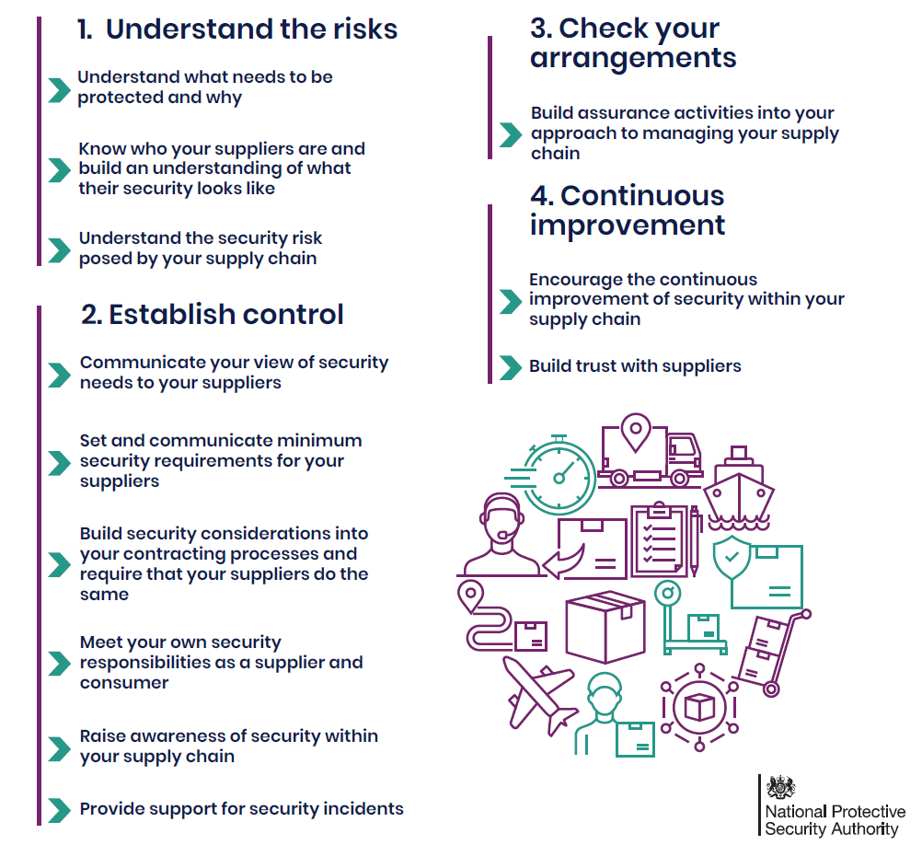
Only 13 % of UK businesses mitigate direct suppliers and only 7% for wider suppliers (NCSC)
WHY? What’s the problem?

Slide 3
Human Resources
Finance
E-commerce
Pampered Pets
Remote IT Infrastructure
Manufacturing
Order control
Local IT Infrastructure
Machine control
Inventory Control
Environmental Control
Large attack surface, but relatively low return on investment for an attacker

Slide 4
Pampered Pets
Mineral wholesaler
Manufacturer.
Logistics company
The investment required to determine the weakest link in a supply chain and attack it, is far less than attacking a target directly.
Many other businesses may be compromised as a result.
Threat actor
Driver Agency
Standard template
Driver agency website
Freelance designer
Web design company
Infected template
malware

Slide 5
1. Awareness
2. Time
3. Capital
4. Expertise
Notes:
Give example of our business and booking engine.

