Slide 1
Abstraction of C&C languages
component F {
port in int a,
out int b,
out int c;
G g;
H h;
a -> g.b;
g.c -> b;
g.d -> h.e;
h.f -> c;
}
MA
SysML v2
1
2
3
4
5
6
7
8
9
10
11
12
13
1
2
3
4
5
6
7
8
9
10
11
12
13
part def F {
port a : IntPort;
port b : ~IntPort;
port c : ~IntPort;
part g : G;
part h : H;
connect a to g.b;
connect g.c to b;
connect g.d to h.e;
connect h.f to c;
}
FSM OD
f:Function
“c”
“b”
“a”
:Channel
“b”
g:Function
“c”
“d”
:Channel
h:Function
“e”
“f”
:Channel
Models of both languages can be mapped onto the function structure model
:Channel

Slide 2
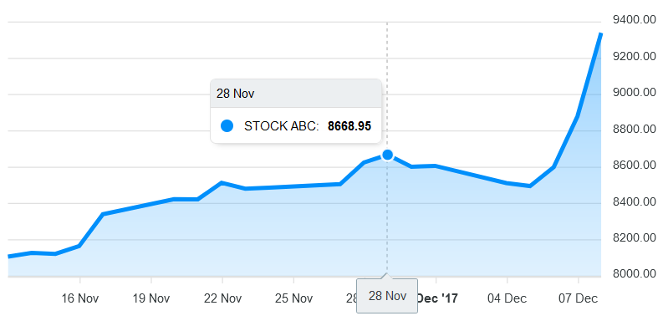
DT Cockpit
component F {
port
in a,
out g,
out h;
G gInstance;
H hInstance;
a -> G.b;
G.c -> g;
G.d -> H.e;
H.f -> h;
}
MA
Containment Tree
1
2
3
4
5
6
7
8
9
10
11
12
13
14
MontiArc Visualization
F: Function
  a: Input
  g: Output
  h: Output
  G: Function
    b: Input
    c: Output
    d: Output
  H: Function
    e: Input
    f: Output
  a -> G.b: Channel
  G.c -> g: Channel
  G.d -> H.e: Channel
  H.f -> h: Channel
F
G
c
g
a
b
d
H
e
f
h
DTCockpit.gui
page DTCockpit(Function mainModel) {
@MAViz(mainModel)
}
Value Visualization

Slide 3
DT Cockpit
component F {
port
in a,
out g,
out h;
G gInstance;
H hInstance;
a -> G.b;
G.c -> g;
G.d -> H.e;
H.f -> h;
}
MA
Containment Tree
1
2
3
4
5
6
7
8
9
10
11
12
13
14
MontiArc Visualization
F: Function
  a: Input
  g: Output
  h: Output
  G: Function
    b: Input
    c: Output
    d: Output
  H: Function
    e: Input
    f: Output
  a -> G.b: Channel
  G.c -> g: Channel
  G.d -> H.e: Channel
  H.f -> h: Channel
F
G
c
g
a
b
d
H
e
f
h
▪▪▪
▪▪▪
▪▪▪
FunctionStructure
Model
DTCockpit.gui
page DTCockpit(Function mainModel) {
@MAViz(mainModel)
}
conforms to
MA2
Fenix
Fenix
CD2Gui
Value Visualization
▪▪▪
▪▪▪
▪▪▪
▪▪▪
▪▪▪
▪▪▪
MontiArc
FunctionStructure
Gui

Slide 4
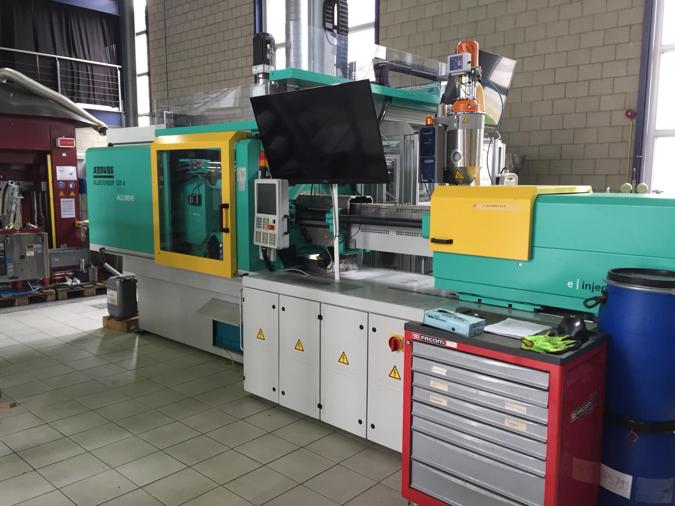
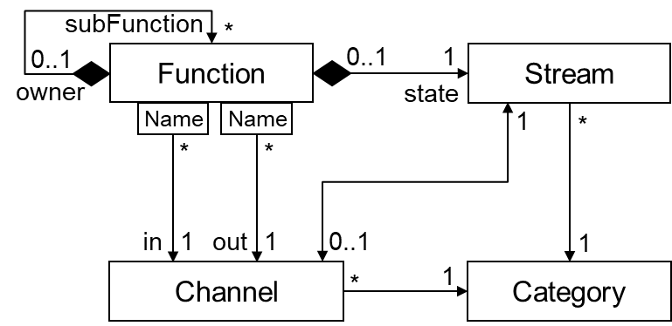

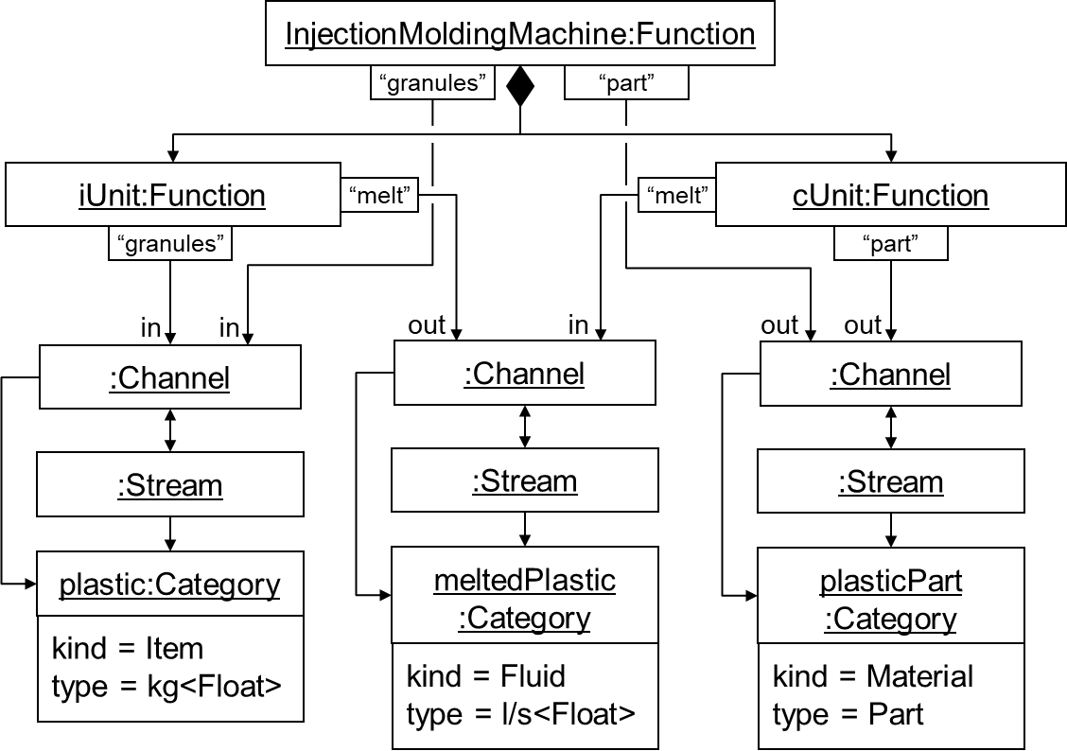
Function-Structure Model: Abstraction of C&C languages
InjectionMoldingMachine IMM
FSM CD
InjectionUnit
Clamping
Unit
granules
Material
granules
melt
Material
melt
part
Item
part
Function
Structure
Model
part def IMM {
port granules: MatPort;
port part : ~ItemPort;
part iUnit : InjectionUnit;
part cUnit : ClampingUnit;
connect granules to
iUnit.granules;
connect iUnit.melt to
cUnit.melt;
connect cUnit.part to part;
}
1
2
3
4
5
6
7
8
9
10
11
SysML v2
1
2
3
4
5
6
7
8
9
10
11
component IMM {
port in Material granules,
out Item part;
InjectionUnit iUnit;
ClampingUnit cUnit;
granules -> iUnit.granules;
iUnit.melt -> cUnit.melt;
cUnit.part -> part;
}
instantiates
MA
FSM OD
Function
Structure
Map to the same function structure

Slide 5
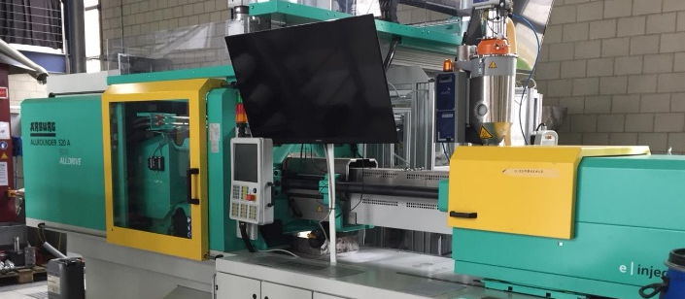
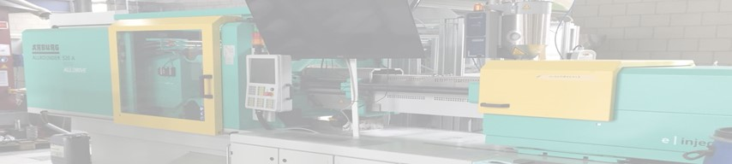
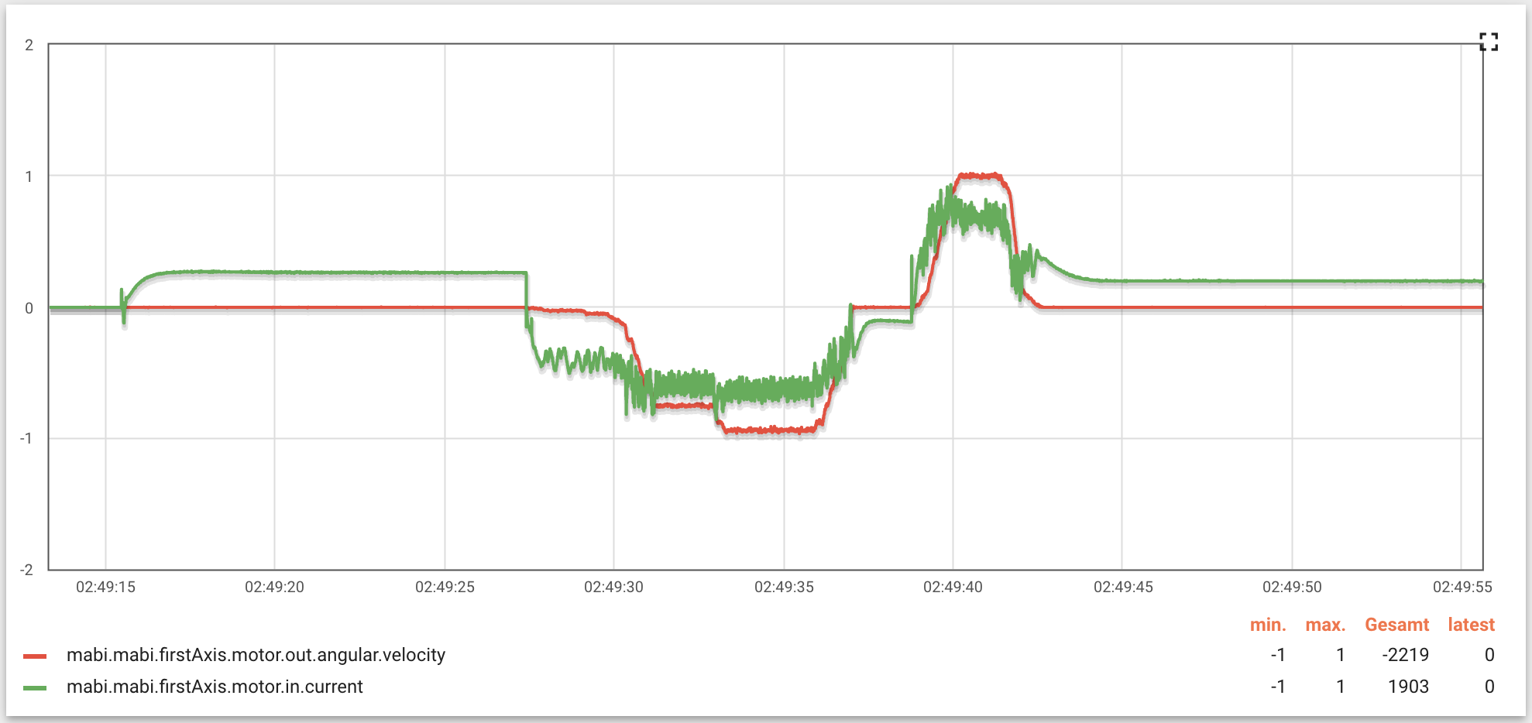
DT Cockpit – Containment Visualization
Containment Tree
Structure Visualization
imm: Function
  granules: Input <Material>
  part: Output <Item>
  iUnit: Function
    granules: Input <Material>
    melt: Output <Material>
  cUnit: Function
    melt: Input <Material>
    f: Output
  granules iUnit.granules
  iUnit.melt cUnit.melt
  cUnit.part part
InjectionMoldingMachine IMM
InjectionUnit
iUnit
granules
Material
granules
melt
Material
described by
ClampingUnit
cUnit
SysML v2
melt
part
Item
part
part def IMM {
…
}
DTCockpit.gui
page DTCockpit(Function function) {
@StructureViz(function)
}
Value Visualization

Slide 6
DT Cockpit – Containment Visualization
Containment Tree
Structure Visualization
imm: Function
  granules: Input <Material>
  part: Output <Item>
  iUnit: Function
    granules: Input <Material>
    melt: Output <Material>
  cUnit: Function
    melt: Input <Material>
    f: Output
  granules iUnit.granules
  iUnit.melt cUnit.melt
  cUnit.part part
InjectionMoldingMachine IMM
InjectionUnit
iUnit
granules
Material
granules
melt
Material
described by
ClampingUnit
cUnit
SysML v2
melt
part
Item
part
part def IMM {
…
}
▪▪▪
▪▪▪
▪▪▪
Structure
Extractor
FunctionStructure
Model
Model-driven visualization
DTCockpit.gui
page DTCockpit(Function function) {
@StructureViz(function)
}
conforms to
Value Visualization
▪▪▪
▪▪▪
▪▪▪
▪▪▪
▪▪▪
▪▪▪
SysML
FunctionStructure
Gui

