Slide 1
FunctionStructure Reference Model
CPF
Energy
Material
Cyber-
Physical System
Software Engineering
RWTH Aachen
http://www.se-rwth.de/
Data

Slide 2
FunctionStructure : das Referenzmodell
FunctionStructure beschreibt die funktionale Struktur von Maschinen, Produkten, verteilt arbeitender Software
Beschrieben wird die Funktion eines Systems (oder einer Komponente)
in Form von Input- und Output-Kanälen
mit konkreter, zumeist getypter Signatur.
Auf den Kanälen fließen energetische-, physikalische- oder Datenströme, diese können als diskrete Events (Button, Schraube) oder kontinuierlicher Fluss (Wasser, Strom, Wärme) verstanden (und modelliert) werden.
Funktionen sind dekomponiert in Substrukturen (Architekturen), die ihrerseits über interne Kanäle interagieren
Funktionen können einen internen Zustand haben (und auf durch die Interaktionen mit der Umgebung wechseln)
Nicht mehr dargestellt:
Die Funktionen können komplexe Eigenschaften besitzen, brechen sich aber letztlich runter auf entweder reine Software, Sensoren, Aktuatoren oder elementare physikalische Funktionen, wie sie der Koller-Katalog in Form von etwa 300 Stück kennt

Slide 3
FunctionStructure
FunctionStructure
wird primär definiert durch ein Klassendiagramm
  Welches ist es denn jetzt?
und assoziierte OCL- Constraints
  Welches ist es denn jetzt?
Die die grundsätzliche Struktur der Schnittstellen, und die hierarchische Dekomposition inclusive der Verschaltung innerer Strukturen dekomponierter Systeme repräsentieren.

Slide 4
FunctionStructure : the CD
hierarchical tree structure
Function has a signature
  Named input channels and
  Named output channels
Channels contain observations:
  modelled as streams of values
Function contain state:
  observed as stream of states
Time series of
observed values
CD
subFunction
*
0..1
Function
0..1
1
Stream
owner
state
Name
Name
1
*
port
*
*
in
1
out
1
0..1
1
Channel
*
1
Category
Material, Data, Energy
using UnitTypes and IT-Datatypes, e.g.
diesel fluid in l/s,
data as classes, records, numbers

Slide 5
FunctionStructure : Streams
hierarchical tree structure
Each channel and each stream has a category
Category describes the form of a stream respectively its values
  Continuous vs. discrete
  Physical, vs. energetic, vs. data
  Typing (SI-Units or datatypes)
Type compatibility
  Channels and their streams have the same category
  Connected channels have the same category
Time series of
observed values
CD
subFunction
*
0..1
Function
0..1
1
Stream
owner
state
Name
Name
1
*
port
*
*
in
1
out
1
0..1
1
Channel
*
1
Category
Material, Data, Energy
using UnitTypes and IT-Datatypes, e.g.
diesel fluid in l/s,
data as classes, records, numbers

Slide 6
FunctionStructure : Decomposition
hierarchical tree structure
Hierarchical (de-) composition possible
  Composition into a tree-structure
  with atomic functions
Functions are connected through channels
  Sharing the same channel:
  one component is sending “out” and
  some components are receiving “in”
  (see later instance examples)
Functions know their channels through port names
Time series of
observed values
CD
subFunction
*
0..1
Function
0..1
1
Stream
owner
state
Name
Name
1
*
port
*
*
in
1
out
1
0..1
1
Channel
*
1
Category
Material, Data, Energy
using UnitTypes and IT-Datatypes, e.g.
diesel fluid in l/s,
data as classes, records, numbers

Slide 7
FunctionStructure : Top-Level-Function
hierarchical tree structure
Special rules:
A top-level function connects to input and output channels, where the opposite side is NOT connected
Channels obey the hierarchy structure
  i.e. if a channel is crossing a component from inside to outside the channel is an explicit output channel of that component
  and vice versa.
Time series of
observed values
CD
subFunction
*
0..1
Function
0..1
1
Stream
owner
state
Name
Name
1
*
port
*
*
in
1
out
1
0..1
1
Channel
*
1
Category
Material, Data, Energy
using UnitTypes and IT-Datatypes, e.g.
diesel fluid in l/s,
data as classes, records, numbers

Slide 8
FunctionStructure + Monitoring Extension
Monitoring
CD
Ideally, each stream can be observed
An observation may be incomplete on a stream
  The physical original may be continuous and only a sample is observed (stored)
  Constrained by a sampling rate
  Or only an interval with start and end time is of interest
Observations can be set on channels and inner states
Data in streams can be of arbitrary defined type
subFunction
*
0..1
0..1
1
1
*
1
Function
Stream
1
Observation
owner
state
Name
Name
1
*
*
0..1
1
{ordered}
*
*
{ordered}
Value
in
1
out
1
0..1
1
1
*
Channel
*
1
Category
1
Material, Data, Energy
using UnitTypes and IT-Datatypes, e.g.
diesel fluid in l/s,
data as classes, records, numbers

Slide 9
Examples

Slide 10
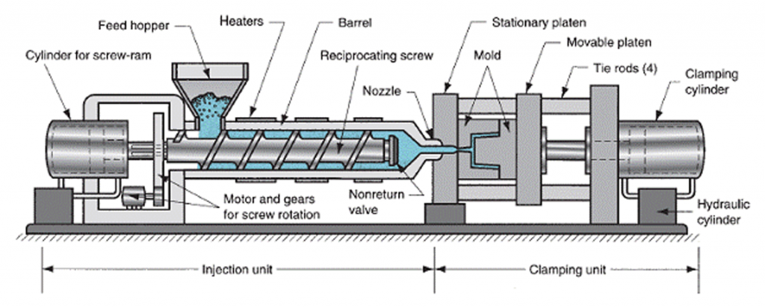
Example system
Functional model of an Injection Molding Machine(IMM)
Input is a flow of plastic granulate
  Measured in [l/s]
Output is finished plastic parts
  Measured by counting [1]
InjectionMoldingMachine
InjectionUnit
Clamping
Unit
Material
Material
Item
granules
granules
melt
melt
part
part

Slide 11
The Example System as an Instantiation of the Function Structure Model
InjectionMoldingMachine:Function
“granules”
“part”
InjectionUnit:Function
“melt”
“melt”
ClampingUnit:Function
“granules”
“part”
:Value
:Value
:LegoBrick
:Channel
value = 1.2
:Channel
value = 2.9
:Channel
…
:Stream
4
:Value
:Stream
4
:Value
:Stream
4
:LegoBrick
5
5
5
value = 2.5
6
value = 2.3
6
…
plastic:Category
melt:Category
plastic:Category
kind = Item
type = kg<Float>
kind = Fluid
type = l/s<Float>
:Value
kind = Material
type = Part
:LegoBrick
value = 1.9
…

Slide 12
Connectors
To fully understand how different kinds of connectors are stored, we take a look on the following examples
Connectors of the outer-most component
Connector between sibling components
Connector from outer- to sub-component
Connector down the component hierarchy
Connector up and down the component hierarchy
Connector split
Connector split from outer- to sub-components

Slide 13
1. Connectors of the outer-most component
OD
F
a
b
F:Function
“a”
“b”
in
out
CD
:Channel
:Channel
subFunction
*
Omitted for Simplicity
0..1
Function
0..1
1
Stream
owner
state
Name
Name
1
*
*
*
in
1
out
1
0..1
1
Channel
*
1
Category

Slide 14
2. Connector between sibling components
F
OD
F:Function
…
G
H
…
a
b
G:Function
H:Function
CD
“a”
“b”
subFunction
*
Omitted for Simplicity
out
0..1
0..1
1
:Channel
in
Function
Stream
owner
state
Name
Name
1
*
*
*
in
1
out
1
0..1
1
Channel
*
1
Category

Slide 15
3. Connector from outer- to sub-component
F
OD
F:Function
G
…
a
b
“a”
G:Function
CD
“b”
subFunction
*
Omitted for Simplicity
0..1
Function
0..1
1
Stream
in
in
owner
state
:Channel
Name
Name
1
*
*
*
in
1
out
1
0..1
1
Channel
*
1
Category

Slide 16
4. Connector down the component hierarchy
F
OD
G
H
“a”
F:Function
I
…
…
…
a
b
c
d
in
in
:Channel
in
in
G:Function
“b”
CD
subFunction
*
Omitted for Simplicity
0..1
0..1
1
“c”
H:Function
Function
Stream
owner
state
Name
Name
1
*
*
*
“d”
I:Function
in
1
out
1
0..1
1
Channel
*
1
Category

Slide 17
5. Connector up and down the component hierarchy
F
F:Function
OD
G
I
…
H
a
b
c
d
J
…
G:Function
I:Function
“b”
“c”
CD
H:Function
J:Function
subFunction
*
Omitted for Simplicity
0..1
Function
0..1
1
Stream
out
“a”
“d”
owner
state
out
Name
Name
1
*
:Channel
in
*
*
in
in
1
out
1
0..1
1
Channel
*
1
Category

Slide 18
6. Connector split
F
G
OD
b
F:Function
…
I
…
a
H
c
I:Function
G:Function
H:Function
“a”
“b”
“c”
subFunction
CD
out
in
*
Omitted for Simplicity
0..1
0..1
1
:Channel
in
Function
Stream
owner
state
Name
Name
1
*
*
*
in
1
out
1
0..1
1
Channel
*
1
Category

Slide 19
7. Connector split from outer- to sub-components
F
G
OD
b
“a”
F:Function
…
a
H
c
G:Function
H:Function
“b”
“c”
CD
in
in
subFunction
*
Omitted for Simplicity
0..1
0..1
1
:Channel
in
Function
Stream
owner
state
Name
Name
1
*
*
*
in
1
out
1
0..1
1
Channel
*
1
Category

Slide 20
Example with Channels
Streichen?
F:Function
OD
F
Float
MA
ab:Stream
Diesel
G
:Stream
c
g
state
in
same type
a
b
in
d
H
G:Function
ab:Channel
diesel:Type
out
l/s<float>
e
f
h
state
out
cg:Channel
Float
:Stream
out
Acceleration
de:Channel
cg:Stream
in
subFunction
CD
:Stream
de:Stream
*
0..1
Function
0..1
1
Stream
state
owner
state
float:Type
String
String
1
*
H:Function
no kind
0..2
0..1
acc:Type
out
fh:Channel
out
in
1
out
1
0..1
1
Channel
*
1
Category
fh:Stream

Slide 21
Alternative with Port Definition

Slide 22
FunctionStructure Alternative with Port Definition
tree structure
Time Series of Values
Variant: Using Ports instead of Channels
Also ehrlich: ich sehe hier keinen Vorteil, die voll qualifizierten Namen habt ihr drin gelassen; die Ports selbst haben aber keinen Namen
Das sharing von Ports, entlang der Hierarchie hoch und wieder runter bleibt;
Und in dieser Fassung sind IO-Ports, also welche die nach links wie Input nach rechts wie Output wirken auch noch nicht dabei. (was aber sein müsste, wenn die Ports ihre Namen kennen würden)
In der MA-Simulation wurde diese Zerlegung übrigens gemacht, um Nachrichten zwischen zu speichern, wenn sie in der Simulation unterwegs sind. Das brauchen wir hier doch nicht?
Was wäre hier der Vorteil?
CD
subFunction
*
Function
0..1
1
Stream
owner
state
Name
Name
1
*
shared port object
0..*
0..*
0..1
Port
*
1
*
InPort
1
Category
in
*
out
0..1
Material, Data, Energy in UnitType
*
OutPort
Connector inside of a function
e.g., Diesel in l/s <Int>

Slide 23
FunctionStructure Alternative with Port Definition
Variant: Not using Qualified Assocs
Aber wenn ihr von qualifizierten Assoziationen weg kommen wollt (weil noch nicht verfügbar): anbei eine Krücke, die das leisten würde
Und die kann natürlich auch noch mal isolierte unverbundene Funktionen ganz gut darstellen (auch wenn das die ursprüngliche Datenstruktur auch schon kann, die aber halt dafür isolierte Channels nutzt)
CD
subFunction
*
0..1
Function
0..1
1
Stream
owner
state
1
*
port
in
*
out
*
Port
*
String name
*
*
in
1
out
1
0..1
1
1
Channel
*
1
Category

Slide 24
CD4Function with Port Definition
tree structure
Time Series of Values
Each port and each stream has a type
  Ports and their streams are of the same type
Stream is intentionally under-specified
Output ports “produce” data, input ports “consume”
it. Data is therefore associated with output ports
and only indirectly with input ports
  Only exception: data is also present at the outermost input ports
CD
subFunction
*
Function
0..1
1
Stream
owner
state
Name
Name
1
*
shared port object
0..*
0..*
0..1
Port
*
1
*
InPort
1
Category
in
*
out
0..1
Material, Data, Energy in UnitType
*
OutPort
Connector inside of a function
e.g., Diesel in l/s <Int>

Slide 25
CD4Function with Port Definition + Monitoring
Monitoring
CD
Each stream can be observed
An observation may be incomplete on a stream
  Stream may be continuous
  Constrained by a sampling rate
  With start and end time
Observations can be set on ports or inner states
subFunction
*
0..1
0..1
1
1
*
Function
Stream
Observation
owner
state
1..*
1..*
1
*
*
{ordered}
*
0..1
*
{ordered}
Value
Port
*
*
1
*
InPort
1
Type
1
in
*
out
0..1
0..1
*
OutPort
Kind

Slide 26
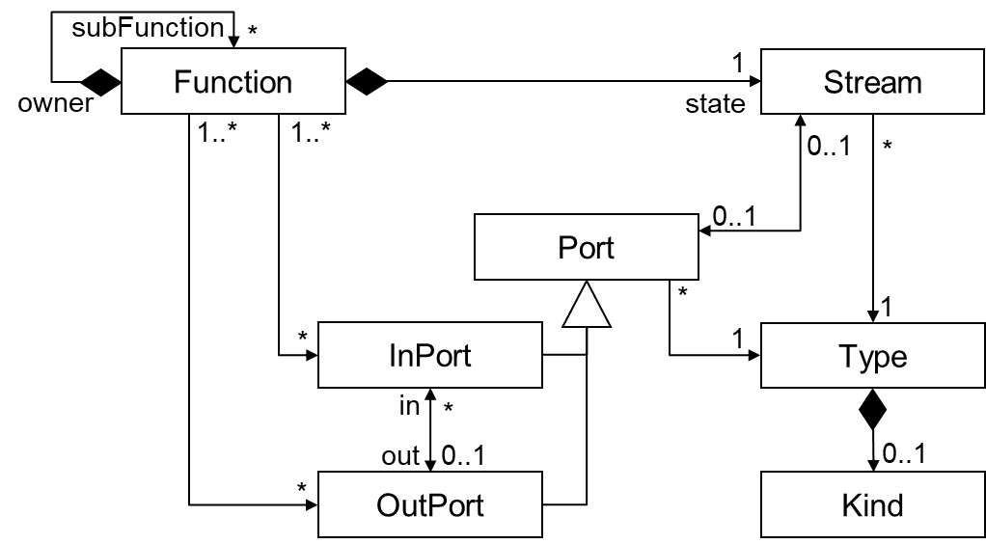
Example with Port Definition
F:Function
OD
F
Float
MA
ab:Stream
Diesel
G
shared
port
c
g
state
:Stream
same type
b
a
d
G:Function
a:Inport
diesel:Type
H
l/s<float>
e
f
h
state
c:Outport
fluid:Kind
Float
:Stream
Acceleration
d:Outport
cg:Stream
out
CD
:Stream
“normal” channel
de:Stream
state
in
float:Type
H:Function
e:Inport
no kind
acc:Type
f:Outport
fluid:Kind
fh:Stream

Slide 27
MA2Fenix

Slide 28
CD4Function2Fenix
Monitoring
CD
Each port is known by
its name attribute
Problem: shared ports
lead to loss of port names
Solution: use qualified
association of type
String to encode port
name in its respective
function
subFunction
*
Function
0..1
1
Stream
1
*
owner
state
Observation
String
String
0..1
*
*
{ordered}
*
1
*
{ordered}
Port
Value
*
1
*
InPort
1
Type
1
qualifier encodes port name
1
in
*
out
0..1
0..1
1
OutPort
Kind

Slide 29
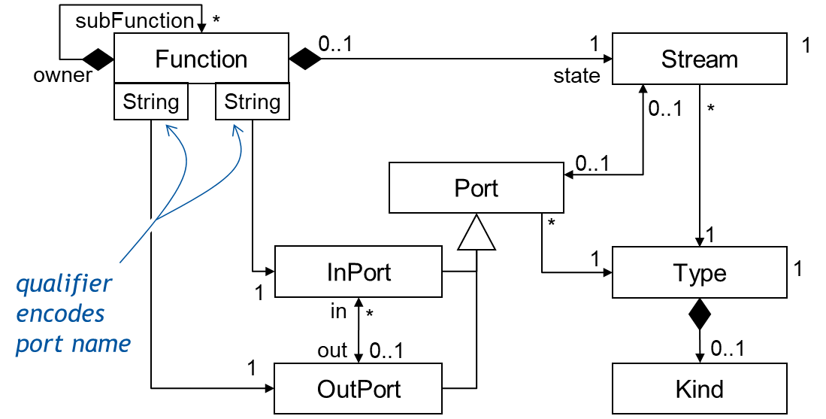
CD4Function2Fenix Example
“h”
F
F:Function
“g”
OD
Float
MA
“a”
int
G
shared
port
c
g
state
:Stream
a
b
d
H
G:Function
“b”
a:Inport
int:Type
“c”
e
f
h
state
“d”
Float
c:Outport
:Stream
float:Type
double
d:Outport
CD
:Stream
“normal” channel
out
state
in
H:Function
“e”
e:Inport
“f”
double:Type
f:Outport

Slide 30
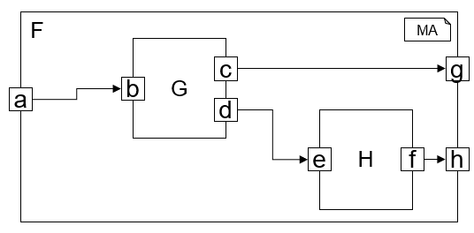
MA2Fenix Example Model
component F {
port in int a,
out boolean g,
out int h;
G g1;
H h1;
…
}
component G {
port in int b,
out boolean c,
out int d;
}
component H {
port in int e,
out int f;
}

Slide 31
MA2Fenix (CD)
component F {
port in int a,
out boolean g,
out int h;
G g1;
H h1;
…
}
component G {
port in int b,
out boolean c,
out int d;
}
component H {
port in int e,
out int f;
}
MA
class F extends Function {}
class G extends Function {}
class H extends Function {}
CD

Slide 32
MA2Fenix (OD) - Functions
f : F {
name = “f”;
}
f$g1 : G {
name = “g1”;
}
f$h1 : H {
name = “h1”;
}
link f (owner) -> (subfunction) g1;
link f (owner) -> (subfunction) h1;
MA
OD
component F {
port in int a,
out boolean g,
out int h;
G g1;
H h1;
a -> g1.b;
g1.c -> g;
g1.d -> h1.e;
h1.f -> h;
}
component G {
port in int b, out boolean c,
out int d;
}
component H {
port in int e, out int f;
}

Slide 33
MA2Fenix (OD) – Ports & Associations
f$a : OutPort{}
f$g : OutPort{}
f$h : OutPort{}
f$g1$d : OutPort{}
f$h1$e : OutPort{}
link f [“a”] -> f$a;
link f [“g”] -> f$g;
link f [“h”] -> f$h;
link f$g1 [“b”] -> f$a;
link f$g1 [“c”] -> f$g;
link f$g1 [“d”] -> f$g1$d;
link f$h1 [“e”] -> f$h1$e;
link f$h1 [“f”] -> f$h;
link f$g1$d (out) <-> (in) f$h1$e;
MA
OD
component F {
port in int a,
out boolean g,
out int h;
G g1;
H h1;
a -> g1.b;
g1.c -> g;
g1.d -> h1.e;
h1.f -> h;
}
component G {
port in int b, out boolean c,
out int d;
}
component H {
port in int e, out int f;
}

Slide 34
MA2Fenix (OD) – Port Types
boolean : Type {
typeidentifier = “boolean”;
}
int : Type {
typeidentifier = “int”;
}
link f$a -> int;
link f$g -> boolean;
link f$h -> int;
link f$g1$b -> int;
link f$g1$c -> boolean;
link f$g1$d -> int;
link f$h1$e -> int;
link f$h1$f -> int;
MA
OD
component F {
port in int a,
out boolean g,
out int h;
G g1;
H h1;
a -> g1.b;
g1.c -> g;
g1.d -> h1.e;
h1.f -> h;
}
component G {
port in int b, out boolean c,
out int d;
}
component H {
port in int e, out int f;
}

