Slide 1
Political Science
Is my major a safeguard or a life plan?
Alessandro Cervantes
UNIV 1201

Slide 2

My Major
I chose Political Science for my bachelor’s major
Political Science is one of the main majors to choose to go to law school one day and graduate as a newly licensed attorney
I chose this as I want to become an attorney and be able to represent myself in court; to have the knowledge to traverse the complex legal system, and to attempt at having my own business non-related to law

Slide 3
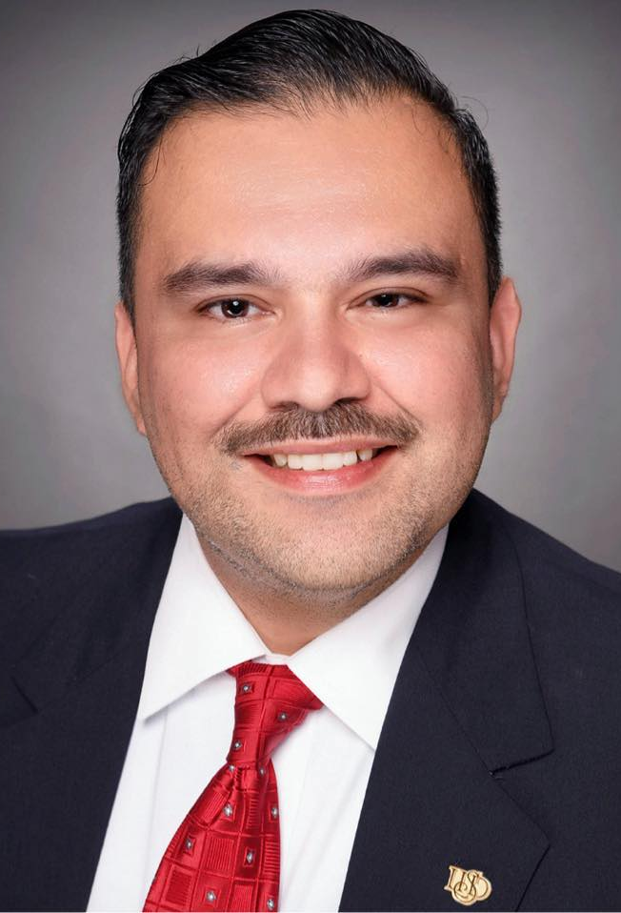
I Interviewed:
• Rodolfo “Rudy” Morales III
• Lawyer for City of Laredo
• Awarded “Professional of The Year” in 2015

Slide 4
Rudy Chose This Career Because
I Chose This Major Because
He wanted to make a “positive impact in [his] community and help people navigate complex legal issues.”
Just like Rudy, I want to advocate for fairness for both myself and others.
I want to be able to represent myself and my company in court, and I want to have the safeguard of being able to work as an attorney if things go wrong

Slide 5
Daily Responsibilities & Roles
Rudy represents clients in various legal matters, coducts legal research, prepares and reviews legal documents, and advocate for others in court.
What that means to me
Although I, unlike Rudy, do not chose to one day become an attorney to represent others or work as a lawyer, I am aware of the possibility.
If my Plan A fails (having my own business), having a license for this profession would allow me to use it as a safeguard and stable job. Thanks to Rudy, I now know what to expect from this.

Slide 6
Enjoyment, Challenges,
Work-Life Balance and Experiences
Just as Rudy answered to one of my questions, I too want to undergo the challenge of pursuing law to have the enjoyment of “seeing positive change”.
I resonated a lot with Rudy when he said, “I make time for my family –my wife and two children–by setting boundaries between professional and personal time.”
To me, the people special to me are the most important thing in my life, I never want to forget that.

Slide 7
Advice for Students Entering the Field
Rudy’s advice for someone entering the field was, “work hard, stay ethical, and stay connected to your community. Strive for excellence […] but never lose sight of the impact you can make”
My Reflection
As I strive for excellence through my academic journey, I want to keep my ethics, my motivation, and my bonds to my community and to the people close to me
Although it sounds complicated to do with such a sophisticated career, I too strive for all this

Slide 8
What I need to succeed
First, I need to get my Bachelor’s degree
Then, I need to apply to law school, graduate after 3 years, and pass the bar exam
However, to become a truly successful attorney, I need multiple skills such as logical reasoning, oral advocacy, attention to detail, moral reasoning, empathy and negotiation, and persistence

Slide 9
Salary, Employment Rate, and Work Setting
$114,767/year
(≈ $55.18/hour)
Employment of lawyers projected to grow
≈ +4% from 2024 to 2034
Law firms
Corporations
governments
public Interest
legal aid
solo practice

Slide 10
My Action Plan
Keep making significant connections and participate in organizations such as Pre-Law
Stay connected with St. Mary’s University, where I want to go to law school
Keep developing my communication skills
Strive for academic excellence
Keep my connection to my community and loved ones
I am already sure of my decision, which is why now is the time to act

Slide 11
Takeaway from the Interview
Becoming an attorney seemed like a daunting concept
Knowing others such as Rudy manage to have a happy family life whilst doing what they love is reassuring to say the least
Although many skills are required, having the legal knowledge is essential in this age and country, something I am willing to have

Slide 12

Final Thoughts
I find myself more convinced than ever before that Political Science is the major for me
I will treat my attorney license as a safeguard rather than a life plan and will try my absolute best to have my own business
I will start building that future from now, I will work hard to develop the skills a good lawyer should have, and I will keep my dream life in sight

Slide 13
References
ZipRecruiter. (2025, October). Employment law attorney salary in Texas. ZipRecruiter. https://www.ziprecruiter.com/Salaries/Employment-Law-Attorney-Salary--in-Texas
U.S. Bureau of Labor Statistics. (2024, May). Lawyers: Occupational outlook handbook. U.S. Department of Labor. https://www.bls.gov/ooh/legal/lawyers.htm

