Slide 1

Fingerprint Based Check-In System
TPJ655 Final Project Presentation
Presenters:
Bilal Nasir – Computer Engineering Technology
Muhammed Amash Khan – Computer Engineering Technology
Instructor: Benjamin Shefler
Seneca College
Date: 06th of April 2023

Slide 2







AGENDA
What is the Product?
Key Features
How it works
How it was built
Diagrams
Viability
Future Development

Slide 3
What is the Product?
A Finger Based Check-In System
- An authentication system to stream line the commercial check in process while increasing security
- Uses Fingerprints to authenticate users

Slide 4
Key Features
Web based application with the GUI
Door lock that unlocks when authenticated
LCD that displays interim messages
Fingerprint scanner
The R307 finger print scanner used in this project waits for a finger to be placed on the scanner, once done, if authenticated, it activates the solenoid to unlock the door. The scanner is also used during the enrollment process to store alongside the user ID.
The user will use to interact with the application. Uses Flask to run a web application that will give the user the option to either log in with just the credentials, or to create a new account.
A 12V solenoid that is activated when the fingerprint is authenticated causing it to contract, in turn unlocking the door.
During the authentication and registering parts of the process. Connects to the 5V of the pi to get power while the SDA and SCL pins connect to their corresponding ones on the Pi.

Slide 5
How it Works
1
User chooses between the options presented in the web application GUI. They either log in with their credentials, unlock the lock by scanning their fingerprint by selecting “Authenticate”, or create a new account.
2
If the first two options are selected, and the system authenticates the user, the door is unlocked for 5 seconds (this value can be modified to the needs of the customer) allowing the user to open the door and go in.
3
If the third option is selected, a new screen appears asking the user to enter their Email ID, User and Password after which they are prompted to enroll their fingerprint by following the instructions on the screen.
4
In order to view the GUI, the web application will be accessed by entering the provided IP address of the raspberry Pi into the browser. For this purpose, any screen can be used, either a monitor with a keyboard or mouse, or for a more modern look, an iPad or tablet which will allow for touch screen use while looking sleek and being efficient.

Slide 6
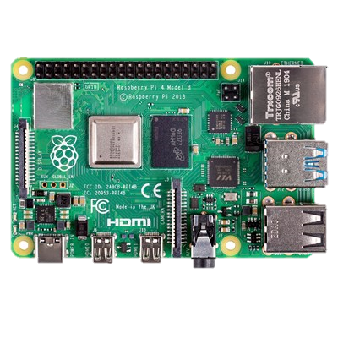
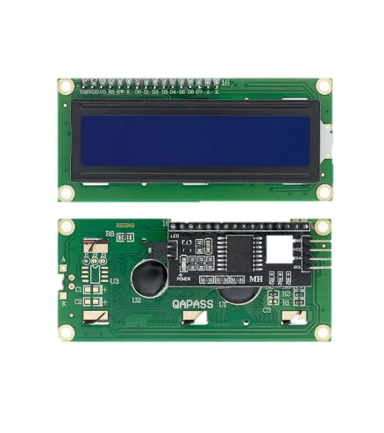
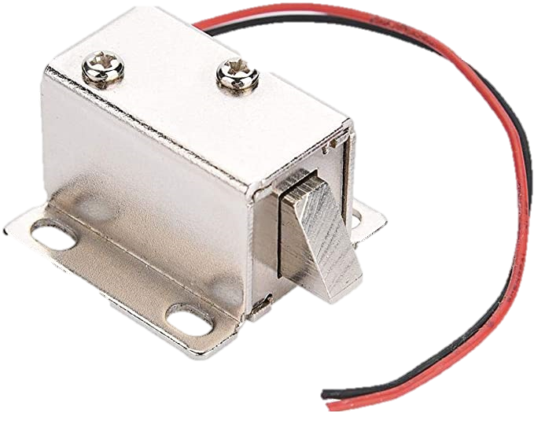
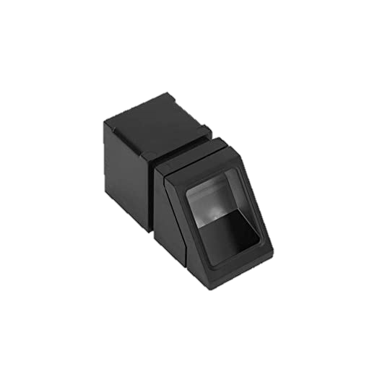

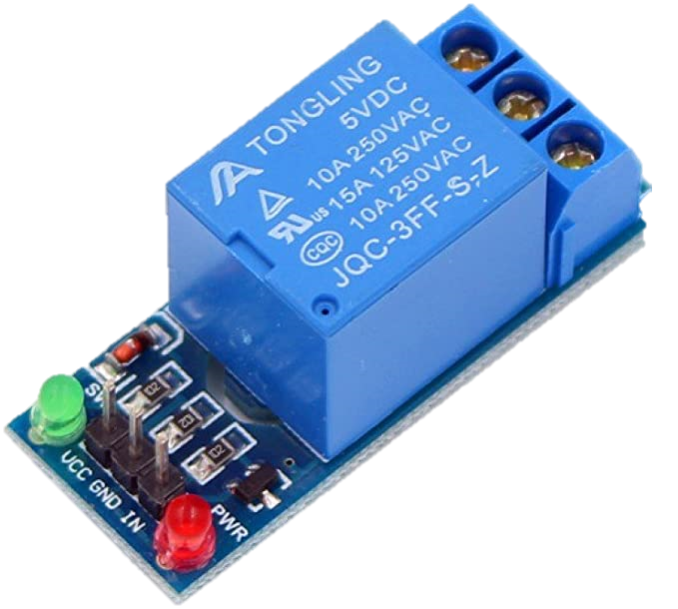
How It was Built
Components & Key Specification
Raspberry Pi 4b 4GB RAM:
Source Voltage: 5.1V
Max power: 15.3 W
Signal Output: 5V and 3.3V
Dimensions: 85mm X 56 mm
LCD:
Input Voltage: 5V
Curent consomption: 24mA
Dimensions: 92mm X 90mm X 27 mm
12 V DC Solenoid:
Input Voltage: 12V
Dimensions: 10mm X 10mm X 10mm
R307 Fingerprint Scanner:
Input Voltage: 5V
Interface: UART
Current consumption: 50mA
Dimensions: 10mm X 10mm
5V Relay:
Supply Voltage: 3.75V to 6V
Dimension: 12.9 x 8.41 x 3.3 cm
Monitor:
Any monitor with the ability to access the web

Slide 7
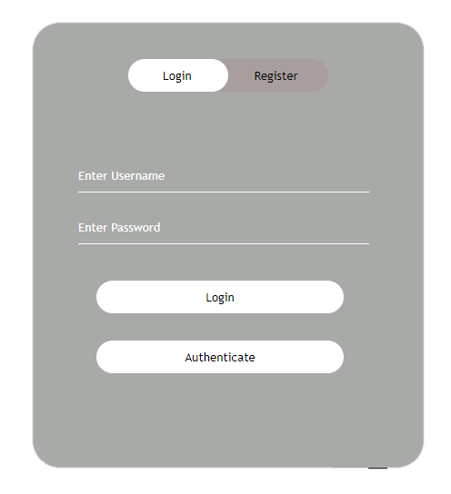
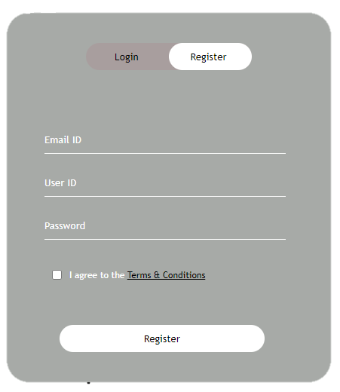
How It was Built
GUI
The log in page, which also serves the home page (on the left)
The registration page to onboard new users (on the right)
User can either login with credentials. Perfect for when hands are dirty or the user is wearing gloves
Or the user can log in with biometrics by selecting "Authenticate“
Finally a completely new account can be created by heading over to "Register". Also enrolls the fingerprint at the same time.

Slide 8
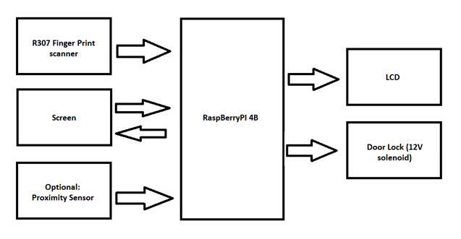
Diagram
Block Diagram

Slide 9
Diagram
Software Diagram
Enter Credentials
Door Unlocked
Options
Authorized
Authorized
User
Unauthorized
Scan Finger
Try Again

Slide 10
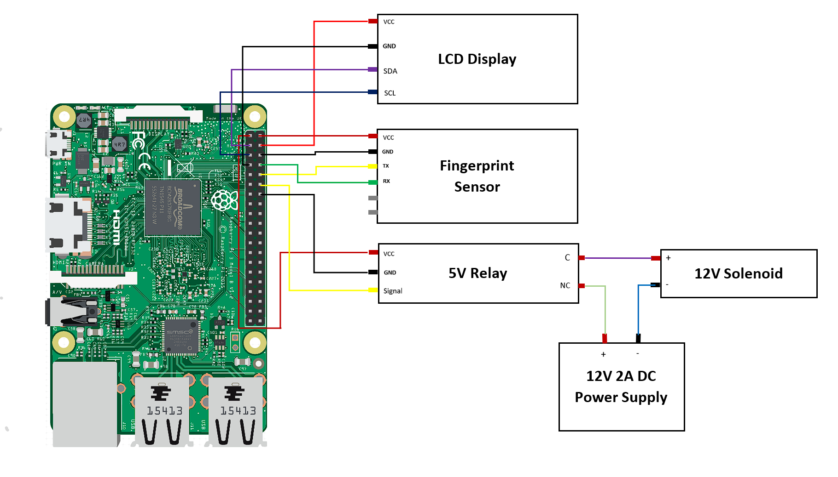
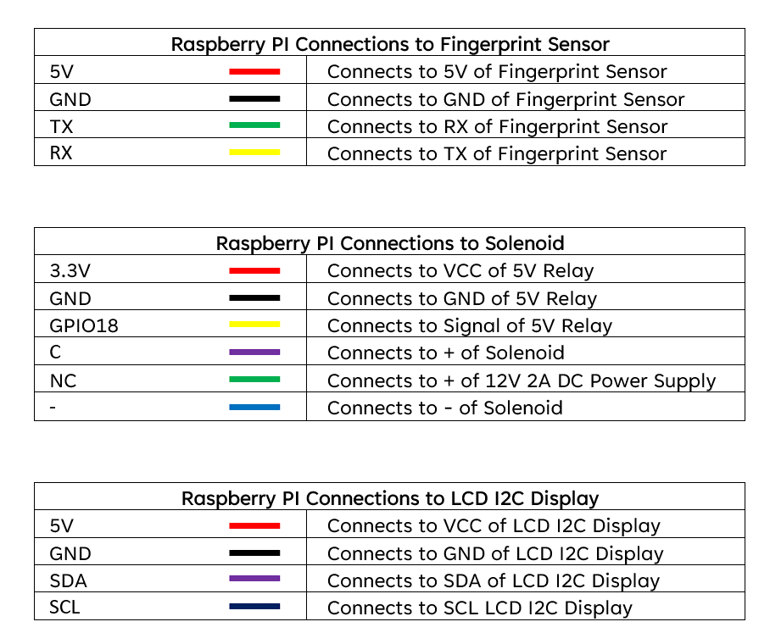
Diagram
Schematic

Slide 11
Viability
Low cost
Low maintenance requirements
compact Size
Easy to connect
Only requires internet
Can be connected anywhere with a socket
Can use any monitor or screen at hand

Slide 12
Future Development
Include a proximity sensor for hassle free exit
A CCTV camera to increase security even further
Change the interior from a breadboard to a PCB to make it even more compact
Include temperature sensors to better monitor the RaspberryPi for better longevity

Slide 13
References
Anon. (-). Raspberry Pi 4 4GB. CanaKit.
https://www.canakit.com/raspberry-pi-4-4gb.html
Heidenreich, M (2020, 25 Nov). How to Use the LCD1602 I2C Display with Raspberry Pi (Python Tutorial with Multi-Threading). YouTube.
https://www.youtube.com/watch?v=DHbLBTRpTWM
Rovai, M (2018, 17 Mar). Python WebServer With Flask & Raspberry Pi. Medium.
https://towardsdatascience.com/python-webserver-with-flask-and-raspberry-pi-398423cc6f5d
Mohanan, V. (2021, 11 May). Interfacing R307 Optical Fingerprint Scanner with Arduino Boards for Biometric Authentication. Circuitstate.
https://circuitstate.com/tutorials/interfacing-r307-optical-fingerprint-scanner-with-arduino-boards-for-biometric-authentication/#r307-specifications
Neupane, A (2021, 12 Mar). Python Flask Authentication Tutorial - Learn Flask Login. YouTube.
https://www.youtube.com/watch?v=71EU8gnZqZQ&t=854s
Tim. (2023, 15 Feb). Raspberry Pi Imager - How to Use. Core Electronics.
https://core-electronics.com.au/guides/raspberry-pi/raspberry-pi-imager/
Tim. (2023, 16 Feb). Controlling a Solenoid with Raspberry Pi and a Relay. Core Electronics.
https://core-electronics.com.au/guides/solenoid-control-with-raspberry-pi-relay/

Slide 14
Thank You
Fingerprint Based Check-In System
TPJ655 Final Project Presentation
Presenters:
Bilal Nasir – Computer Engineering Technology
Muhammed Amash Khan – Computer Engineering Technology
Instructor: Benjamin Shefler
Seneca College
Date: 06th of April 2023

