Slide 1
Event Store
Liam Westley
Dare Devs User Group – April 2014
All code and slides will be available at
https://github.com/westleyl/DareDevsApril2014
Notes:
CQRS stands for Command Query Responsibility Segregation. It's a pattern that I first heard described by Greg Young. At its heart is a simple notion that you can use a different model to update information than the model you use to read information. This simple notion leads to some profound consequences for the design of information systems.

Slide 2


Event Store
Domain Specific Database (DSD)
CQRS architectures
Message queuing
Storing events and notifications
Auditing and archiving
Notes:
CQRS stands for Command Query Responsibility Segregation. It's a pattern that I first heard described by Greg Young. At its heart is a simple notion that you can use a different model to update information than the model you use to read information. This simple notion leads to some profound consequences for the design of information systems.

Slide 3

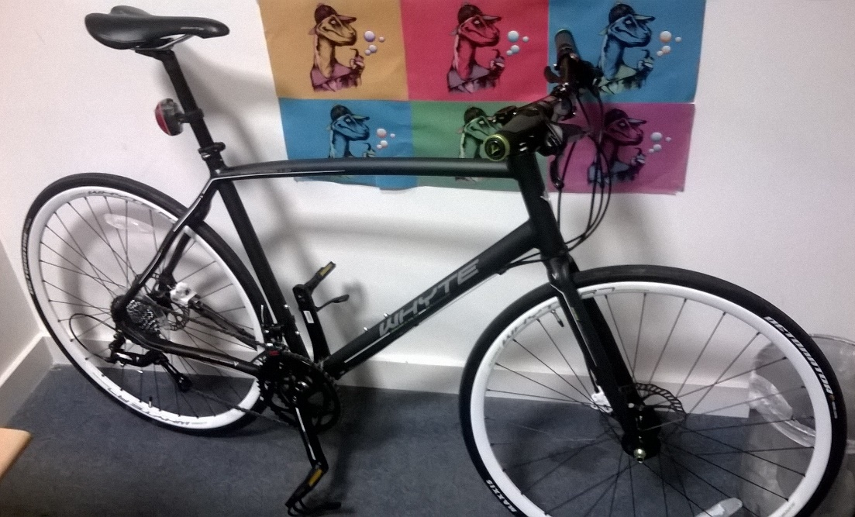
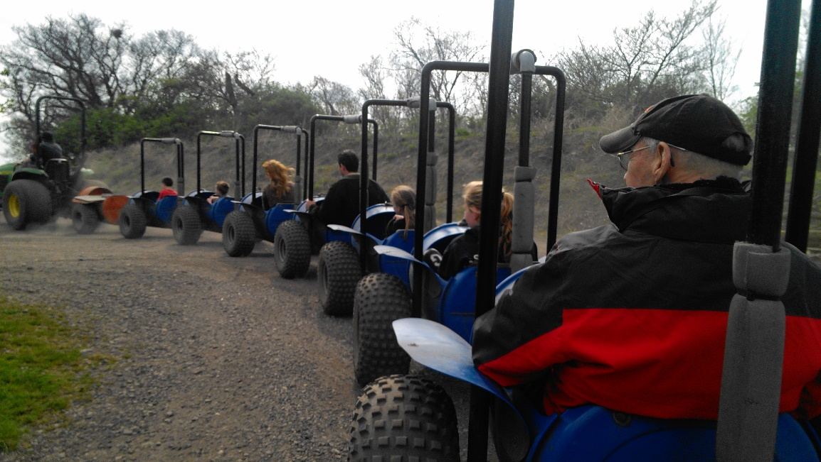
Who is Liam Westley?
< commute
play >
< work

Slide 4
The Old World
Relational Database Management Systems (RDBMS) like SQL Server
Optimised for write, read *and* update
Flexible, dynamic queries
Indices help with returning data, but are often incorrectly defined, or aren’t even created
Object-relational impedance mismatch
Designed for client/server operation rather than HTTP/TCP based communication
Notes:
Important points
Optimisation is possibly the wrong word, it’s generalisation
Any query is possible, but hey, if I don’t have an index, how performant will, SELECT * FROM Users WHERE Name=‘Liam’ actually be?
Jeff Attwood once wrote a blog suggesting OR mapping as the Vietnam of Computer Science (http://www.codinghorror.com/blog/2006/06/object-relational-mapping-is-the-vietnam-of-computer-science.html)
possibly not as bad as that, but there is a real mismatch between RDBMS and objects

Slide 5
Brave New World
Document databases such as … MongoDB, CouchDB, RavenDB and Event Store
Store objects, as … well objects, in JSON, BSON (Binary JSON-ish), XML
Often include REST and HTTP interfaces for GET, POST, UPDATE, DELETE
Metadata can be as important as the object data itself – not just versioning

Slide 6
‘Two roads diverged in a wood, and I -
I took the one less travelled by,
And that has made all the difference.’
The Road Not Taken
Robert Frost, 1920

Slide 7
Event Store – What?
Even tighter focus than document databases
Create and read only – no updates, no deletes
REST / HTTP / TCP interfaces
AtomPub format
Designed to be cached (especially by HTTP)
Auto versioning; CQRS and message queuing
Javascript projections provide a very flexible alternative to indices

Slide 8
Event Store – How?
An open source document database
written in C#
compile with MSBuild (with Psake) for Windows
compile with Mono for Linux
C++ for JavaScript V8 engine
Install as SingleNode or High Availability (HA) cluster – both open source (BSD 3)
Web based management interface
Notes:
EventStore repository is available on github; https://github.com/eventstore
Main site ; http://geteventstore.com

Slide 9

Notes:
In console – run SingleNode, demonstrating data/log and explaining http wildcard parameters to support both machine name and localhost.
Also, how to use netsh to punch a hole through the HTTP firewall – if CMD is not running as admin then it won’t have permission to listen on an HTTP port.
Management console – Streams, Projections (more later), Charts etc.

Slide 10
Atom API
Atom API specifies the format of data being returned, but also the posting of new items
Post new events directly from HTTP
Read ATOM data streams
XML or JSON
Read single events
XML or JSON
Read latest(s) event published
Notes:
Discuss HTTP caching – Last-Modified, If-Modified-Since and archive pages.

Slide 11
Notes:
In console – use curl to add a new event via a data file SampleData.json.
curl -i -u admin:changeit -d @SampleEvent.json -H "Content-Type: application/json" -X POST http://127.0.0.1:2213/streams/DDDNorth3
Use Guid creation tool to create new events (you can’t have same GUID twice on Atom publishing).
Get an entire stream,
curl -u admin:changeit -H "Accept:application/json" http://127.0.0.1:2213/streams/$stats-127.0.0.1:2113
Get just the lastest event,
curl -u admin:changeit -H "Accept:application/json" http://127.0.0.1:2213/streams/$stats-127.0.0.1:2113/head/backward/1

Slide 12
Projections
Written in Javascript
Filter specific streams, and are able to interrogate the event body or metadata
New copies of events, emit, or pointers to original events, linkTo
Can maintain state on a stream
Management - create/update/delete projections via HTTP
Notes:
There is something good about being forced into thinking how the data will be used, because if you don’t have a projection, you can’t get the data you want. RDBMS allows random data requests, without indices. This is not always necessarily a good thing.

Slide 13
Projections
Event sent – session with room and speaker details
http://127.0.0.1:2213/streams/DDDNorth3
Projection: For each session, by room and start time
DDDNorth3 stream
Room-XXX stream
Time-XXX stream

Slide 14
Notes:
Browse to the management console, http://127.0.0.1:2213.
Click on Projections, New Projection, give it a name, Sessions-ByRoom, and copy in the JavaScript below.
fromStream('DDDNorth3')
.when({
'$any': function (state, event) {
var roomNumber = event.body['room'];
linkTo('Room-' + roomNumber, event);
}
});
Select Continuous, tick Emit Enabled and then click on Post. It should run immediately. You may by challenged for the administration login for the management console, 'admin'/'changeit'.
(if time allows)
Then create an example of ByStartTime, now data is spliced into other stream.
Then add some state, events being captured (if Liam gets time, he could have delegates marking rooms, and the state could be a count of delegates, emitted with time into a stream. i.e. 10:01 – 10 people, 10:02 – 11 people.

Slide 15
C# Client API
Event Store API available as a Nuget package
For handling events communicates via TCP
Projections management communicates via HTTP
With a High Availablity (HA) cluster initial negotiation uses HTTP
Useful built in extension methods for handling JSON

Slide 16
Notes:
C# project in Visual Studio 2010
Demonstrate getting projections using the projection manager, adding session information, and then recalling that session data in streams, including handling updates.

Slide 17
Performance
SingleNode capable of persisting 100’s of events per second
In stress testing of simple events, we exceeded 300 events per second, including running a projection creating items in two additional streams.
Also capable of returning 100’s of pages per second
Reading these simple events, with additional meta data we can deliver just under 100 ‘head’ pages per second, with 50 events per page
Using C# client with TCP – very important to only open TCP (EventStore) connection once, and reuse for the entire application lifetime (including web sites/APIs)

Slide 18
Event Store
XCOPY backup for database, trivial to script
Backup tools coming; ntbackup and netbackup
Source on Github and supported via Google Groups
Better documentation coming soon, including documentation for High Availability
TopShelf service wrapper available as a gist
http://geteventstore.com
http://codeofrob.com @robashton blogs
Notes:
EventStore repository is available on github; https://github.com/eventstore
TopShelf Windows service wrapper is available on github; https://gist.github.com/trbngr/5083266

Slide 19
{ liam westley } @westleyl
liam.westley@tigernews.co.uk http://geekswithblogs.net/twickers
http://www.huddle.com/jobs
Mention
Liam sent
you!!

