Slide 1
Everything’s about BUG HUNTING
02
<p> I almost wish I hadn't gone down that rabbit-hole—and yet—and yet—it's rather curious, you know, this sort of life!”.</p>

Slide 2
Bug Hunting is less about finding errors and more about changes more uncovering hidden stories in code
Someone

Slide 3
Pentest is not PAIN TEST !!!
<ul>
<li> The goal is NOT to blame dev team </li>
<li> The goal is NOT to blame vendors </li>
<li> The goal is to HELP them! </li>
<li> The goal is to handle it before Hackers </li>
</ul>

Slide 4
Pentest and others activities

Slide 5


Pentest types
Blackbox – No knowledge
Greybox – Partial knowledge
User account / technology stack
Whitebox – Full knowledge
Access to source code
No info on target
Infrastructure documentation

Slide 6

Pentest process in companies
Restitution meeting
The report is presented to project team
Project team and vendor can plan fix and reset environment if needed
PENTEST
Duration is ~1 week
Pentest report is sent to project team Project team can plan Restitution meeting
Presentation meeting
Application presentation
Decisions taken:
Planning
Project team needs to fill pentest requirements file
Project team prepare environment
Pentest request

Slide 7









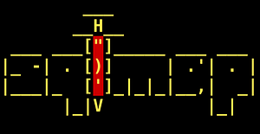
Classical timeline
Recon
Enumeration
Exploitation
Report
Identify running services, endpoints
Understand how the application is working and identify potential vulnerabilities
Find and validate vulnerabilities
Document the findings
PTART
RedScan

Slide 8
OWASP
<p> The Open Worldwide Application Security Project (OWASP) is a nonprofit foundation that works to improve the security of software </p>
<ul>
<li> OWASP Top 10: A list of most critical vuln for web </li>
<li> OWASP ASVS: A framework for verification.</li>
<li> OWASP WSTG: Web security Testing guide.</li>
<li> OWASP Projects : ZAP, Defect Dojo, ESAPI,
AMASS Depedency checks etc… </li>
</ul>
Notes:
main branch
This branch follows the syndicate’s public release schedule. Everything on this branch is official, so any commit landing here must have been validated by a release manager.
Official releases are marked either using git tags or release branches.
When ready, the dev branch is merged (without squashing) into the main branch by the release manager.
dev branch
Commits in this branch have undergone Quality Assurance (QA), they pass unit tests and code style linting. To ensure all this, only the repository maintainers have commit rights into this branch.
Code lands on this branch via GitHub Pull Requests (PR) from feature branches.
feature branches
Each branch deals with a single feature. They depart from the dev branch and go back to it via a PR, ensuring it is peer reviewed and it passes QA, unit tests and code style linting.
Commit early / commit often principle. No special commit message format is enforced in this branch.
Before submitting a PR for merging into dev, commits in a feature branch shall be rebased to the current HEAD and squashed into one or several properly formatted commits (See Commit discipline)).
Feature branches should be deleted after merging them back into dev.
task branches (optional)
When features are big enough they can be divided into tasks.
task branches depart from and, later, merge into their corresponding feature branch after peer review. Commit early / commit often principle. No special commit message format enforced.
release branches (discussion ongoing)
Fork from main branch. Hotfixes are applied to release branches by release managers after peer review.

Slide 9
OWASP Top Ten (2017vs2021)
A01:2021- Broken Access Control
A02:2021- Cryptographic Failures
A03:2021- Injection
A04:2021- Insecure Design
A05:2021- Security Misconfiguration
A06:2021- Vulnerable And out. Components
A07:2021- Ident. And Authent.
A08:2021- Soft. and Data Integrity.
A09:2021- Sec. Logging and Monitoring.
A10:2021- Server-Side Request Forgery
A01:2017- Injection
A02:2017- Broken Authentication
A03:2017- Sensitive Data Exposure
A04:2017- XML External Entities
A05:2017- Broken Access Control
A06:2017- Security Misconfiguration
A07:2017- Cross Site Scripting
A08:2017- Insecure Deserialization
A09:2017- Using Component with known vulns
A10:2017- Insufficient Logging & Monitoring
Notes:
A01:2021-Broken Access Control moves up from the fifth position to the category with the most serious web application security risk; the contributed data indicates that on average, 3.81% of applications tested had one or more Common Weakness Enumerations (CWEs) with more than 318k occurrences of CWEs in this risk category. The 34 CWEs mapped to Broken Access Control had more occurrences in applications than any other category.
A02:2021-Cryptographic Failures shifts up one position to #2, previously known as A3:2017-Sensitive Data Exposure, which was broad symptom rather than a root cause. The renewed name focuses on failures related to cryptography as it has been implicitly before. This category often leads to sensitive data exposure or system compromise.
A03:2021-Injection slides down to the third position. 94% of the applications were tested for some form of injection with a max incidence rate of 19%, an average incidence rate of 3.37%, and the 33 CWEs mapped into this category have the second most occurrences in applications with 274k occurrences. Cross-site Scripting is now part of this category in this edition.
A04:2021-Insecure Design is a new category for 2021, with a focus on risks related to design flaws. If we genuinely want to "move left" as an industry, we need more threat modeling, secure design patterns and principles, and reference architectures. An insecure design cannot be fixed by a perfect implementation as by definition, needed security controls were never created to defend against specific attacks.
A05:2021-Security Misconfiguration moves up from #6 in the previous edition; 90% of applications were tested for some form of misconfiguration, with an average incidence rate of 4.5%, and over 208k occurrences of CWEs mapped to this risk category. With more shifts into highly configurable software, it's not surprising to see this category move up. The former category for A4:2017-XML External Entities (XXE) is now part of this risk category.
A06:2021-Vulnerable and Outdated Components was previously titled Using Components with Known Vulnerabilities and is #2 in the Top 10 community survey, but also had enough data to make the Top 10 via data analysis. This category moves up from #9 in 2017 and is a known issue that we struggle to test and assess risk. It is the only category not to have any Common Vulnerability and Exposures (CVEs) mapped to the included CWEs, so a default exploit and impact weights of 5.0 are factored into their scores.
A07:2021-Identification and Authentication Failures was previously Broken Authentication and is sliding down from the second position, and now includes CWEs that are more related to identification failures. This category is still an integral part of the Top 10, but the increased availability of standardized frameworks seems to be helping.
A08:2021-Software and Data Integrity Failures is a new category for 2021, focusing on making assumptions related to software updates, critical data, and CI/CD pipelines without verifying integrity. One of the highest weighted impacts from Common Vulnerability and Exposures/Common Vulnerability Scoring System (CVE/CVSS) data mapped to the 10 CWEs in this category. A8:2017-Insecure Deserialization is now a part of this larger category.
A09:2021-Security Logging and Monitoring Failures was previously A10:2017-Insufficient Logging & Monitoring and is added from the Top 10 community survey (#3), moving up from #10 previously. This category is expanded to include more types of failures, is challenging to test for, and isn't well represented in the CVE/CVSS data. However, failures in this category can directly impact visibility, incident alerting, and forensics.
A10:2021-Server-Side Request Forgery is added from the Top 10 community survey (#1). The data shows a relatively low incidence rate with above average testing coverage, along with above-average ratings for Exploit and Impact potential. This category represents the scenario where the security community members are telling us this is important, even though it's not illustrated in the data at this time.

Slide 10
OWASP WSTG
<p> Security testing will never be an exact science where a complete list of all possible issues that should be tested can be defined.</p>
<ul>
<li> Consistent </li>
<li> Reproductible </li>
<li> Rigorous </li>
<li> Under quality control</li>
<li> Testing can be categorized as passive or active</li>
</ul>

Slide 11
OWASP WSTG Passive
<p> During passive testing, a tester tries to understand the application's logic and explores the application as a user. At the end of this phase, the tester should generally understand all features of the system.</p>
<p>For example, a tester may find a page at the following URL: `https://www.example.com/login/auth_form`
This may indicate an authentication form where the application requests a username and password.
In this case, the application shows two access points. All the input points found in this phase represent a target for testing.</p>

Slide 12
OWASP WSTG Active
<p> During active testing, a tester begins to use the methodologies described in each sections..</p>
<p>The set of active tests was split into 12 categories</p>
<ul>
<li> Identity Management Testing </li>
<li> Input Validation Testing </li>
<li> Business Logic Testing </li>
<li> Etc… (Sample)</li>
</ul>

Slide 13
Mitre CWE
<p> Common Weakness Enumeration is a community-developed list of software and hardware weaknesses.</p>
<ul>
<li> Entries: (e.g., CWE-89 for SQL Injection, CWE-79 for Cross-Site Scripting).</li>
<li> Categories and Views: (e.g., Input Validation, Resource Management).</li>
<li> Mitigations: Recommendations for reducing/eliminating each weakness. </li>
<li> https://cwe.mitre.org </li>
</ul>

Slide 14
CVSS
<p> Common Vulnerability Scoring System: Standardized way to evaluate vulnerabilities based on their impact, exploitability, and environmental factors.</p>
<ul>
<li> From 0.0 to 10.0 : Ten is the most critical vulnerability.</li>
<li> Base Score: Represents the inherent characteristics of a vulnerability. </li>
<li> Temporal Score: Adjust the base score using exploit and fix maturity.</li>
<li> Environmental Scope: Based on orgs environment, considering global impacts on assets and operations. </li>
<li> v3.1 vs v4.0 : https://www.first.org/cvss/ </li>
</ul>

Slide 15
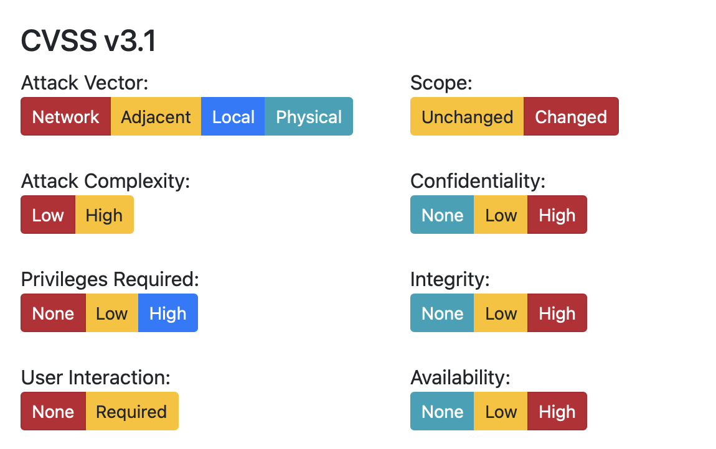
CVSS v3.1 Base
Notes:
v3

Slide 16
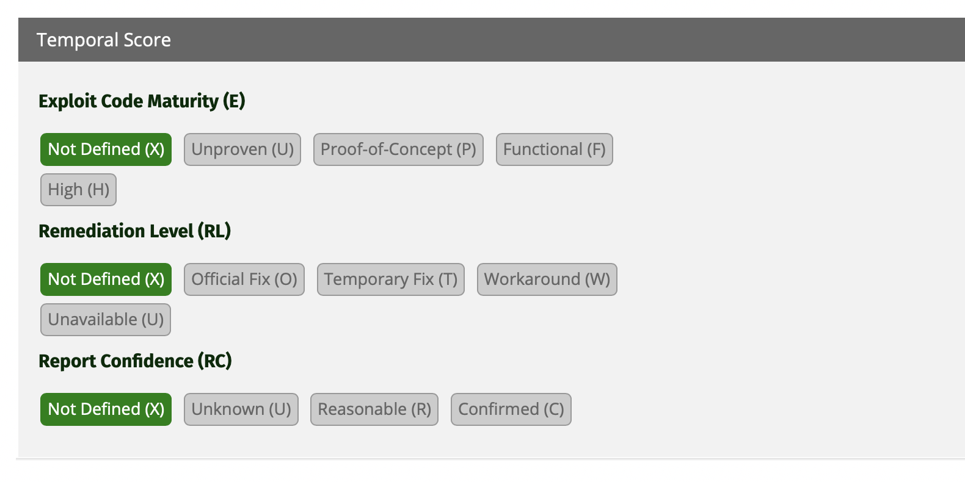
CVSS v3.1 Temporal
Notes:
v3

Slide 17
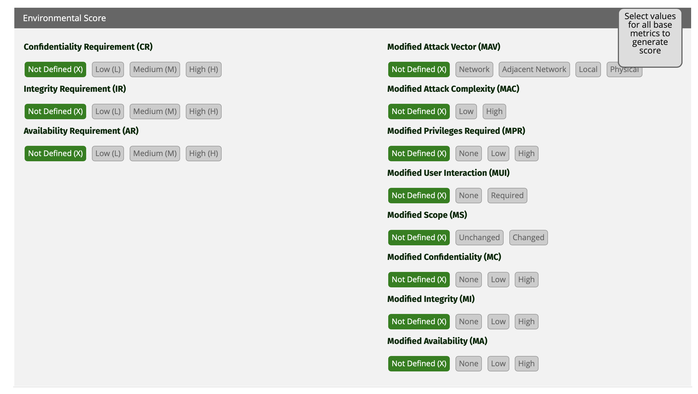
CVSS v3.1 Environmental
Notes:
v3

Slide 18
How would you evaluate a simple user SQL Injection on a PHP application ? (5min)

Slide 19
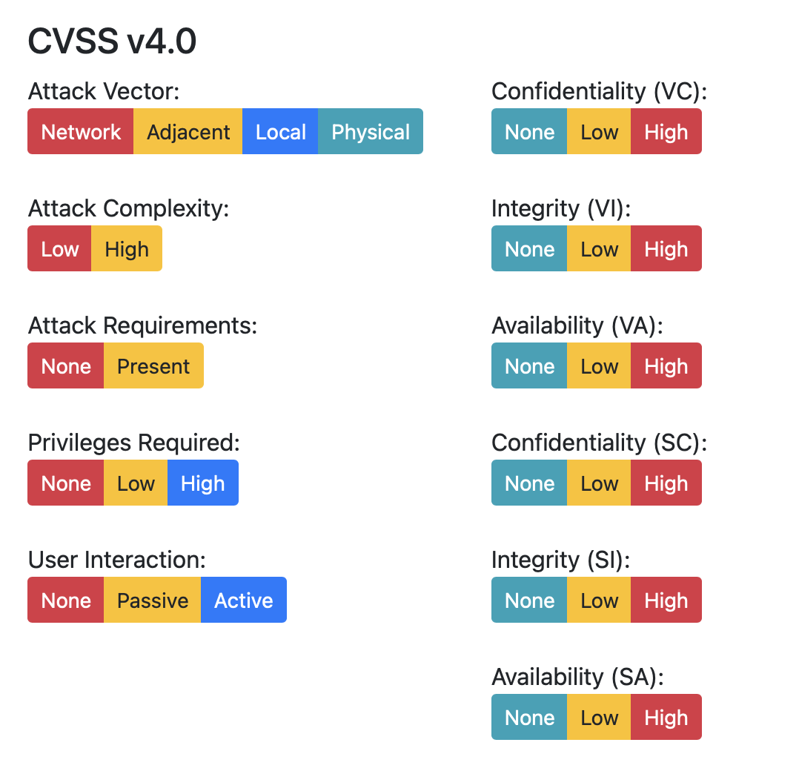
CVSS v4.0 Base
Notes:
v3

Slide 20
CVE
<p> Common Vulnerabilities and Exposure: Standardized list of publicly known cybersecurity vulnerabilities. Helps identify, track, and communicate information about security vulnerabilities.</p>
<ul>
<li> CVE ID: Unique identifier for each vulnerability (e.g., CVE-2023-5122) </li>
<li> Description: Summary of the vulnerability, including affected systems and potential impact. </li>
<li> References: Links to additional resources such as advisories, patches, and technical details. </li>
<li> https://cve.mitre.org </li>
</ul>

Slide 21
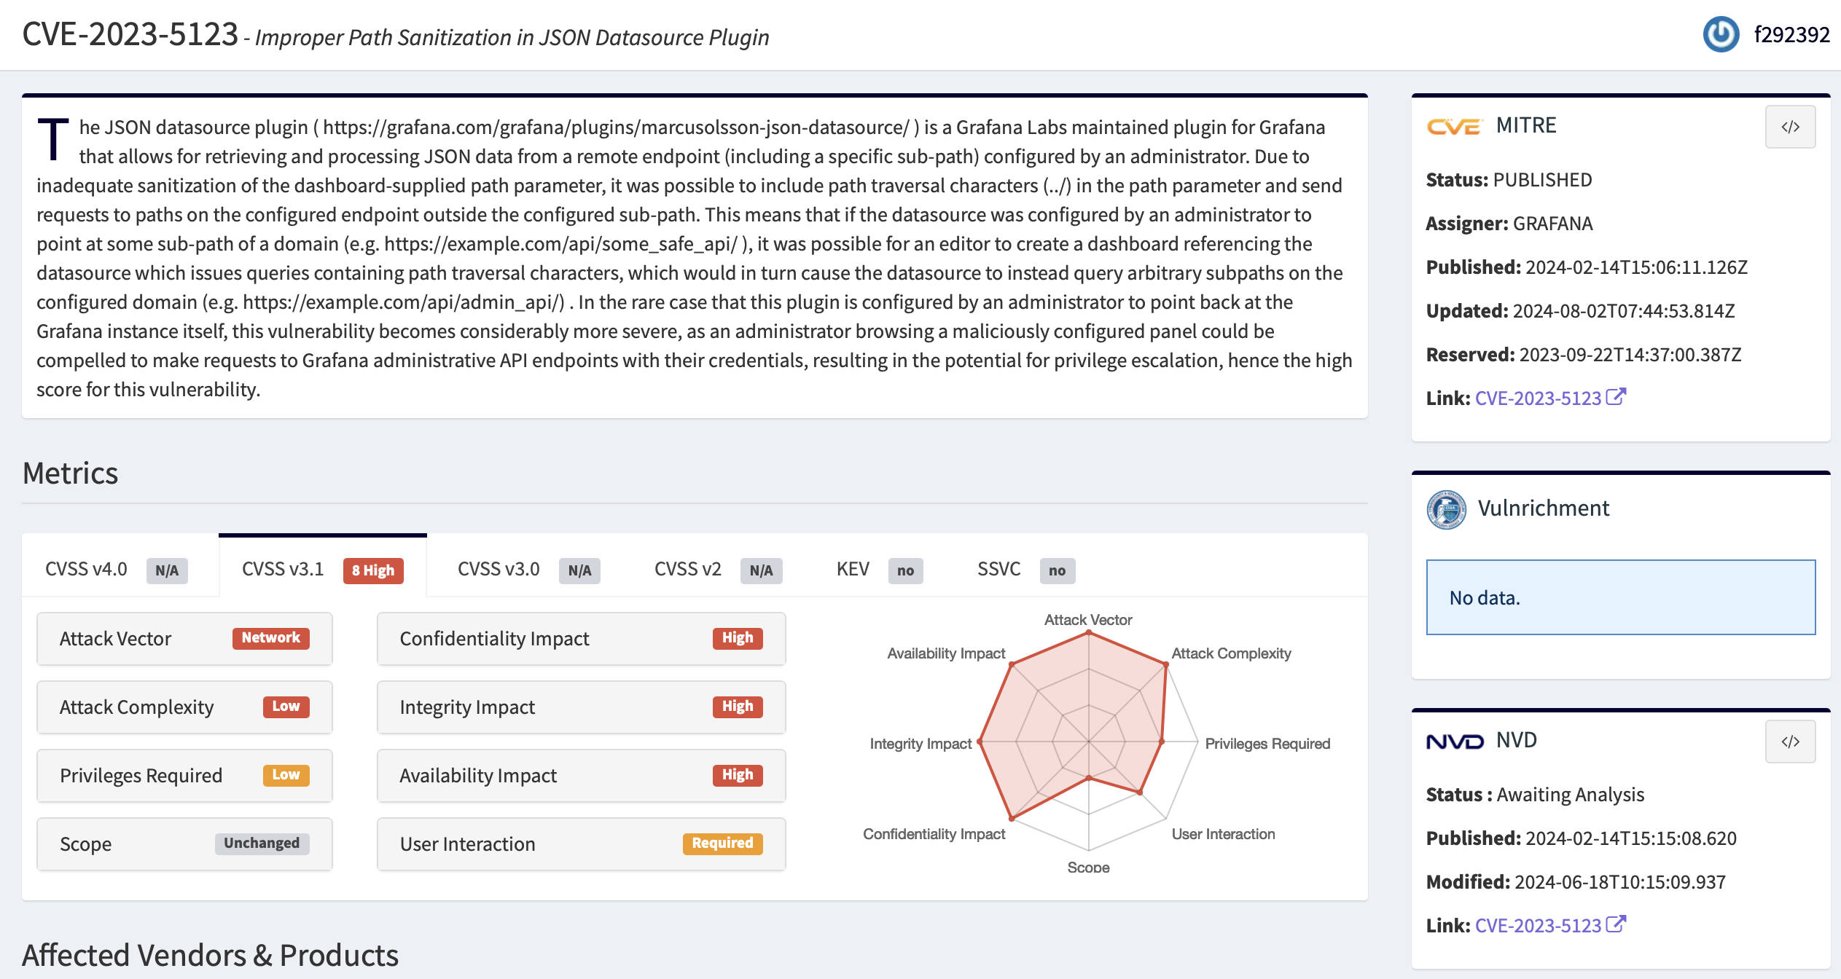
GOOD CVE

Slide 22
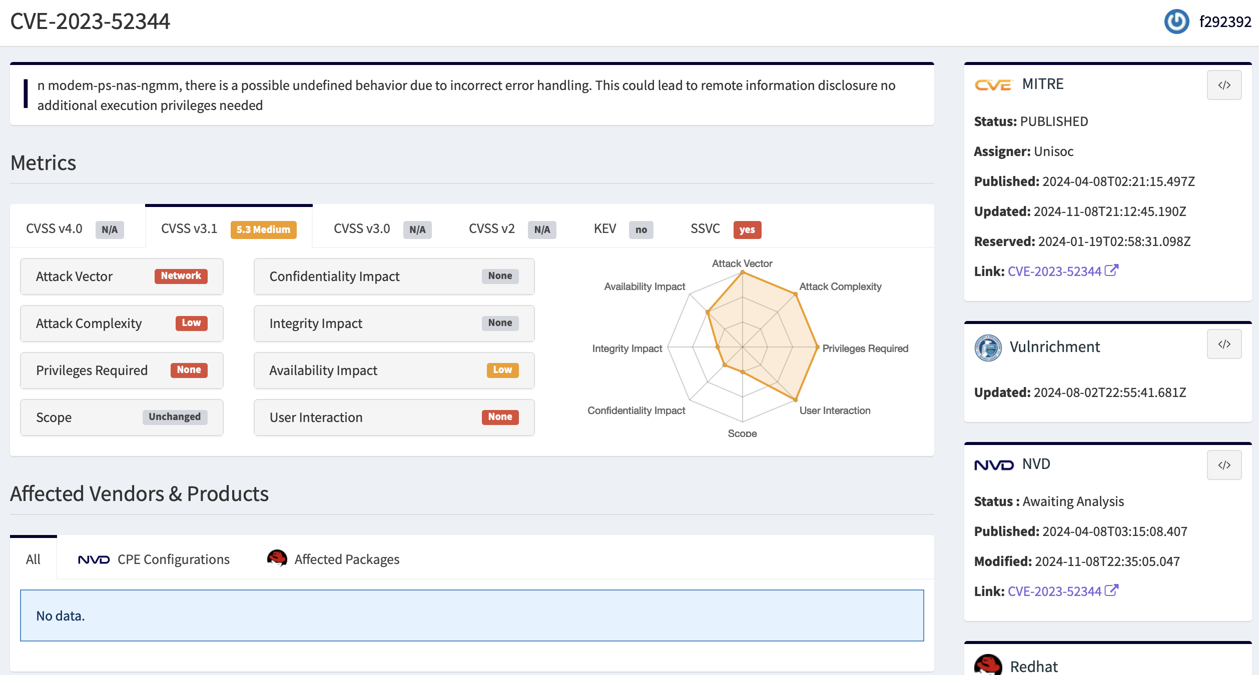
BAD CVE

Slide 23

Declare a CVE
<p> CVE entries can only be published by organizations designated as CVE Numbering Authorities (CNAs). Currently 416 CAN are registered </p>
<ul>
<li> Vendors and Software Maintainers: (e.g., Google, MS, Adobe, etc..) </li>
<li> CERTs: Organizations like CERT/CC and national CERTs (e.g., US-CERT, JPCERT) </li>
<li> Third-Party CNAs: Security organizations and companies,
such as Rapid7 or Tenable. </li>
<li> CNA of Last Resort: The CVE Program has a CNA of Last Resort, typically managed by the MITRE Corporation </li>
</ul>

Slide 24
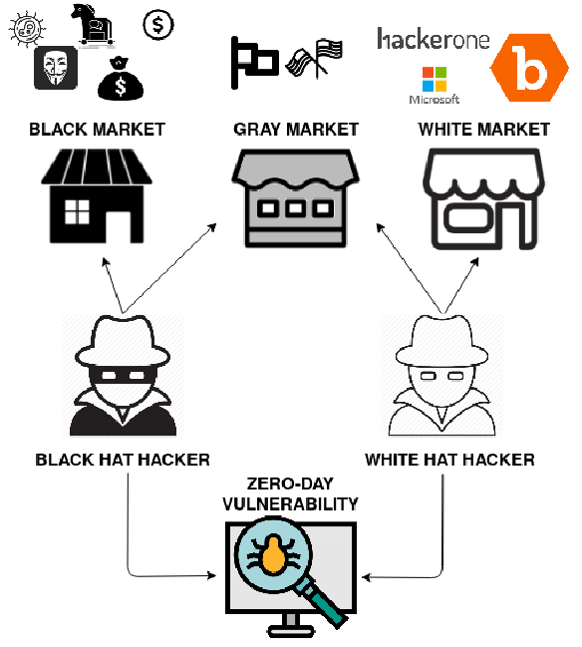
Vulnerability Market

Slide 25
Gray Market
<p> A market where security researchers sell zero-day vulnerabilities and exploits to companies or governments rather than publicly disclosing them or reporting to the affected vendor.</p>
<ul>
<li> Higher Rewards $$$$ </li>
<li> Questionable Ethics: Who bought ? and how your exploit will be used ? </li>
<li> Difficult targets: IOS, Android, Windows, Routers, Mail, Apache etc… </li>
<li> https://zerodium.com </li>
</ul>

Slide 26
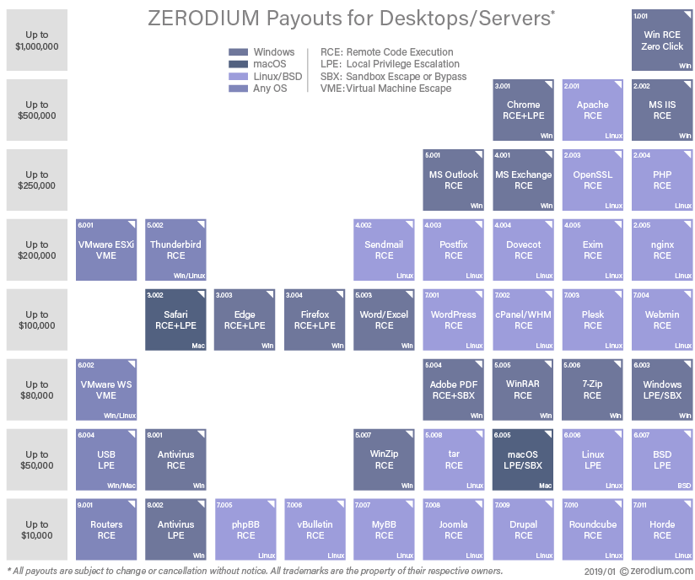
Gray Market $$

Slide 27
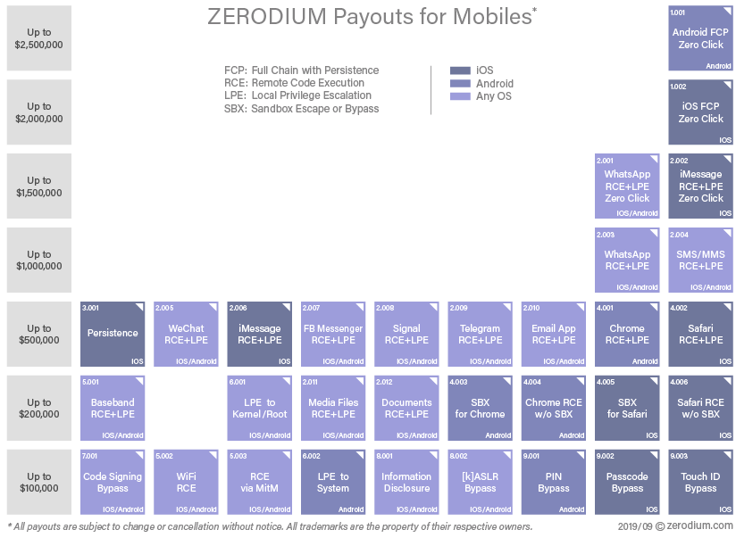
Gray Market $$$$$$

Slide 28
Bug Bounties
<p> A program that encourages security researchers and ethical hackers to find and report vulnerabilities in exchange for rewards </p>
<ul>
<li> Rewards/Swags/Nothing</li>
<li> Ethical: Improve overall security of products</li>
<li> Accessible to all: You can try it !!</li>
<li> Hackerone Bugcrowd Intigriti YesWeHack MSRC Google </li>
</ul>

Slide 29

Warning
<p> Bug bounties could be considered as pyramidal systems. New programs are generally open to top hackers first allowing them to increase scoreboard gap.</p>
<p> According statistics, the average bounty for a critical is 3650$ even if the amount could appear important, you must consider taxes from the payout.</p>
<p> Some programs are unfair: Inconsistent Payout, Lack of clear scope/rules, Duplicate reports, Triage hell.</p>
<p> Time to reward could be long.</p>

Slide 30
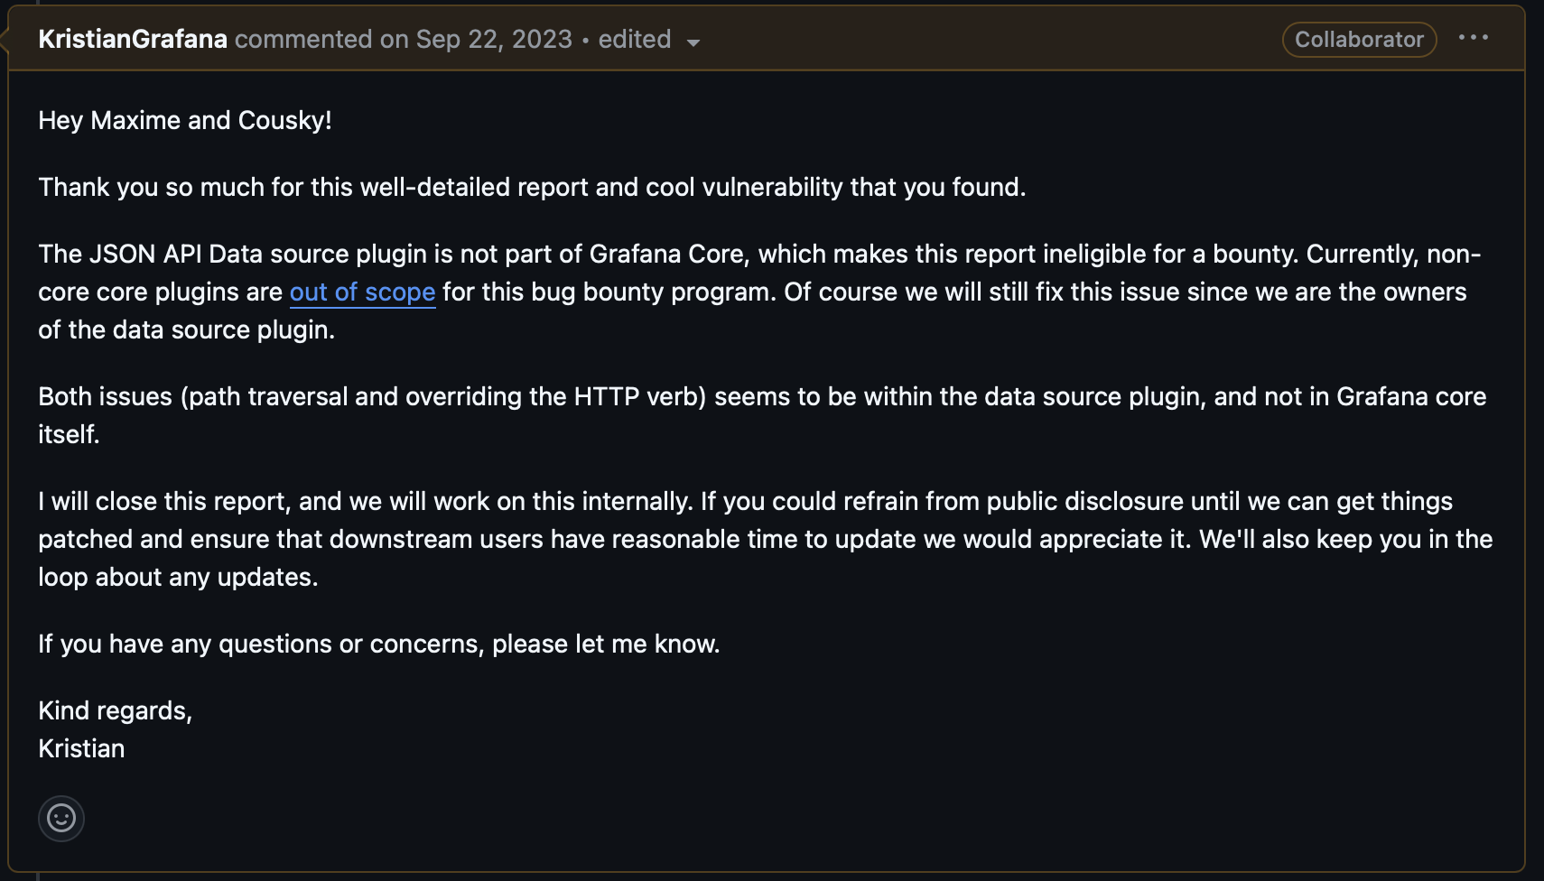
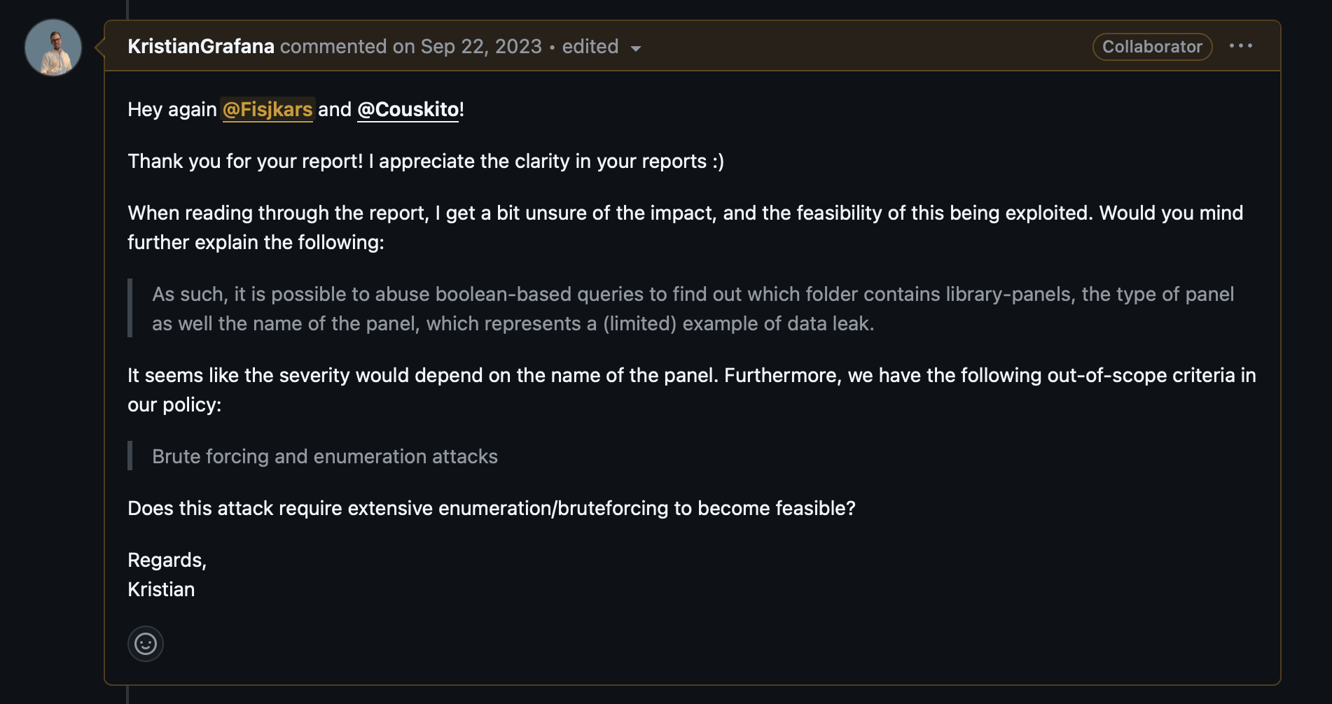
Study Case : Grafana
<p> A Michelin CERT reported a “high” vulnerability on Grafana JSON plugins and a “medium” vulnerability on Grafana core</p>

Slide 31
Study Case : MSRC
<p> MSRC bug bounty programs response is often considered as a bad program, here the timeline of vulnerability disclosure on XXXX</p>
<ul>
<li> Nov 2021: LPE submitted </li>
<li> Jan 2022: No bounty awarded; Fix developed </li>
<li> Jui 2022: Retest => LPE fixed, however backup retrieved </li>
<li> Sep 2022: Award received $$$$ </li>
</ul>

Slide 32
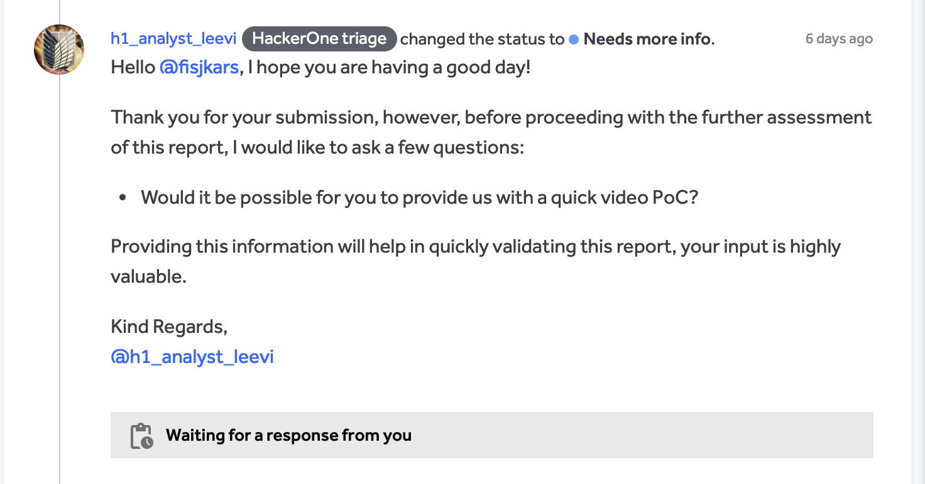
Study Case : Current
<p> Due to a high amount of bad report, Triage team don’t even try to understand report </p>

