Slide 1
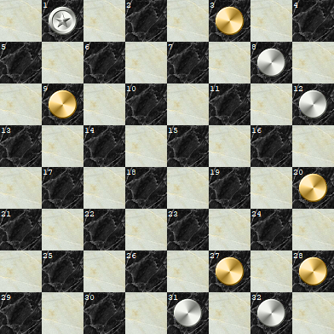

Tsetlin Machine Checkers
American checkers/English draughts
-Martin Bråten
Gold starts, wins/losses from gold’s perspective
Loss = 0
Win = 1
Draw = 2
Blank square = 0
Golden pawn = 1
Golden king = 2
Silver pawn = 3
Silver king = 4
[4, 0, 1, 0,
0, 0, 0, 3,
1, 0, 0, 3,
0, 0, 0, 0,
0, 0, 0, 1,
0, 0, 0, 0,
0, 0, 1, 1,
0, 0, 3, 3],[0]
[0, 0, 1, 0, 0, 0, 0, 0, 1, 0, 0, 0, 0, 0, 0, 0, 0, 0, 0, 1, 0, 0, 0, 0, 0, 0, 1, 1, 0, 0, 0, 0,
0, 0, 0, 0, 0, 0, 0, 0, 0, 0, 0, 0, 0, 0, 0, 0, 0, 0, 0, 0, 0, 0, 0, 0, 0, 0, 0, 0, 0, 0, 0, 0,
0, 0, 0, 0, 0, 0, 0, 1, 0, 0, 0, 1, 0, 0, 0, 0, 0, 0, 0, 0, 0, 0, 0, 0, 0, 0, 0, 0, 0, 0, 1, 1,
1, 0, 0, 0, 0, 0, 0, 0, 0, 0, 0, 0, 0, 0, 0, 0, 0, 0, 0, 0, 0, 0, 0, 0, 0, 0, 0, 0, 0, 0, 0, 0,
0]

Slide 2
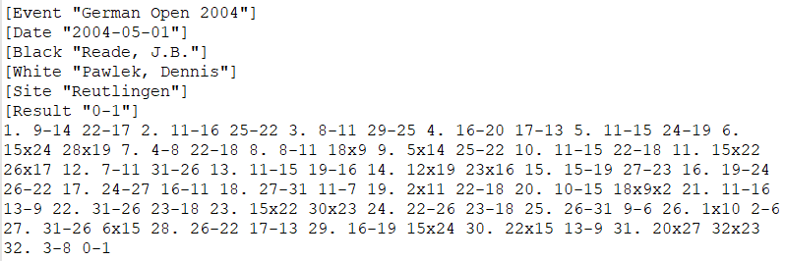
Current challenges
Small dataset(OpenCheckersArchive2.0)
About 22000 unique matches as list of moves.
Low accuracy
68%-70%.
Possible solutions
Adding metadata
Early testing show no more than maximum 0.5% increase in accuracy.
Including boards that are not final
Early testing show a slight decrease in accuracy, about 1-2%.
Generate more boards based on rules
More high quality data should in theory increase accuracy.

