Slide 1

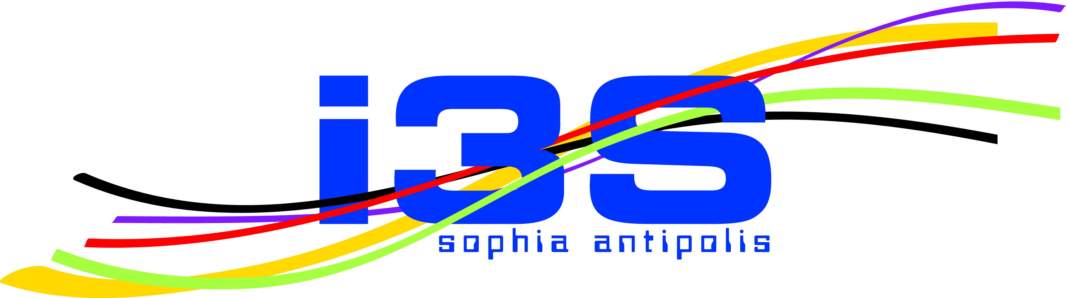
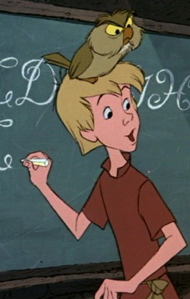


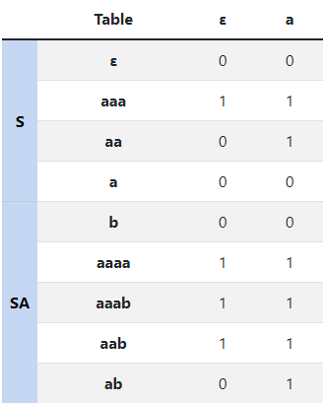
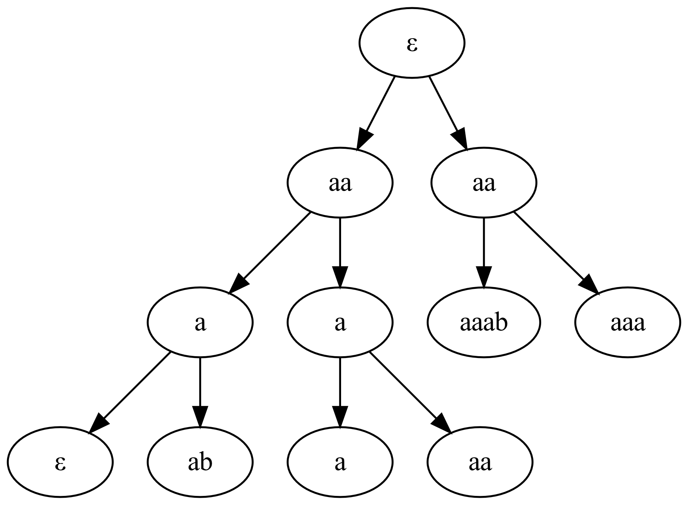
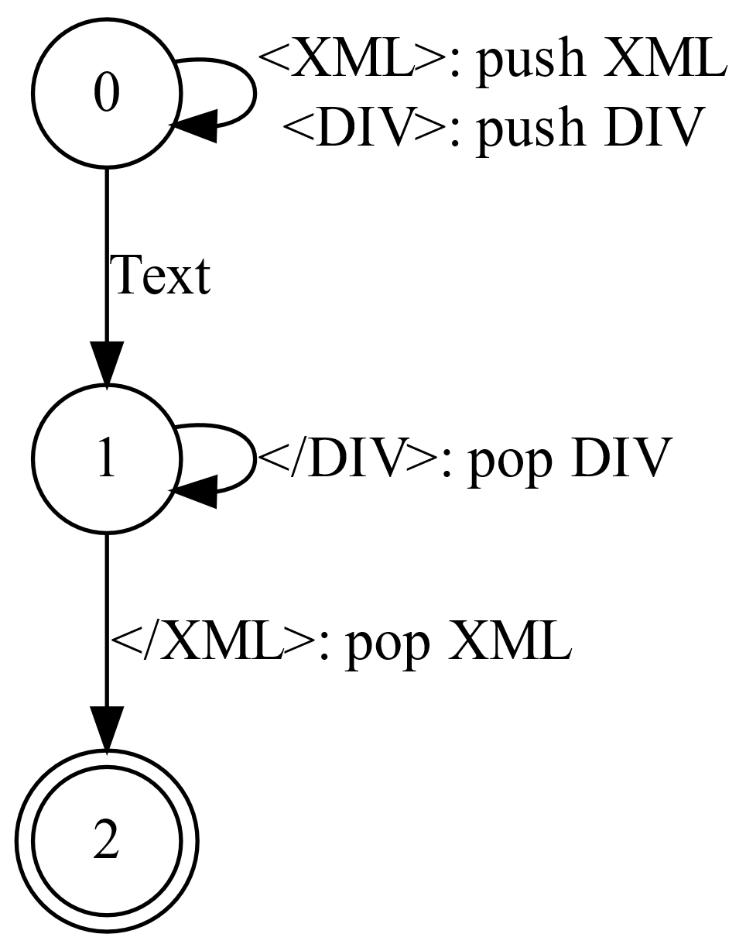
Learning ICS-EMME-ELLE
Di Giusto Cinzia, Lozes Etienne, Fissore Davide
XML
Learning
XML (eXtensible Markup Language) is a standard format for data exchange.
They are defined through DTD : data-type definitions and can be streamed with
Trees → Huge space needed
Visibly pushdown automata !
The learning is based on the Angluin¹ style framework:
A Learner wants to learn a language U and can ask to a teacher for
Mermbership queries : a word is in U ?
Equivalence queries : the learner sends a conjecture C and receives a positive answer if C ≡ U, a counter-example on the other case
Visibly Pushdown Automata
Why VPA ?
A visibly pushdown automaton is an automaton able to represent a subclass of Context Free Grammars where:
The successor of a state is uniquely Determined by the symbol read on the entry and the current stack symbol
VPA are less expressive then canonical pushdown automata, but they are more interesting since problems like inclusion or universality are decidable.
A non-deterministic VPA can be determinized implying that every logic operation between two VPA is also decidable.
Regular languages
Acceptance for XML :
Empty stack + final states
Originally the Learning was meant to understand regualr languages and various algorithms were implemented with two main data structures :
The Observation Table
The Discrimination Tree
Note :
Push symbols ⇔ Open tags
Pop symbols ⇔ Close tags
A simple example
Let our XML grammar G defined as follows :
d(XML) = DIV
d(DIV) = Text + DIV
«Text» is a Terminal,
«XML» and «DIV» are non-Terminal
Note : A non-Terminal implies a push of its value on the stack and a pop at end of the lecture of the rule.
For example G accepts words like
<XML><DIV><DIV>Text</DIV></DIV></XML>
Or more generarly : <XML><DIV>^{n}Text</DIV>^{n}</XML>
«Canonical» VPA
Discriminatio Tree
XML (eXtensible Markup Language) is a standard format for data exchange.

Slide 2
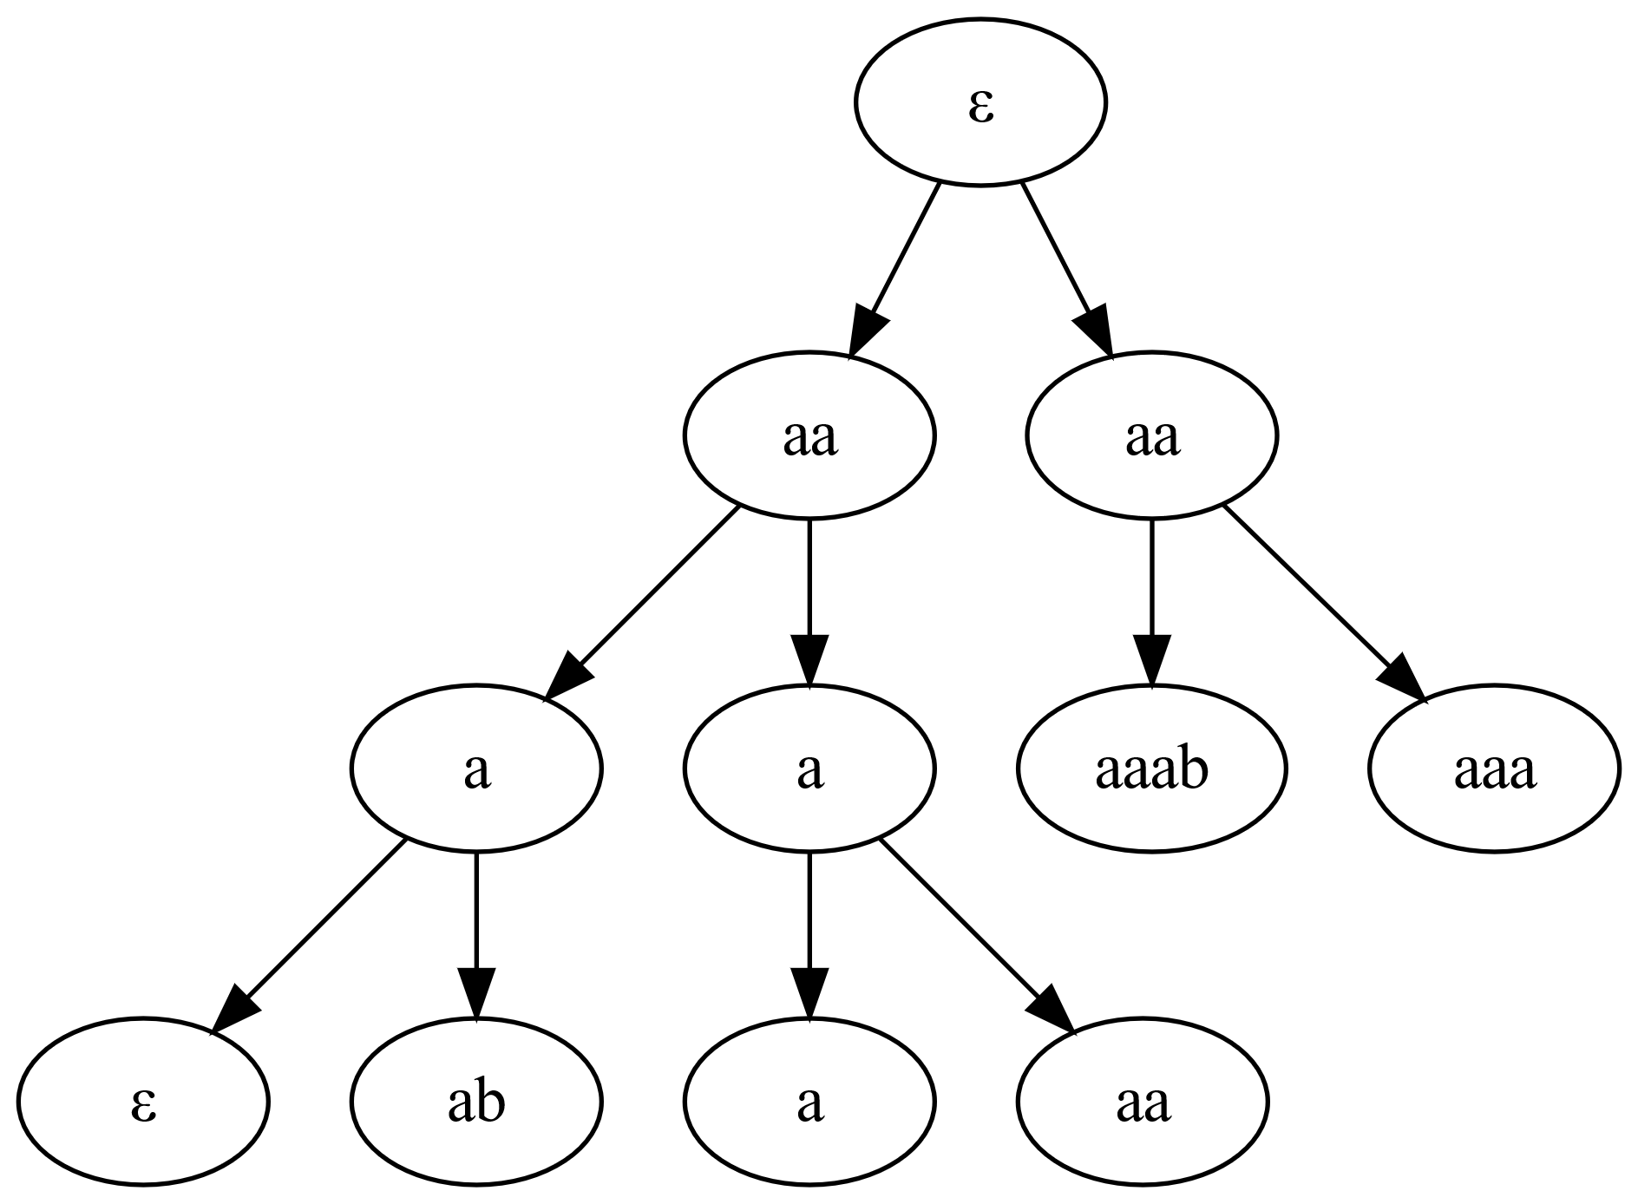
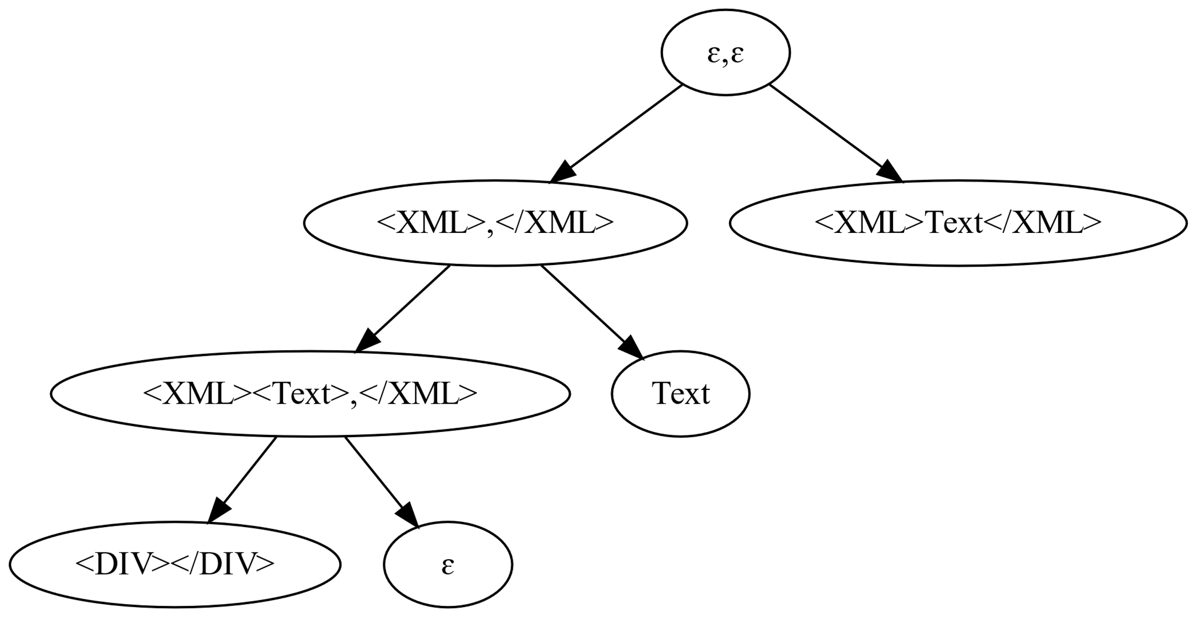
Learning XML : VPA and Discrimination Tree
Di Giusto Cinzia, Lozes Etienne, Fissore Davide
XML
About learning
XML (eXtensible Markup Language) is a standard format for data exchange.
They can be streamed with
Trees → Huge space needed
Visibly pushdown automata !
The learning is based on the Angluin¹ style framework:
A Learner wants to learn a language U and can ask to a teacher for
Mermbership queries : a word is in U ?
Equivalence queries : the learner sends a conjecture C and receives a positive answer if C ≡ U, a counter-example on the other case
Visibly Pushdown Automata
Why VPA ?
A visibly pushdown automaton is an automaton able to represent a subclass of Context Free Grammars where:
VPA are less expressive then canonical pushdown automata, but they are more interesting since problems like inclusion or universality are decidable.
Regular languages
Acceptance for XML :
Empty stack + final states
Note :
Push symbols ⇔ Open tags
Pop symbols ⇔ Close tags
Originally the Learning was meant to understand regualr languages and various algorithms were implemented with two the Observation Table or the
the Discrimination Tree data structure to store the information obtained from the teacher
A simple example
Let our XML grammar G defined as follows :
d(XML) = Text + DIV
d(DIV) = Text + DIV
«Text» is a Terminal,
«XML» and «DIV» are non-Terminal
Note : A non-Terminal implies a push of its value on the stack and a pop at end of the lecture of the rule.
For example G accepts words like
<XML><DIV><DIV>Text</DIV></DIV></XML>
Or more generarly : <XML><DIV>^{n}Text</DIV>^{n}</XML>
How do they work ?
Observation Table
…
«Canonical» VPA
Discrimination Tree
In general it is not possible to have a unique (or canonical) VPA with a minimum number of states: the information can be stored on the stack or in the current location of the automaton.
SEVPA
A single entry VPA is a VPA composed by n-modules such that a module has only 1 entry state for call transitions.
This constraint creates unique minimal VPAs.
An other example :
Let our XML grammar G defined as follows :
d(XML) = Text + DIV
d(DIV) = Text + DIV
«Text» is a Terminal,
«XML» and «DIV» are non-Terminal
Note : A non-Terminal implies a push of its value on the stack and a pop at end of the lecture of the rule.
For example G accepts words like
<XML><DIV><DIV>Text</DIV></DIV></XML>
Or more generarly : <XML><DIV>^{n}Text</DIV>^{n}</XML>

Slide 3


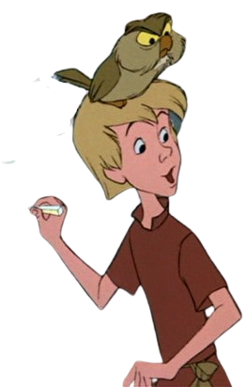

About Learning
About Learning
Dana Anglui’s framework :
The Learner wants to learn a language U
The Teacher knows U
Dana Anglui’s framework :
The Learner wants to learn a language U
The Teacher knows U

Slide 4
Titlef gg
fffff
Titlef gg
fffff

Slide 5





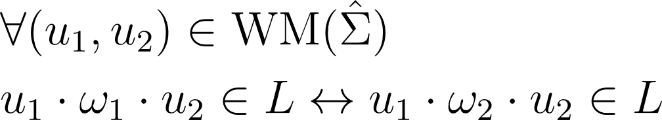
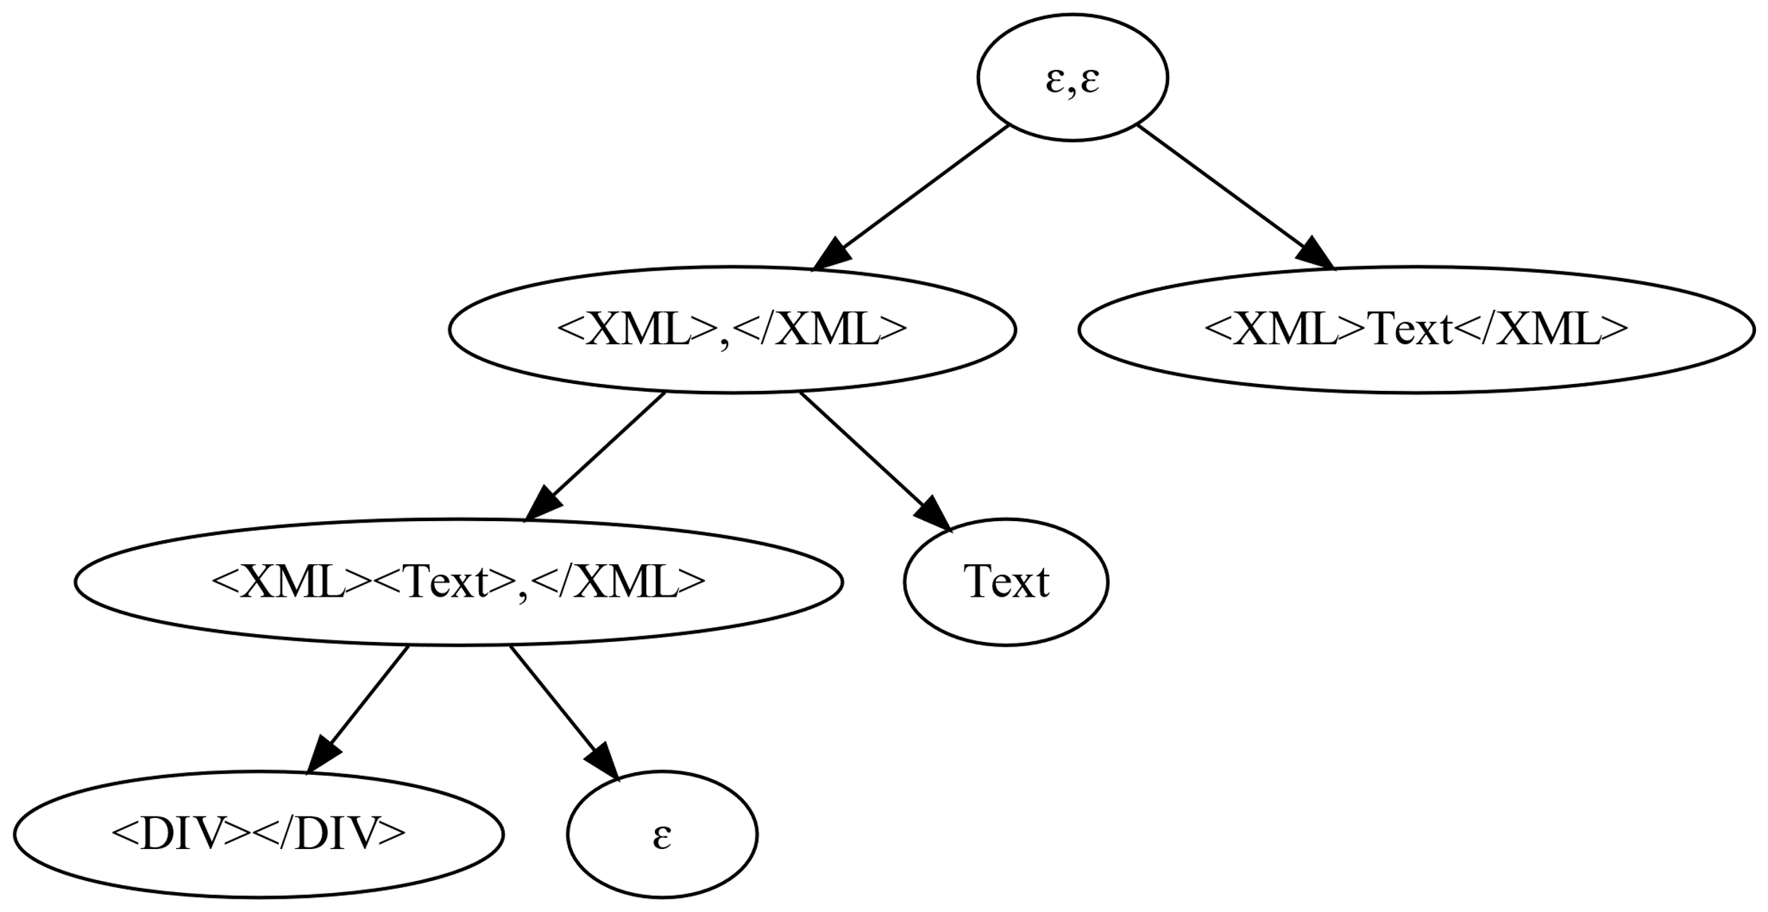

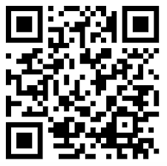

Learning XML : VPA and Discrimination Tree
Cinzia Di Giusto, Davide Fissore, Etienne Lozes
AFFILIATION
Why VPA ?
And Communication ? ??
For ∀ Non-Deterministic VPA V₁, there ∃ a Deterministic VPA V₂ such that L(V₁) = L(V₂)
→ Every binary operation between 2 VPA is decidable !
Arthur : Does w ∈ U ?
Merlin : Yes/No
VPAs
Arthur creates a conjecture C.
Arthur : Does C = U ?
Teacher : if C = U → Yes
else → a counter-example
VPA := Visibly pushdown automata.
They can recognize context free languagages.
The alphabet is :
Note :
Push symbols ⇔ Open tags
Pop symbols ⇔ Close tags
What is Learning ?
Acceptance for XML :
Empty stack + final states
XML
Dana Angluin’s framework :
The Learner wants to learn a language U
The Teacher knows U
XML (eXtensible Markup Language) is a standard format for data exchange.
XML representable w/VPA!
«Canonical» VPA
Regular automataon have a unique minimal representant, this is not true for VPA
An XML grammar to LEARN
k-SEVPA
G :=
d(XML) = Text + DIV
d(DIV) = Text + DIV
Single entry VPA are VPAs where states are partitioned into k modules.
Each module has only one entry for call transitions
d : X → <X> RULE </X>
Example:
<XML><DIV>Text</DIV></XML> ∈ G
Discrimination Tree
Leaves meaning
The learning phase
Leaves represent the VPA states and throught Membership questions, we build the corresponding VPA
From WM, we can build a particular binary tree called Discrimination tree.
Inner Nodes contain a couple (u₁, u₂) and leaves are labelled with a string.
In Visibly Pushdown Language (VPL), we can adapt the Myhill-Nerode congruence :
two words are equivalent if
LCA
…
Why discrimination ?
It is a couple of words
u₁, u₂ such that in
u = u₁ ∘ u₂ each call symbol has a corresponding
ret symbol
…
References
Demo
Notes:
States | location for VPA ?

Slide 6
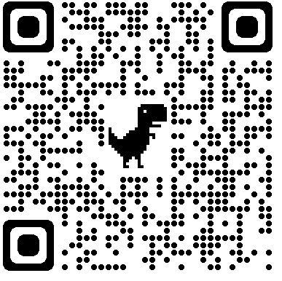
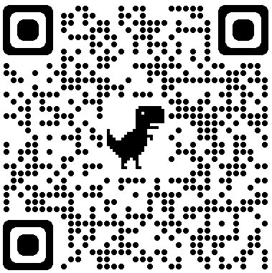
Learning XML : VPAs and Discrimination Trees
Cinzia Di Giusto, Davide Fissore, Etienne Lozes
Université Nice Côte d’Azur, CNRS, I3S, Sophia Antipolis, France
Stage d’été 2022
Why VPA ?
Note :
Push symbols ⇔ Open tags
Pop symbols ⇔ Close tags
And Communication ? ??
For ∀ Non-Deterministic VPA V₁, there ∃ a Deterministic VPA V₂ such that L(V₁) = L(V₂)
→ Every binary operation between 2 VPA is decidable !
Arthur : Does w ∈ U ?
Merlin : Yes/No
VPAs
Arthur creates a conjecture C.
Arthur : Does C = U ?
Merlin : if C = U → Yes
else → a counter-example
VPA := Visibly pushdown automata.
They can recognize context free languagages.
The alphabet is :
What is Learning ?
Acceptance for XML :
Empty stack + final states
XML
Dana Angluin’s framework :
The Learner wants to learn a language U
The Teacher knows U
XML (eXtensible Markup Language) is a standard format for data exchange.
XML representable w/VPA!
«Canonical» VPA
Regular automata have a unique minimal (or canonical) representant, this is not true for VPA
An XML grammar to LEARN
k-SEVPA
G :=
d(XML) = Text + DIV
d(DIV) = Text + DIV
Single entry VPA are VPAs where states are partitioned into k modules.
Each module has only one entry for call transitions
d : X → <X> RULE </X>
Example:
<XML><DIV>Text</DIV></XML> ∈ G
Discrimination Tree
Leaves meaning
The learning phase
Thanks to Well-Matched words, we can build the Discrimination tree :
Inner Nodes contain a couple (u₁, u₂) forming a WM
Leaves are labelled with a string.
Leaves represent the states of the VPA and are determinded through Membership queries
In Visibly Pushdown Languages (VPL), we can adapt the Myhill-Nerode congruence :
two words are equivalent if
LCA
The LCA L (Lowest Common Anchestor) of two leaves l1, l2 is the unique inner node such that l1 is on the right of L ↔ l2 is on the left of L
VPA from Disc. Tree ?
Children on the right of nore (ɛ, ɛ) are accepting
It is a couple of words, called well-matched words,
u₁, u₂ such that every call symbol of u = u₁ ∘ u₂ has a corresponding ret symbol
From this discriminator tree, we can buildthe same VPA for the grammar G. Where:
state 0 := leaf ɛ
state 1 := leaf Text
state 2 := leaf <XML>Text</XML>
Demo
This leaf means that
<XML>Text</XML> ∈ U
ɛTextɛ ∉ U
This is the bottom state
ɛ is the initial state
References
This work has been supported by the French government, through the UCA DS4H Investments in the Future project managed by the National Research Agency (ANR) with the reference number ANR-17-EURE-0004.”
.bib
Notes:
States | location for VPA ?

