Slide 1
RL Sales Negotiation Agent
Experiment Results — DQN vs A2C
March 12, 2026

Slide 2
Experiment Overview
Objective:
Train RL agents to handle customer objections in a simulated sales negotiation environment.
Algorithms:
DQN (Deep Q-Network) and A2C (Advantage Actor-Critic) via Stable Baselines 3.
Evaluation:
1,000 episodes per model. Key metrics: average reward, conversion rate, action distribution.
Experiments:
DQN baseline (exit threshold = 5), DQN variant (exit threshold = 7), A2C baseline.
SalesNegotiationEnv — Custom Gymnasium Environment

Slide 3
DQN
Framework: Stable Baseline 3.
Online Training with epsilon greedy sampling strategy.
Architecture: Q-net with 2 layer MLP [128, 64].

Slide 4
DQN — Configuration
Training Setup
Parameter | Value
gamma | 0.99
learning_rate | 3e-5
batch_size | 256
buffer_size | 50,000
target_update_interval | 20,000
learning_starts | 40,000
train_freq | 4
exploration_initial_eps | 1.0
exploration_final_eps | 0.05
exploration_fraction | 0.25
max_grad_norm | 1
total timesteps: 400,000
eval freq: 5,000
n eval episodes: 1000
checkpoint freq: 5,000
Stable Baselines 3 — DQN

Slide 5
DQN — Results
44.7%
1.51
3.8
Conversion Rate
Avg Reward
Avg Episode Length
Evaluated over 1,000 episodes using best model checkpoint.
DQN Evaluation Results

Slide 6
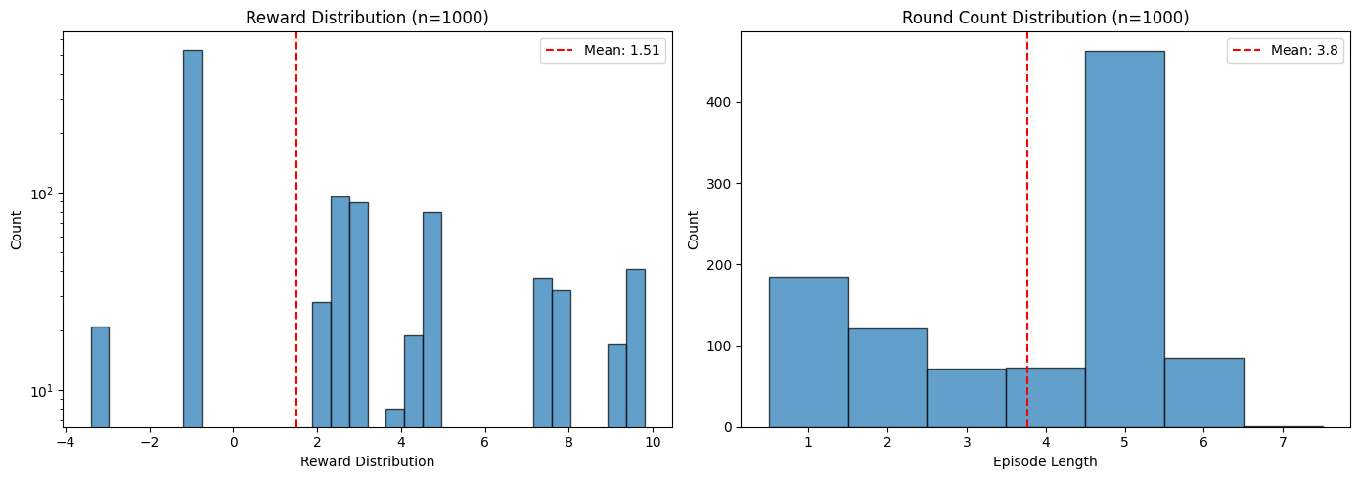
DQN — Evaluation (Conv. Rate: 44.70%)
chart_0.png

Slide 7
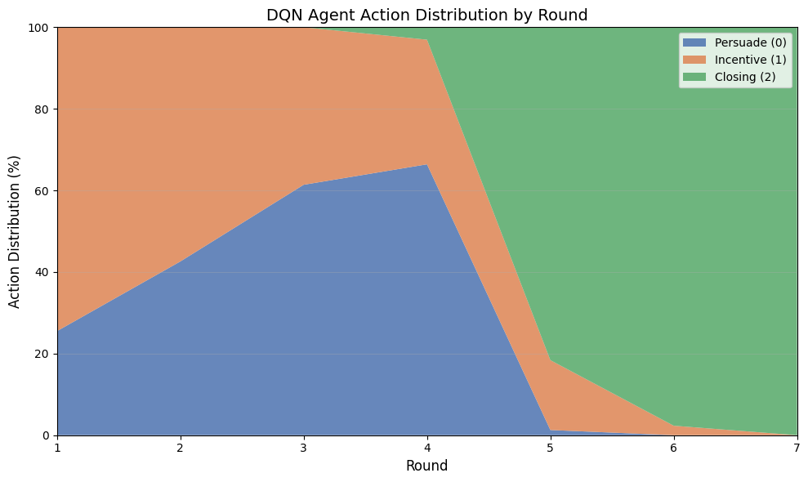
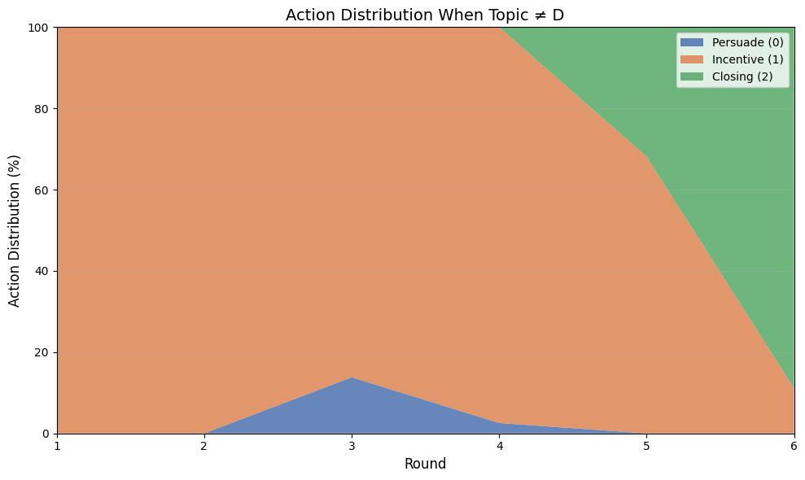
DQN — Action Distribution Comparison
All Actions
Excluding Topic D
chart_2.png | chart_3.png

Slide 8
Key Takeaways
Objection Handling Strategy
If objection is A/B/C: prioritize incentives. In particular, always use incentives for the first two rounds when possible.
If objection is D and round < 5, persuade. If round >= 5: enforce close.
Early Closing
If objection is A/B/C: closing starting at round 5 (moderately), enforce closing at round 6 and after.
If objection is D, moderate closing at round 4, enforce at round 5 and after.

Slide 9
DQN Experiment: change exit threshold to 7
Same model architecture, only change customer_exit_threshold from the gym environment (from 5) to 7.

Slide 10
DQN — Results
46.0%
1.66
4.5
Conversion Rate
Avg Reward
Avg Round
Evaluated over 1,000 episodes using best model checkpoint.
DQN Evaluation Results

Slide 11
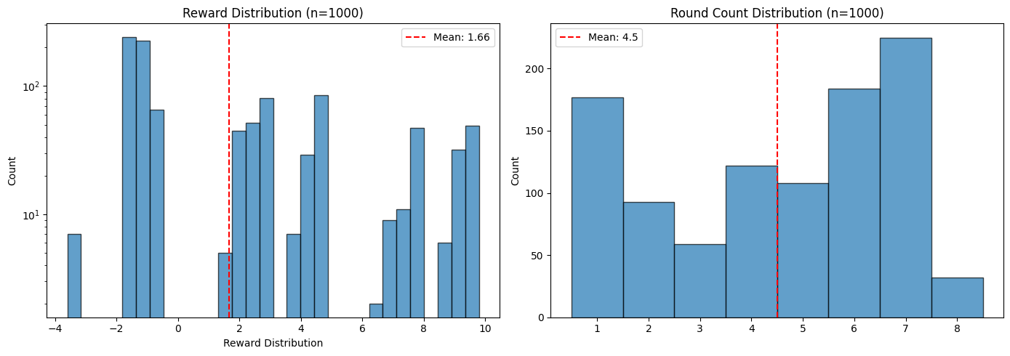
DQN Experiment: exit threshold

Slide 12
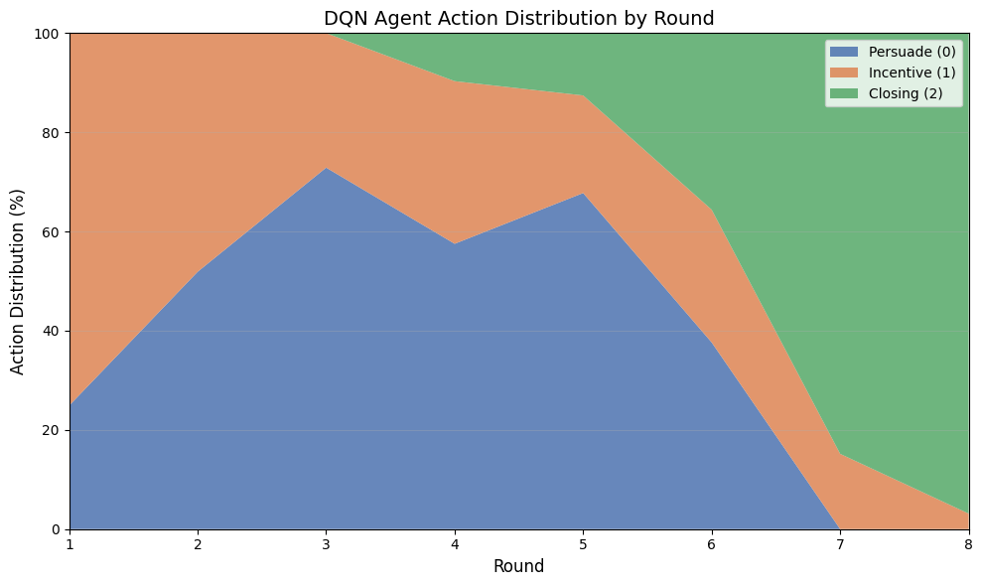
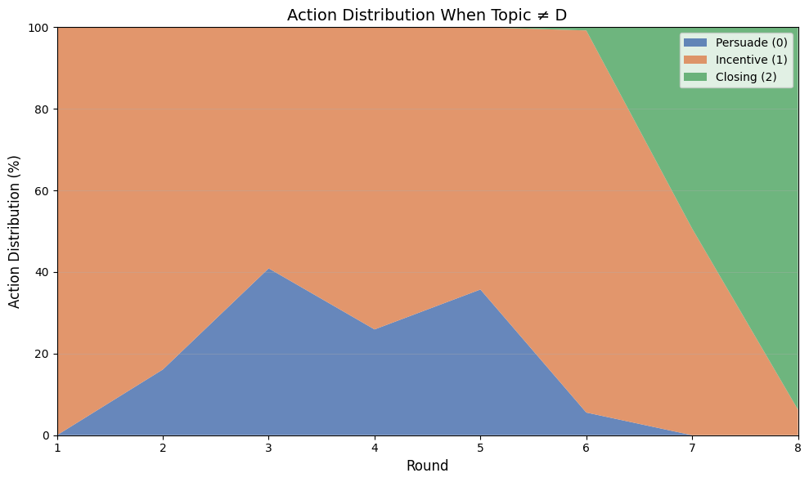
DQN Experiment: exit threshold — Action Distribution Comparison
All Actions
Excluding Topic D

Slide 13
Key Takeaways
Objection Handling Strategy
If objection is A/B/C: still prioritize incentives. (Always use incentive at round 1.) But has a higher percentage of persuade than when exit threshold = 5.
If objection is D and round < 5, persuade. If round >= 5: enforce close.
Early Closing
If objection is A/B/C: closing starting at round 7 (moderately), enforce closing at round 8 and after.
If objection is D, moderate closing at round 4, enforce at round 6 and after.

Slide 14
A2C
A2C models with 2-layer MLP policy-net and value-net (both [128,64]).

Slide 15
A2C + GAE — Full Pseudocode
Step 1 — Collect Rollouts
Step 4 — Compute Losses
for each env n = 1..N, step t = 0..T-1:
a_t ~ π( · | s_t ; θ )
Execute a_t → r_t, s_{t+1}, done_t
Store ( s_t, a_t, r_t, s_{t+1}, done_t )
Critic loss:
L_critic(w) = (1/NT) Σ [ R_t − V(s_t;w) ]²
Actor loss:
L_actor(θ) = −(1/NT) Σ log π(a_t|s_t;θ) · Â_t
Entropy bonus:
H(θ) = −(1/NT) Σ π log π
Step 2 — TD Residuals + GAE Advantages
δ_t = r_t + γ · V(s_{t+1}; w)·(1-done) − V(s_t; w)
Â_T = 0
for t = T-1 down to 0:
Â_t = δ_t + γ · λ · (1 - done_t) · Â_{t+1}
Step 5 — Update Weights
θ ← θ − α_θ * ∇_θ( L_actor − β·H )
w ← w − α_w * ∇_w L_critic
where alpha_theta and alpha_w is the learning rate
Step 3 — Returns (Critic Target)
R_t = Â_t + V(s_t ; w)
Note: Â_t uses V(s;w) as baseline → low variance. Minus β·H maximizes entropy for exploration.

Slide 16
A2C — Configuration
Training Setup
Parameter | Value
net_arch | dict( pi=[128, 64], # Actor layers vf=[128, 64] # Critic layers )
gamma | 0.99
learning_rate | 5e-5
n_steps | 10
gae_lambda | 0.9
ent_coef(β) | 0.01
vf_coef | 0.5
max_grad_norm | 1
total timesteps: 300,000
eval freq: 5,000
n eval episodes: 1000
checkpoint freq: 5000
Stable Baselines 3 — A2C

Slide 17
A2C — Results
32.0%
1.08
2.7
Conversion Rate
Avg Reward
Avg Round
Evaluated over 1,000 episodes using best model checkpoint.
A2C Evaluation Results

Slide 18
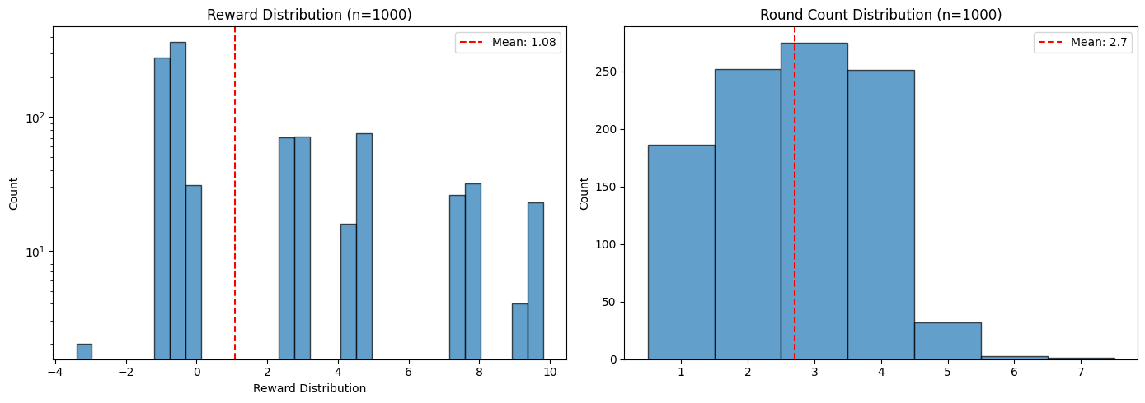
A2C — Evaluation (Conv. Rate: 32.00%)
chart_7.png

Slide 19
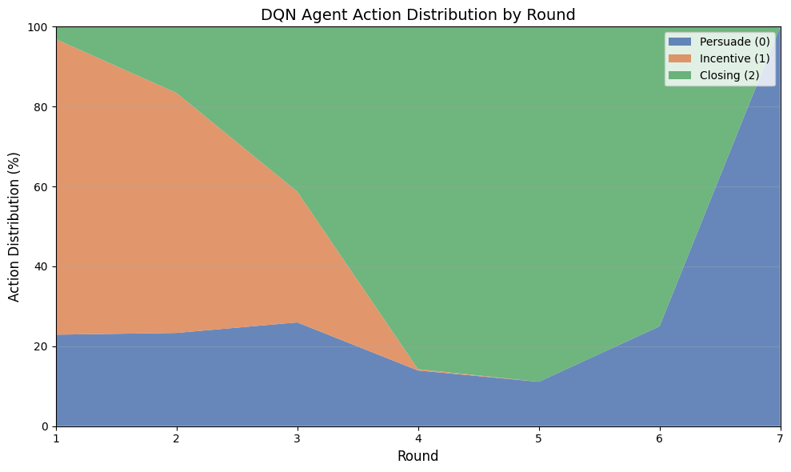
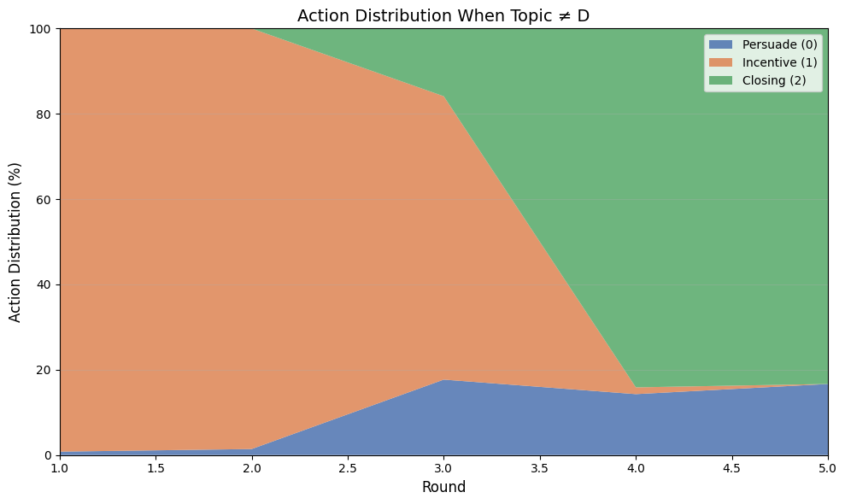
A2C — Action Distribution Comparison
All Actions
Excluding Topic D
chart_8.png | chart_9.png

Slide 20
Model Comparison
Metric | DQN | A2C
Conversion Rate | 44.7% | 32.0%
Avg Reward | 1.51 | 1.08
Learning Rate | 3e-5 | 5e-5
Total Timesteps | 400,000 | 300,000
DQN achieves significantly higher conversion rate (44.7%) vs A2C (32.0%), with exit threshold = 7 pushing to 46.0%.
All models evaluated over 1,000 episodes

