Slide 1
📊
AI-Powered
Fitness Coach
FitMind
AI-Powered Fitness & Nutrition Companion
Mohamed Taha · Medhat Ahmed · Ahmed Saber · Mohammed Gamal
Dr. Osama Ismail · TA. Doaa Ghaleb · Cairo University FCAI · 2026

Slide 2
⚠ Problem
The Fitness App Gap
80%
5+
0
abandon in 2 weeks
apps to track health
apps adapt to conditions
Manual logging is too tedious
No unified health picture
Injuries & meds ignored
Most fitness apps give everyone the same generic plan — no adaptation, no safety, no context.
🎯 Plans never adapt to your progress or lifestyle
⚕️ Chronic conditions, injuries, allergies — completely ignored
🔇 No AI insights — only raw tracking data
2

Slide 3
🏆 Competitors
How FitMind Compares
Feature | FitMind | Freeletics | MyFitnessPal | Noom
🏋 AI Workout Plans | ✓ | Partial | ✗ | ✗
🥗 AI Nutrition Plans | ✓ | Partial | ✗ | Partial
📷 Camera Meal Scan | ✓ | ✗ | ✗ | ✗
🎙 Voice Logging | ✓ | ✗ | ✗ | ✗
🤖 Daily AI Coaching | ✓ | ✓ | ✗ | ✓
⚕ Health Condition Safety | ✓ | ✗ | ✗ | ✗
📊 Unified Fitness Score | ✓ | ✗ | ✗ | ✗
Freeletics = closest competitor (AI workout + nutrition coaching); Partial = category exists but limited depth
3

Slide 4
✦ Solution
Introducing FitMind
🎯
📷
Personalized AI Plans
Multimodal Logging
• 17-question health assessment
• Injuries, allergies, meds — built in
• Weekly workout + daily nutrition plan
• Plans re-generated as goals change
• Camera: photograph meal → AI reads macros
• Voice: speak what you ate → logged instantly
• Text entry always available
🤖
📊
Daily AI Coaching
Unified Fitness Score
• Celery Beat runs analysis every night
• All logs (food, workouts, sleep, water) analyzed
• Personalized tip delivered each morning via FCM
• 0–100 composite score — 6 health dimensions
• Nutrition, Workouts, Hydration, Sleep
• 7-day rolling window, updated nightly
4

Slide 5
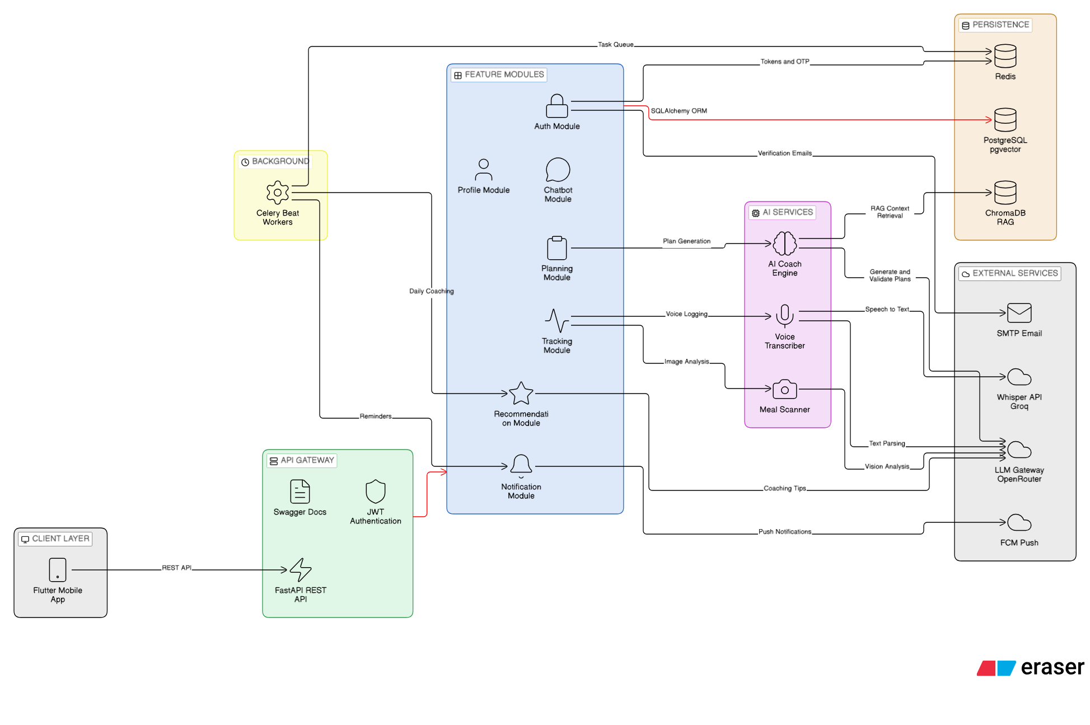
🏗 Architecture
System Architecture
5

Slide 6
⚡ AI Pipeline
Plan Generation Pipeline
User Profile
→
Generate Qwen 235B
→
Judge gpt-4o-mini
→
Fix Once (if needed)
→
Allergy Gate
→
Deliver to User
Three-Channel System Prompt
🎯 P — Deterministic TDEE targets (Mifflin-St Jeor, activity multiplier 1.20–1.90)
⚕️ C — Condition-specific safety rules (per injury / allergy / medication)
📦 B — Whitelisted food & exercise IDs from RAG retrieval
🔒 Allergy gate is deterministic — not LLM-based. Any whitelisted food containing a flagged allergen is silently removed before delivery.
235B
gpt-4o-mini
17
1200–5000
params, Qwen plan model
safety judge
health assessment fields
kcal TDEE clamp
6

Slide 7
🔍 RAG
Hybrid Search — How We Find the Right Foods
User Query
BM25 Okapi
ChromaDB Semantic
Reciprocal Rank Fusion (k=60)
Top-K Results
→
+
→
→
📚 Food database — 8,789 items (USDA + nutrition.csv)
🧠 Embeddings — paraphrase-multilingual-MiniLM-L12-v2 (384 dimensions)
⚡ BM25 keyword scoring + ChromaDB cosine similarity — run in parallel
🔀 RRF formula: score = Σ 1 / (k + rank_i) where k=60
🌍 Multilingual model supports Arabic & English queries
8,789
384
k=60
2×
foods in DB
embedding dims
RRF constant
retrieval runs parallel
7

Slide 8
📊 Score
FitMind Score — How It Works
Score Components
0–100
🍎 Nutrition compliance
25%
💪 Strength (workouts)
20%
Composite Score
7-day rolling window
🏃 Endurance (cardio)
20%
⚡ Agility & flexibility
15%
💧 Hydration
10%
😴 Sleep quality
10%
📐 Nightly calculation via Celery Beat · numpy polyfit for trend slopes · macro balance score
8

Slide 9
📐 Math
TDEE & Feature Engineering
TDEE Calculation (Mifflin-St Jeor)
Feature Engineering
♂ BMR = 10×kg + 6.25×cm − 5×age + 5
♀ BMR = 10×kg + 6.25×cm − 5×age − 161
× Activity multiplier (1.20 → 1.90)
Sedentary: 1.20 | Light: 1.375 | Moderate: 1.55
Active: 1.725 | Very Active: 1.90
✓ Clamped to 1,200 – 5,000 kcal/day
📈 numpy polyfit → calorie trend slope (7 days)
⚖️ Macro balance score: protein/carbs/fat ratio
📅 Workout frequency adherence (vs. plan)
💧 Hydration adherence: actual vs. 35 ml/kg
😴 Sleep quality: 7–9 h = optimal range
🏅 Completion rate: logged sets ÷ planned sets
🔄 All features computed nightly · fed into FitMind Score · stored per user per day
9

Slide 10
🔧 Tech Stack
Technology Stack
🐍
FastAPI
🐘
PostgreSQL
🔴
Redis
🌿
Celery
Backend API
Primary DB
Cache & Broker
Task Queue
📱
Flutter
🔥
Firebase
🤖
Qwen 235B
👁
Qwen2.5-VL
Mobile (iOS+Android)
Push Notifications
AI Plan Gen
Meal Vision
🎙
Groq Whisper
🧠
ChromaDB
🐋
Docker
🌐
Next.js
Voice STT
Vector DB
Deployment
Landing Page
10

Slide 11
✅ Testing
Testing & Evaluation
48+
100%
20+
3
unit & integration tests
core module coverage
AI plans manually reviewed
platforms tested on-device
Test Coverage
AI Plan Evaluation
🧪 Unit — auth, tracking, planning, coaching (mocked)
🔗 Integration — FastAPI TestClient + real PostgreSQL
🤖 AI Safety — diabetic, knee injury, asthma profiles
📱 E2E — signup → plan → log → score (physical device)
✅ Macro targets within ±5% of TDEE for 95% of plans
🔒 All allergy-flagged foods removed — 100% deterministic
⚕️ Health condition safety rules verified manually
📋 Structured JSON output validated on every generation
11

Slide 12
🔮 Future
Future Vision
💬
⌚
AI Chatbot
Wearable Integration
• Real-time Q&A inside the app
• Context-aware — knows your full profile
• Ask anything: diet, form, plan adjustments
• Auto-sync Apple Watch & Samsung Galaxy Watch
• Heart rate, steps, sleep — auto-collected
• Eliminates manual sleep & step logging
🌍
👨‍⚕️
Arabic Language Support
Coach Marketplace
• Full Arabic UI with RTL layout
• Localized Egyptian & MENA food database
• Supports AR and RTL — dataset currently in EN
• Platform for certified coaches & nutritionists
• Client progress monitoring dashboard
• Professional service monetization layer
12

Slide 13
Thank You
Questions?
Mohamed Taha · Medhat Ahmed · Ahmed Saber · Mohammed Gamal
Dr. Osama Ismail · TA. Doaa Ghaleb · Cairo University FCAI · 2026

