Slide 1

FitMind
AI-Powered Fitness & Nutrition Companion
Mohamed Taha · Medhat Ahmed · Ahmed Saber · Mohammed Gamal
Dr. Osama Ismail · TA. Doaa Ghaleb · Cairo University FCAI · 2026

Slide 2




PROBLEM
The Fitness App Gap
80%
5+
0
quit within 2 weeks
apps to track health
apps adapt to conditions
Manual logging is too tedious
No unified health picture
Injuries & meds ignored
Every user gets the same generic plan — no adaptation, no safety.
Plans never adapt to your progress or lifestyle
Chronic conditions, injuries and allergies are ignored
Tracking apps show data — none turn it into daily advice
2

Slide 3

COMPETITORS
How FitMind Compares
Feature | FitMind | Freeletics | MyFitnessPal | Noom
AI Workout Plans | ✓ | Partial | ✗ | ✗
AI Nutrition Plans | ✓ | Partial | ✗ | Partial
Camera Meal Scan | ✓ | ✗ | ✗ | ✗
Voice Logging | ✓ | ✗ | ✗ | ✗
Daily AI Coaching | ✓ | ✓ | ✗ | ✓
Health Condition Safety | ✓ | ✗ | ✗ | ✗
Unified Fitness Score | ✓ | ✗ | ✗ | ✗
Freeletics is the closest competitor — AI workout and nutrition coaching. Partial = feature exists but limited depth.
3

Slide 4




SOLUTION
Introducing FitMind
Personalized AI Plans
Multimodal Logging
• 17-question health assessment up front
• Injuries, allergies & medications built in
• Weekly workout + daily nutrition plan
• Camera — photograph a meal, get macros
• Voice — speak what you did, it gets logged
• Text entry always available as fallback
Daily AI Coaching
Unified Fitness Score
• Nightly analysis of all logged activity
• One personalized tip delivered each morning
• Sent as a push notification via Firebase
• 0–100 composite across 6 health dimensions
• Nutrition, workouts, hydration & sleep combined
• 7-day rolling window, recalculated nightly
4

Slide 5

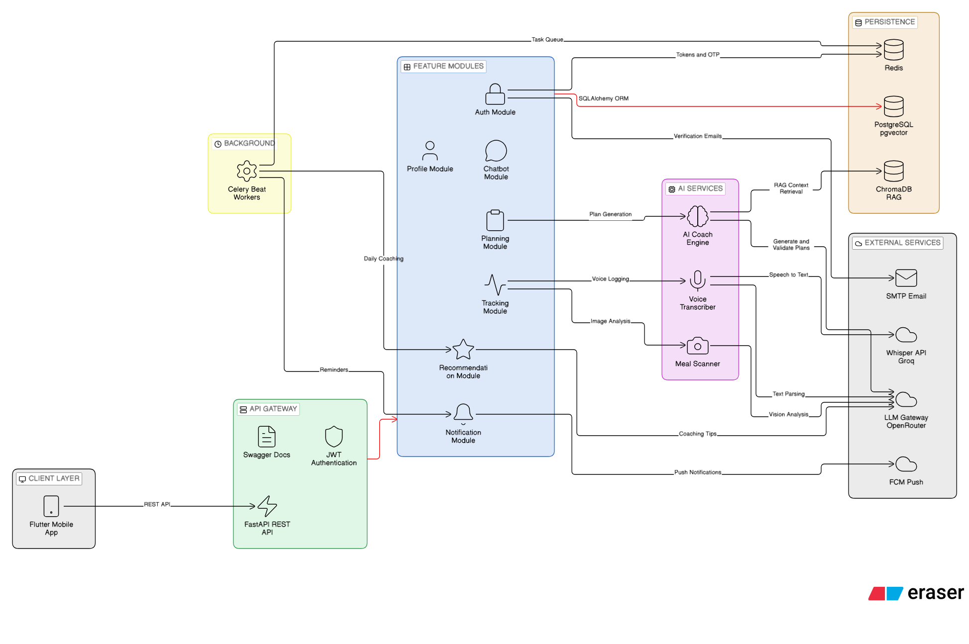
ARCHITECTURE
System Architecture
5

Slide 6





AI PIPELINE
Plan Generation Pipeline
1. User Profile
Three-Channel System Prompt
Assessment answers feed the TDEE targets
• P — deterministic TDEE targets (Mifflin-St Jeor)
• C — condition-specific safety rules per profile
• B — whitelisted food & exercise IDs from RAG
2. Generate — Qwen 235B
3-channel prompt: targets, safety rules, food IDs
3. Judge — gpt-4o-mini
Independent LLM checks plan safety and format
4. Fix Once (if needed)
1,200 – 5,000 kcal
One automatic repair pass if the judge flags it
TDEE clamp range
5. Allergy Gate
Deterministic filter removes any flagged foods
6

Slide 7




RAG
Hybrid Search for Food Retrieval
1. Query Comes In
8,789
A food or exercise lookup during plan generation
foods indexed
2. BM25 Okapi
384
Keyword scoring over the food & exercise database
embedding dimensions
3. ChromaDB Semantic
k = 60
384-dim multilingual embeddings, cosine similarity
RRF constant
4. Reciprocal Rank Fusion
2×
Rankings merged: score = Σ 1/(k+rank), k = 60
retrieval paths, fused
7

Slide 8






SCORE
FitMind Score — How It Works
Score Components
0–100
Nutrition compliance
25%
Strength (workouts)
20%
Composite Score
7-day rolling window
Endurance (cardio)
20%
Agility & flexibility
15%
Hydration
10%
Sleep quality
10%
Calculated nightly via Celery Beat · numpy polyfit for trend slopes · macro balance score
8

Slide 9

MATH
TDEE & Feature Engineering
TDEE — Mifflin-St Jeor
Feature Engineering
• BMR = 10×kg + 6.25×cm − 5×age (+5 men / −161 women)
• Activity ×1.20 (sedentary) to ×1.90 (very active)
• Clamped to 1,200 – 5,000 kcal / day
• numpy polyfit → 7-day calorie trend slope
• Macro balance score from protein/carb/fat ratio
• Workout frequency adherence vs. weekly plan
Worked example
25yo male · 80 kg · 180 cm · moderate activity → TDEE ≈ 2,798 kcal / day
9

Slide 10





TECH STACK
Technology Stack
FastAPI
PostgreSQL
Redis
Celery
Backend API
Primary DB
Cache & Broker
Task Queue
Flutter
Firebase
Qwen 235B
Qwen2.5-VL
Mobile app
Push notifications
AI plan generation
Meal vision
Groq Whisper
ChromaDB
Docker
Next.js
Voice transcription
Vector database
Deployment
Landing page
10

Slide 11
TESTING
Testing & Evaluation
48+
100%
20+
3
unit & integration tests
core module coverage
AI plans manually reviewed
platforms tested on-device
Test Coverage
AI Plan Evaluation
• Unit — auth, tracking, planning, coaching (mocked)
• Integration — FastAPI TestClient + real PostgreSQL
• E2E — full signup-to-score flow on real devices
• Macros land within ±5% of TDEE targets
• 100% deterministic allergy-food removal
• Diabetic, injury & asthma profiles hand-checked
11

Slide 12

ROADMAP
Future Vision
AI Chatbot
Wearables
Arabic & RTL
Coach Marketplace
Real-time in-app Q&A aware of your full health profile
→
Auto-sync Apple Watch & Galaxy Watch — heart rate, steps, sleep
→
Full Arabic UI, RTL layout, localized MENA food database
→
Certified coaches manage clients through a shared dashboard
12

Slide 13

Thank You
Questions?
Mohamed Taha · Medhat Ahmed · Ahmed Saber · Mohammed Gamal
Dr. Osama Ismail · TA. Doaa Ghaleb · Cairo University FCAI · 2026

