Slide 1

FitMind
AI-Powered Fitness & Nutrition Companion
Mohamed Taha · Medhat Ahmed · Ahmed Saber · Mohammed Gamal
Dr. Osama Ismail · TA. Doaa Ghaleb · Cairo University FCAI · 2026

Slide 2



PROBLEM
The Fitness App Gap
Generic
Unsafe
Passive
Same plan for every user, any goal
Conditions & allergies routinely ignored
Shows data — never turns it into advice
Every user gets the same generic plan — no adaptation, no safety.
Beginners and elite athletes get the identical plan
One wrong recommendation can aggravate an injury
Motivation fades without anyone checking in
2

Slide 3

COMPETITORS
How FitMind Compares
Feature | FitMind | Vora | Fitbit | Samsung Health | Zing Coach
AI Workout Plans | ✓ | ✓ | Partial | ✓ | ✓
AI Nutrition Plans | ✓ | Partial | Partial | Partial | Partial
Camera Meal Scan | ✓ | ✓ | ✓ | ✗ | ✗
Voice Logging | ✓ | Partial | ✓ | ✗ | Partial
Daily AI Coaching | ✓ | ✓ | ✓ | ✓ | ✓
Condition Safety | ✓ | ✗ | ✗ | ✗ | ✗
Unified Fitness Score | ✓ | Partial | ✗ | Partial | ✗
Wearable & Biometric Sync | ✗ | ✓ | ✓ | ✓ | Partial
Live Form-Check (Vision) | ✗ | ✗ | ✗ | ✗ | ✓
Shaded rows: capabilities where FitMind currently trails — included so the comparison cuts both ways.
3

Slide 4



SOLUTION
Introducing FitMind
Personalized AI Plans
Multimodal Logging
• 17-question health assessment
• Injuries, allergies & meds included
• Camera scan → macros instantly
• Voice log → hands-free tracking
Daily AI Coaching
Unified Fitness Score
• Checked hourly, sent at your hour
• One AI tip, straight to your phone
• 0–100 across 6 health areas
• Computed live from your last 7 days
4

Slide 5









REQUIREMENTS
Functional Requirements
FR-01
FR-02
FR-03
FR-04
FR-05
Account & Onboarding
Health Assessment
AI Workout Plans
AI Nutrition Plans
Meal Logging
FR-06
FR-07
FR-08
FR-09
FR-10
Workout Logging
Hydration & Weight
Sleep Tracking
FitMind Score
Daily & Weekly Coaching
All ten shipped and covered in the sections that follow — this slide is the traceability map.
5

Slide 6

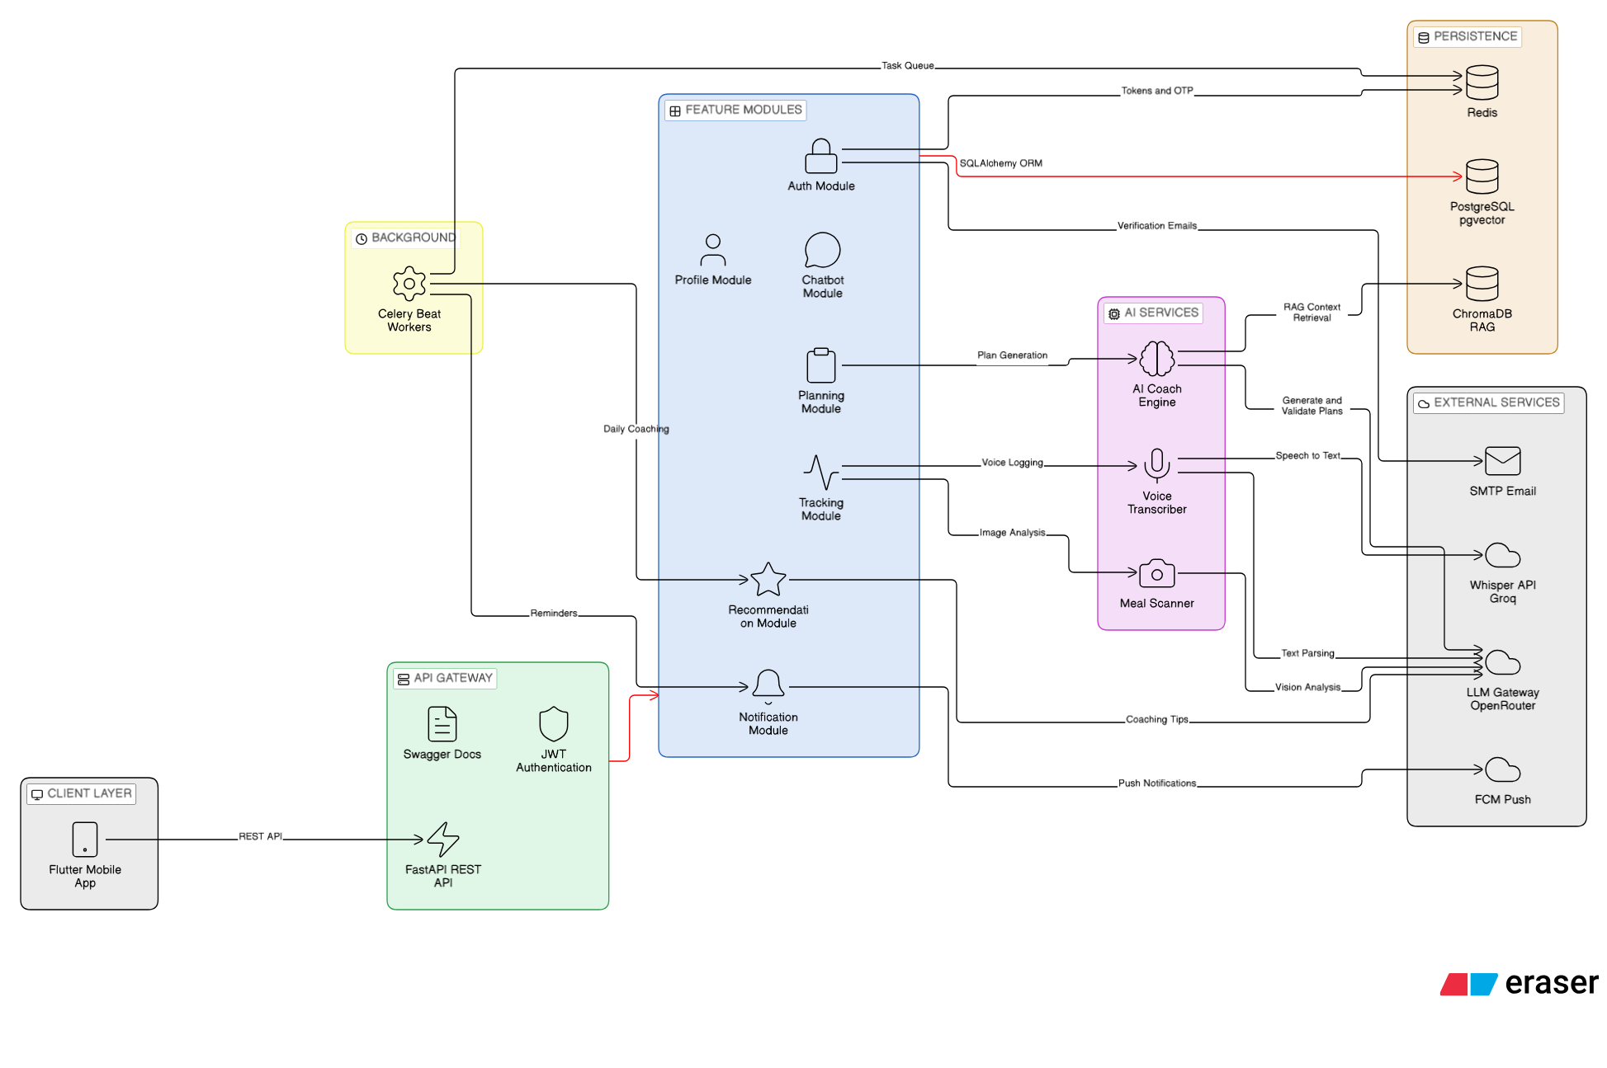
ARCHITECTURE
System Architecture
6

Slide 7





AI PIPELINE
Plan Generation Pipeline
1. User Profile
Assessment answers feed the TDEE targets
Three-Channel System Prompt
• P — deterministic TDEE targets
• C — condition-specific safety rules
• B — whitelisted food & exercise IDs
2. Generate — Qwen 235B
Targets, safety rules & food IDs combined
3. Judge — gpt-4o-mini
Checks the plan for safety and format
4. Fix Once (if needed)
One repair pass if the judge flags it
1,200 – 5,000 kcal
5. Allergy Gate
TDEE clamp range
Removes any allergy-flagged foods
7

Slide 8


RAG
Hybrid Search for Fitness Knowledge
1. AI Coach or Plan Request
ACSM · NSCA
A chat message or plan-generation call comes in
WHO · ISSN · IOC · NIH sources
2. BM25 Okapi
20 + 20
Keyword scoring over scraped guideline articles
BM25 + dense candidates
3. ChromaDB Semantic
k = 60
Dense embeddings over the same knowledge base
RRF constant
4. Reciprocal Rank Fusion
2
Rankings merged: score = Σ 1/(k+rank), k = 60
rankers fused
Feeds AI Coach chat & plan generation — food lookup itself is separate (SQL + pgvector).
8

Slide 9

SCORE
FitMind Score — How It Works
Score Components
0–100
Nutrition compliance
25%
Composite Score
Strength (workouts)
20%
Last 7 days of logs
Rule-based, no ML
Endurance (cardio)
20%
Computed on demand
Agility & flexibility
15%
Hydration
10%
Sleep quality
10%
e.g. Nutrition = logging consistency (40%) + calorie adherence (35%) + protein adherence (25%)
9

Slide 10
MATH
TDEE Calculation
BMR — Mifflin-St Jeor
Activity & Limits
• Men: 10×kg + 6.25×cm − 5×age + 5
• Women: 10×kg + 6.25×cm − 5×age − 161
• Goal delta: +450 kcal to build muscle
• −400 kcal to lose weight, +0 to maintain
• Sedentary ×1.20 · Light ×1.375
• Moderate ×1.55 · Active ×1.725
• Very active ×1.90
• Clamped to 1,200 – 5,000 kcal / day
Worked example
25yo male · 80 kg · 180 cm · moderate activity → TDEE ≈ 2,798 kcal / day
10

Slide 11

ANALYTICS
Feature Engineering
Trend Slopes
Macro Balance Score
• numpy polyfit fits a line through daily values
• Calorie trend — is intake rising or falling?
• Volume trend — progressing or plateaued?
• Actual protein/carb/fat % vs. plan target
• Score = 100 − total macro deviation
• Catches "right calories, wrong macros"
Exercise Progressions
Consistency Score
• Per-lift: first session vs. most recent
• e.g. "Bench Press +18%" this month
• Sorted so the biggest movers surface first
• Calories 40% + frequency 40% + logging 20%
• On track at ≥65% (and ≥75% on calories)
• Gates whether coaching messages send
11

Slide 12

WEEKLY ANALYSIS
Weekly Progress Report
1. Sunday, 09:00 UTC
Celery Beat triggers for every opted-in user
On-Track Formula
• Consistency = 40% calories + 40% frequency + 20% logging
• On track when consistency ≥ 65%
• ...and calorie adherence ≥ 75% too
2. 7-Day Feature Aggregation
Same engineering pipeline, scoped to the week
3. LLM Writes the Report
Assessment, wins, improvement areas, projection
4. Delivered & Saved
"Your Weekly Progress Report"
Push notification + a persisted coaching message
the actual push notification title
12

Slide 13



TECH STACK
Technology Stack
FastAPI
PostgreSQL
Redis
Celery
Backend API
Primary DB
Cache & Broker
Task Queue
Flutter
Firebase
Qwen 235B
Qwen2.5-VL
Mobile app
Push notifications
AI plan generation
Meal vision
Whisper
ChromaDB
Docker
Next.js
Groq — voice-to-text
Vector database
Deployment
Landing page
13

Slide 14
TESTING
Testing & Evaluation
API Testing
AI Output Evaluation
• Postman suite covers every REST endpoint
• Environment configs per deployment
• Manual + semi-automated request suites
• Synthetic profiles — goals & conditions
• Rubric checks — allergen safety, fit
• Every plan scored before it ships
No CI pipeline runs yet — API and AI-output checks are run manually ahead of each release.
14

Slide 15
ROADMAP
Future Vision
AI Chatbot
Wearables
• Real-time Q&A on your plan
• Aware of your full health profile
• Auto-synced Apple & Galaxy Watch
• Heart rate, steps & sleep, live
Full Arabic Workouts
Coach Marketplace
• Plans already generate in Arabic
• Exercise library not fully localized yet
• Coaches manage real clients
• Shared client progress dashboard
15

Slide 16

Thank You
Questions?
Mohamed Taha · Medhat Ahmed · Ahmed Saber · Mohammed Gamal
Dr. Osama Ismail · TA. Doaa Ghaleb · Cairo University FCAI · 2026

