Slide 1

FitMind
AI-Powered Fitness & Nutrition Companion
Mohamed Taha · Medhat Ahmed · Ahmed Saber · Mohammed Gamal
Dr. Osama Ismail · TA. Doaa Ghaleb · Cairo University FCAI · 2026

Slide 2




PROBLEM
The Fitness App Gap
80%
5+
0
quit within 2 weeks
apps to track health
apps adapt to conditions
Manual logging is too tedious
No unified health picture
Injuries & meds ignored
Every user gets the same generic plan — no adaptation, no safety.
Plans never adapt to your progress or lifestyle
Chronic conditions, injuries and allergies are ignored
Tracking apps show data — none turn it into daily advice
2

Slide 3

COMPETITORS
How FitMind Compares
Feature | FitMind | Freeletics | MyFitnessPal | Noom
AI Workout Plans | ✓ | Partial | ✗ | ✗
AI Nutrition Plans | ✓ | Partial | ✗ | Partial
Camera Meal Scan | ✓ | ✗ | ✗ | ✗
Voice Logging | ✓ | ✗ | ✗ | ✗
Daily AI Coaching | ✓ | ✓ | ✗ | ✓
Health Condition Safety | ✓ | ✗ | ✗ | ✗
Unified Fitness Score | ✓ | ✗ | ✗ | ✗
Freeletics is the closest competitor — AI workout and nutrition coaching. Partial = feature exists but limited depth.
3

Slide 4



SOLUTION
Introducing FitMind
Personalized AI Plans
Multimodal Logging
• 17-question health assessment
• Injuries, allergies & meds included
• Camera scan → macros instantly
• Voice log → hands-free tracking
Daily AI Coaching
Unified Fitness Score
• Nightly analysis of your data
• One AI tip each morning, via push
• 0–100 across 6 health areas
• Recalculated every night
4

Slide 5

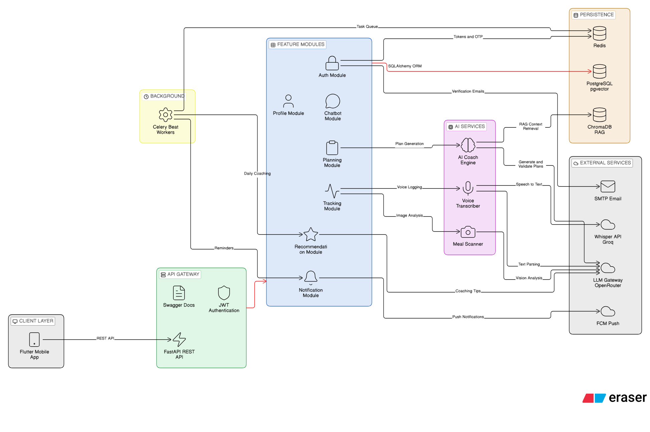
ARCHITECTURE
System Architecture
5

Slide 6






AI PIPELINE
Plan Generation Pipeline
1. User Profile
Assessment answers feed the TDEE targets
Three-Channel System Prompt
• P — deterministic TDEE targets
• C — condition-specific safety rules
• B — whitelisted food & exercise IDs
2. Generate — Qwen 235B
Targets, safety rules & food IDs combined
3. Judge — gpt-4o-mini
Checks the plan for safety and format
4. Fix Once (if needed)
One repair pass if the judge flags it
1,200 – 5,000 kcal
5. Allergy Gate
TDEE clamp range
Removes any allergy-flagged foods
6

Slide 7



RAG
Hybrid Search for Food Retrieval
1. Query Comes In
8,789
A food or exercise lookup during plan generation
foods indexed
2. BM25 Okapi
384
Keyword scoring over the food & exercise database
embedding dimensions
3. ChromaDB Semantic
k = 60
384-dim multilingual embeddings, cosine similarity
RRF constant
4. Reciprocal Rank Fusion
2×
Rankings merged: score = Σ 1/(k+rank), k = 60
retrieval paths, fused
7

Slide 8






SCORE
FitMind Score — How It Works
Score Components
0–100
Nutrition compliance
25%
Strength (workouts)
20%
Composite Score
7-day rolling window
Endurance (cardio)
20%
Agility & flexibility
15%
Hydration
10%
Sleep quality
10%
Calculated nightly via Celery Beat · numpy polyfit for trend slopes · macro balance score
8

Slide 9

MATH
TDEE & Feature Engineering
TDEE — Mifflin-St Jeor
Feature Engineering
• BMR = 10×kg + 6.25×cm − 5×age
• (+5 for men, −161 for women)
• Activity ×1.20 to ×1.90
• Clamped to 1,200 – 5,000 kcal / day
• numpy polyfit → 7-day calorie trend
• Macro balance score (protein/carb/fat)
• Workout frequency vs. weekly plan
Worked example
25yo male · 80 kg · 180 cm · moderate activity → TDEE ≈ 2,798 kcal / day
9

Slide 10



TECH STACK
Technology Stack
FastAPI
PostgreSQL
Redis
Celery
Backend API
Primary DB
Cache & Broker
Task Queue
Flutter
Firebase
Qwen 235B
Qwen2.5-VL
Mobile app
Push notifications
AI plan generation
Meal vision
Whisper
ChromaDB
Docker
Next.js
Groq — voice-to-text
Vector database
Deployment
Landing page
10

Slide 11
TESTING
Testing & Evaluation
48+
100%
20+
3
unit & integration tests
core module coverage
AI plans reviewed
platforms on-device
Test Coverage
AI Plan Evaluation
• Unit tests — auth, tracking, planning
• Integration — FastAPI TestClient + DB
• E2E — full flow on real devices
• Macros within ±5% of TDEE targets
• 100% deterministic allergy removal
• Hand-checked: diabetic, injury, asthma
11

Slide 12

ROADMAP
Future Vision
AI Chatbot
Wearables
• Real-time Q&A on your plan
• Aware of your full health profile
• Auto-synced Apple & Galaxy Watch
• Heart rate, steps & sleep, live
Arabic & RTL
Coach Marketplace
• Full Arabic UI with RTL layout
• Localized MENA food database
• Coaches manage real clients
• Shared client progress dashboard
12

Slide 13

Thank You
Questions?
Mohamed Taha · Medhat Ahmed · Ahmed Saber · Mohammed Gamal
Dr. Osama Ismail · TA. Doaa Ghaleb · Cairo University FCAI · 2026

