Slide 1
Key phrases extraction
Sergey Sokolov
10-14 December 2018

Slide 2
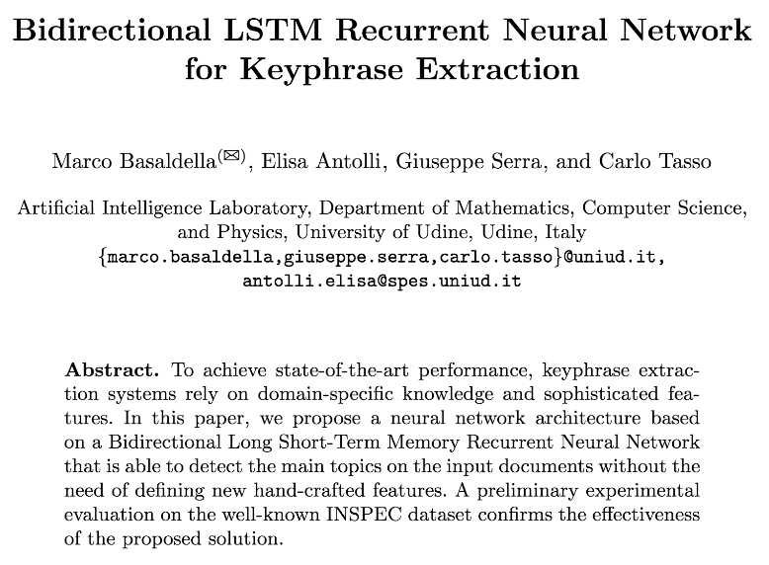
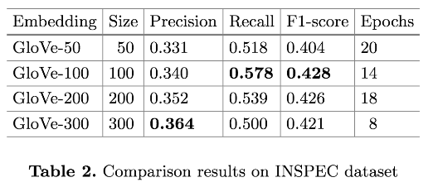
Paper
https://github.com/dmlc/gluon-nlp/blob/keyphrase/scripts/keyphrase/BiLSTM_for_Keyphrase_Extraction.pdf

Slide 3
Dataset
INSPEC – dataset of titles and abstracts of scientific papers with associated key phrases per each paper
Total: 2200 records = 1000 train + 500 val + 700 test
Each record: free text of paper’s title + abstract
Each label: free text of key phrases from *.uncontr file
English only

Slide 4
Formulate ML task
By predicting key phrases for the text, we mean classifying each word of the text into 3 classes:
Beginning of a key phrase
Continuation of a key phrase
Not a part of key phrases
Then, by taking continuous text of classes “beginning key phrase” to last ‘continuation of a keyphrase’ we solve business task

Slide 5
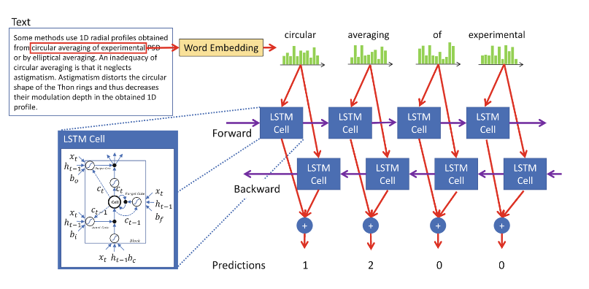
Proposed approach

Slide 6
Custom dataset
Provide indexed access to records
Define “segments” of dataset to load parts we need

Slide 7
Data preprocessing
Tokenize records
Create new record’s label by classifying each word of the record to 3 possible classes:
NO_KP – Not a key phrase, 0
BEGIN_KP – Beginning of a key phrase, 1
INSIDE_KP – Continuation of a key phrase, 2

Slide 8
How to do embeddings in GluonNLP

Slide 9
Embedding
Allows to associate N-dimensional vector with a word
Currently supported embeddings:
GloVe - https://nlp.stanford.edu/projects/glove/
fastText - https://fasttext.cc/
Create embedding via
nlp.embedding.create('fasttext', source='wiki.simple')

Slide 10
Data pipelining
Tokenize text into single list using predefined or custom tokenizer
Create Counter based on list of all words
Create Vocab based on Counter
Create Embedding from predefined list or custom file
Assign Embedding to Vocab via vocab.set_embedding(…)
Use vocab.embedding.idx_to_vec to initialize Embedding layer

Slide 11
Let’s look into the code

Slide 12
Results
With few lines of code reproduced the model and training pipeline
Achieved state-of-the-art results:
0.413 (vs. paper 0.428)
Questions?

