Slide 1
Scaling Training with MXNet
Multi GPU training with MXNet and Sagemaker
Sergey Sokolov
10-14 December 2018

Slide 2
Agenda
Introduction
Multi GPU Training in Gluon – 60 min
Lab: Multi GPU Training with Sagemaker – 30 min

Slide 3

Introduction
Notes:
Multi GPU and parallel training makes the work cycle much faster. This has a substantial effect on productivity when developing models
Previous wisdom was to avoid premature optimisation.
Now it is easier to scale computation with gluon and SageMaker
Optimise early to become more productive.

Slide 4
Multiple GPU

Slide 5
Data Parallel ResNet – CIFAR10
70,000
10,000
test
512
batch
128
512
batch
512
batch
512
batch
512
batch
128
512
batch
60,000
train
512
batch
128
128
30 epochs
~117 batches
4 NVIDIA Tesla V100

Slide 6

Data Locations
kvstore:
'device‘
'local‘
GPU
CPU
W
X, Y
P3 = 5,120 cores

Slide 7
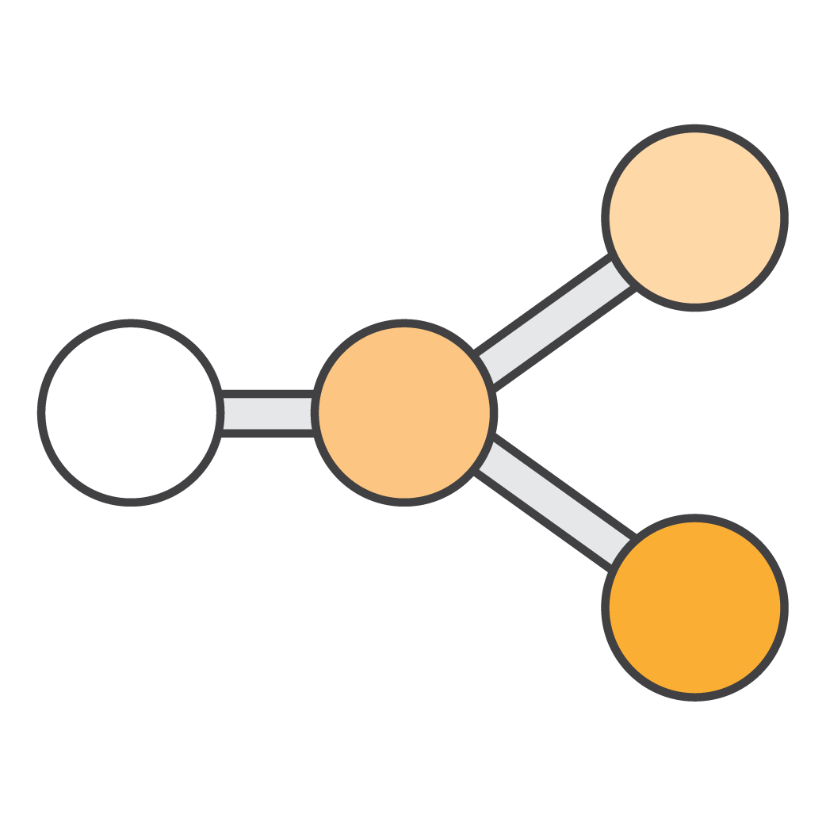

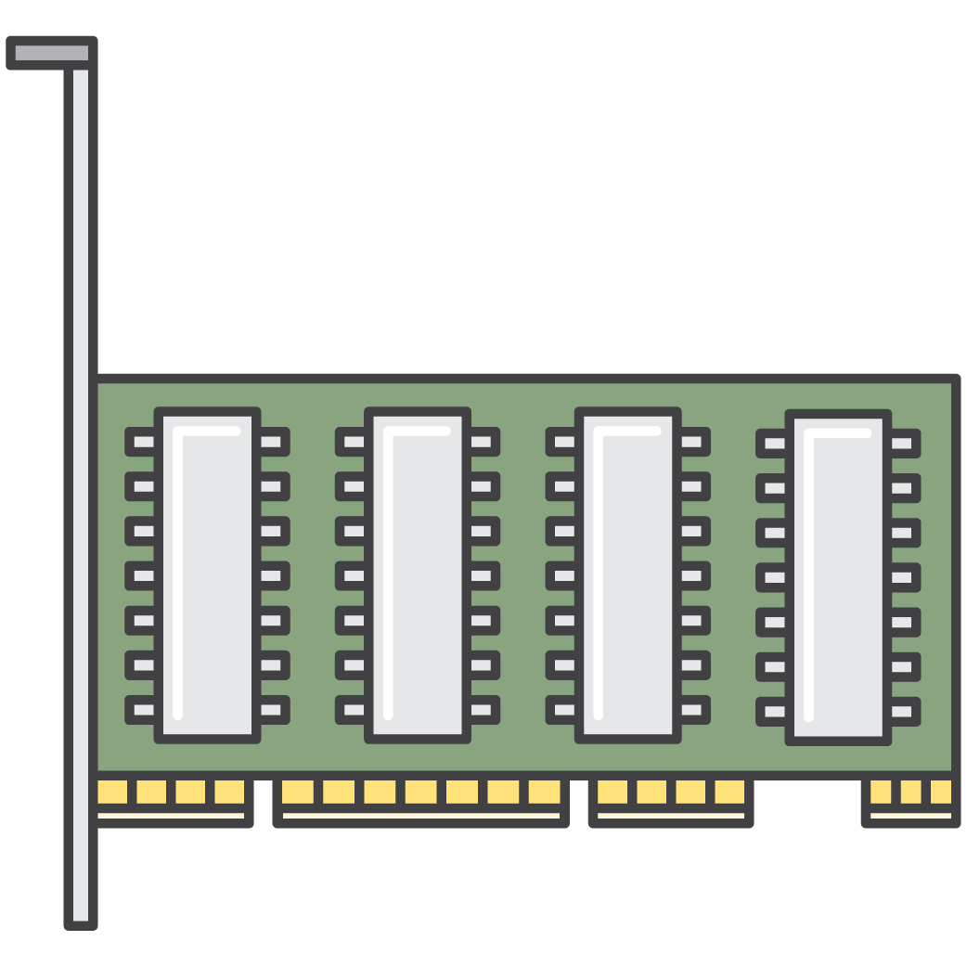
Writing Parallel Code in MXNet
Lazy Evaluation
Parallel Scheduling
NDArray.as_in_context()

Slide 8
Multi GPU Training in Gluon: example
multiple_gpus_gluon/multiple_gpus_gluon.ipynb

Slide 9
Setting Up for the Labs
AWS Account with SageMaker permissions
p3.8xlarge notebook instance (for multiple GPUs)
Open a terminal from the notebook
cd SageMaker
`git clone https://github.com/Ishitori/MXNetWorkshopHongKong`
Open the notebook ‘multiple_gpus_gluon/multiple_gpus_gluon.ipynb‘

Slide 10
Steps to Multiple GPU Training
multiple_gpus_gluon/multiple_gpus_gluon.ipynb
Choose “local“ or “device“ kvstore
Initialize the parameters and copy all of them to each GPU
Split up the batch into portions and copy each portion onto a GPU
Run forward and backward
Sum the gradients across all GPUs and broadcast to all GPUs
Update the weights

Slide 11
Multi GPU Training with Sagemaker
multiple_gpus_gluon/multiple_gpus_gluon.ipynb

Slide 12
Setting Up for the Labs
AWS Account with SageMaker permissions
t2.medium notebook instance
s3 bucket with access from SageMaker role
Open a terminal from the notebook
cd SageMaker
`git clone https://github.com/Ishitori/MXNetWorkshopHongKong`
Open the notebook ‘multiple_gpus_gluon/ multiple_gpus_sagemaker.ipynb‘

