Slide 1
MXNet Performance tricks

Slide 2
System performance

Slide 3
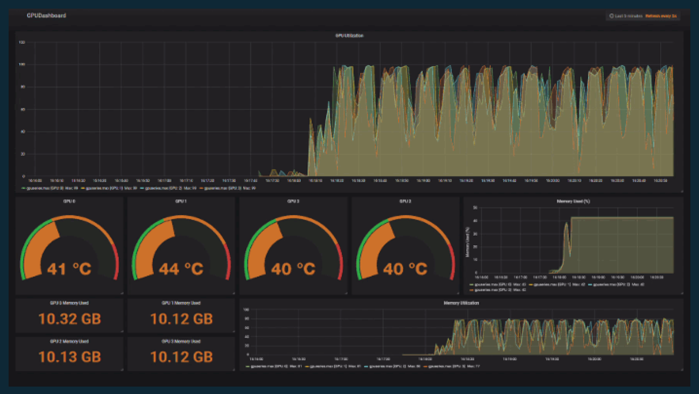
GPU: gpu_monitor (github)

Slide 4
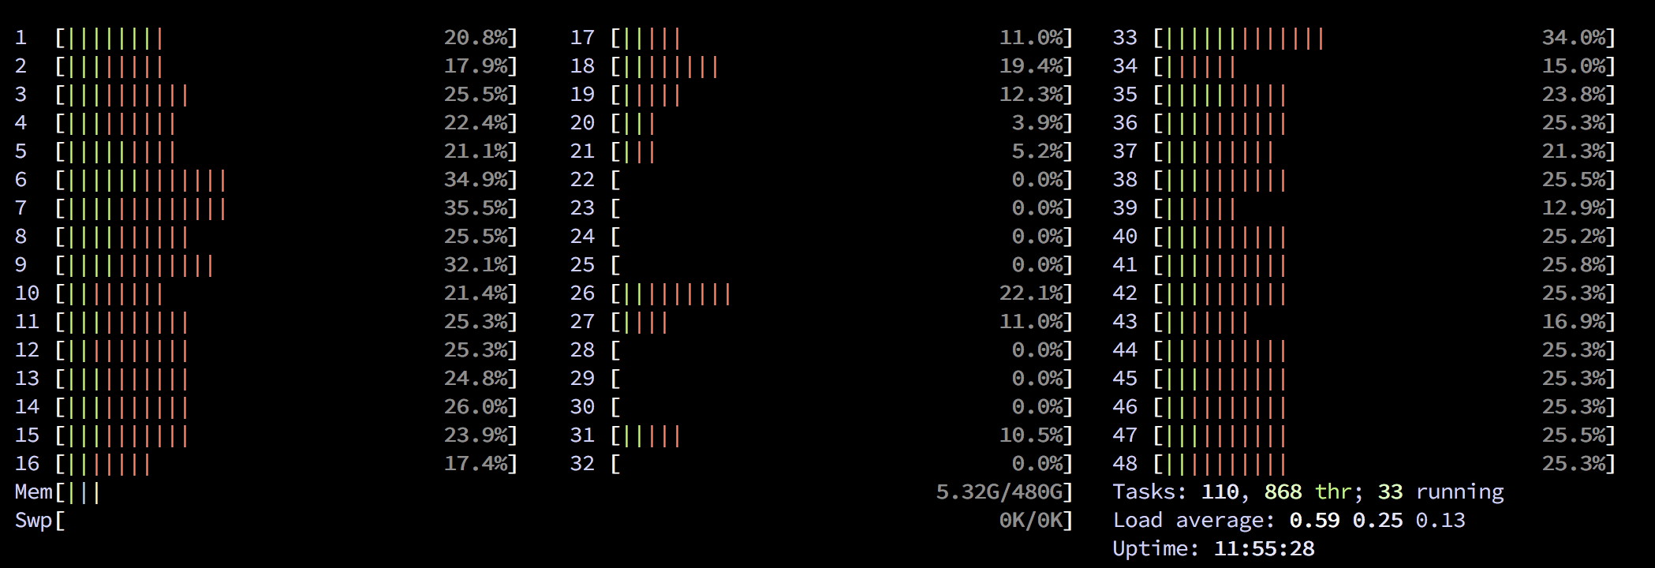
CPU / RAM: > htop

Slide 5
Lab (optional): Install GPU monitor
Setup Grafana by following:
/performance_tricks_gpu_optimization/how_to_setup_grafana_on_dlami.txt

Slide 6
Performance
Tips and tricks

Slide 7
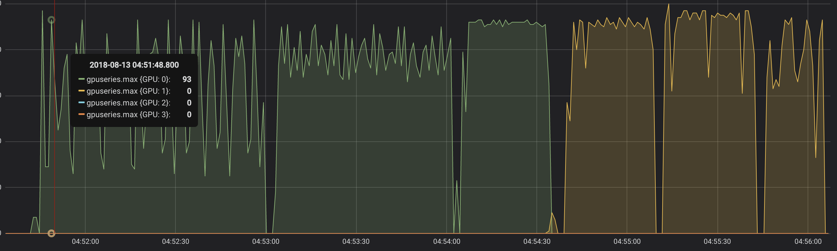
GPU utilization
130 samples/sec
1.25x
2.41x
2.46x
2.53x
3.84x

Slide 8
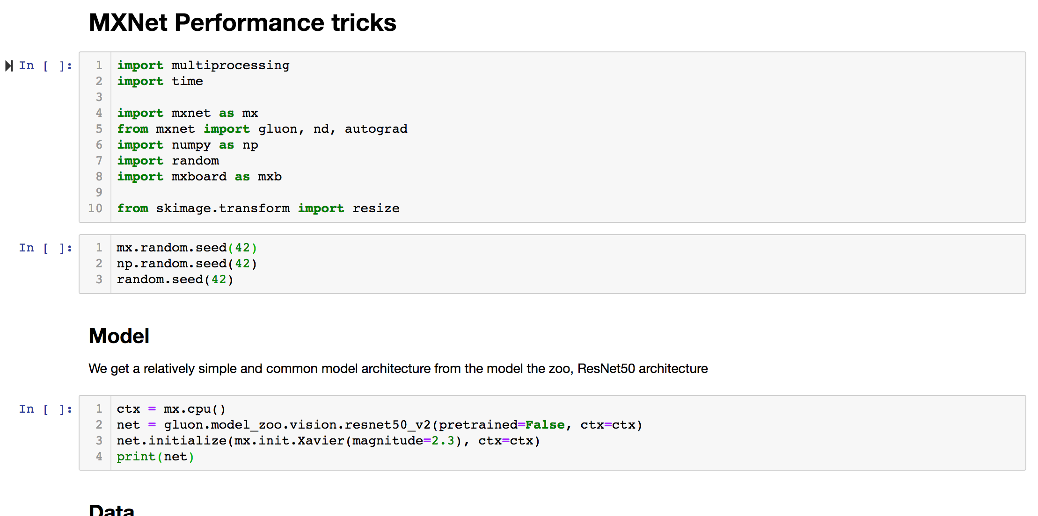

Slide 9
Environment
mxnet-mkl (32x)
vs
mxnet

Slide 10
I/O Bound
→ GPU Starvation

Slide 11
#1 Asynchronously pre-fetching data (low CPU) (1.25x)
DataLoader(num_workers=CPU_COUNT-3)
#2 Offline preprocessing (full CPU)

Slide 12
GPU → CPU memcopy synchronization idling
#3 Smart synchronization calls (2.46x)

Slide 13
Copy to GPU
Copy to GPU
Forward/Backward
Metric
Forward/Backward
Copy to GPU
Copy to GPU
Metric
Forward/Backward
Forward/Backward
Copy to GPU
Metric
Metric
Copy to GPU

Slide 14
Execution engine
Imperative → Symbolic (2.41x)
net.hybridize()

Slide 15
Hyperparameters
Batchsize (2.56x)

Slide 16
Optimizer
Performance:
Time to accuracy

Slide 17
Mixed precision training
float32 → float16 (3.84x)
net.cast("float16")

Slide 18
Conclusion
Use Gluon to debug and iterate quickly
Hybridize and optimize for speed
Know your model: Visualize performance

