Slide 1
Intent detection and slot filling
Sergey Sokolov
10-14 December 2018

Slide 2
SNIPS NLU benchmark 2017
Benchmarking of various NLU engines:
API.ai, Wit.ai, Luis.ai, Alexa, Snips
GitHub
Blog post

Slide 3
Dataset
Labeled dataset of 7 intents and 50+ slots
Slots data is highly unbalanced
E.g. only 3 examples of ‘genre’ slot for ‘PlayMusic’ intent
Total: 13784 records in train set + 700 val set
English only

Slide 4
Problem formulation
Very similar to previous examples taken together:
Intent detection – sentence classification
Slot filling – classification of each word

Slide 5
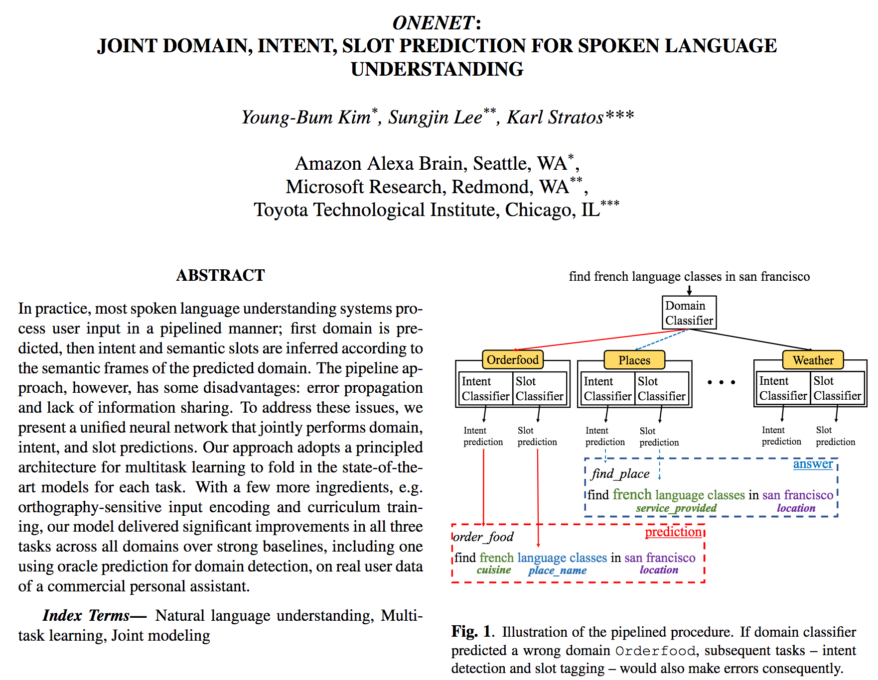
Source of inspiration
https://arxiv.org/pdf/1801.05149.pdf

Slide 6
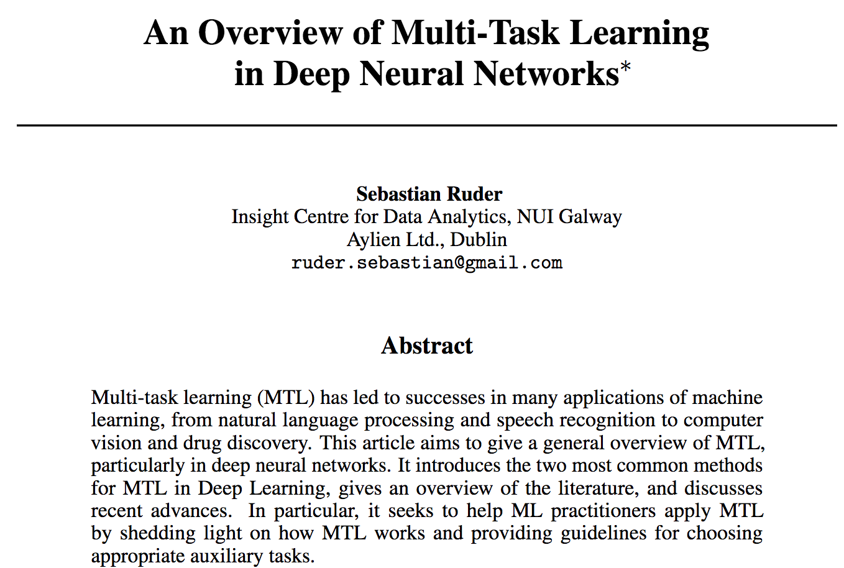
Multi-task learning
https://arxiv.org/pdf/1706.05098.pdf

Slide 7
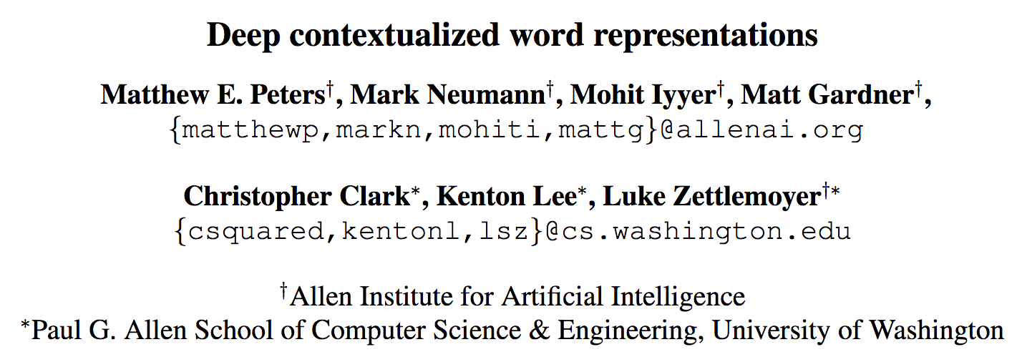
Embeddings from Language Models (ELMo)
We can get effective data representation by using pretrained biLM model
Paper, GluonNLP tutorial

Slide 8
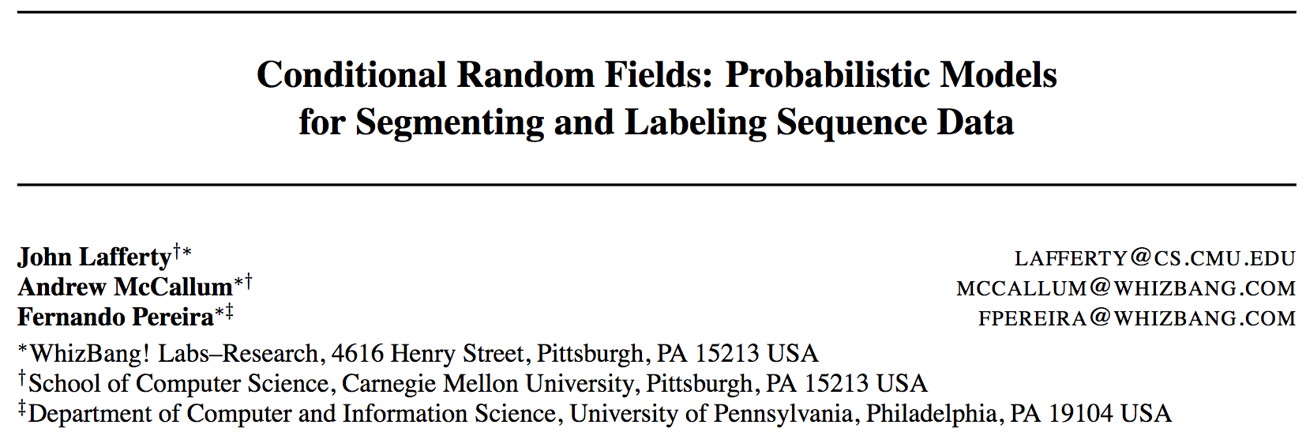
Conditional Random Fields (CRF)
Used to encode known relationships between observations
In our case, we know that, slot class order is non-random
E.g. a sequence ‘NO_ENTITY’, ‘album_INSIDE’ is invalid
Link to the paper

Slide 9
Let’s look into the code

Slide 10
Discussion of the results
Improving F1 score doesn’t always mean improving training: getting final result correctly is also important
Visualization of the results is key to understanding the performance difference
ELMo is simple to use with GluonNLP

