Slide 1
30
12
10
8
GAP
GAP
GAP
Conv3: 493x493x8
Conv2: 498x498x10
Max Pool: 491x491x8
Max Pool: 491x491x8
FC: 1928648 -> 128 ->14

Slide 2
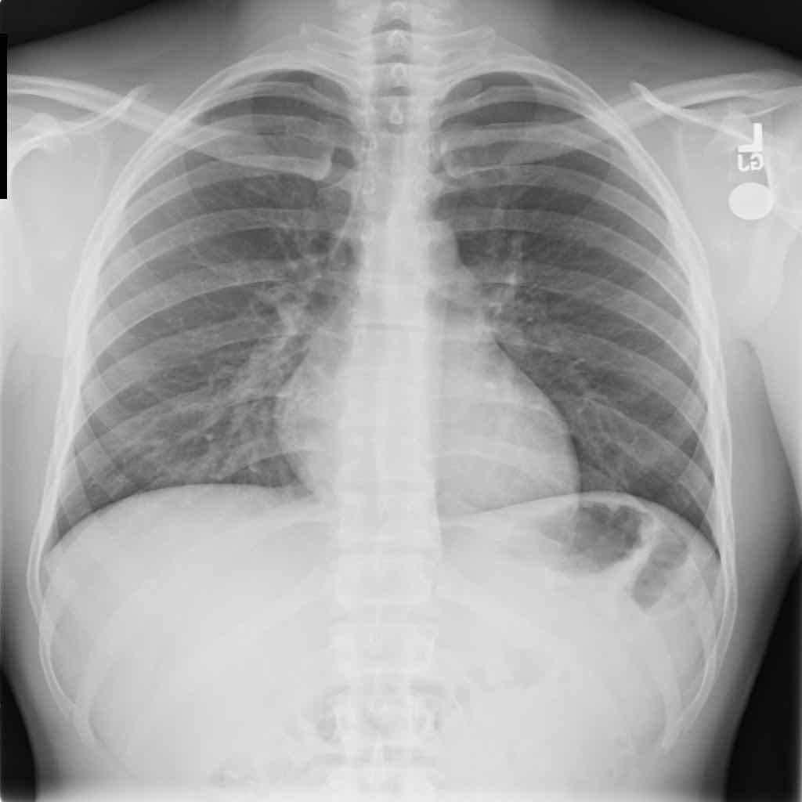
937800
762048
148840
26912
Reshape
Reshape
Reshape
Conv1: 505x505x12
Conv3: 493x493x10
Conv2: 498x498x8
Input:512x512x1
Max Pool: 491x491x12
Max Pool: 491x491x10
Max Pool: 491x491x8
FC: 937800 -> 128 ->14

