Slide 1
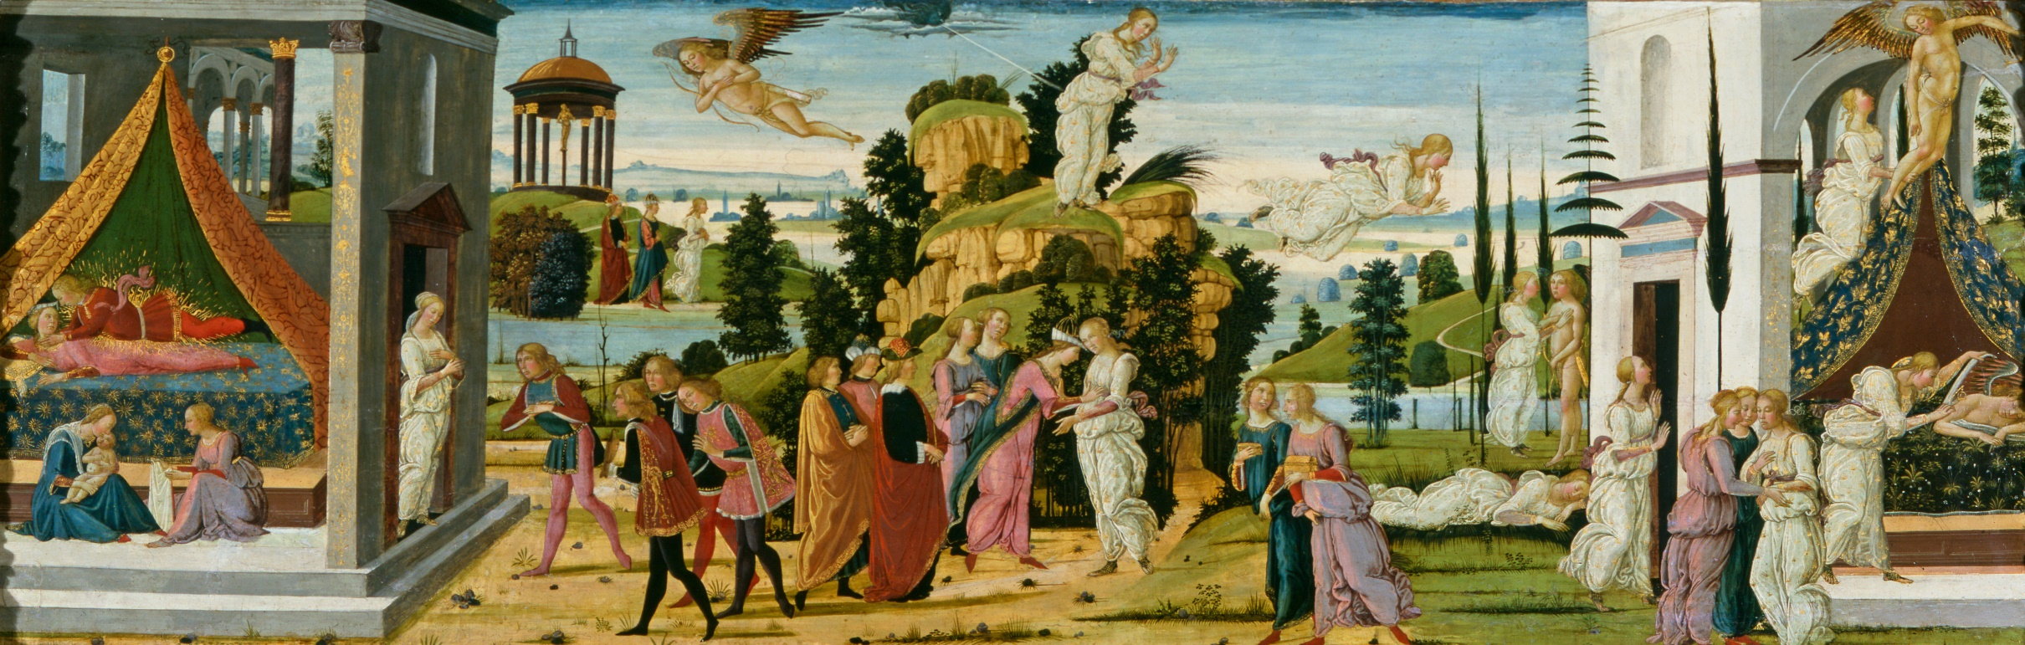
Jacopo del Sellaio
Cupid and Psyche, c. 1473

Slide 2
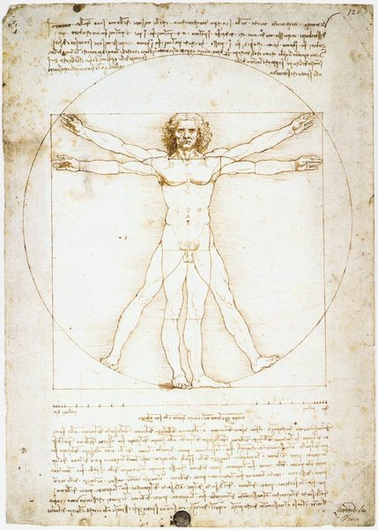
Renaissance
A period of great cultural change and achievement in Europe
Late 1300s to about 1600
Marks transition between Medieval and Early Modern Europe
Growth of humanism and a challenge to medieval attitudes in the arts, science, and religion
Leonardo da Vinci
Vitruvian Man (c.1485)

Slide 3
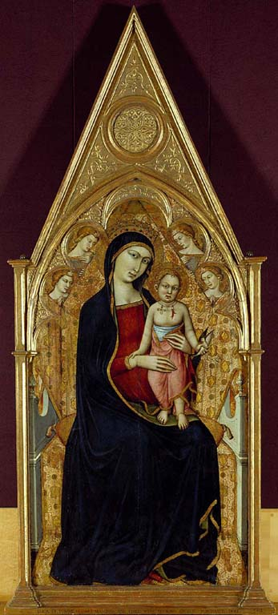
Luca de Tomme
Virgin and Child Enthroned c.1367-1370
The Fitzwilliam Museum

Slide 4
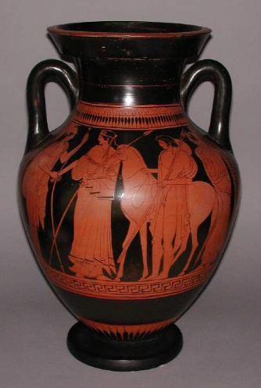
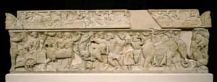
The Pashley Sarcophagus, 101-200AD
The Fitzwilliam Museum
Amphora, 470-460 BC
The Fitzwilliam Museum

Slide 5
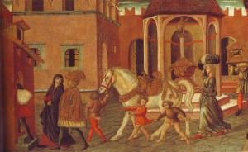
1480 painting

Slide 6
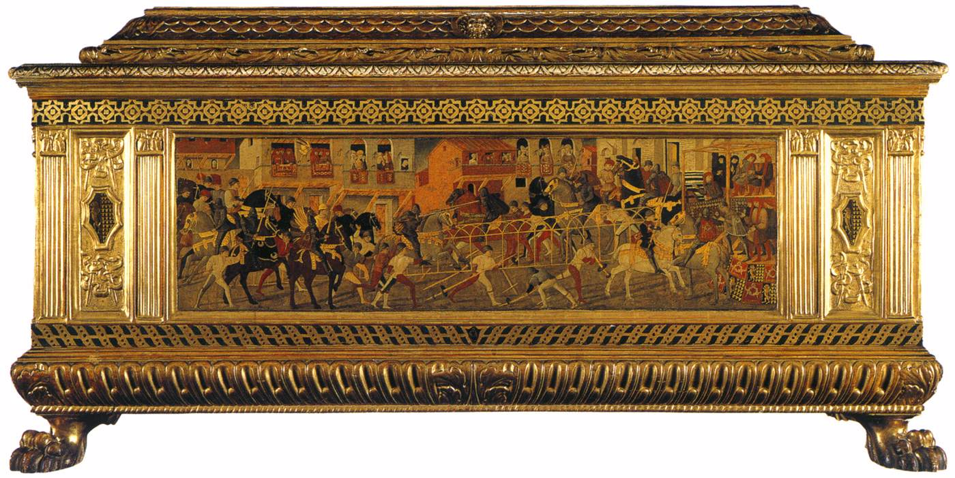
Cassone with painted front panel
Tempera on panel, c. 1460
National Gallery London

Slide 7
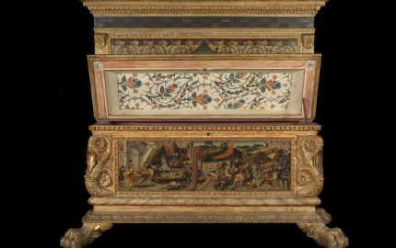
Biagio d’Antonio and Jacopo del Sellaio
Morelli Wedding Chests (1472)

Slide 8
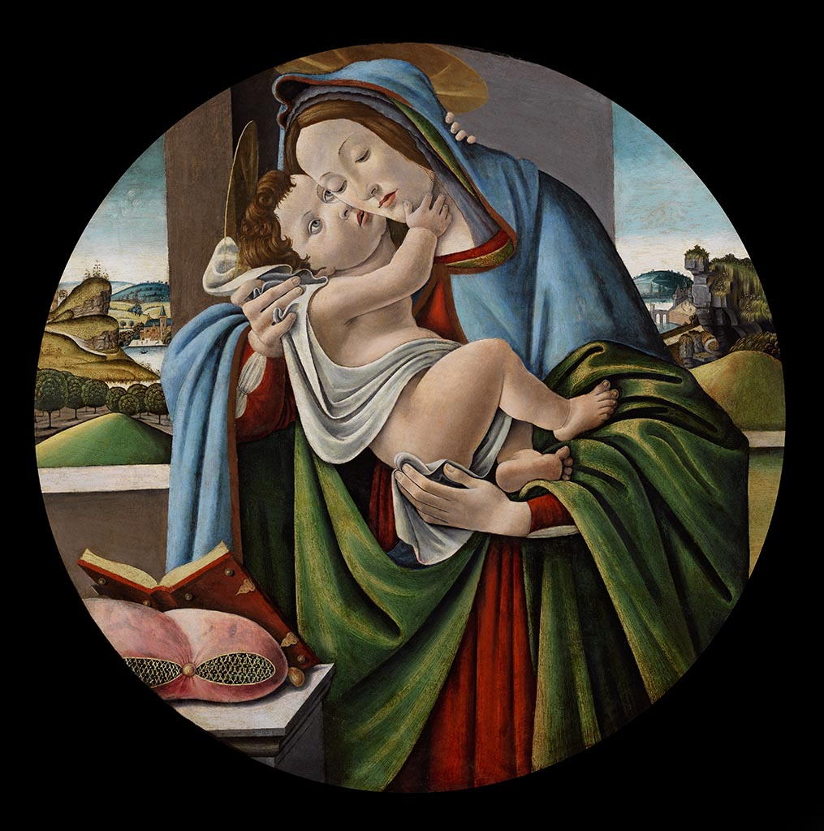
Training
Studio of Fra Fillippo Lippi
Alongside Botticelli
Studio of Botticelli (c.1480-9)
Virgin and Child

Slide 9
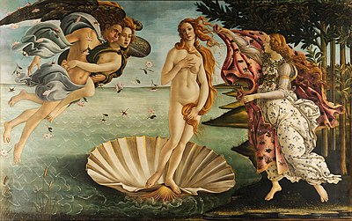
Sandro Botticelli
Birth of Venus (c.1484-86)
The Uffizi, Florence

Slide 10
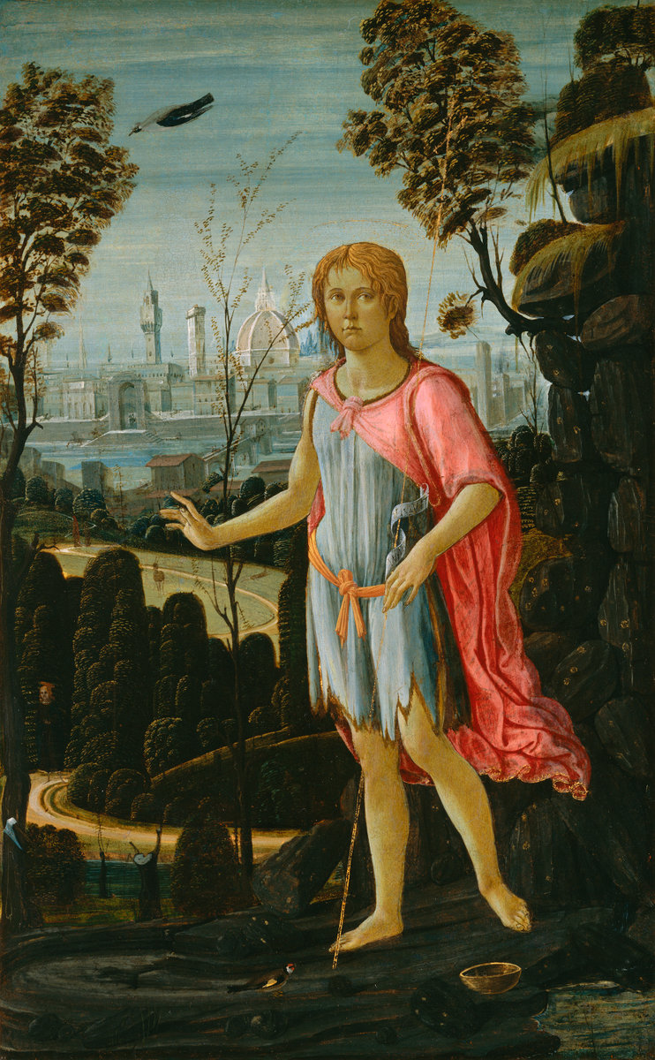
Jacopo del Sellaio John the Baptist c. 1480 National Gallery of Art

Slide 11
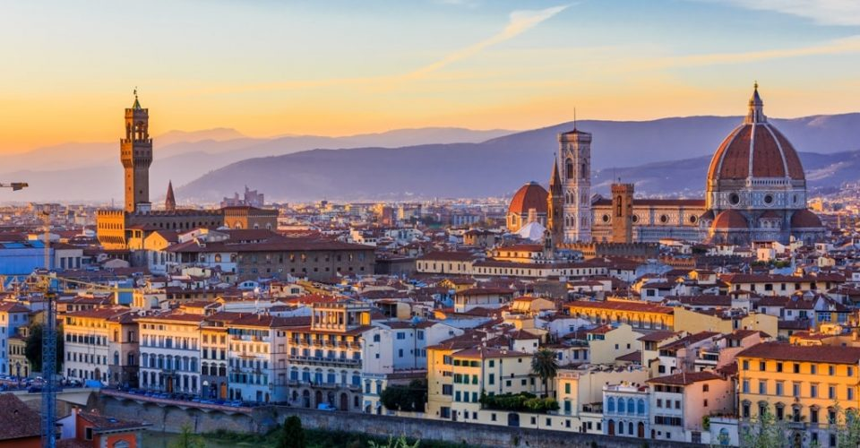

Slide 12
Jacopo del Sellaio
Cupid and Psyche, c. 1473

Slide 13
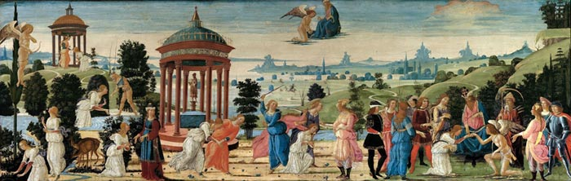
Jacopo del Sellaio
Cupid and Psyche, c. 1473

