Slide 1
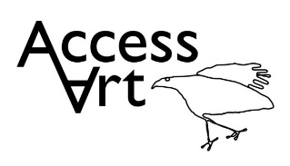

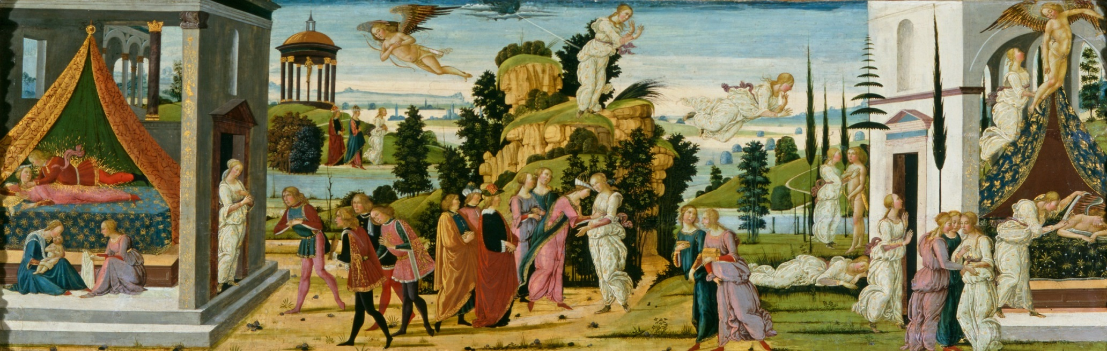

INSPIRE2020
© Martin Bond

Slide 2
Programme
10.00 | Registration with tea and coffee
10.30 | Take One Picture Approach
11.00 | Drawing warm up
11.30 | Gallery workshop (ways in through visual investigation)
12.30 | Lunch (not provided)
13.30 | Sketchbook activity on gallery
14.00 | Studio workshop
15.30 | Final thoughts

Slide 3
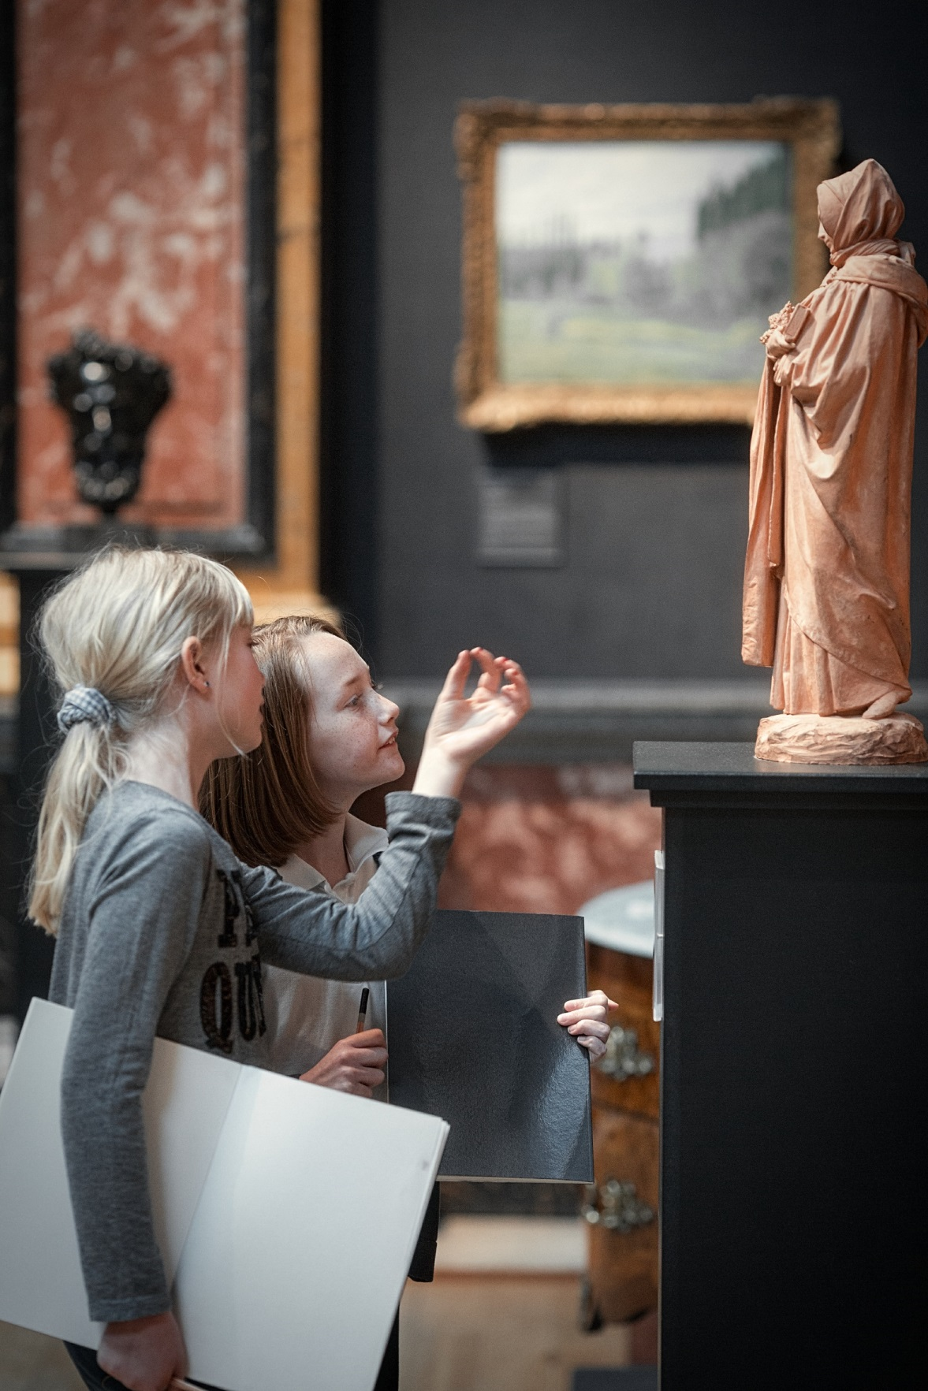

Slide 4
Look
Think
Imagine

Slide 5
Inspire 2020 aims to:
Support teachers to develop confidence working with the museum collection, supporting enquiry led learning and advocating for art and design within their setting
Support teachers to develop knowledge of museum objects, art skills and techniques and cross-curricular teaching
Enable pupils to make meaningful connections with arts and heritage
Promote learning outside the classroom as a means of enhancing learning within the classroom
Act as a vehicle for raising pupils’ self-esteem
Provide a platform for celebrating local schools’ and pupils’ creativity through the exhibition
Notes:
National projects, numbers

Slide 6
When evaluating submissions we will look for:
An investigative approach: Pupil-led research
Process: Pupils have the opportunity to learn a new process inspired by the painting
Cross-curricular learning: The project must link subjects across the curriculum
Links with the wider community

Slide 7
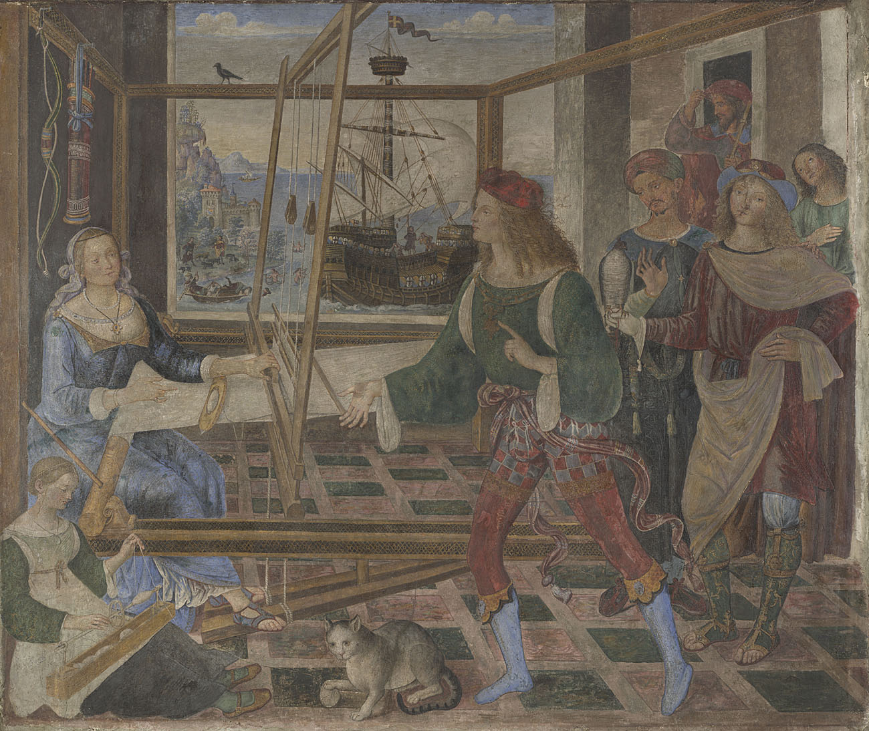
Penelope with the Suitors, Pintoriccho, The National Gallery

Slide 8
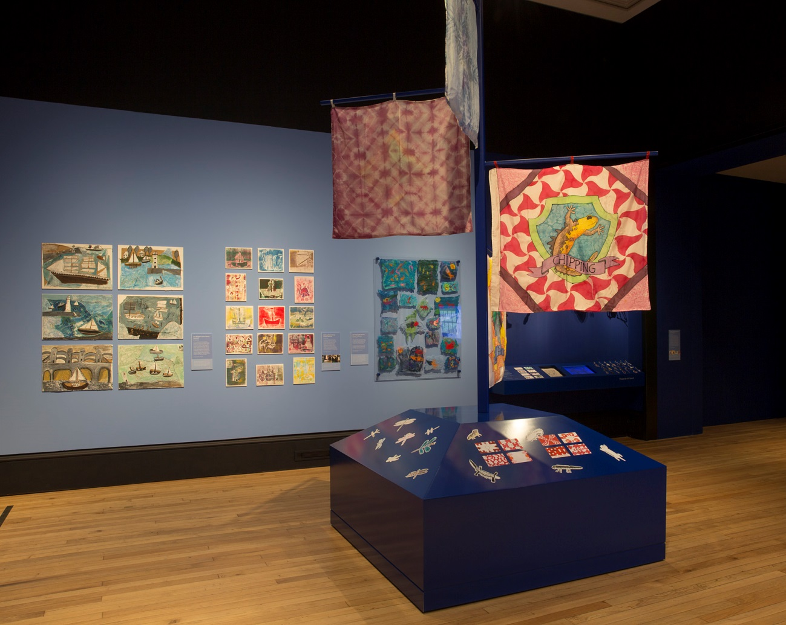
The Exhibition

Slide 9
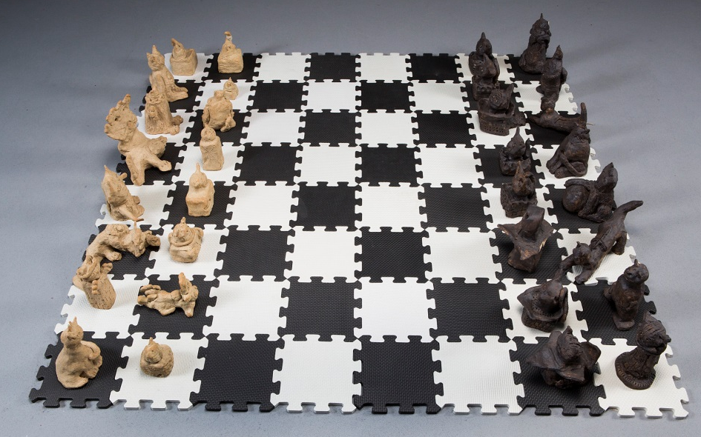
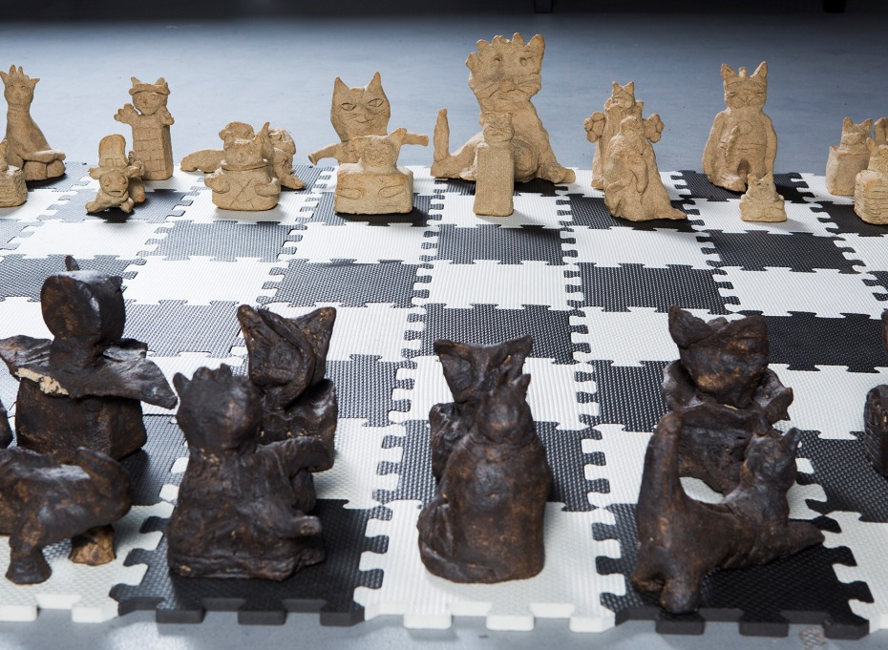
Investigative
Notes:
Pupil led

Slide 10
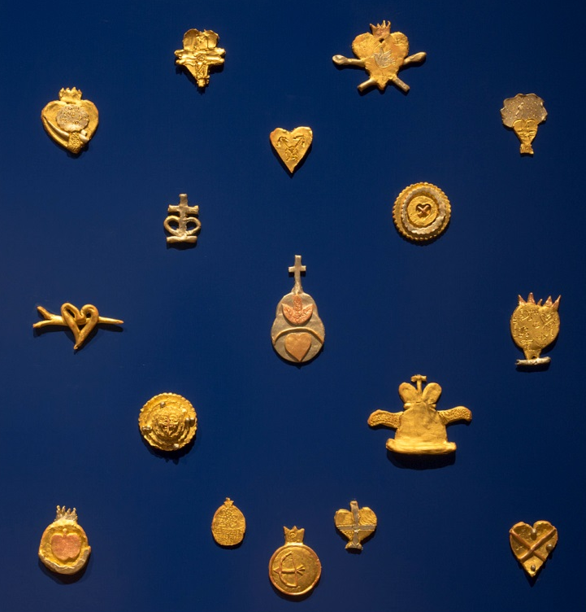
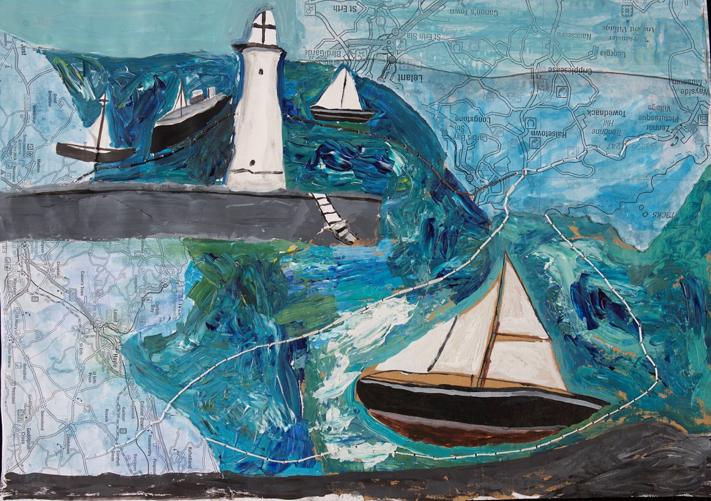
Cross - curricular
Notes:
Cross curricular

Slide 11
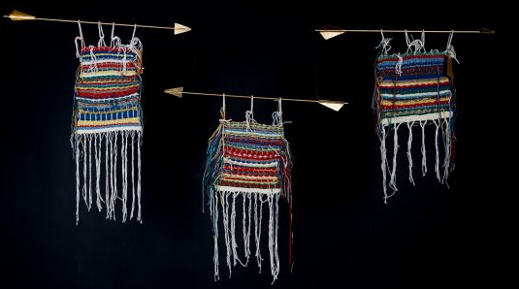
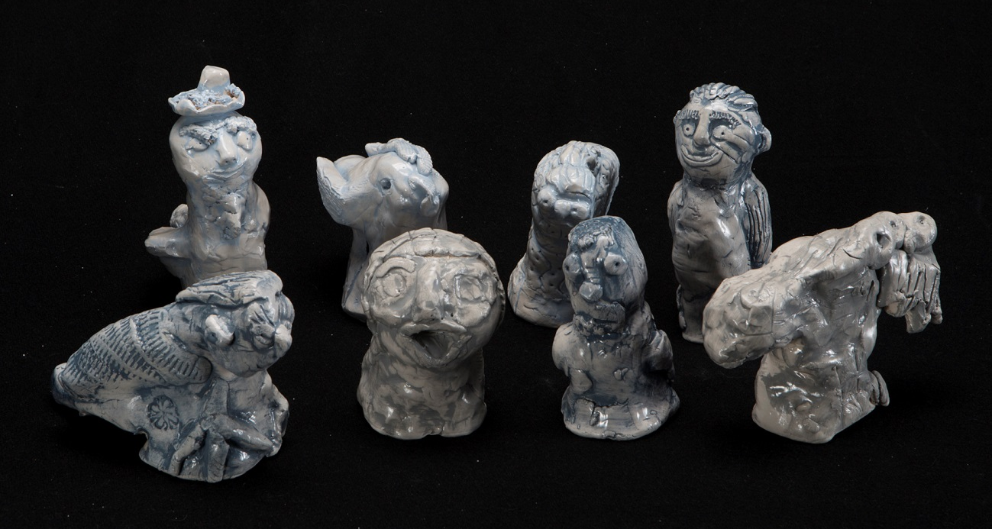
New processes
Notes:
New processes

Slide 12
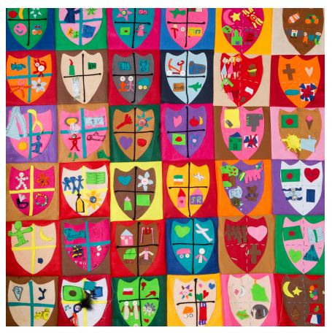
Community
Notes:
Comminity

Slide 13
Timeline
October 2019
Closing date for submitting work for consideration to the INSPIRE2020 display
November 2019
Schools notified if their work has been chosen for the display
December 2019- March 2020
INSPIRE2020 exhibition

Slide 14
Top tips for planning your project
Link closely to the painting
Involve children in the planning process
Look at previous projects on the website
Discover new links
Make local links, draw on expertise within your community
Document the process
Evidence cross-curricular learning

