Slide 1
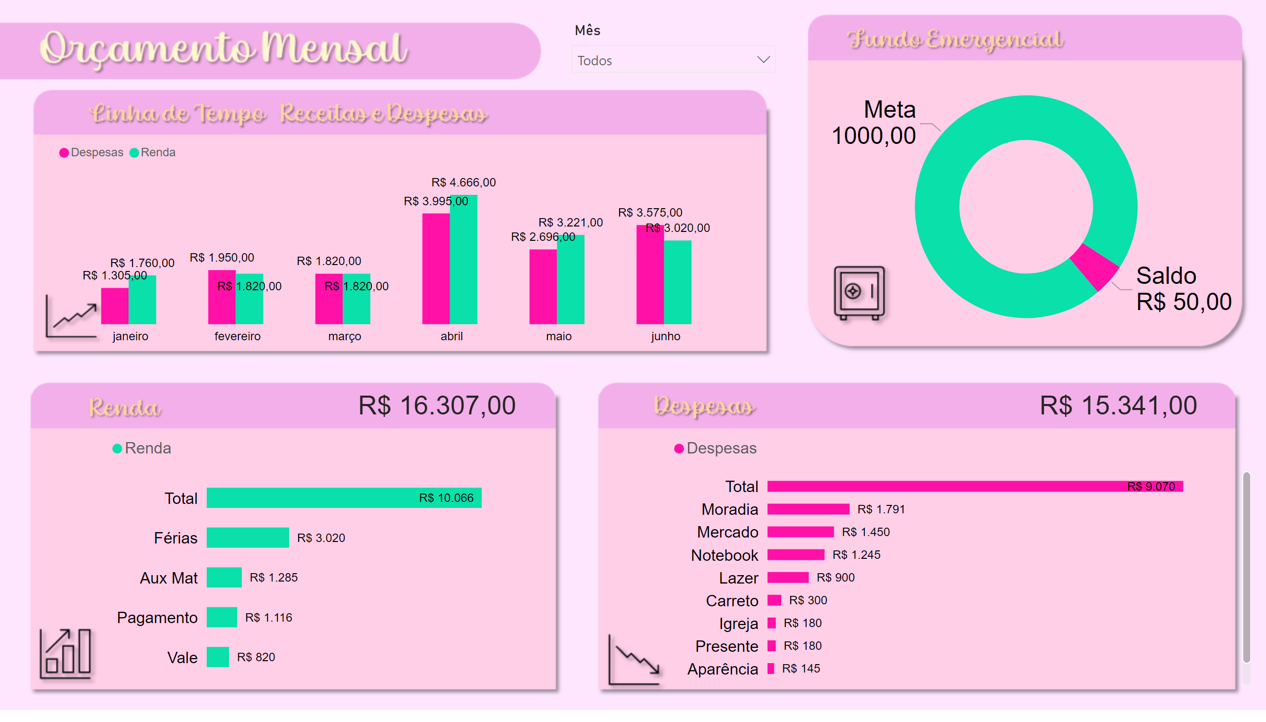

Orçamento
Notes:
clusteredColumnChart
No alt text provided
donutChart
No alt text provided
clusteredBarChart
No alt text provided
clusteredBarChart
No alt text provided
slicer
No alt text provided
card
No alt text provided
card
No alt text provided

Slide 2
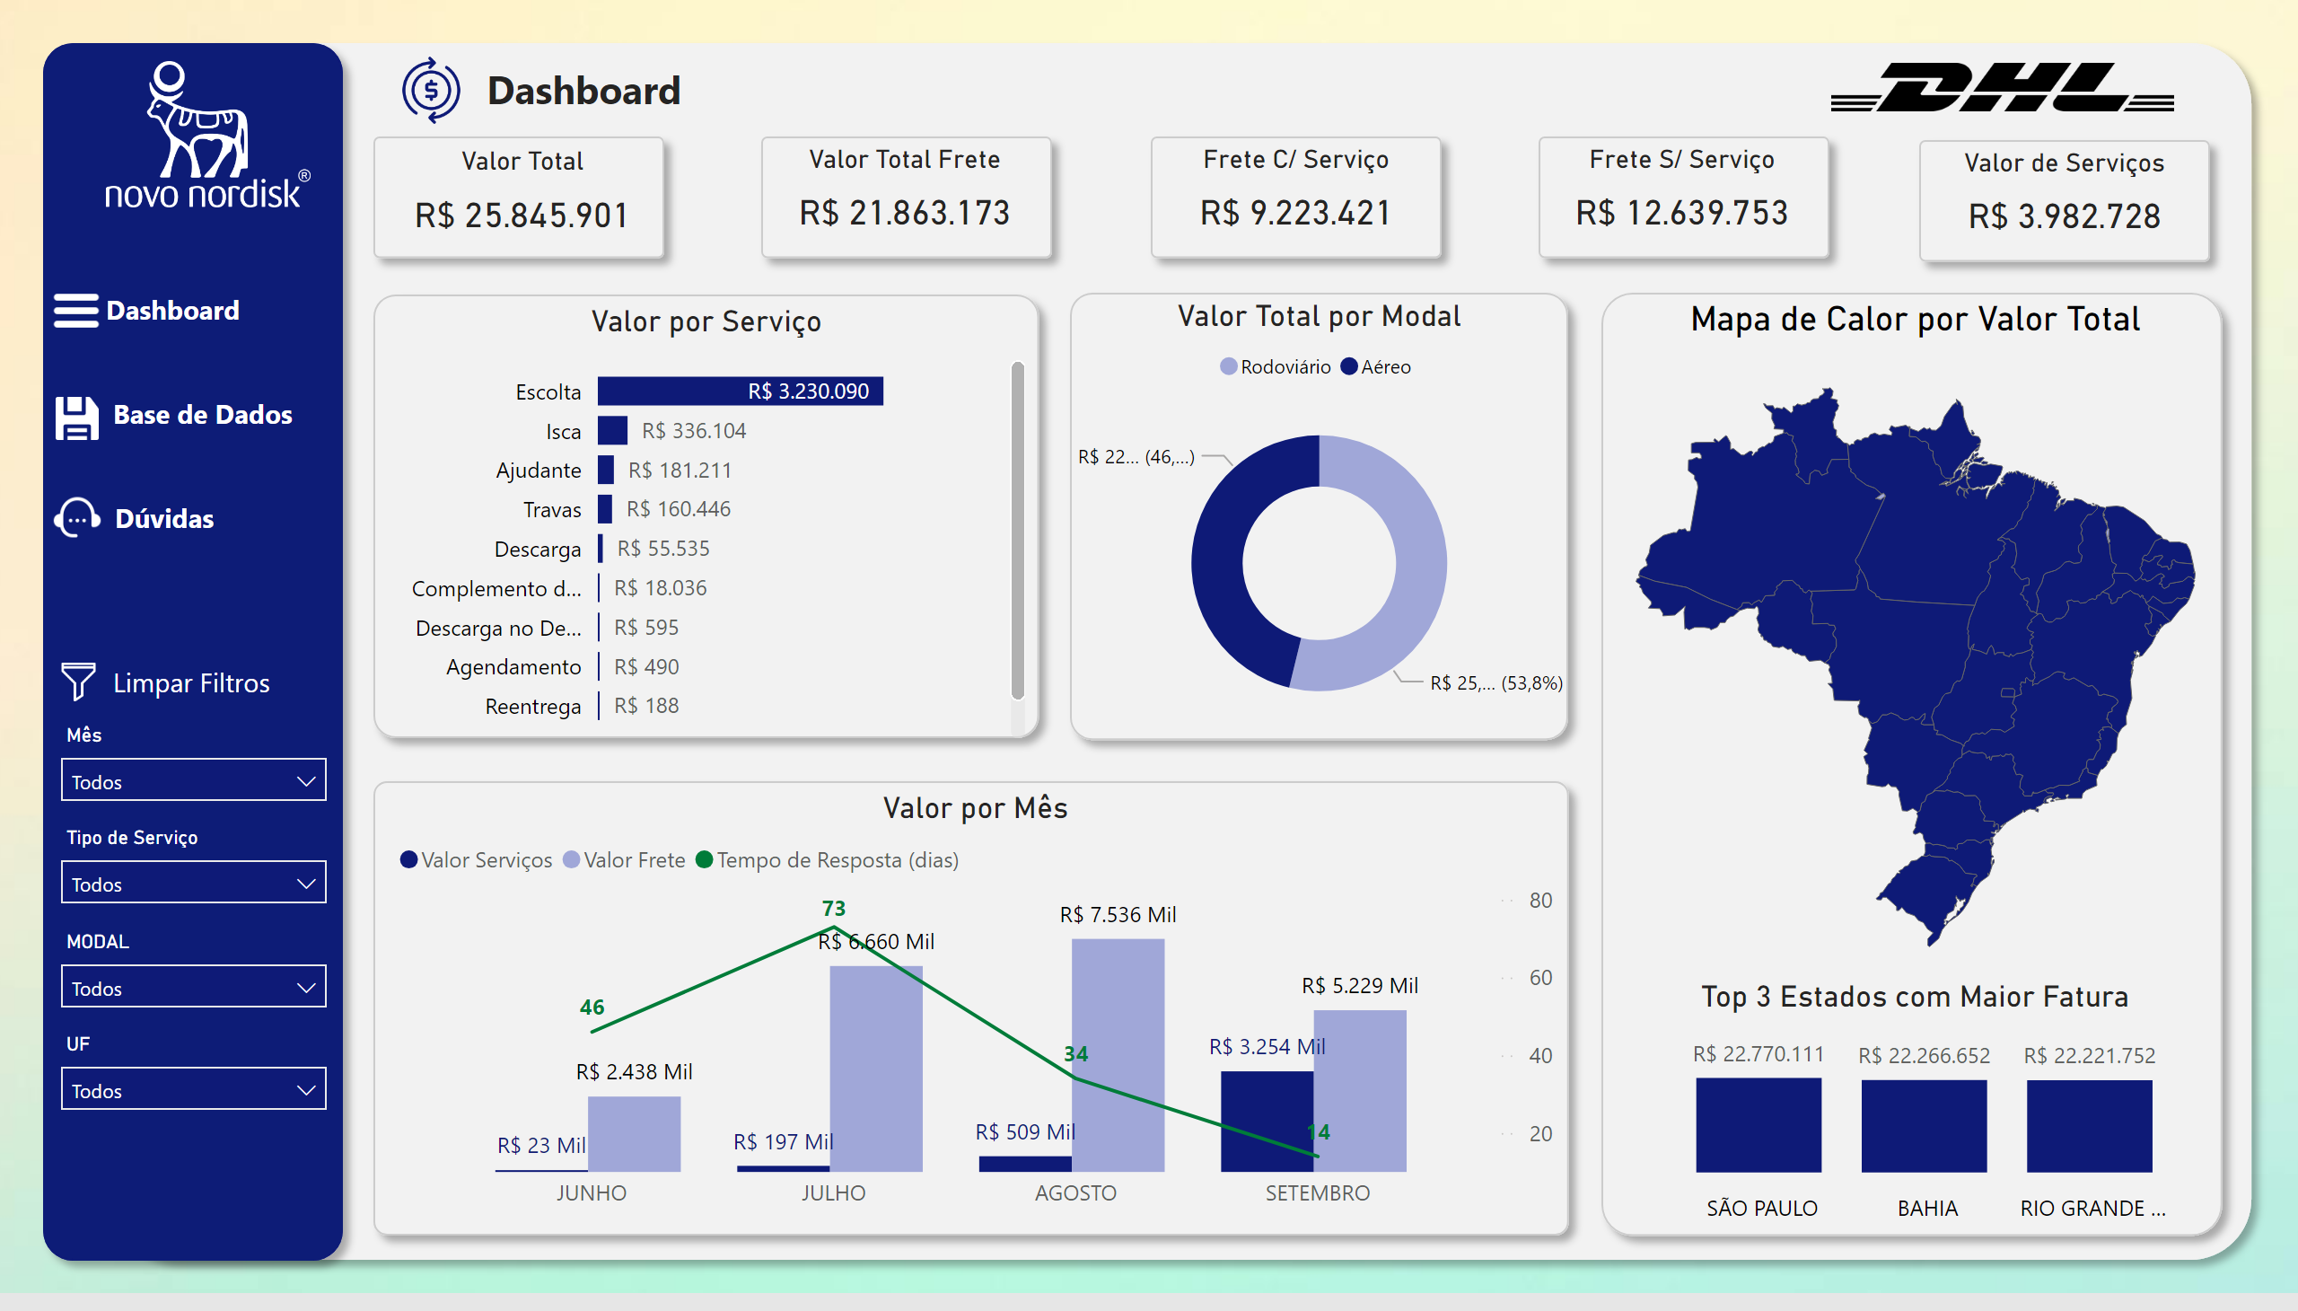



Orçamento
Notes:
clusteredColumnChart
No alt text provided
donutChart
No alt text provided
clusteredBarChart
No alt text provided
clusteredBarChart
No alt text provided
slicer
No alt text provided
card
No alt text provided
card
No alt text provided

Slide 3
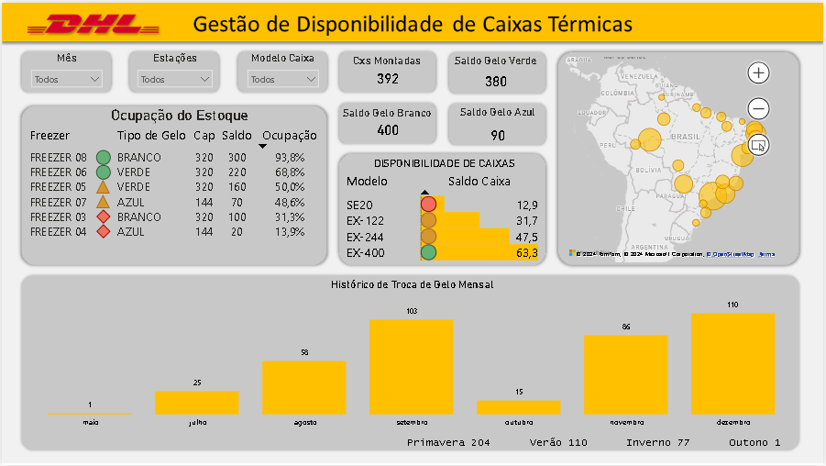
Orçamento
Notes:
clusteredColumnChart
No alt text provided
donutChart
No alt text provided
clusteredBarChart
No alt text provided
clusteredBarChart
No alt text provided
slicer
No alt text provided
card
No alt text provided
card
No alt text provided

Slide 4

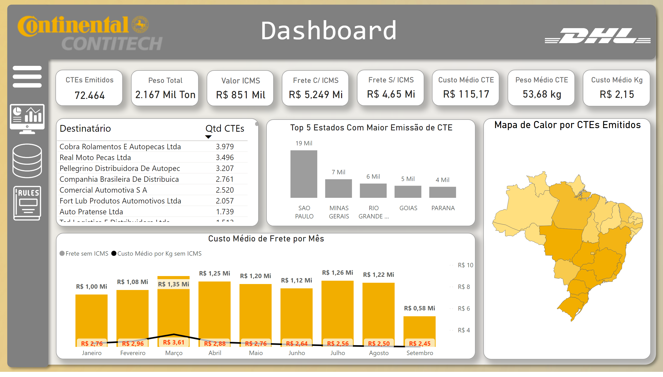


Orçamento
Notes:
clusteredColumnChart
No alt text provided
donutChart
No alt text provided
clusteredBarChart
No alt text provided
clusteredBarChart
No alt text provided
slicer
No alt text provided
card
No alt text provided
card
No alt text provided

Slide 5
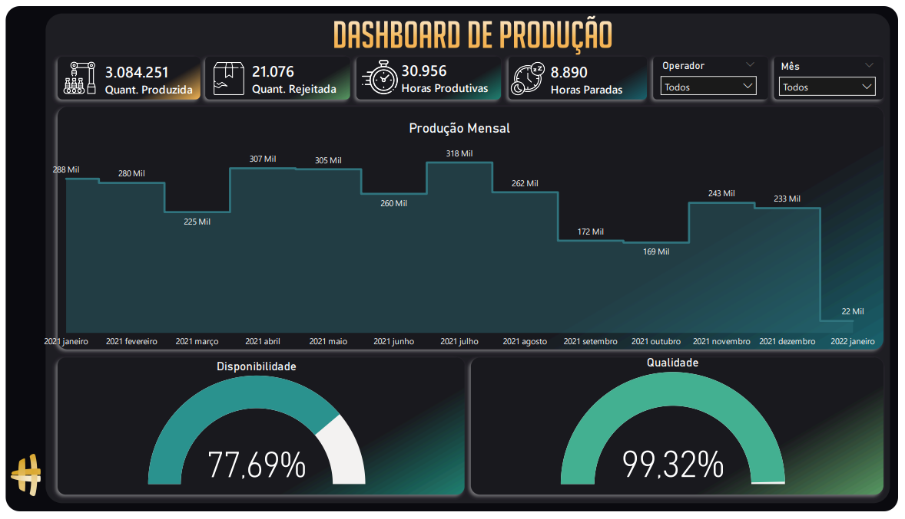

Slide 6
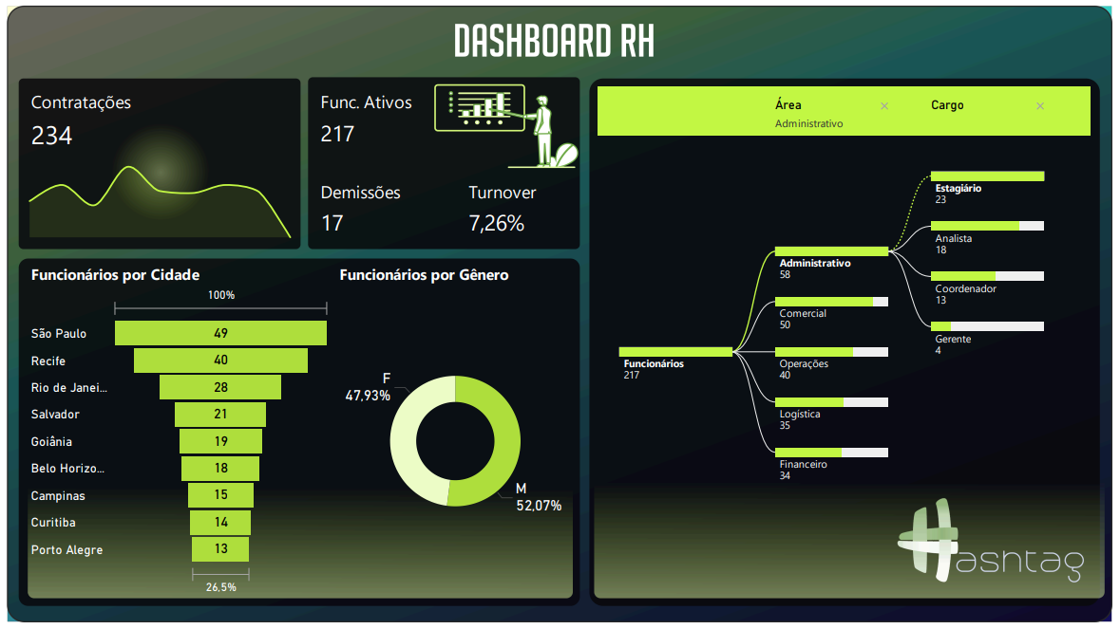

Slide 7
