Slide 1
JSON
JavaScript Object Notation

Slide 2

JSON is a lightweight, text-based, language-independent syntax for defining data interchange formats.
It was derived from the ECMAScript programming language, but is programming language independent.
JSON defines a small set of structuring rules for the portable representation of structured data.

Slide 3
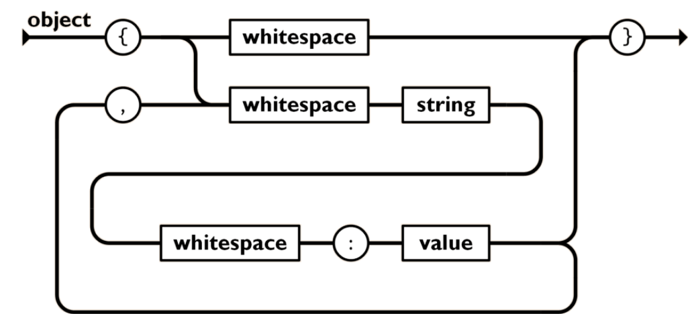
JSON is built on two structures:
A collection of name/value pairs: In various languages, this is realized as an object, record, struct, dictionary, hash table, keyed list, or associative array.
{"menu": {
"id": "file",
"value": "File",
"popup": {
"menuitem": [
{"value": "New", "onclick": "CreateNewDoc()"},
{"value": "Open", "onclick": "OpenDoc()"},
{"value": "Close", "onclick": "CloseDoc()"}
]
}
}}

Slide 4
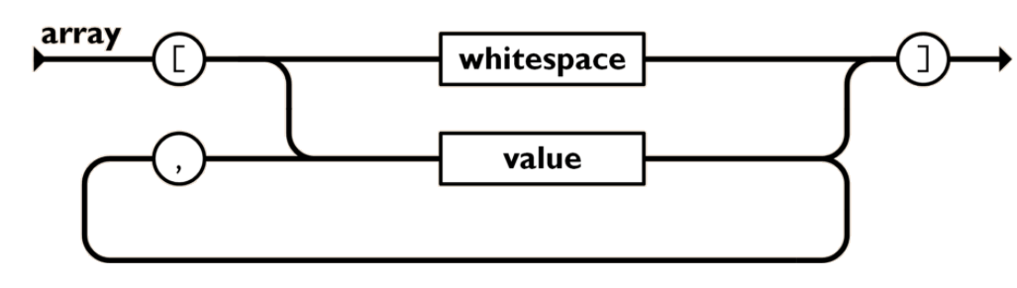
An ordered list of values: In most languages, this is realized as an array, vector, list, or sequence.
{"menu": {
"id": "file",
"value": "File",
"popup": {
"menuitem": [
{"value": "New", "onclick": "CreateNewDoc()"},
{"value": "Open", "onclick": "OpenDoc()"},
{"value": "Close", "onclick": "CloseDoc()"}
]
}
}}

Slide 5
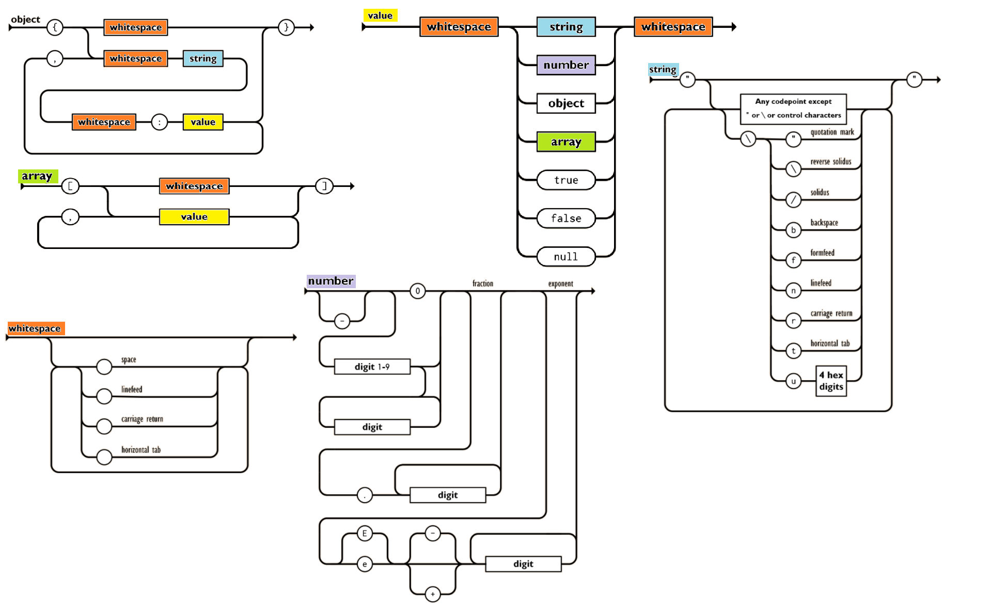

Slide 6
JSON Demo

Slide 7
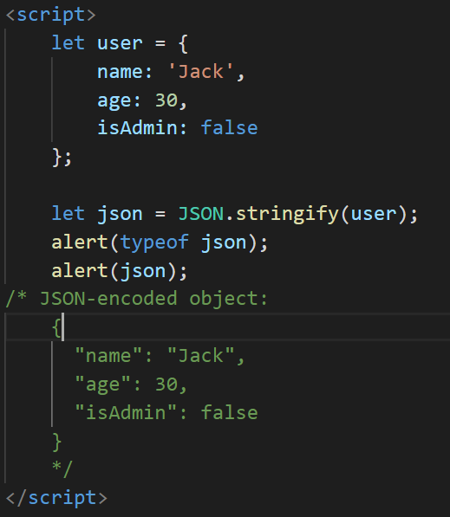
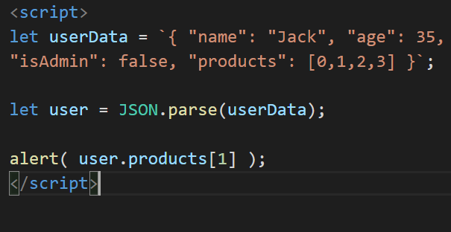
JSON.Stringify and JSON.Parse

Slide 8
Summary
JSON is a data format that has its own independent standard and libraries for most programming languages.
JSON supports plain objects, arrays, strings, numbers, booleans, and null.
JavaScript provides methods JSON.stringify to serialize into JSON and JSON.parse to read from JSON.
Both methods support transformer functions for smart reading/writing.

Slide 9
References
https://www.ecma-international.org/publications-and-standards/standards/ecma-404/
https://www.json.org/json-en.html
https://javascript.info/json

