Slide 1
JSON
JavaScript Object Notation

Slide 2

JSON is a lightweight, text-based, language-independent syntax for defining data interchange formats.
It was derived from the ECMAScript programming language, but is programming language independent.
JSON defines a small set of structuring rules for the portable representation of structured data.

Slide 3
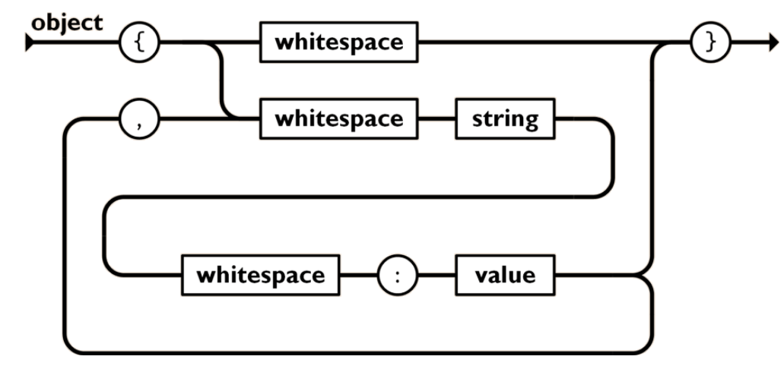
JSON is built on two structures:
A collection of name/value pairs. In various languages, this is realized as an object, record, struct, dictionary, hash table, keyed list, or associative array.
{"menu": {
"id": "file",
"value": "File",
"popup": {
"menuitem": [
{"value": "New", "onclick": "CreateNewDoc()"},
{"value": "Open", "onclick": "OpenDoc()"},
{"value": "Close", "onclick": "CloseDoc()"}
]
}
}}

Slide 4
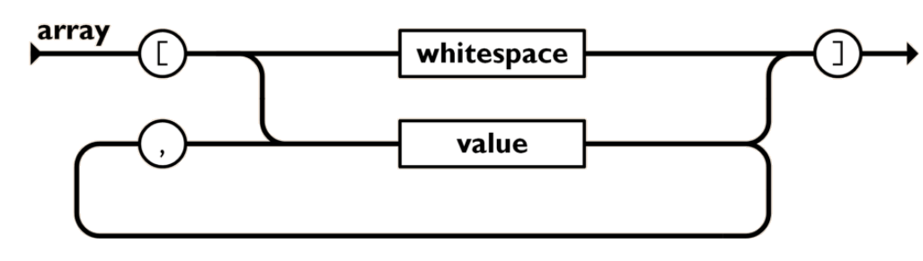
An ordered list of values. In most languages, this is realized as an array, vector, list, or sequence.
{"menu": {
"id": "file",
"value": "File",
"popup": {
"menuitem": [
{"value": "New", "onclick": "CreateNewDoc()"},
{"value": "Open", "onclick": "OpenDoc()"},
{"value": "Close", "onclick": "CloseDoc()"}
]
}
}}

Slide 5
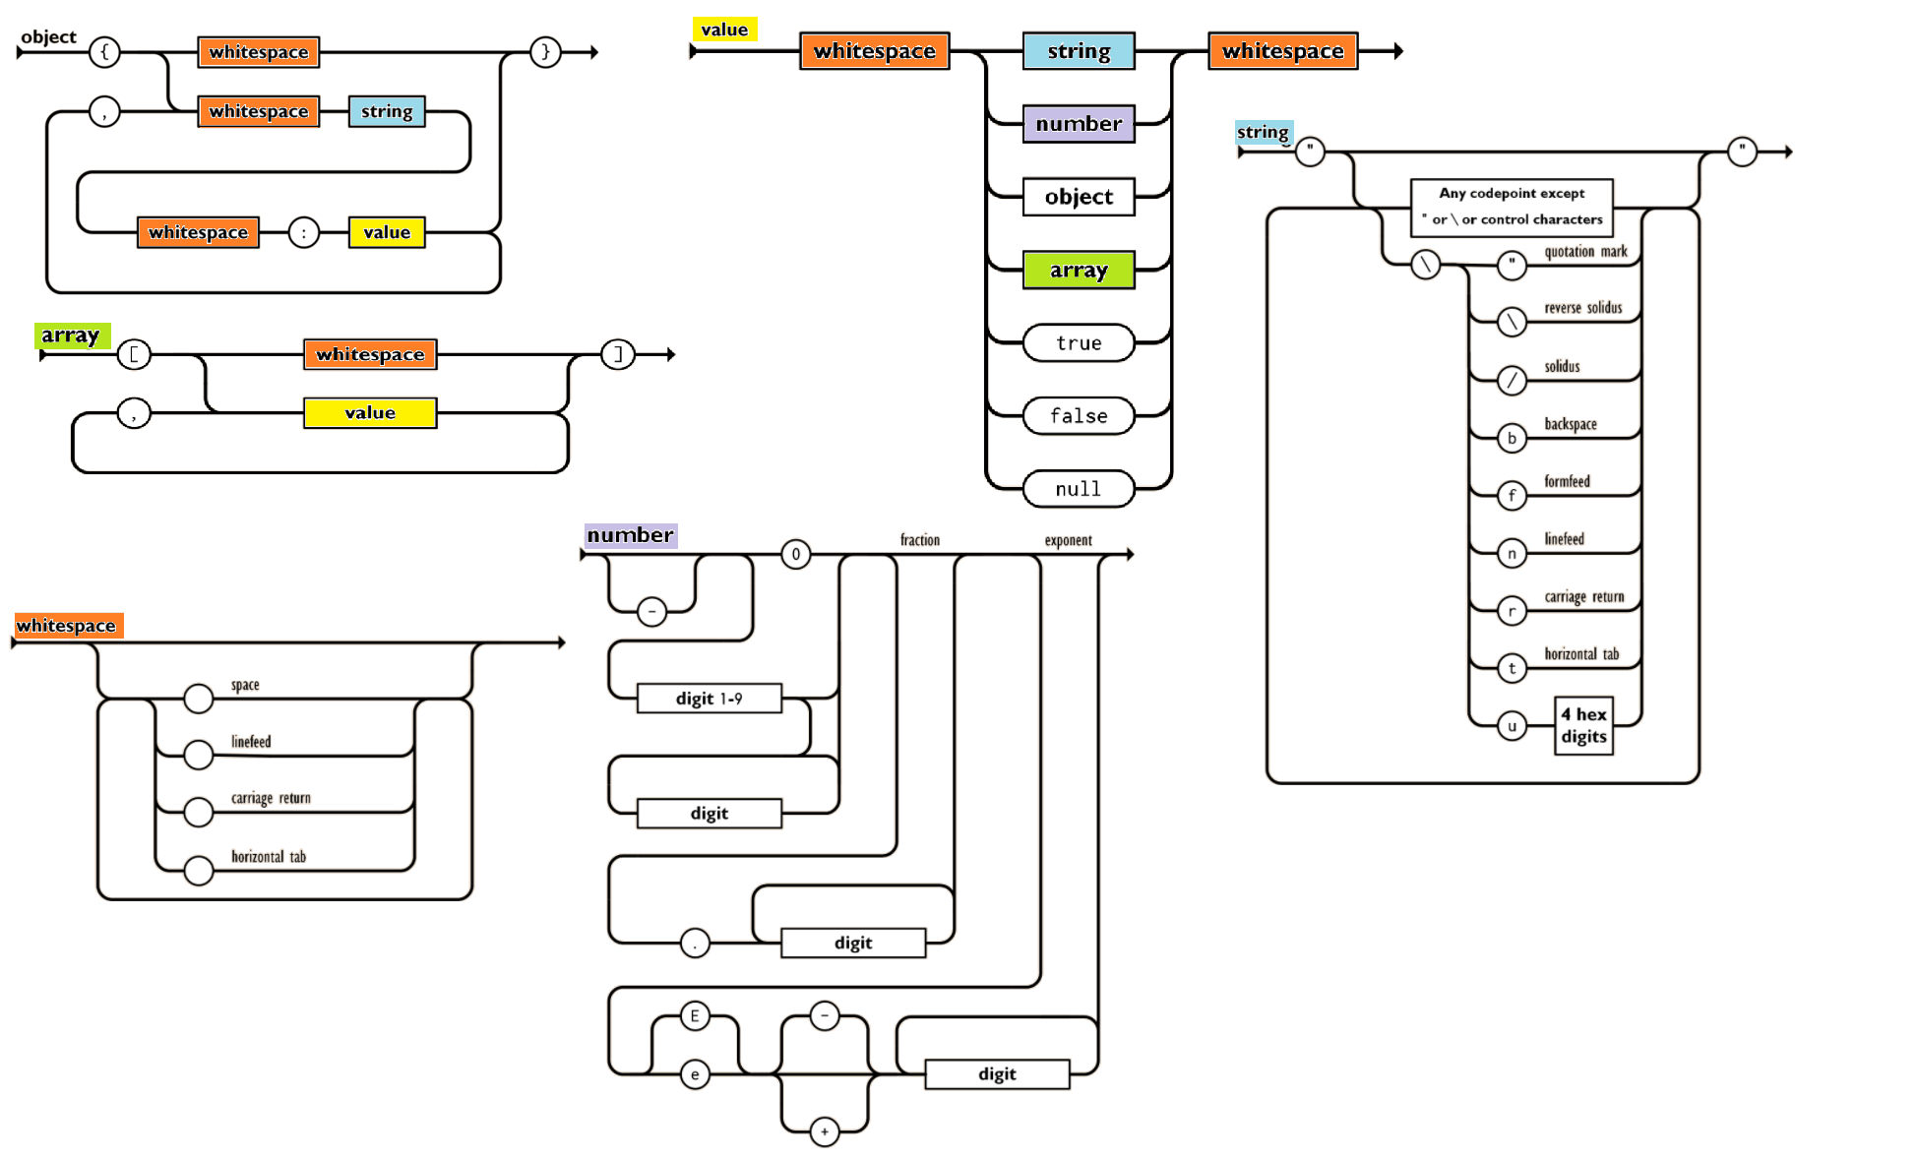

Slide 6
Demo of forming and exchanging a JSON

Slide 7
References
https://www.ecma-international.org/publications-and-standards/standards/ecma-404/
https://www.json.org/json-en.html

