Slide 1
CalQfy
A Home of calculators

Slide 2
INTRODUCTION
“CalQfy” is a simple Website aimed to provide fast, comprehensive, convenient, free online calculators to help you "do the maths" quickly in different areas.
Additionally, it has specific calculators to help the user to find their desire output quickly.

Slide 3
Different types of Calculators
Calqfy is the solution to find different mathematical solutions for now it contains 4 types of calculator :-
● Basic Calculator
● Scientific Calculator
● Age Calculator
● Percentage Calculator

Slide 4
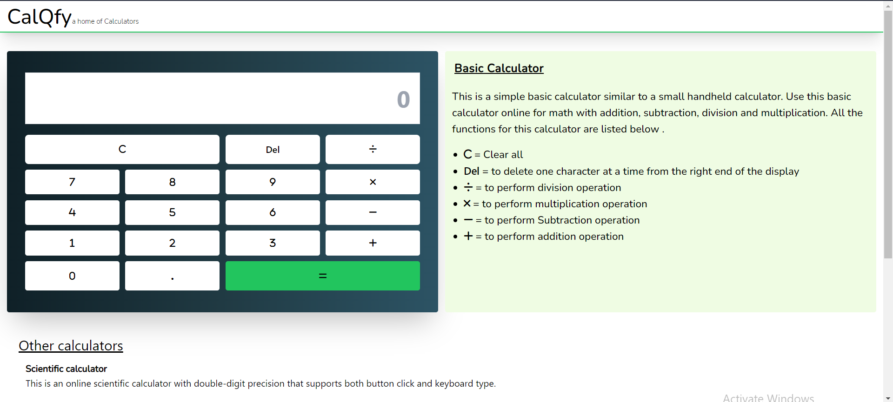
Basic Calculator
This is a simple basic calculator that focuses on calculating simple maths similar to a small handheld calculator. The Capability of the basic calculator is to do online maths with addition, subtraction, division, and multiplication operations .

Slide 5
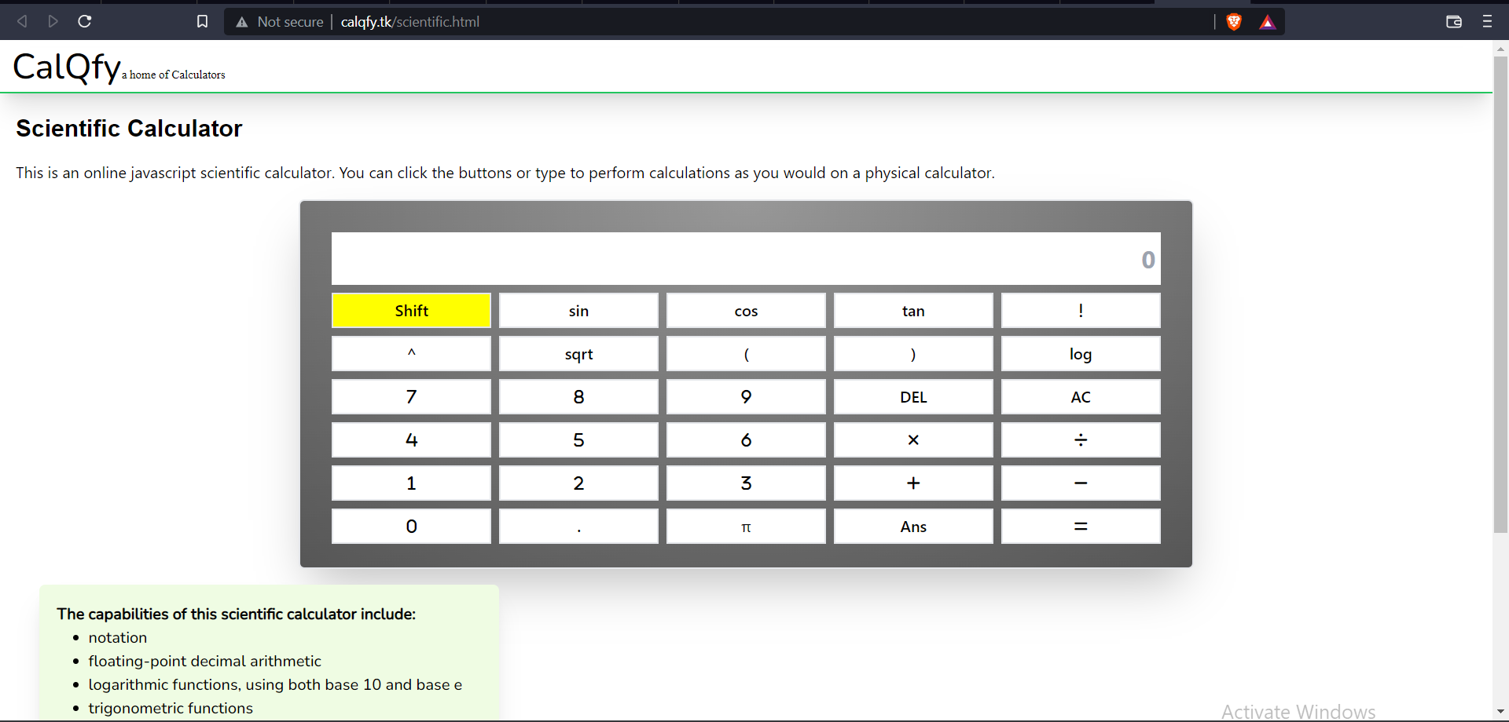
Scientific Calculator
It is an online scientific calculator with advanced features .This calculator is very helpful for more advanced mathematical problems and also it is more advanced than our Basic Calculator.
Features & Capabilities:-
● floating-point decimal arithmetic
● logarithmic functions
● trigonometric functions
● exponential functions and roots
● quick access to constants such as pi and e

Slide 6
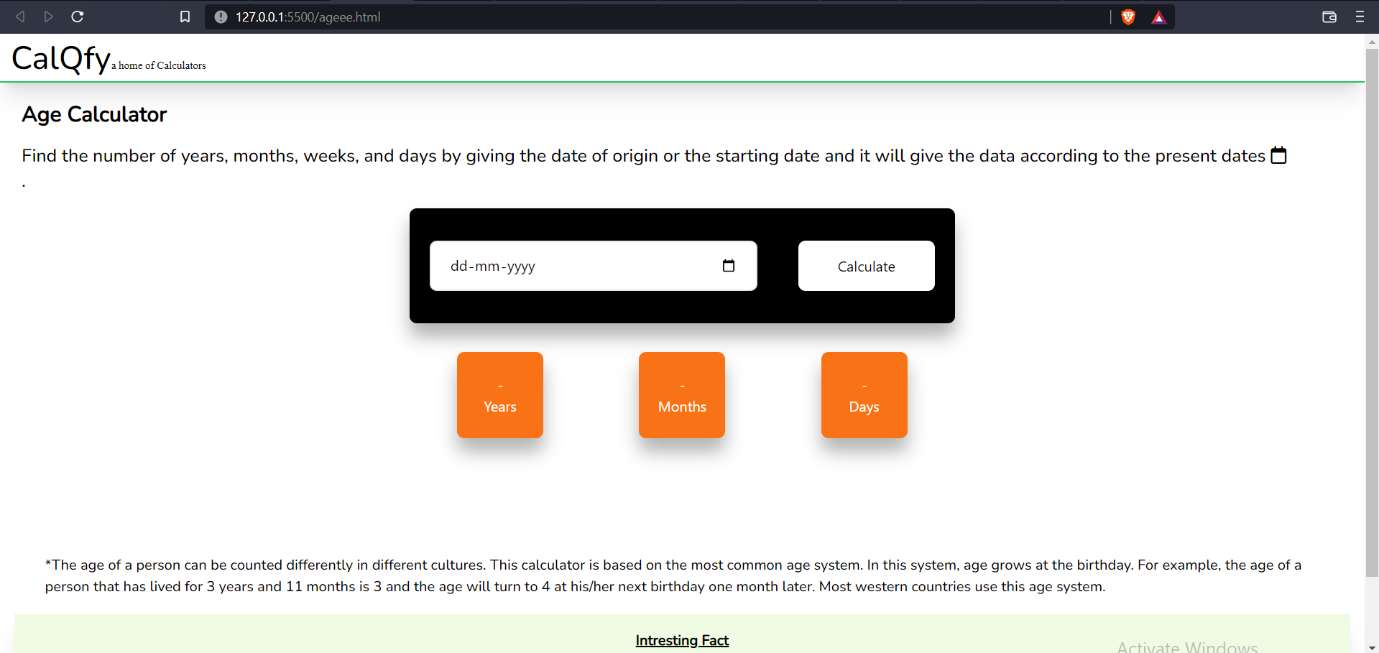
AGE CALCULATOR
This Calculator Calculate the age of a person, place or thing. The age calculator calculates age given a date of birth in years, months and days. You can also use this calculator to find length of time between two dates.
The age calculator finds the age time span in years months and days .

Slide 7
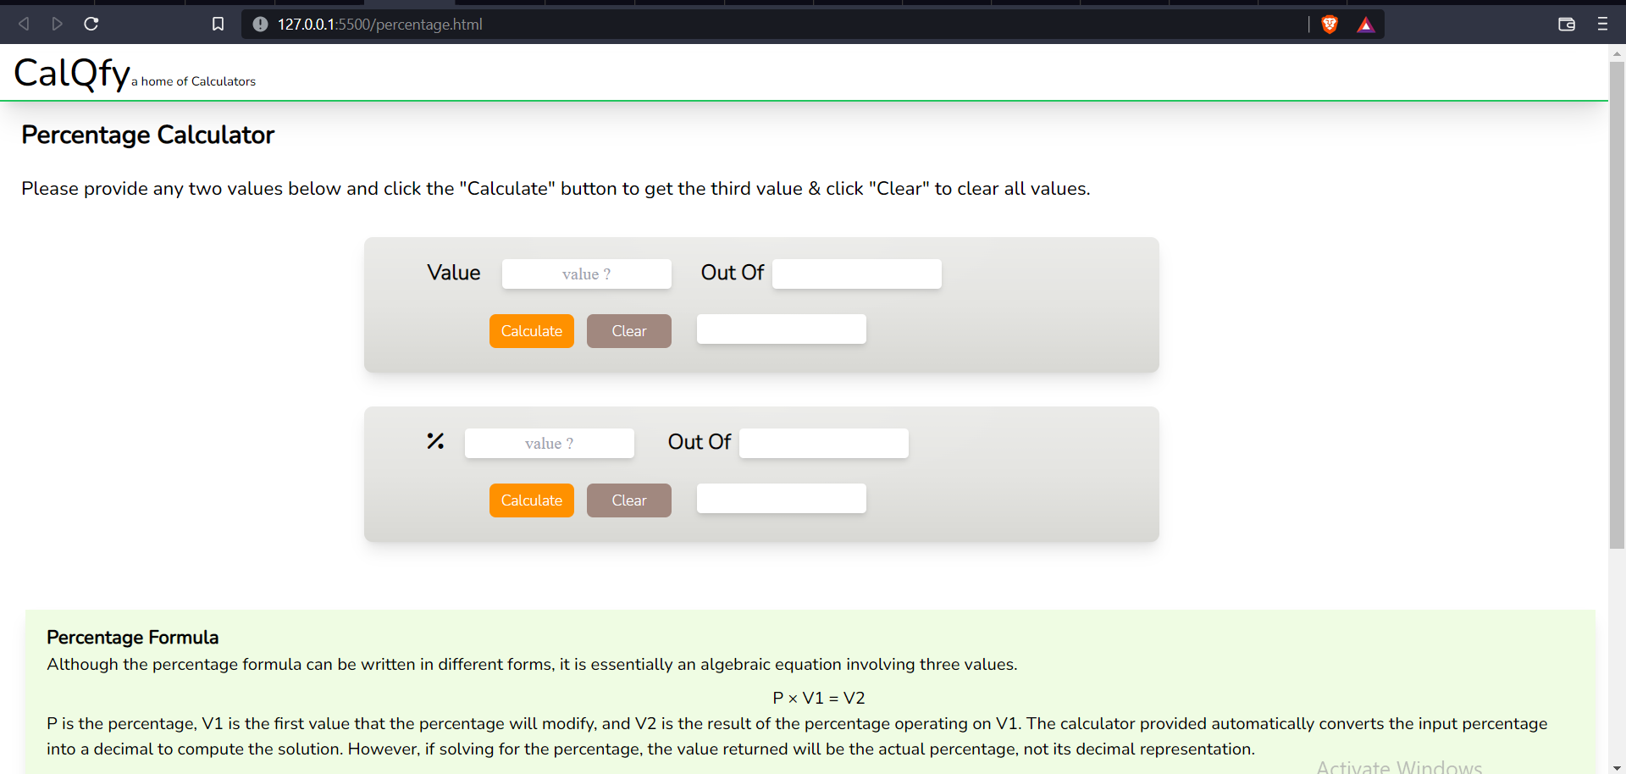
Percentage Calculator
This Calculator is a free online tool to calculate percentages, including the percentage difference between two given values, In order to save time.

Slide 8
TECHNOLOGY OVERVIEW
Technologies selected for implementing the CalQfy website are HTML - For the structural part of the website, Tailwind Css & Css- for the designing part of the website, JavaScript- for adding the functions in the calculators and both for the website, GitHUB and Git - for version controlling and Hosting the Repository of the website . The development was done in Windows environment using Visual Studio Code.

Slide 9
CONCLUSION
So at the very end we hope that the “CalQfy” website should be a good option to get the solution of any problem in a faster and efficient way without any errors and through the internet anyone could access the website .
We also aimed to add more features and a variety of calculators in future .

Slide 10
THANK YOU

