Slide 1
EFFECTIVE PRODUCTIVITY WITH MS OFFICE AUTOMATION
Presented By: Fiza Sahar

Slide 2
Objective:
Understand the concept of an operating system (OS).
Learn about different types of OS: Android, iOS, Linux, macOS, and Windows.
Explore key features of Windows 11.
Learn how to use taskbar, file explorer, and file management tools.
Understand file extensions and their significance.
Learn common Windows keyboard shortcuts for efficiency.

Slide 3
What Is Operating System ?
An Operating System (OS) is a software that acts as an interface between computer hardware components and the user. Every computer system must have at least one operating system to run other programs. Applications like Browsers, MS Office, Notepad Games, etc., need some environment to run and perform its tasks.
An operating system brings powerful benefits to computer software and software development. Without an operating system, every application would need to include its own UI.
There Are Different types of OS:
Android, IOS
Linux, Mac OS
Windows

Slide 4
Types Of Operating System:
1. Android & iOS – These are operating systems for mobile phones and tablets.
Android is used in most smartphones, especially Samsung, Google, and other brands.
iOS is Apple's mobile OS, used in iPhones and iPads.
2. Linux & macOS – These are mainly used in computers and laptops.
Linux is an open-source OS, meaning anyone can modify and use it freely. It is popular among developers.
macOS is Apple's OS for Mac computers, known for its smooth design and security.
3. Windows – A popular OS for computers and laptops, developed by Microsoft. It is user-friendly and widely used in offices, schools, and homes.

Slide 5
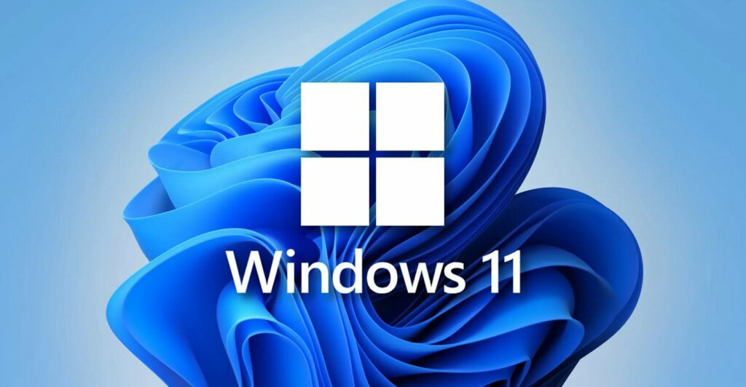
Introduction of Windows:
Windows Operating System (OS) is a graphical user interface (GUI) based operating system developed by Microsoft Corporation. It is designed to provide users with a user-friendly interface to interact with their computers. The first version of the Windows Operating System was introduced in 1985, and since then, it has undergone many updates and upgrades. Windows Operating System is compatible with a wide range of hardware and software applications, making it a popular choice for both personal and business computing.
Windows 11: It is the latest version of the Windows operating system, released by Microsoft in October 2021. It builds upon the foundation of Windows 10, with a focus on enhancing the user experience and improving performance and security.

Slide 6
Features Of windows 11:
Control Panel – A settings hub where users can manage security, display, sound, and other system preferences.
Internet Browser – Windows includes Microsoft Edge for browsing the internet with features like tabbed browsing and search suggestions.
File Explorer – Helps users find, open, and organize files and folders easily.
Taskbar – A bar at the bottom of the screen for quick access to apps, open windows, and system icons like volume and battery.
Microsoft Paint – A simple drawing tool for creating and editing images with basic features like brushes, shapes, and text.
Start Menu – A menu that opens when clicking the Start button, giving access to apps, settings, and a search bar.
Task Manager – A tool to check running programs, CPU and memory usage, and close unresponsive apps.
Disk Cleanup – Frees up space by deleting unnecessary files like temporary data and cache.
Cortana – A voice assistant that helps with tasks like reminders, emails, and searches.

Slide 7
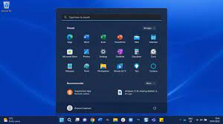
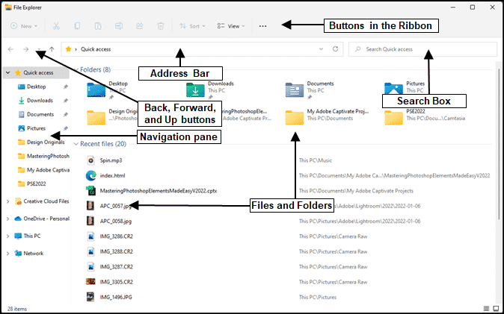
The Windows 11 taskbar is a centered bar at the bottom of the screen that provides quick access to apps, search, Task View, Widgets, notifications, and Quick Settings. It supports Snap Layouts for multitasking and can be customized.
File Explorer in Windows is a tool that helps users browse, open, and manage files and folders. It provides a simple interface to search, copy, move, rename, and delete files. It also allows access to drives, USB devices, and cloud storage like OneDrive.

Slide 8
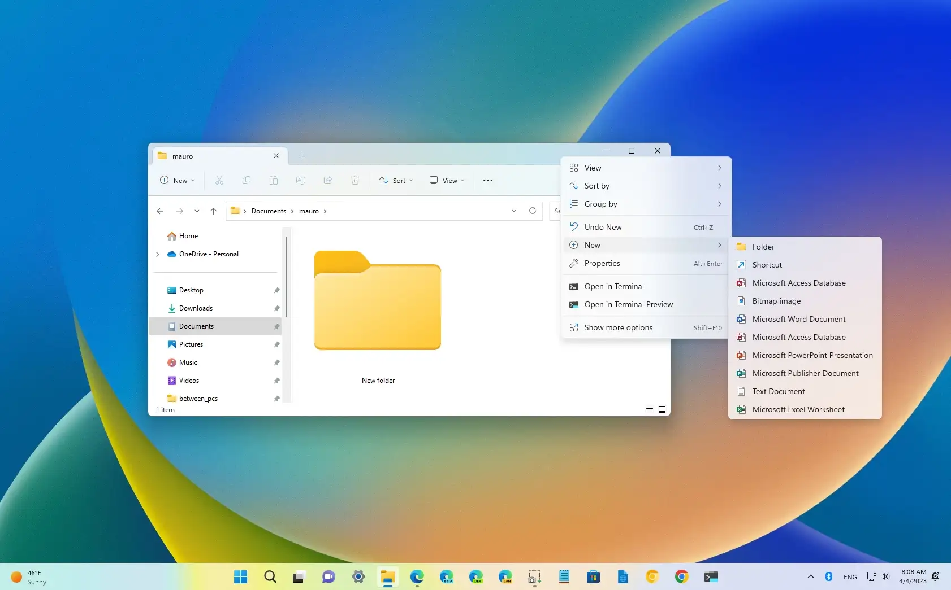
Creating a New Folder in Windows 11:
Open File Explorer by pressing Windows + E or clicking the File Explorer icon on the taskbar.
Go to the location where you want to create the folder.
Right-click on an empty space, then choose New > Folder.
Name the folder and press Enter.

Slide 9
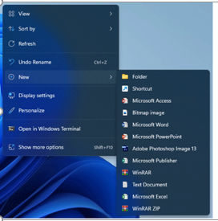
Creating a New File in Windows 11:
Open File Explorer and go to the location where you want to create the file.
Right-click on an empty space, then choose New.
Select the type of file you want to create (e.g., Text Document, Word Document, etc.).
Name the file and press Enter.

Slide 10
Extensions Of File :
File extensions are the letters after the dot in a file name that tell you what type of file it is. For example:
.txt for text files
.jpg for image files
.docx for Word documents
.mp4 for video files
.pdf for PDF documents
Each extension helps programs know how to open and work with the file.

Slide 11
Short Cut Keys:
Here are some common short keys in Windows:
Ctrl + C – Copy
Ctrl + V – Paste
Ctrl + X – Cut
Ctrl + Z – Undo
Ctrl + A – Select all
Alt + Tab – Switch between open apps
Windows + E – Open File Explorer
Windows + D – Show or hide the desktop
Ctrl + Shift + Esc – Open Task Manager
Ctrl + S – Save
Windows + L – Lock your computer

Slide 12
Summary:
This lecture covers the basics of operating systems (OS), explaining the different types like Android, iOS, Linux, macOS, and Windows. Students will gain a detailed understanding of Windows, focusing on its versions, particularly Windows 10 and Windows 11. The features of Windows 11, including the taskbar, file explorer, and file management, will be explored. The lecture also includes practical guidance on creating new folders and files, understanding file extensions, and using common keyboard shortcuts to navigate and manage the system effectively.

Slide 13
Thank You !

