Slide 1
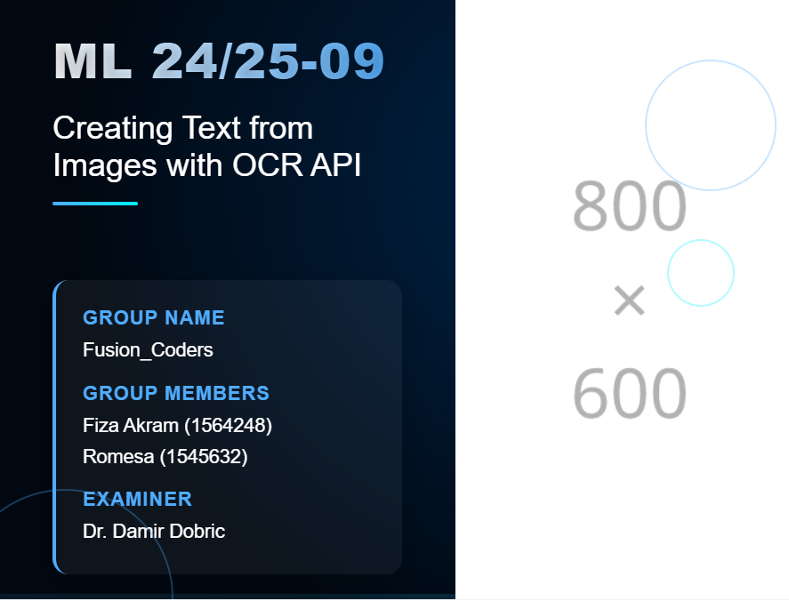


Slide 2

Introduction
Text extraction from images faces several challenges:
Varied image quality and resolution
Different text orientations
Complex backgrounds and noise
Diverse font styles and sizes
Lighting variations and shadow
Project Objective:
Develop a robust system that uses multiple image processing
techniques to improve OCR accuracy

Slide 3
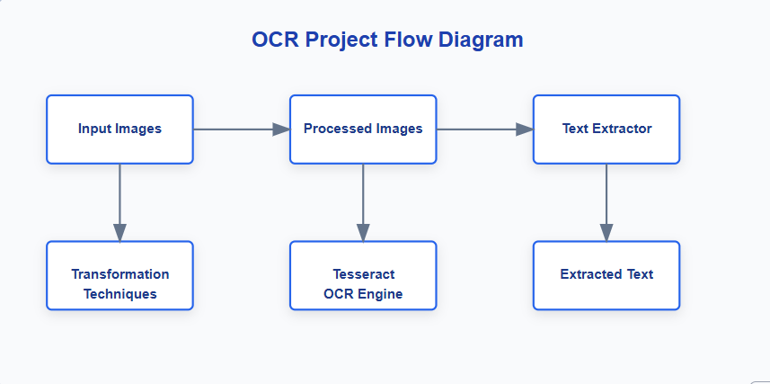
System Architecture
Three Main Components:
Image Processors: Apply transformations to optimize images
Text Extractor: Uses Tesseract OCR to extract text
Batch Processor: Coordinates workflow for multiple images

Slide 4
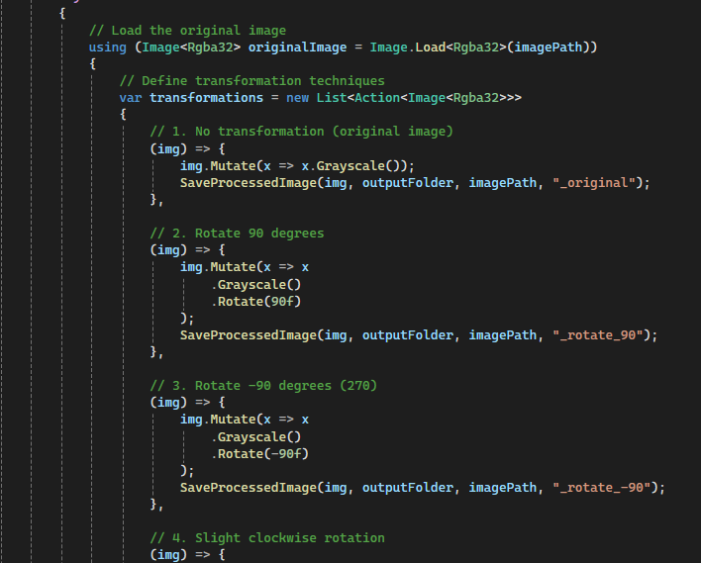
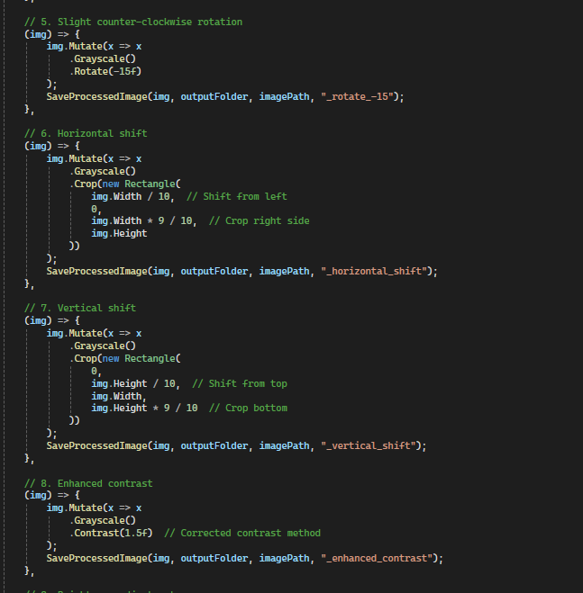
Implementation - Image Processing

Slide 5
Image Processing Transformations
This code defines a list of transformations that are applied sequentially to an image:
No Transformation (Grayscale): Converts the image to grayscale.
Rotate 90°: Converts to grayscale, then rotates the image 90°.
Rotate -90° (270°): Converts to grayscale, then rotates the image -90° (270°).
Rotate 15°: Converts to grayscale, then rotates slightly clockwise (15°).
Rotate -15°: Converts to grayscale, then rotates slightly counter-clockwise (-15°).
Horizontal Shift: Converts to grayscale and shifts the image horizontally by cropping sides.
Vertical Shift: Converts to grayscale and shifts the image vertically by cropping top and bottom.
Enhanced Contrast: Converts to grayscale and enhances the contrast (1.5x).
Brightness Adjustment: Converts to grayscale and adjusts the brightness (+20%).
Slight Skew: Converts to grayscale and applies a slight 5° rotation as an alternative to skewing.

Slide 6



Image Processing Transformations Output

Slide 7
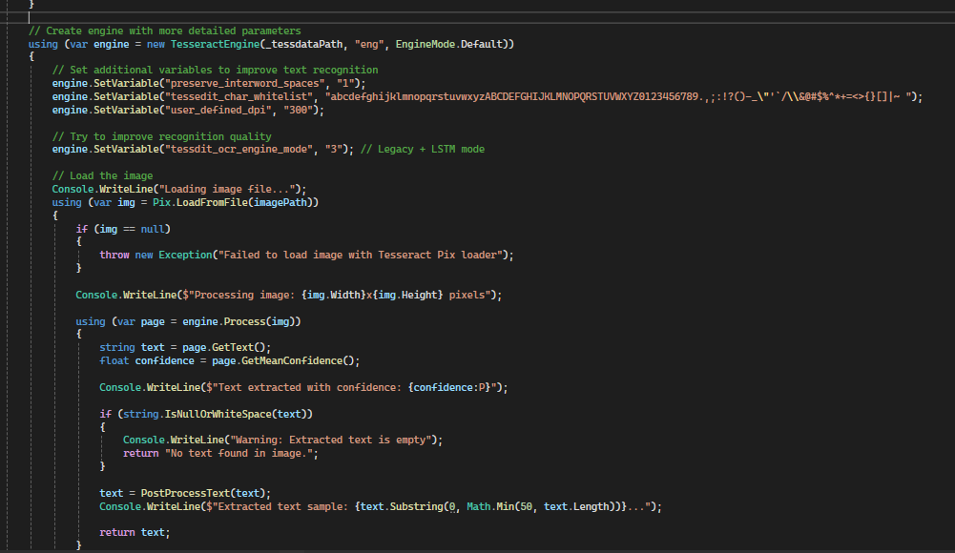
Text Extraction with Tesseract

Slide 8
Tesseract OCR Configuration
Tesseract Engine Setup:
Initializes with English language and Default mode.
Configures settings for better recognition (e.g., interworld spaces, allowed characters, 300 DPI, and OCR engine mode).
Image Loading:
Loads the image usingPix.LoadFromFile(imagePath). Throws error if failed.
Text Extraction:
Processes the image, extracts text, and calculates confidence.
If text is found, it’s post-processed, and a sample is displayed. If not, shows a warning.

Slide 9

Batch Processing Workflow
Process Flow:
Load images from input folder
Apply multiple transformations to each image
Extract text from each processed version
Save extracted text to output folder
Fall back to original image if processing fails
Error Handling:

Slide 10
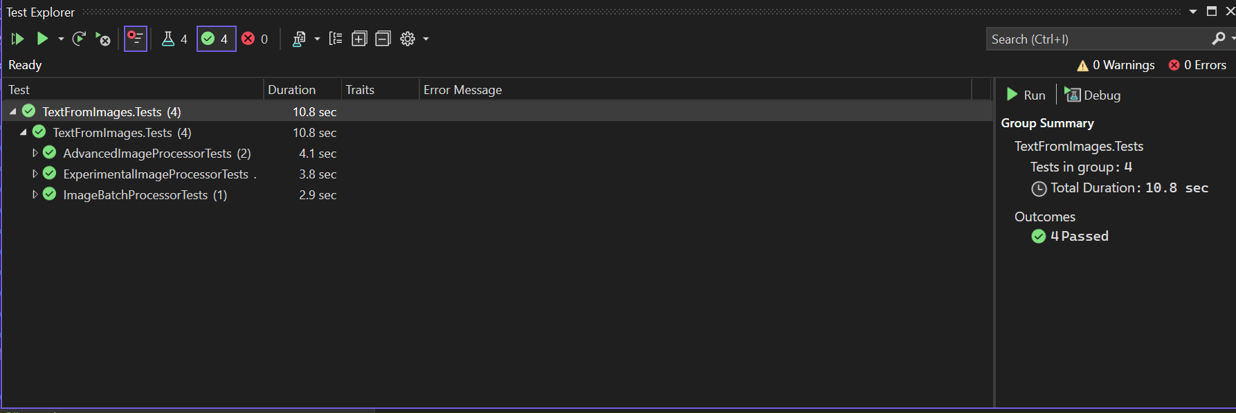
Unit Testing for Image Processing
AdvancedImageProcessorTests:
Save Processed Images: Verifies images are saved correctly.
Invalid Path Handling: Ensures invalid image paths throw an error.
ExperimentalImageProcessorTests:
Apply All Techniques: Ensures all processing techniques are applied and saved.
ImageBatchProcessorTests:
Batch Processing: Verifies batch processing of images and text extraction.

Slide 11
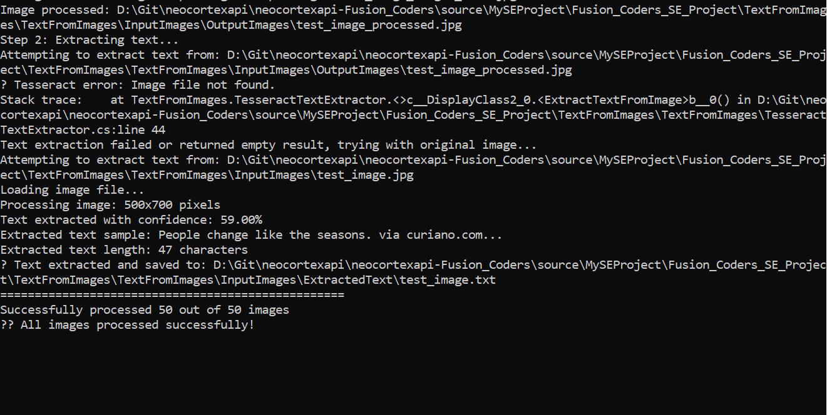
Output of the Project:

Slide 12
Conclusion
This project successfully demonstrates the importance of advanced image pre-processing in improving OCR-based text extraction. By implementing a modular and flexible system, it allows seamless integration of additional transformations and alternative OCR engines, ensuring adaptability to diverse image conditions.
Key Contributions:
Enhanced OCR Accuracy – Applying multiple pre-processing techniques to maximize text recognition success rates.
Modular System Architecture – Ensuring clear separation between image processing and text extraction for better scalability.
Optimized Post-processing – Refining extracted text to improve readability and accuracy.

Slide 13


