Slide 1
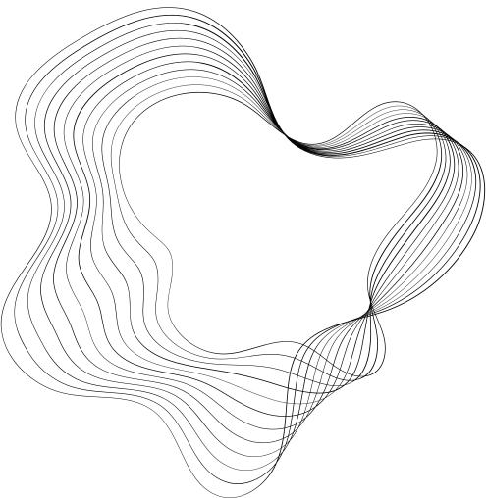

FACIAL
SENTIMENT ANALYSIS

Slide 2


TEAM MEMBERS
Fiza Ayub
Syed Muhammad Abubakar
Wahab Hassan Janjua
Muhammad Haroon Farooq

Slide 3





GOALS AND OBJECTIVES
Objective n° 1
Objective n° 2
Objective n° 3
Enhancement of Facial Expression Recognition (FER) Accuracy
Achievement of Real-time FER Performance
Advancement of FER Technologies and Ethical Considerations

Slide 4

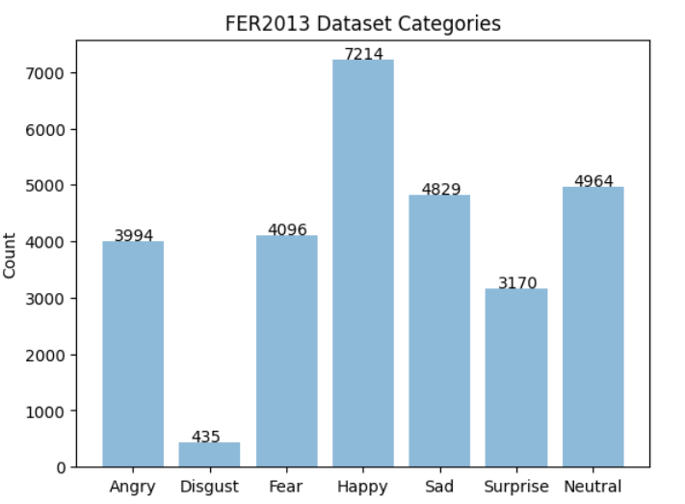
DATASET STATISTICS

Slide 5
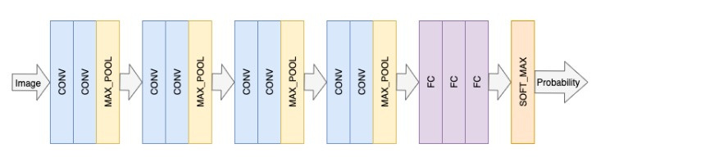

MODEL

Slide 6
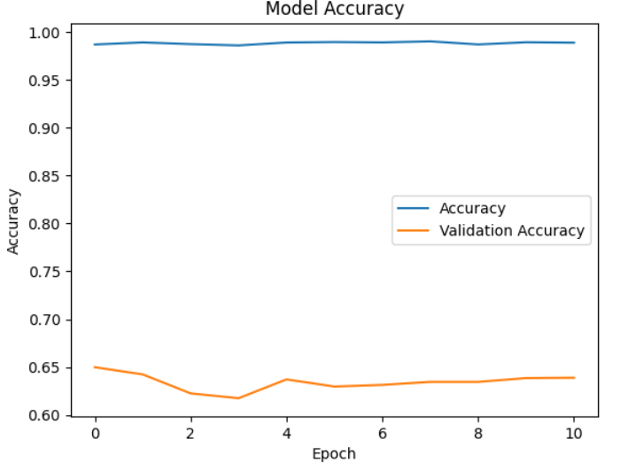
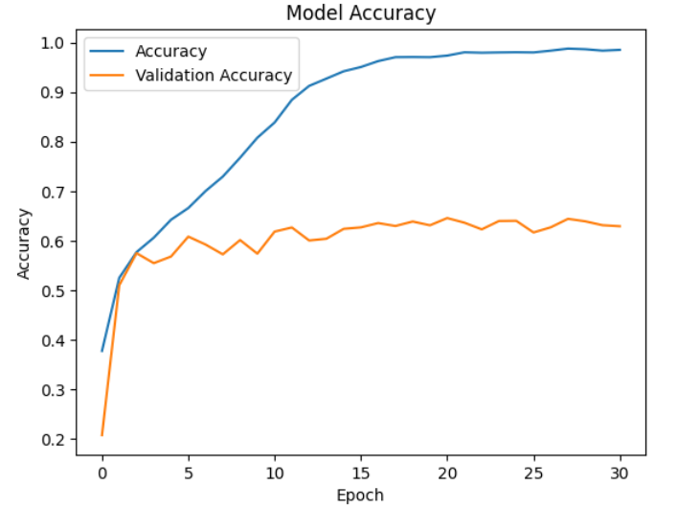
ACCURACY

Slide 7
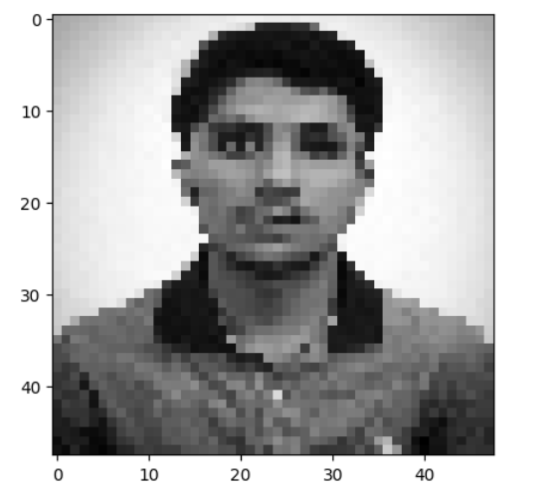
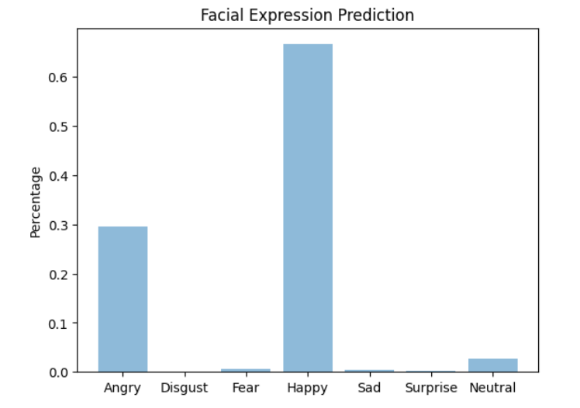

Slide 8

THANK'S FOR WATCHING

