Slide 1
Agentic AI-Based Travel Planning Assistant Using LangChain
Travel & Tourism Domain
Built with LangChain,
Groq LLM,
Streamlit,
JSON Datasets,
Open-Meteo API

Slide 2
Problem Statement & Business Use Case
Travelers use multiple platforms for flights, hotels, attractions, and weather.
Automates itinerary creation and personalized recommendations.
Useful for travel agencies, booking platforms, and tourism companies.

Slide 3
System Architecture & Agentic Workflow
LangChain Agent receives user query.
Tools: Flight Search, Hotel Recommendation, Places Discovery, Weather Lookup, Budget Estimation.
Agent reasons, invokes tools and generates itineraries.

Slide 4
Implementation & Features
JSON datasets: flights, hotels, places.
Real-time weather using Open-Meteo API.
Day-wise itinerary, hotel recommendations, budget estimation.
Streamlit-based interactive UI.

Slide 5
Results, Benefits & Future Enhancements
Complete travel plan with flights, hotels, weather, and budget.
Improves user experience and saves planning time.
Future: Dynamic city coordinates, advanced ranking, PDF export, deployment.

Slide 6
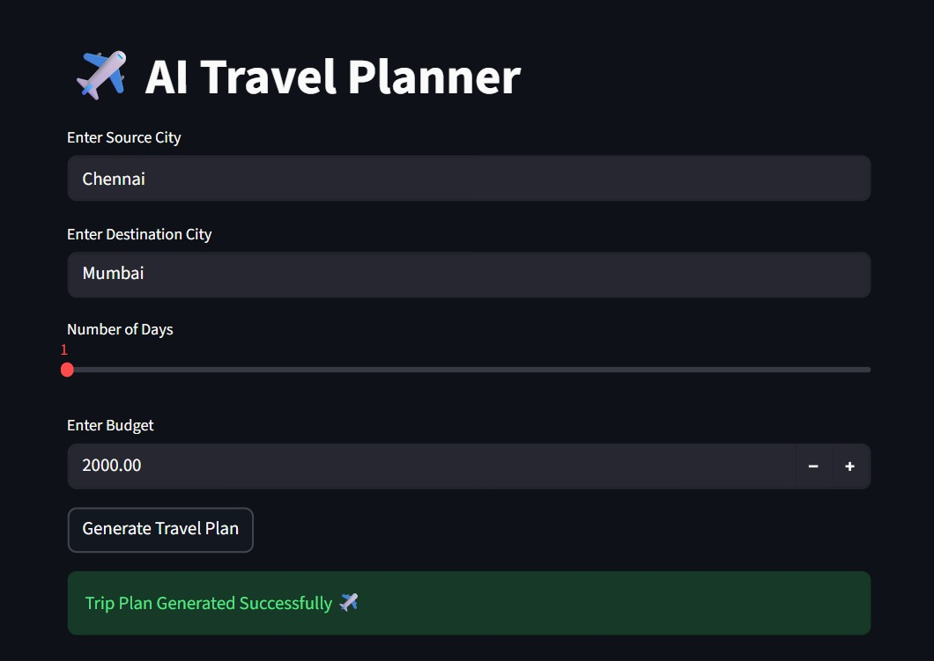

Slide 7
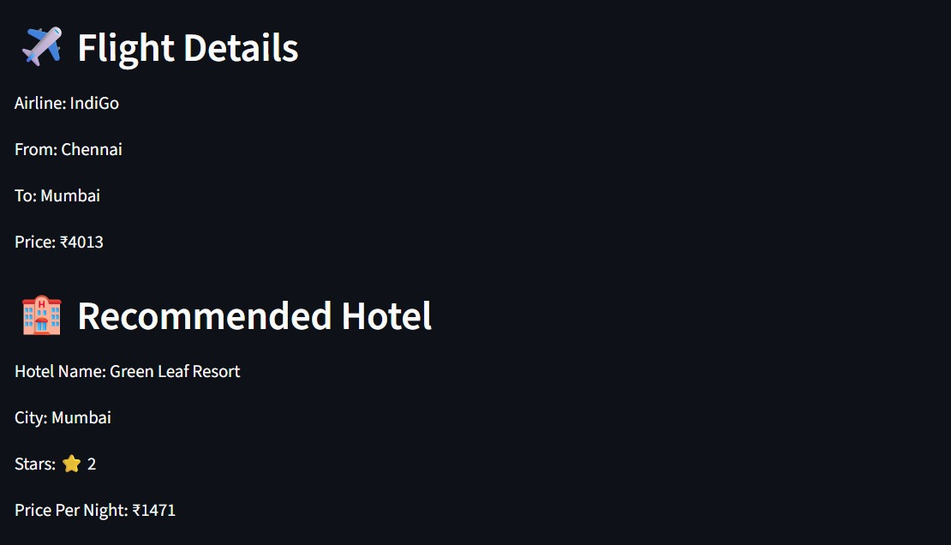

Slide 8
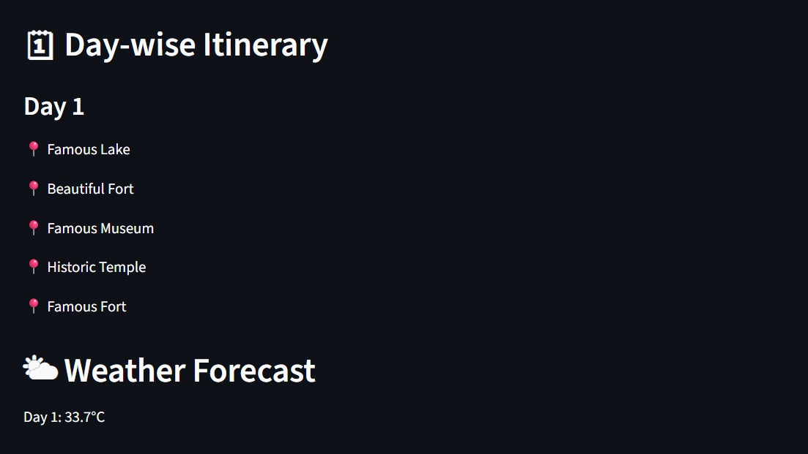

Slide 9
